Slide 1
Class II – Saltwater Disposal, Enhanced Recovery, and Annular Disposal Wells
Presented on behalf of
the Injection and Mining Division
Baton Rouge, Louisiana

Slide 2
Topics of Discussion
Saltwater Disposal Wells (Conversions)
Form UIC 2-SWD Conversion
Enhanced Recovery (ER) Wells
Form UIC 2-ER
Annular Disposal Wells
Form UIC-9
Community Saltwater Disposal Wells
Form UIC-13
Commercial Wells
Form UIC-2 COM SWD

Slide 3
Class II Saltwater Disposal Wells
(Form UIC-2 SWD Conversion)

Slide 4
The UIC-2 SWD Conversion Application (Application) has been revised. We are making additional minor changes to the form to accommodate requests and comments from our test group, therefore the final version may differ slightly from the version shown in this presentation. Eventually all UIC forms will be revised and updated.
The following sample Application will illustrate each component of the revised Class II SWD Conversion Application and how to successfully complete the form.
A saltwater disposal well conversion application is being used during this presentation as an example since applications to convert wells for use as saltwater disposal wells are more complicated in nature than Class II SWD Applications to drill new wells.

Slide 5
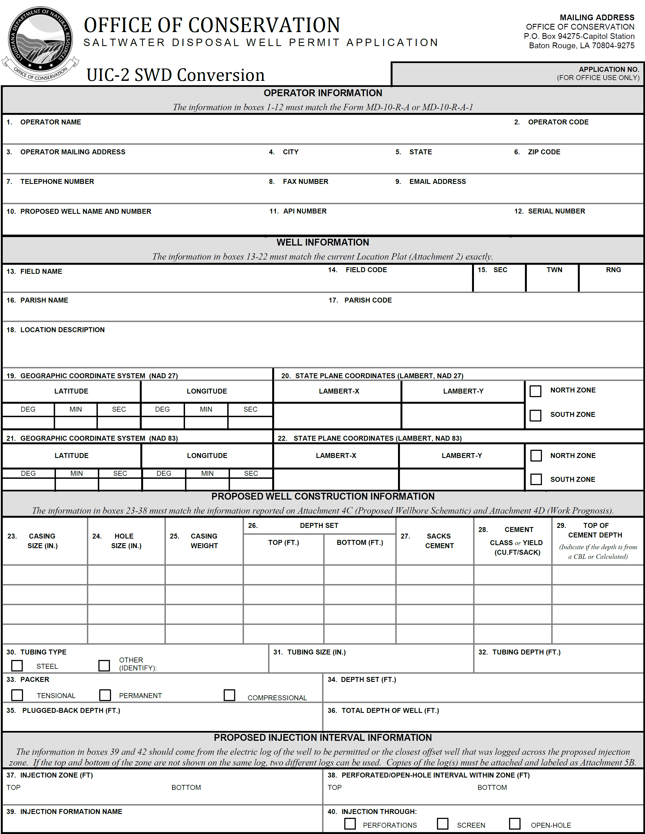
Form UIC-2 SWD Conversion
OPERATOR INFORMATION
WELL INFORMATION
Notes:
Form UIC-2 SWD Conversion components
Operator Information
Well Information

Slide 6
PROPOSED WELL CONSTRUCTION INFORMATION
PROPOSED INJECTION INTERVAL INFORMATION
Notes:
Proposed Well Construction Information
Proposed Injection Interval Information

Slide 7
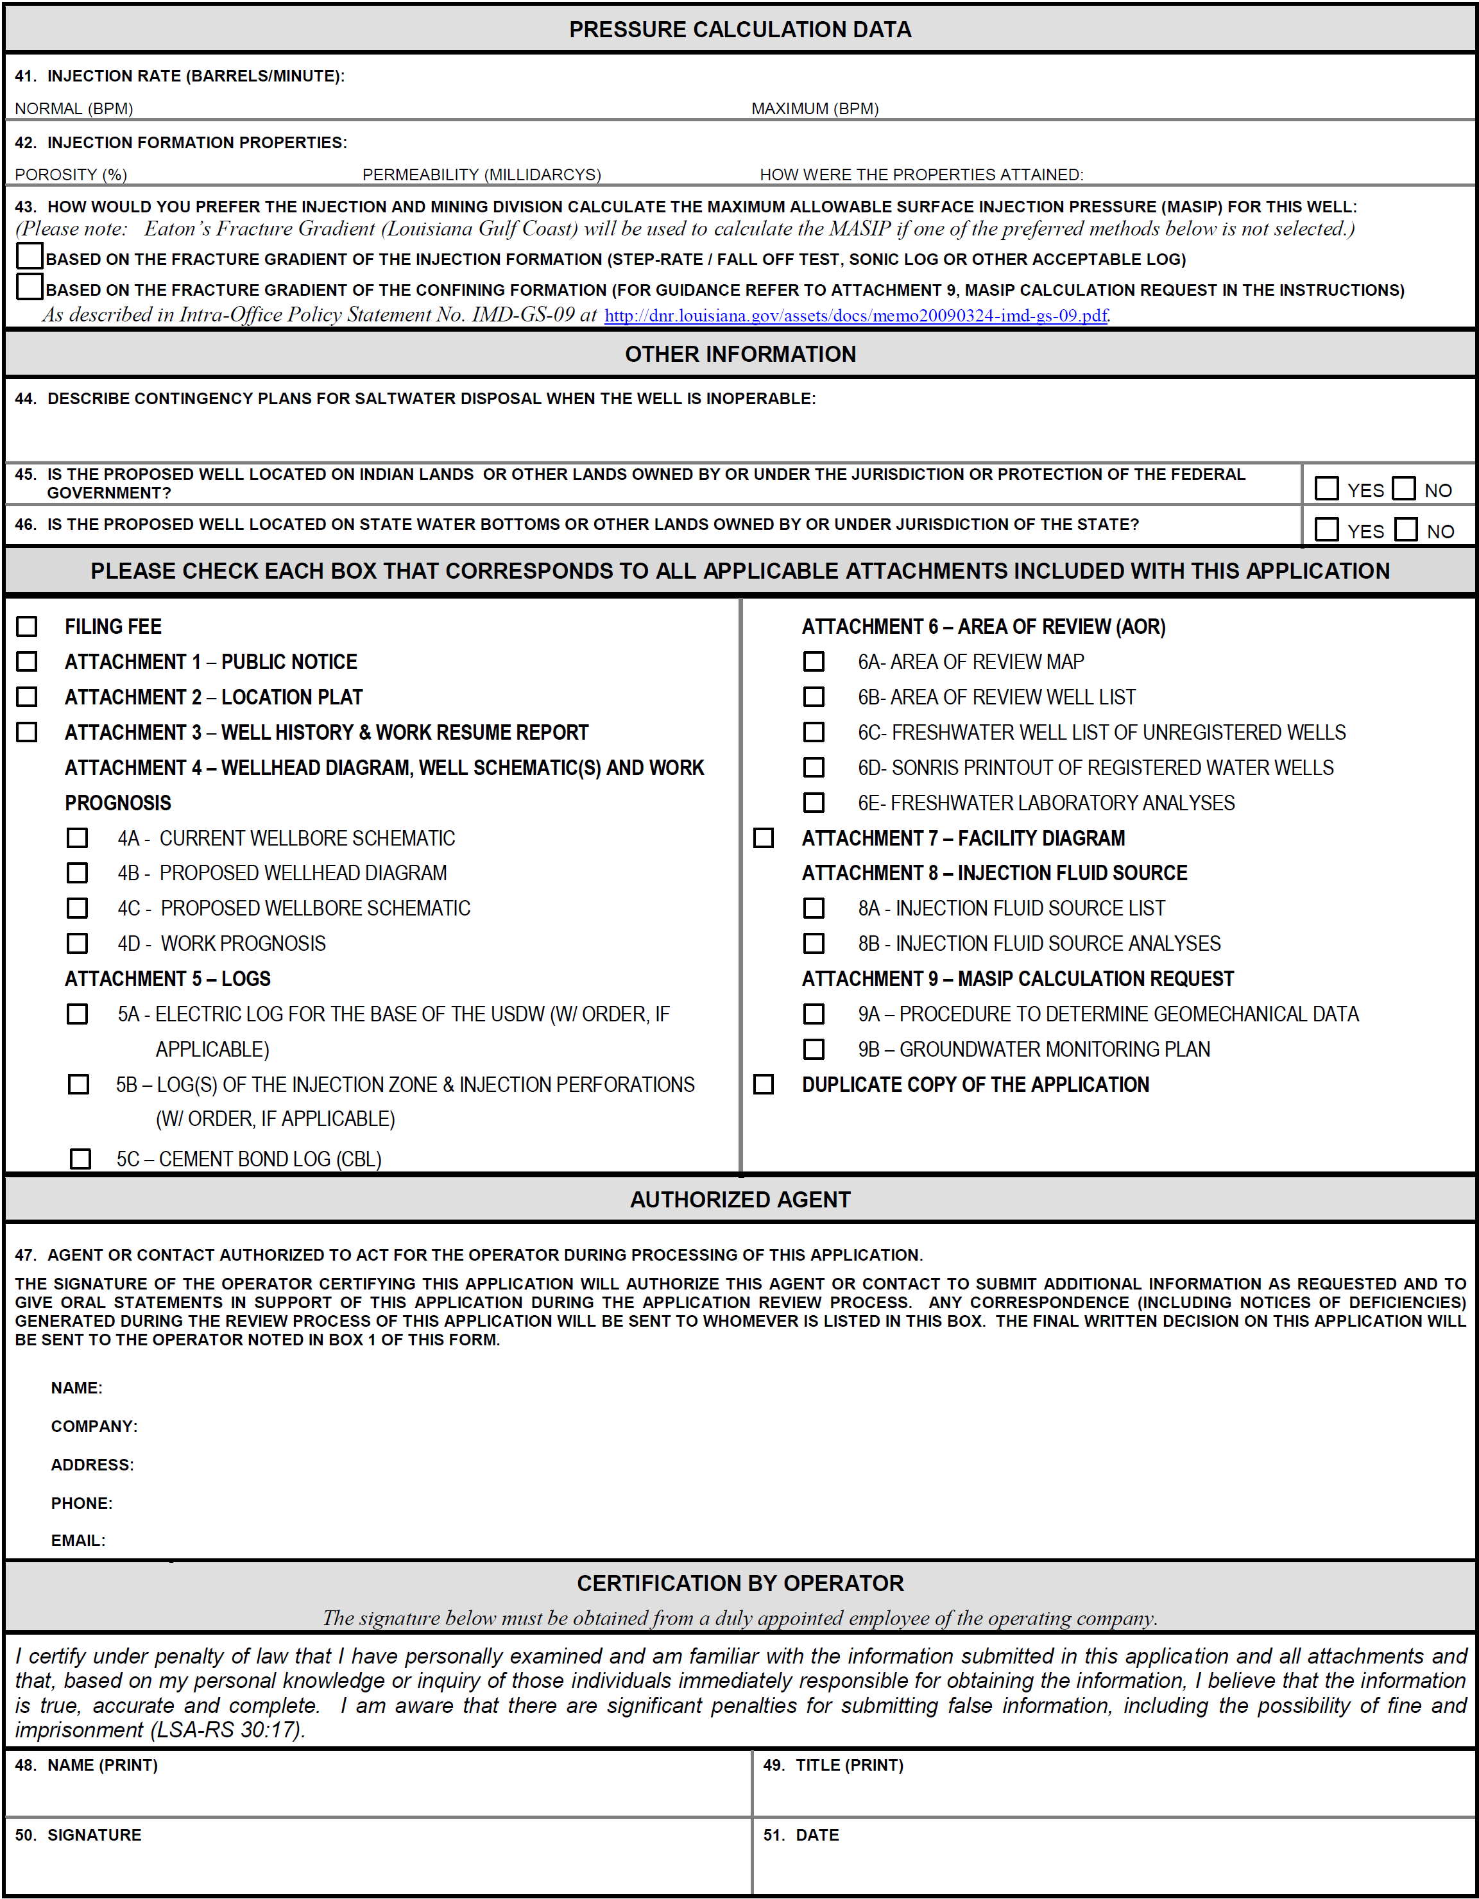
Form UIC-2 SWD Conversion cont’d
PRESSURE CALCULATION DATA
OTHER INFORMATION
CHECK BOXES FOR ATTACHMENTS

Slide 8
AUTHORIZED AGENT
CERTIFICATION BY OPERATOR

Slide 9
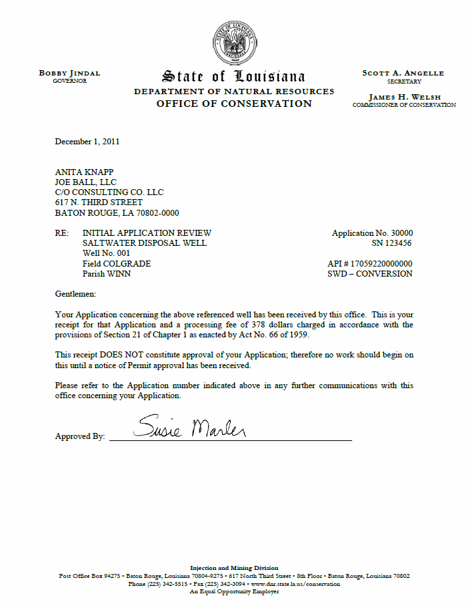
Note: Upon receipt of the original Application submittal, an Initial Application Review letter will be sent to the Authorized Agent noting the assigned Application Number, missing or incorrect information and acknowledgement of fee payment.
As shown in our example, the Application number is found in the reference section of the letter.

Slide 10
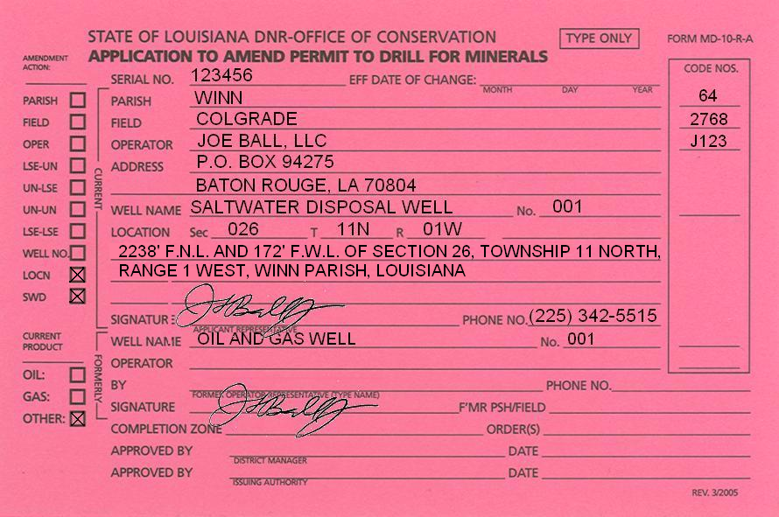
Complete and submit two (2) completed copies of Form MD-10-R-A
(Pink Card) with original signatures.
Leave the effective date of change blank

Slide 11
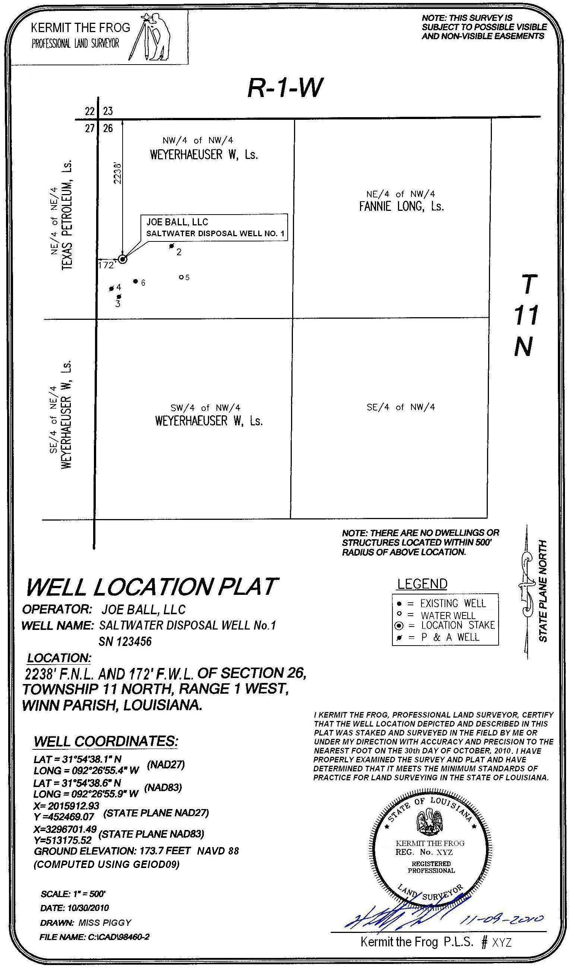
A Certified Plat is required to be submitted with the Application
As Drilled Location Plat

Slide 13
As Drilled Location Plat
Submit a copy of the Certified Plat for the well to be converted. Verify that the plat information matches information on the Pink card.

Slide 14
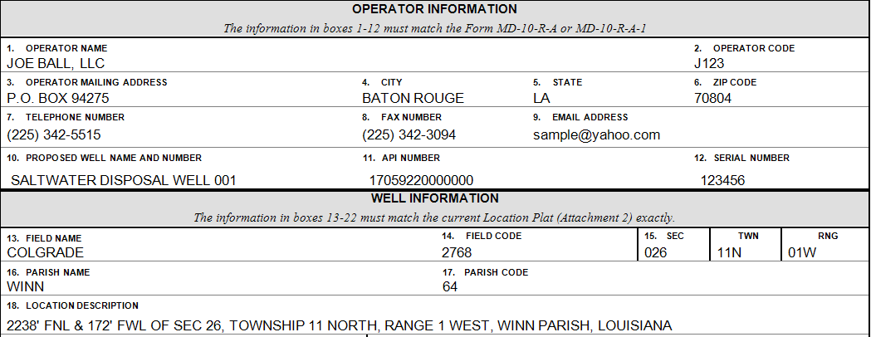
Information must be transferred from the Pink Card to Item numbers 1 – 18 of the Application.

Slide 15
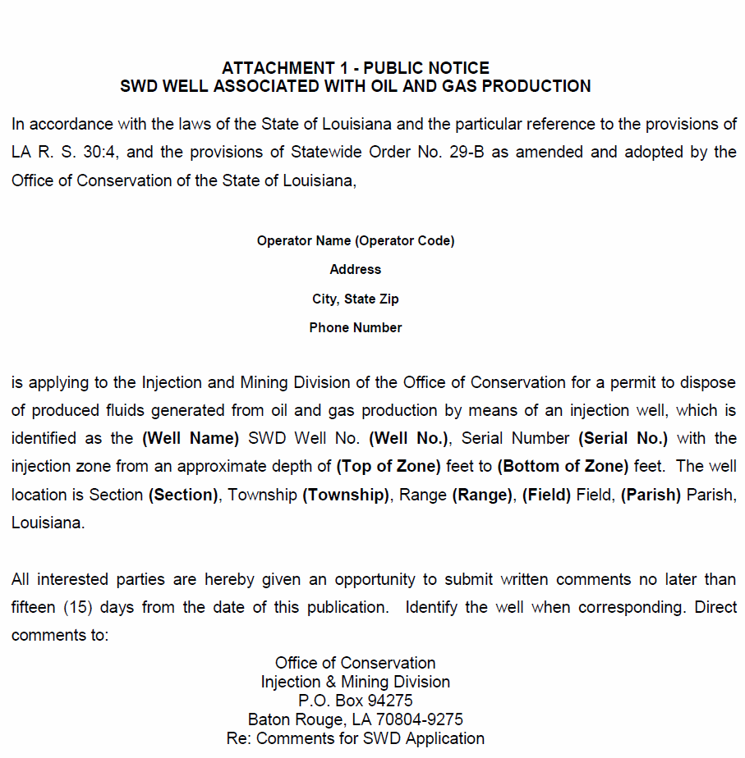
Public Notice
(SWD Well Associated with Oil and Gas Production)
(Attachment 1)
At least 15 days prior to filing an application (but no more than 6 months prior), a notice of the Application must be published in the legal advertisement section of the official state journal, The Advocate (in Baton Rouge).
The Advocate will send the operator a notarized Proof of Publication, which must be labeled, Attachment 1, and included as part of the Application.
The Operator will be billed by The Advocate for the publication.
If the Proof of Publication has not been received when the Application is sent to the IMD, it may be sent later provided that you write the Application Number and Attachment 1 on the Proof of Publication.

Slide 16
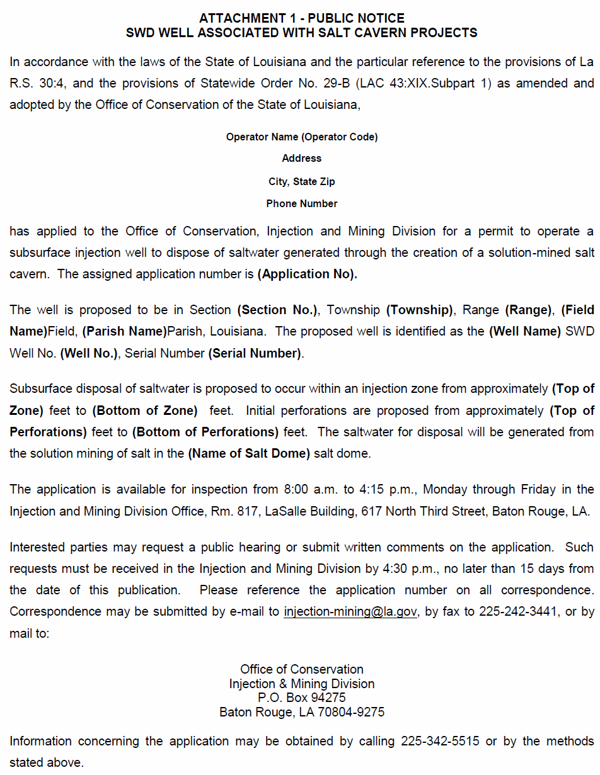
Public Notice
(SWD Well Associated with Salt Cavern Projects)
(Attachment 1)
If the proposed SWD well is associated with any type of SALT CAVERN PROJECT, then the applicant must publish a notice that an application has been filed with the Office of Conservation within 30 days of the receipt of the Initial Application Review letter.
The notice must be published one time in the legal advertisement section of the official state journal, The Advocate (in Baton Rouge), and the official journal of the parish in which the proposed activity is to occur.
The Operator will be billed by each journal for the publication.

Slide 17
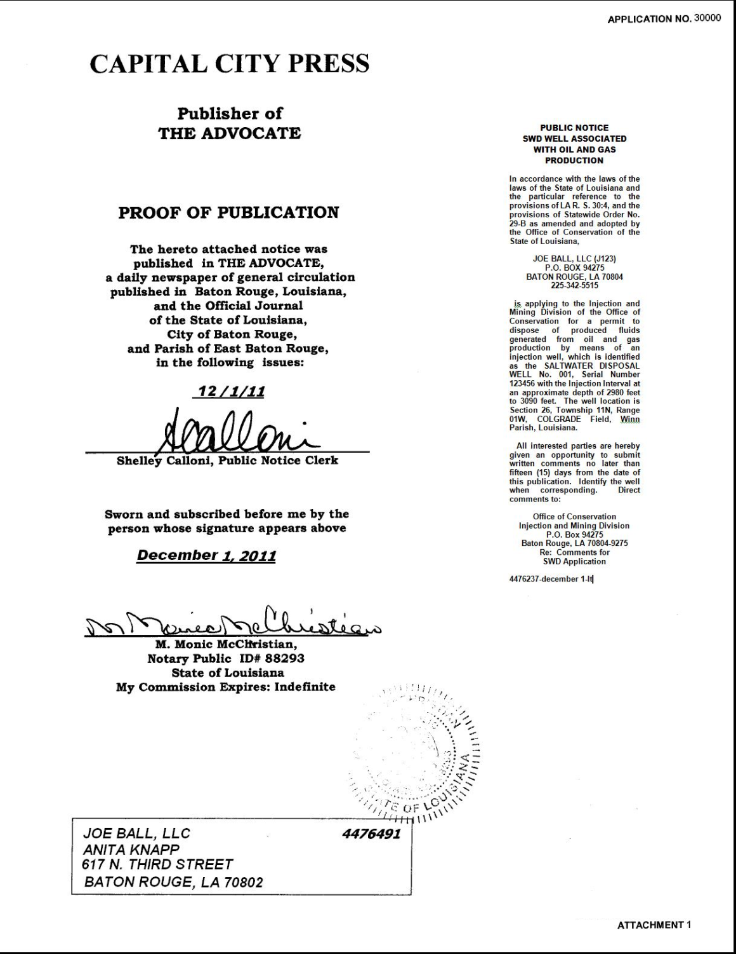
The notarized Proof of Publication sent to the Operator must be labeled, Attachment 1, and must be submitted to the Injection and Mining Division (IMD) upon receipt by the Applicant.
The Application number should be written on the upper right corner of each page of any revisions or submittals.
The Attachment number should be written on the lower right corner of each page of any revisions or submittals.

Slide 18
Location Plat
(Attachment 2)
As Drilled Location Plat
The IMD has issued an Intra-Office Policy Statement, Policy No. IMD-GS-10 (Policy), regarding Location Plat Requirements. All location plats submitted with this Application must meet the requirements of the Policy.
The Policy can be downloaded from the DNR website: Go to www.dnr.louisiana.gov, click on the Conservation tab at the top of the page >> click on Injection and Mining (under Divisions at the bottom of the page) >> click on IMD-GS-10 (under the Injection and Mining Policy Statements tab at the bottom of the page).
The certified Location Plat must be labeled, Attachment 2, and included as part of the Application.
The Location Plat, Attachment 2 and the Area of Review Map, Attachment 6A can be combined and submitted as one document if the scale is such that all wells are clearly labeled and legible.
Attachment 2

Slide 19
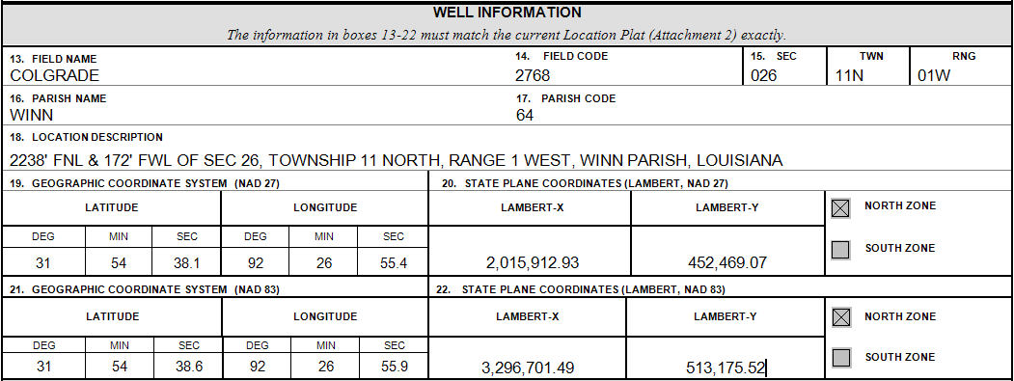
Items 13-22 of the Application should be completed using the Location Plat and current well location information.
As Drilled Location Plat
Attachment 2

Slide 20
Attachment 3 - Well History and Work Resume Reports (Form WH-1)
A photocopy of each Well History and Work Resume Report (Form WH-1) that has previously been filed with the Office of Conservation for the well being converted must be labeled, Attachment 3 and included as part of the Application.

Slide 21
Attachment 3

Slide 22
Attachment 3

Slide 23
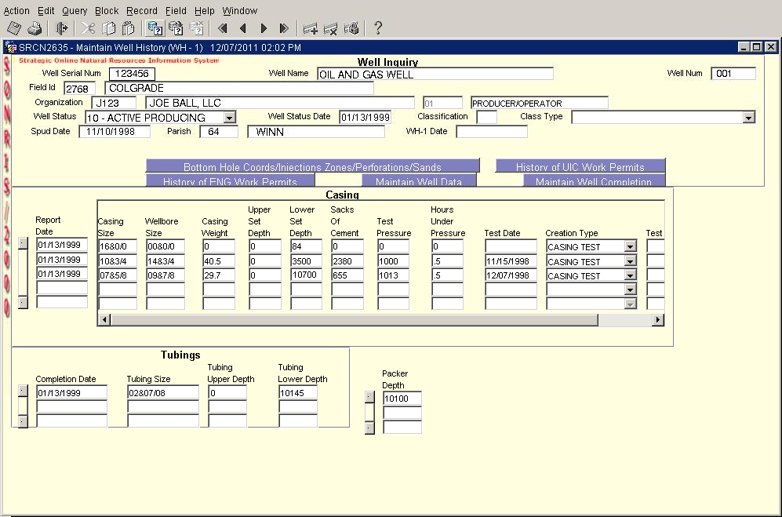
If the well is currently constructed in a manner that is contradictory to information in SONRIS then the Well History Reports, driller‘s logs, cement tickets or other information substantiating the well‘s current configuration should be included in the Application.
The Current Wellbore Schematic, Attachment 4A must reflect information in SONRIS and previous WH-1s.

Slide 24
In this Example, casing information from the WH-1
matches information found in SONRIS

Slide 25
Attachment 4 - Wellhead Diagram, Well Schematic(s) and Work Prognosis
The application must include the following:
Attachment 4A - Current Wellbore Schematic
Attachment 4B - Wellhead Diagram
Attachment 4C - Proposed Wellbore Schematic and
Attachment 4D - Work Prognosis

Slide 26
Current Wellbore Schematic
(Attachment 4A)
This schematic should reflect the current configuration of the well including all sidetracks.
It must also reflect information reported on all Well History and Work Resume Reports (Form WH-1) included as part of Attachment 3 of this Application, driller‘s logs, cement tickets or other information substantiating the well‘s current configuration.
Ensure that all information provided on the schematic corresponds to information found in SONRIS.
If the well was drilled horizontally, please indicate it as such on the existing wellbore schematic.

Slide 27
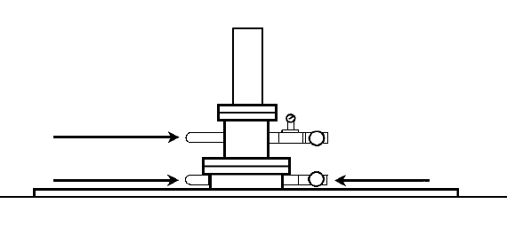
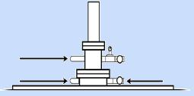
The Current Wellbore Schematic (Attachment 4A) should include the following:
2” BULL PLUG
2” BULL PLUG
2” BALL VALVE
1. All casing strings:
Diameter, Weight (per foot), Depth set (top and bottom)
GROUND LEVEL
16” conductor @ 3/8”
driven to 84 ft
2. Hole (drill bit) diameters
10-3/4” casing @ 40.5
lbs/ft to 3,500 ft,
cemented to surface
with 2380 sacks of
Class A cement.
3. Cement Specifications:
Type or Class, Yield (cu.ft/sack), Number of sacks, Top of cement in each string of casing.
Hole Size 14-3/4”
4. Existing cement squeeze(s), if any:
Type or class, Yield (cu.ft/sack), Number of sacks, Top of cement.
2-3/8” Tubing to 10,100 ft
5. Tubing:
Diameter, Type or material, Top and bottom Depths
Arrow Tension Packer
set at 10,100 ft
6. Packer:
Type, Depth set
7. Existing production perforated, open-hole, or screened interval:
Top, Bottom
Hole Size 9-7/8”
Production Perforations from 10,208 – 10,212 ft and 10,185 – 10,189
7-5/8” casing @ 29.7 lbs/ft to 10,700 ft, cemented to surface with 655 sacks of Class A cement.
8. Depths:
Total Depth, Plugged-back depth
PBTD = 10,381 ft
TD = 10,700 ft
Attachment 4A

Slide 28
Proposed Wellhead Schematic (Attachment 4B)
2” BULL PLUG
2” BULL PLUG
2” BALL VALVE
This schematic should, at a minimum, include the following surface equipment:
GROUND LEVEL
16” conductor @ 3/8”
driven to 84 ft
1. Well head
2. Pressure gauges
3. Flow line diameters at wellhead
4. Monitoring equipment, if used
10-3/4” casing @ 40.5
lbs/ft to 3,500 ft,
cemented to surface
with 2380 sacks of
Class A cement.
Hole Size 14-3/4”
2-3/8” Tubing to 10,100 ft
The Wellhead Schematic, Attachment 4B and the Proposed Schematic, Attachment 4C can be combined if both are legible, otherwise a separate schematic should be submitted.
Arrow Tension Packer
set at 10,100 ft
Hole Size 9-7/8”
Production Perforations from 10,208 – 10,212 ft and 10,185 – 10,189
7-5/8” casing @ 29.7 lbs/ft to 10,700 ft, cemented to surface with 9800 sacks of Class A cement.
PBTD = 10,381 ft
TD = 10,700 ft
Attachment 4B

Slide 29
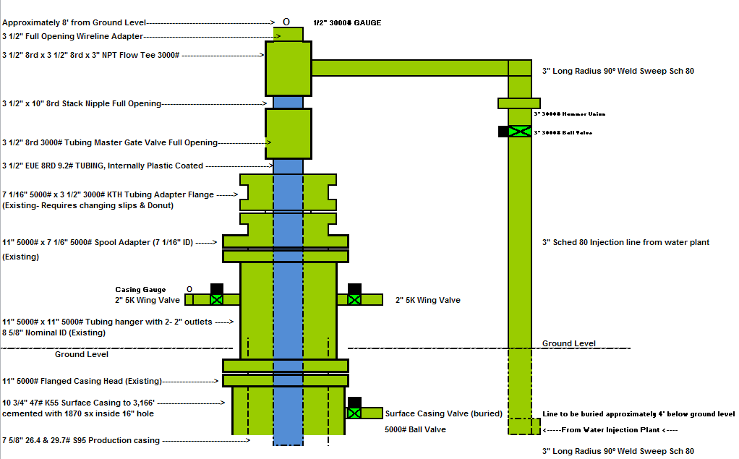
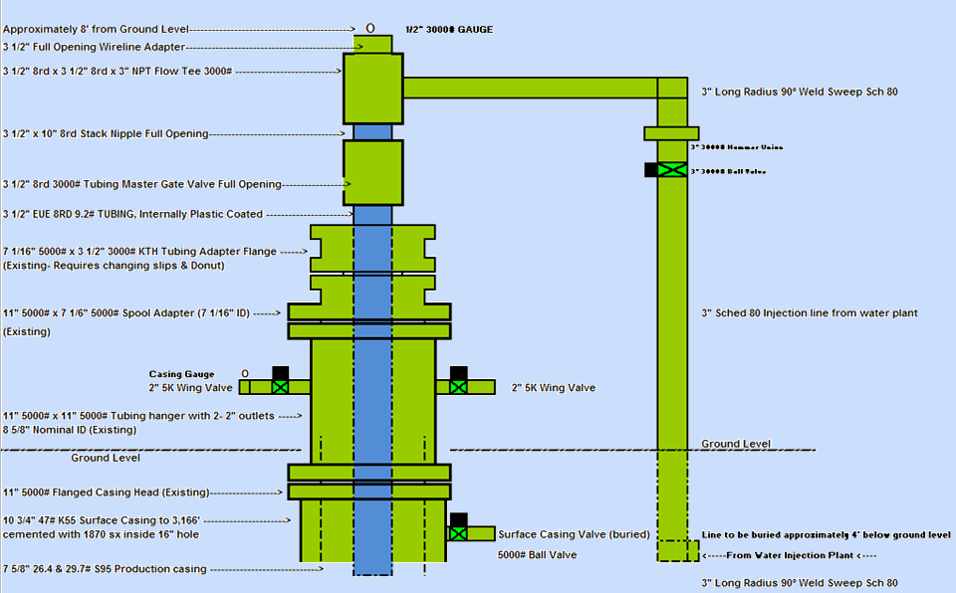
Sample Wellhead Schematic (shown as a separate attachment)
(Attachment 4B)
Attachment 4B
Attachment 4B

Slide 30
Proposed Wellbore Schematic
(Attachment 4C)
Proposed Wellbore Schematic should include all of the details provided in the ―Proposed Well Construction Information section of the Application Item numbers 23 – 38.
If the well was drilled horizontally, please indicate it as such on the proposed wellbore schematic.
Ensure that all information provided on the Proposed Wellbore Schematic reflects the current wellbore configuration as well as the proposed method to convert the well ensuring that details on the schematic correlates to the procedure outlined in the Work Prognosis, Attachment 4D.

Slide 31
The Proposed Wellbore Schematic (Attachment 4C) should include the following:
2” BULL PLUG
2” BULL PLUG
2” BALL VALVE
1. All casing strings (including any proposed new strings of casing):
Diameter, Weight (per foot), Depth set (top and bottom)
GROUND LEVEL
16” conductor @ 3/8”
driven to 84 ft
2. Hole (drill bit) diameters
3. Cement Specifications:
Type or Class, Yield (cu.ft/sack), Number of sacks, Top of cement in each string of casing (Indicate whether calculated, logged, or to be logged)
10-3/4” casing @ 40.5
lbs/ft to 3,500 ft,
cemented to surface
with 2380 sacks of
Class A cement.
4. Proposed plugging procedure:
Of the abandoned producing interval and isolating the proposed injection zone
Hole Size 14-3/4”
Top of Zone 4,120 ft
Squeeze 100 sxs, Class A cement at 4,070 feet
5. Proposed cement squeeze(s), if any:
Type or Class, Yield (cu.ft/sack), Number of sacks, Top of cement (Indicate whether calculated or logged)
2-3/8” Tubing to 4,100 ft
Arrow Tension Packer
set at 4,100 ft
Injection Perforations from 5,080 – 5,130 ft and 5,150 – 5,170
6. Injection tubing:
Diameter, Type or material, Top and bottom Depths
Squeeze 100 sxs, Class A cement at 5,310 feet.
7. Packer:
Type, Depth set
Bottom of Zone 5,270 ft
CIBP @ 5,320 ft w/ 10 cmt
8. Proposed injection zone:
Top, Bottom
Hole Size 9-7/8”
CIBP @ 10,200 ft w/ 10 cmt
Production Perforations from 10,208 – 10,212 ft and 10,185 – 10,189
7-5/8” casing @ 29.7 lbs/ft to 10,700 ft, cemented to 9800 ft with 655 sacks of Class A cement.
9. Proposed initial perforated, open-hole, or screened interval:
Top, Bottom
10. Depths:
Total Depth, Plugged-back depth
PBTD = 5,310 ft
TD = 10,700 ft
Attachment 4C

Slide 32
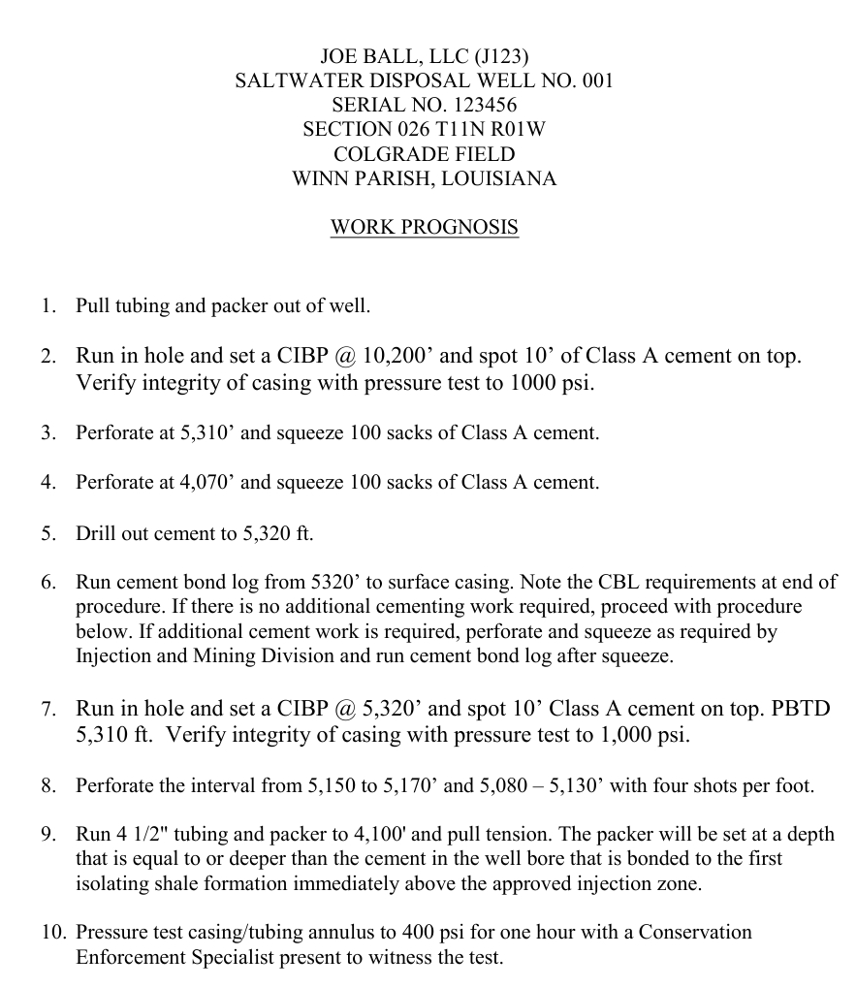
Work Prognosis (Attachment 4D)
The Work Prognosis should describe the sequence of work to be performed and include (but is not limited to) the following:
running any required Electric Logs (e-logs) for sidetracks, deepening the well, etc.
Sufficient plugs must be used to adequately isolate each perforated producing pool from one another.
Any new string of casing or liner that is cemented in an existing well must be pressure tested before drilling out the casing shoe and reported on the Affidavit of Test of Casing in Well (Form-CSG T).
Prove Isolation of the Proposed Injection Zone, ie block squeeze and run a CBL.
Perforating the Proposed Injection Zone
The packer must be set at a depth that is deeper than the cement in the wellbore that is bonded to the first confining shale formation immediately above the proposed injection zone.
A Mechanical Integrity Pressure Test (MIPT) must be performed under the supervision of the appropriate Conservation Enforcement Specialist (CES).
If required—an inspector-witnessed Static Fluid Level (SFL), or running a Radioactive Tracer Survey (RTS), Temperature Log or similar log capable of detecting fluid movement between the well casing and borehole.
Attachment 4D
If an injectivity test is to be performed, indicate how much water will be injected, duration of the test and test pressure.

Slide 33
2” BULL PLUG
2” BULL PLUG
2” BALL VALVE
GROUND LEVEL
16” conductor
driven to 84 ft
Hole Size 14-3/4”
10-3/4” casing @ 40.5 lbs/ft to 3,500 ft
with 2380 sacks
Class A cement.
Top of Zone 4,120 ft
Squeeze 100 sxs, Class A cement at 4,070 feet
Tubing to 4,100 ft
Packer set at 4,100 ft
Injection Perforations from 5,080 – 5,130 ft and 5,150 – 5,170
Squeeze 100 sxs, Class A cement at 5,310 feet
Bottom of Zone 5,270 ft
CIBP @ 5,320 ft w/ 10 cmt
Hole Size 9-7/8”
CIBP @ 10,200 ft w/ 10 cmt
How to properly plug back the well
A Cement plug of at least 100 feet placed no higher than 50 feet above the uppermost perforated interval as long as at least 100 feet of cement extends above the uppermost perforation; or
A Bridge plug with at least 10 feet of cement on top placed no higher than 50 feet above the uppermost perforated interval; or
A Cement retainer with at least 20 feet of cement on top placed no higher than 50 feet above the uppermost perforated interval.
Production Perforations from 10,208 – 10,212 ft and 10,185 – 10,189
7-5/8” casing @ 29.7 lbs/ft to 10,700 ft, cemented to 9800 ft with 655 sacks Class A cement.
PBTD = 5,310 ft
TD = 10,700 ft

Slide 34
Proposed Injection Interval Information
Items 39 – 42
This Section should match information marked on Attachment 5B and consists of:
Top and bottom of the proposed injection zone
Injection Zone definition: a geological formation, group of formations or part of a formation receiving fluids through a well..
Top and bottom of the proposed injection interval
Injection Interval definition: the part of the injection zone in which the well is screened, or in which the waste is otherwise directly emplaced. (It may also be referred to as the perforated interval, open-hole interval or screened interval).
Injection Formation Name
Proposed Method of Injection

Slide 35
Rules of Thumb for Establishing the Proposed Injection Zone
100 feet of net shale must exist between the top of the proposed injection zone and the base of the USDW.
100 feet of net shale must exist between the proposed injection zone and any productive intervals.
A sufficient shale must confine the top and bottom of the proposed injection zone. As a rule of thumb, IMD defines a sufficient shale as approximately 30 feet thick.
Multiple sands can be permitted
The proposed injection zone may contain more than one sand unit, provided that the base of the USDW and productive intervals are isolated.
Permitting a zone of multiple sand units will allow for future perforations within the permitted injection zone by only applying for a Work Permit (Form UIC-17).

Slide 36
Establishing the Proposed Injection Zone
Establish the base of the USDW.
SURFACE CASING
BASE OF THE USDW
Select a proposed top and bottom of zone with sufficient confining shales.
Check for 100 feet of net shale separation between the base of the USDW and the top of the proposed zone.
SAND
100 ft of Net Shale
SHALE
TOP OF ZONE
INJECTION PERFORATIONS
Check for 100 feet of net shale separation from productive intervals.
BOTTOM OF ZONE
SHALE
SAND
INJECTION CASING (LONG STRING)

Slide 37
Review of Interpreting an Underground Source of Drinking Water (USDW) on Electric Logs
USDW means an aquifer or its portion:
which supplies any public water system; or
which contains a sufficient quantity of ground water to supply a public water system; and
currently supplies drinking water for human consumption; or
contains fewer than 10,000 mg/l total dissolved solids; and
which is not an exempted aquifer.
SURFACE CASING
BASE OF THE USDW
The base of the USDW can be determined from the deep induction curve, generally the dotted curve, on the e-log. Resistivity changes with temperature and depth, therefore the guidelines below are used to approximate the lowermost USDW in sands at the following depths:
TOP OF ZONE
INJECTION PERFORATIONS
BOTTOM OF ZONE
INJECTION CASING
Ground surface to 1,000 feet: 3 ohms or higher is
considered USDW;
*Remember: The base of the USDW is typically established at the base of the sand unit that contains the lowermost USDW. Clay or shale intervals with resistivities higher than those listed above are not considered USDW.
2. 1,000 feet to 2,000 feet: 2 ½ ohms or higher is
considered USDW; and
2,000 feet and deeper: 2 ohms or higher is
considered USDW.

Slide 38
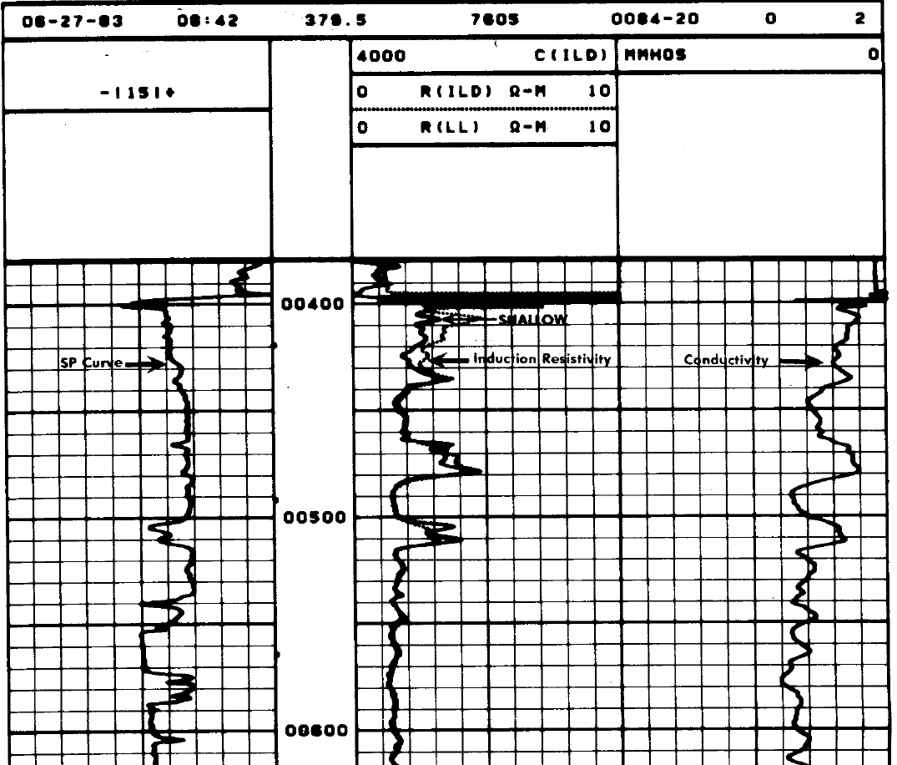
Exercises in Determining USDW on Electric Logs – Example #1
Less than 1,000 feet, ≥ 3 ohms is USDW
USDW at
515 FEET

Slide 39
Determining USDW on Electric Logs – Example #2
Scale 0
20
Less than 1,000 feet, ≥ 3 ohms is USDW

Slide 40
Remember: 1,000 feet to 2,000 feet: 2 ½ ohms or higher is USDW
Scale 0
20

Slide 41
USDW at
1,435 FEET
Scale 0
20
Remember: 1,000 feet to 2,000 feet: 2 ½ ohms or higher is USDW

Slide 42
If the log of the well proposed for conversion shows the base of the USDW, mark the depth of the base of the USDW on the log and label the log as Attachment 5A.
If the e-log of the proposed well does not show the base of the USDW, then the applicant should expand the search to the e-logs of the closest wells to the proposed well until an e-log is located that shows the base of the USDW. Once an e-log is found, mark the depth of the base of the USDW and label the log as Attachment 5A and include as part of the Application.

Slide 43
Determining the Proposed Injection Interval
Applicants should conduct a search of available e-logs in the project area to identify the closest well with an e-log that shows the top and bottom of the proposed injection zone.
SURFACE CASING
BASE OF THE USDW
SAND
100 ft of Net Shale
SHALE
TOP OF ZONE
INJECTION PERFORATIONS
BOTTOM OF ZONE
SHALE
SAND
INJECTION CASING (LONG STRING)

Slide 44
Begin by looking at the log of the well proposed for conversion. If the log of the well proposed for conversion shows the proposed injection zone, mark the depths of the top and bottom of the proposed injection zone on the log and label it as Attachment 5B.
If the e-log of the proposed well does not show the top and bottom of the proposed injection zone, then the applicant should expand the search to the e-logs of the closest wells to the proposed well until an e-log is located that shows the proposed injection zone.
It may be necessary to submit more than one e-log to show both the top and bottom of the proposed injection zone, if both do not occur on the same log. One e-log may show the top of the injection zone, but not the bottom; and, another e-log may show the bottom of the proposed injection zone, but not the top.
If more than one log is required to be submitted, mark the depth of the top or bottom of the proposed injection zone and the proposed completion interval (initial perforations, screen or open hole). Label the log(s) as Attachment 5B and include them as part of the Application.

Slide 45
Productive Interval Search
Why is this needed? Injection into a productive zone is prohibited unless authorized by the Commissioner per LAC 43:XIX.303.D
An injection zone of multiple sands may be permitted provided that the sands capable of hydrocarbon production are isolated. Please conduct a one-mile radius search from the proposed well location to locate productive wells.
If productive wells are located within a one-mile radius, evidence of at least 100 feet of net shale between the proposed injection zone and any productive intervals must be provided.

Slide 46
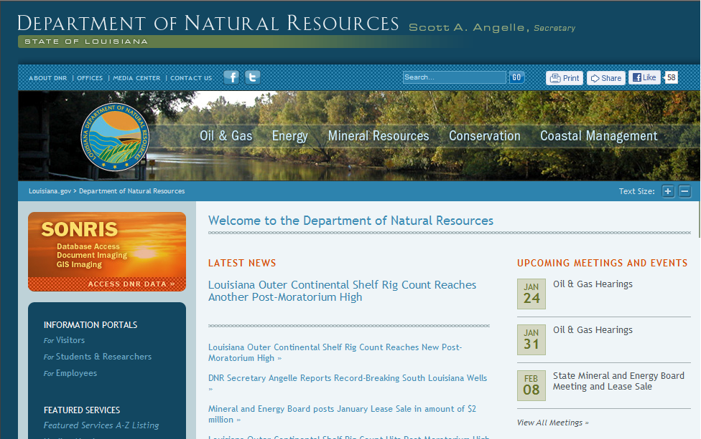
Steps to conduct a Productive Interval Search
Step 1: Go to the DNR homepage at http://dnr.louisiana.gov/

Slide 47
Step 2: Select the SONRIS button

Slide 48
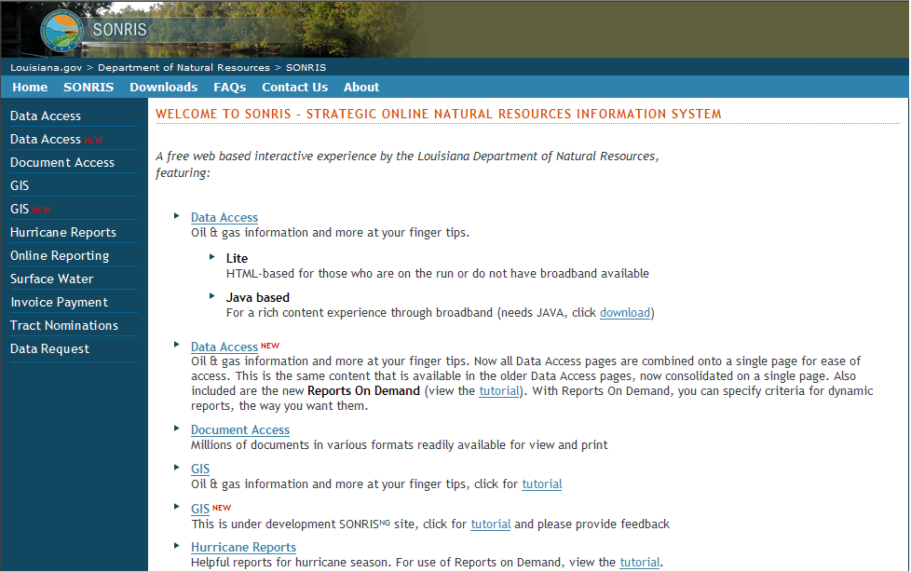
Step 3: Select the Data Access New button

Slide 49
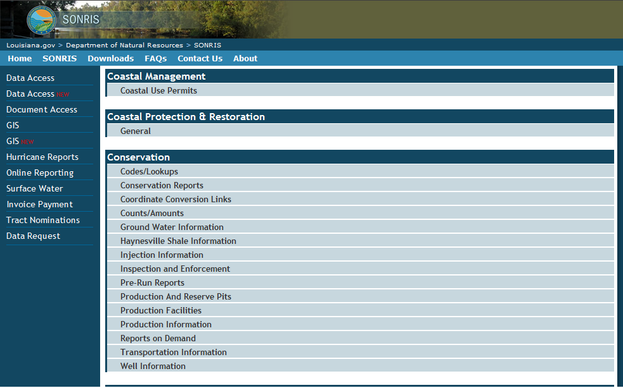
Step 4: Under the Conservation tab, select Injection Information

Slide 50
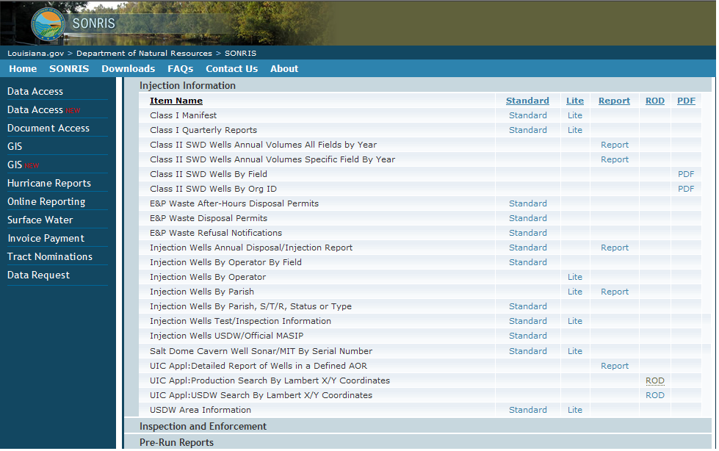
Step 5: Scroll down to UIC Appl: Production Search By Lambert X/Y Coordinates & select Reports on Demand (ROD) link

Slide 51
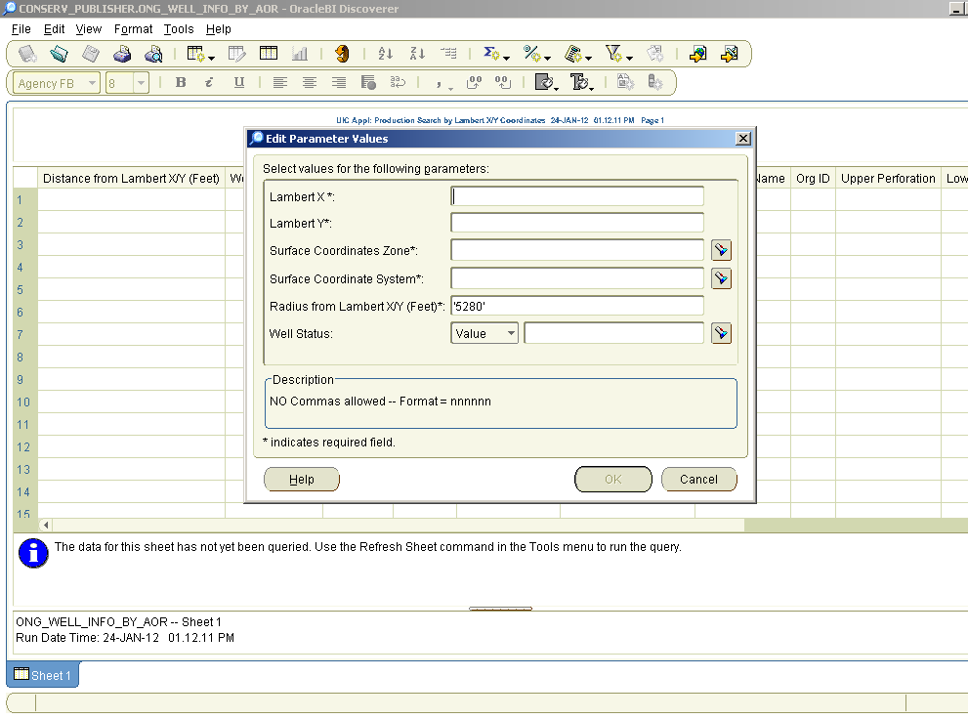
Step 6: In the Edit Parameter Values box enter the Lambert X and Y coordinates of the well

Slide 52
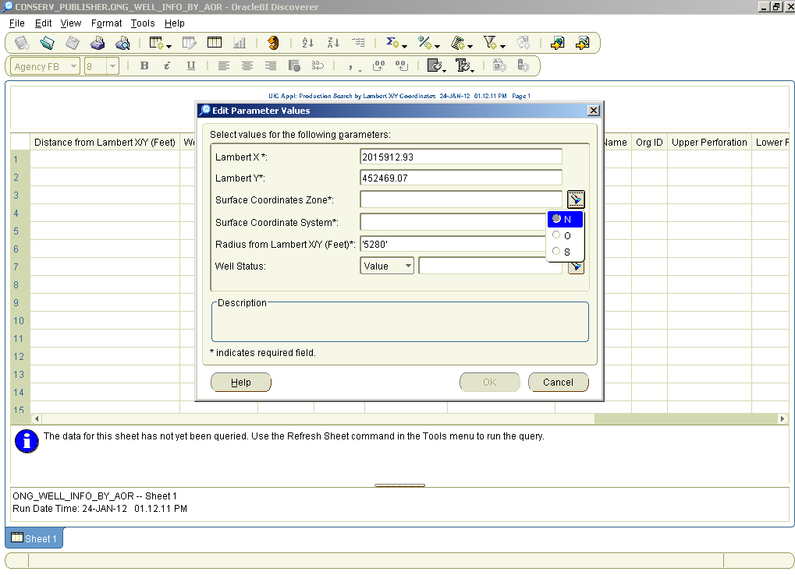
Step 7: Use the drop down box to select the Surface Coordinates Zone

Slide 53
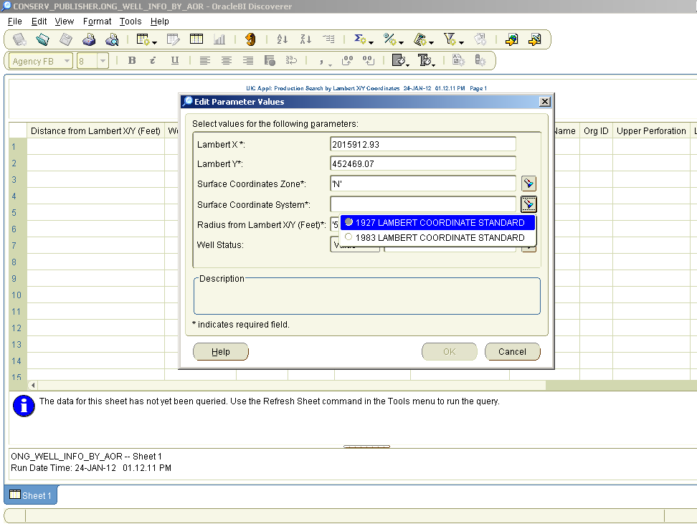
Step 8: Use the drop down box to select the Surface Coordinate System

Slide 54
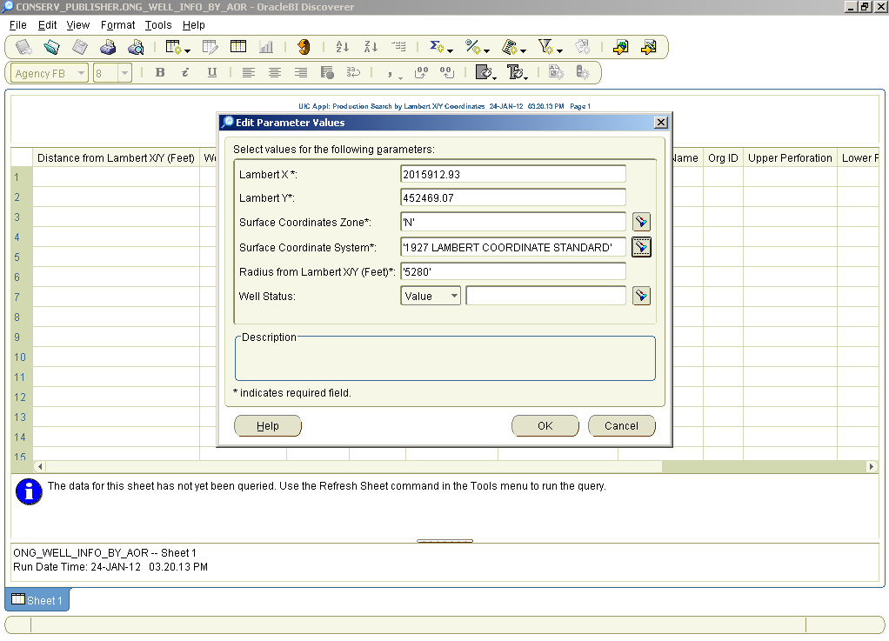
Step 9: To conduct a one-mile radius search from the proposed well location to locate productive wells, press the OK button

Slide 55
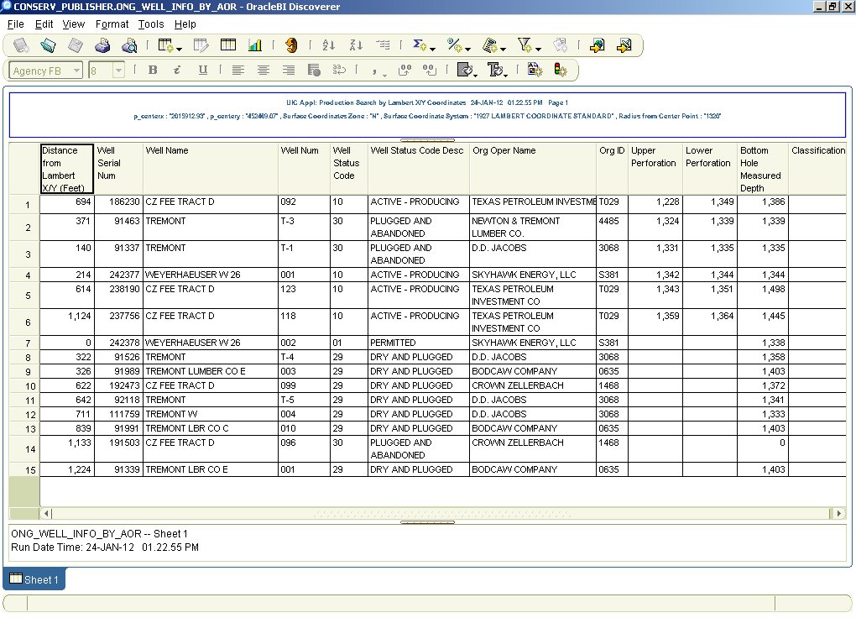
Step 10: The resulting Production Search is shown in spreadsheet format

Slide 56
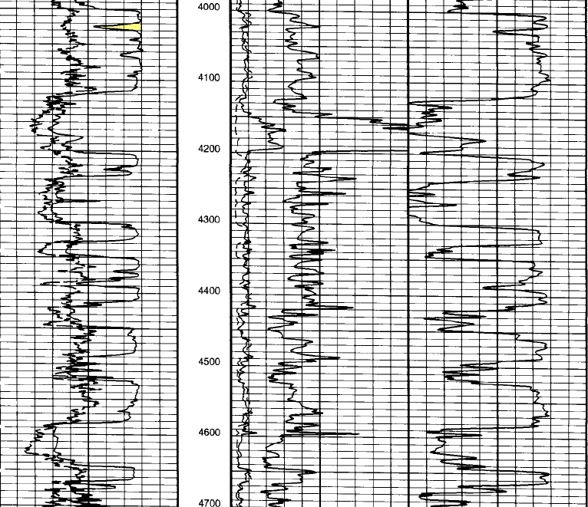
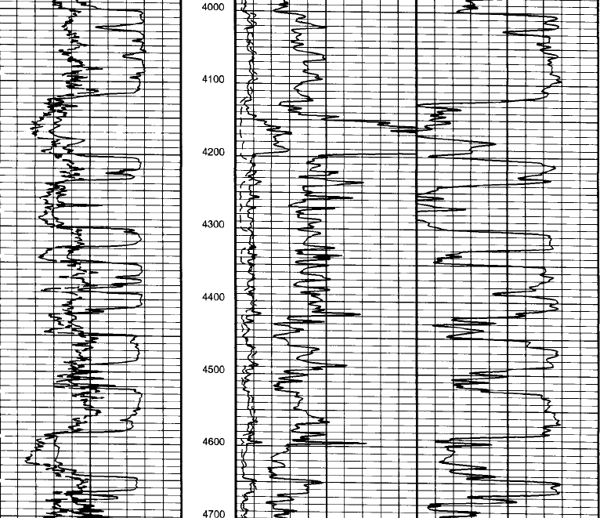
Here’s the marked e-Log of our example
Sand Stringer
Top of Zone at 4,120 feet
Isolating Shale

Slide 57
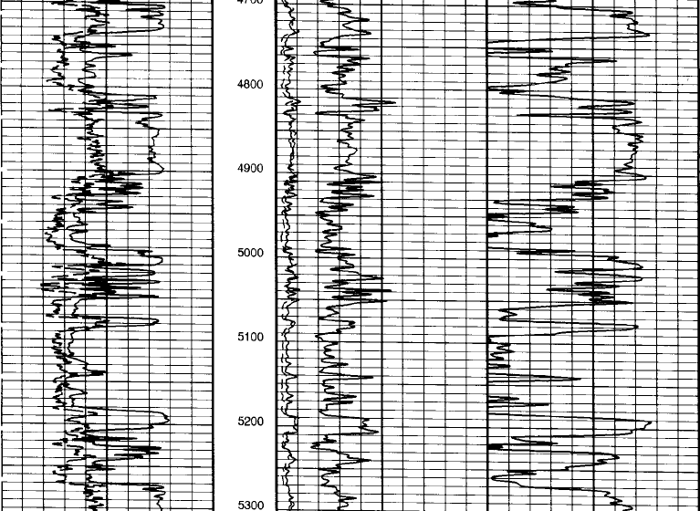
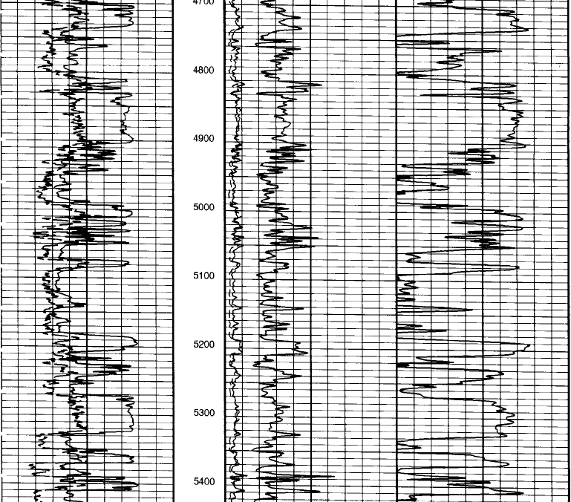
Perforations from
5,080 – 5,130 &
5,150 - 5,170 feet
Bottom of Zone at 5,270 feet
Isolating Shale
Sand Stringer

Slide 58
Cement Bond Log (CBL)
Sufficient external cement isolation is required as per the requirements of LAC XIX.43:419 and should prevent upward fluid migration.
The applicant must submit any available CBLs of the proposed well to demonstrate that the annulus between the injection casing and the wellbore has sufficient cement isolation of the proposed injection zone.
If a CBL was performed prior to submission of the Application, please submit a copy with the Application and label it as Attachment 5C.
When the CBL is performed on the well, it must show a minimum continuous interval of 60% bonded cement between the injection casing and the wellbore, which is bonded to the first confining shale formation immediately above the proposed injection zone and indicate evidence of cement at or below the bottom of the proposed injection zone.
The Cement Bond Log (CBL) Interpretation Guide must be used in order to determine the minimum continuous interval of bonded cement that is required to isolate the proposed injection zone. The CBL Interpretation Guide is located on the DNR website at the following link:
Go to www.dnr.louisiana.gov, click on the Conservation tab at the top of the page >> click on Forms (on the left side of the page) >> scroll down to Cement Bond Logging Guidelines under the Injection and Mining tab and click the PDF link.
If the CBL does not prove cement isolation of the proposed injection zone, the IMD will require perforating and squeezing cement above and or below the zone and subsequent logging.

Slide 59
Review of LOGS to be included in
Attachment 5
Logs must be provided to indicate the base of the lowermost USDW, the proposed injection zone, and prove cement isolation.
The Application must include electric logs (e-logs), preferably with a one or two inch scale, that show the proposed injection zone, the base of the USDW and, if available, a Cement Bond Log.
Mark each log with the Serial Number of the well, and ensure that it includes the header with scale and that the e-logs include at least 1,000 feet below the bottom of the proposed injection zone or the TD. (Photocopies of the logs are acceptable).
An e-log of the well itself, if available, should always be included as part of the Application.
Below are examples of portions of our marked e-logs.

Slide 60
So just to review, here’s our marked example USDW Log,
Labeled Attachment 5A

Slide 62
USDW at
1,435 FEET
Attachment 5A

Slide 63
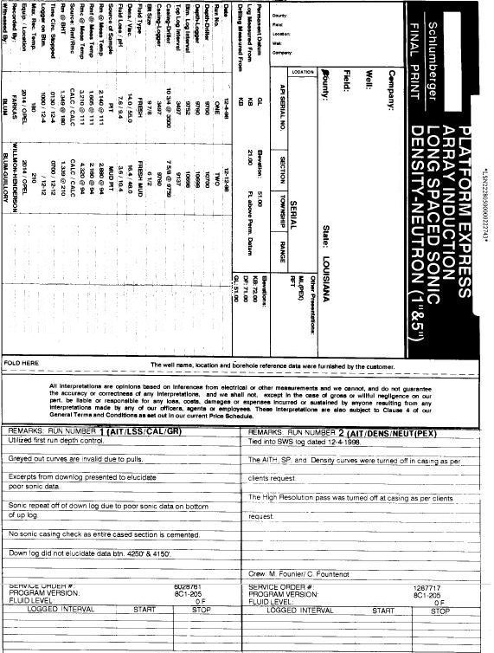
And our marked example log
Indicating the proposed zone, labeled Attachment 5B.
WINN
2238’ FNL and 172’ FWL OF SEC 26, TWN 11 N, RGE 1 WEST
17059220000000
2238’ FNL and 172’ FWL OF SEC 26, TWN 11 N, RGE 1 WEST
WINN
JOE BALL, LLC
26
COLGRADE
OIL AND GAS WELL NO. 001
11N
123456
01W

Slide 64
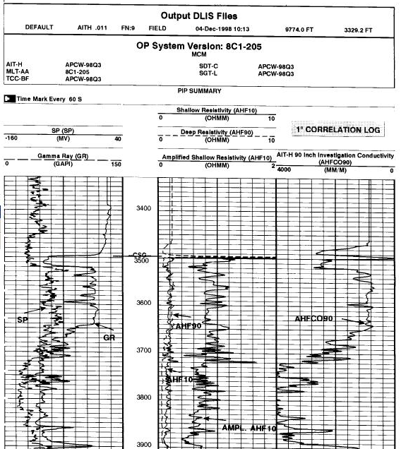

Slide 65
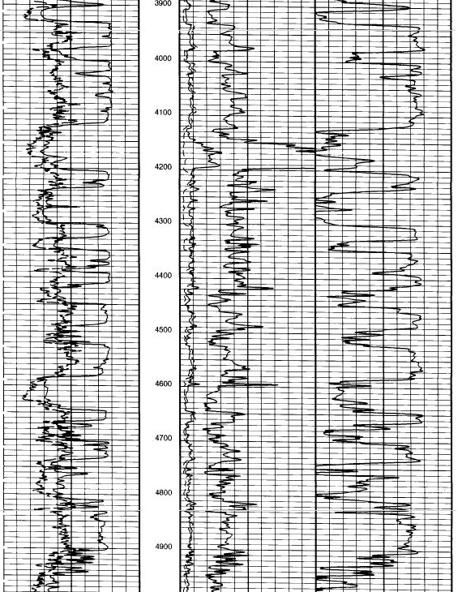
Packer at 4,100 feet
Top of Zone at 4,120 feet

Slide 66
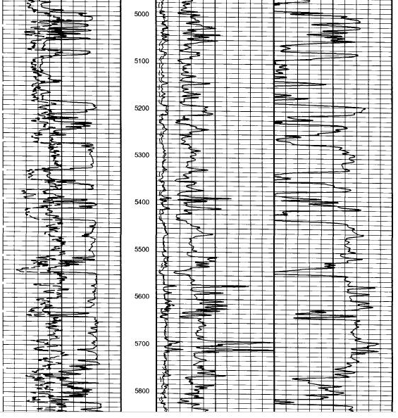
Perforations from
5,080 – 5,130 &
5,150 - 5,170 feet
Bottom of Zone at 5,270 feet
Attachment 5B
A CBL is not included. Item 6 on the Work Prognosis indicates that a CBL will be run during the conversion procedure.

Slide 67
Here is our completed Proposed Injection Interval Information from the Example logs
Items 39 – 42
This information consists of:
Top and bottom of the proposed injection zone
Top and bottom of the proposed injection interval.
Injection formation name
Proposed method of injection.

Slide 68
Pressure Calculation Data
Items 43 – 46
Injection Rate in Barrels per Minute
Injection Fluid Expected Temperature
Injection Formation Properties (Porosity and Permeability)
MASIP Calculation Basis:
Eaton’s Fracture Gradient Chart, Louisiana Gulf Coast
Step rate fall off test
Based on the fracture gradient of the confining formation

Slide 69
MASIP CALCULATION BASIS
Eaton’s Fracture Gradient Chart, Louisiana Gulf Coast
The MASIP will be calculated not to exceed 90% of the fracture pressure of the injection zone as predicted by Ben Eaton’s 9 pounds per gallon (ppg) pore pressure curve. The specific gravity (weight) of the injection fluid is required to complete the calculation.
Or……
Step Rate - Fall Off Test
A Fall Off Test is a pressure transient test that consists of shutting in an injection well and measuring the pressure fall off. It is impacted by the magnitude, length, and rate fluctuations of the injection period. A properly conducted Step Rate and/or Fall Off Test can prove bottom hole fracture pressure. Falloff testing analysis can also provide transmissibility, skin factor, and well flowing and static pressures. Contact an Engineer with this Division for guidelines pertaining to step rate fall off tests.
Or…..

Slide 70
MASIP CALCULATION BASIS, Cont’d
Fracture gradient of the confining formation
Under the directive of Intra-Office Policy Statement No. IMD-GS-09, the MASIP can be calculated by limiting the pressure at the depth of injection to 75% of the pressure needed to fracture the confining formation.
The Policy Statement requires the applicant comply with additional control measures to assure protection of the lowermost USDW.
The following information must be provided:
Geomechanical data of the confining zone above the proposed injection zone, labeled Attachment 9A
An area of review (AOR) of one-half mile must be conducted
If the top of the proposed injection zone is within 1,000 feet of the base of the USDW, the MASIP cannot exceed 0.25 psi/ft.
The surface casing must be set at least 100 feet below the base of the USDW.
A monitor well Application (UIC-25) along with a Groundwater Monitoring plan, labeled Attachment 9B will be required.

Slide 71
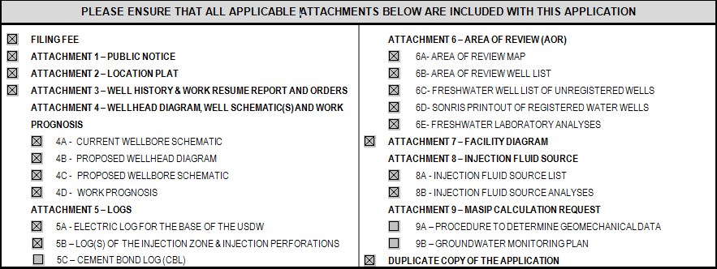
Item numbers 47 through 49 requests additional information relevant to the permitting process.
A checklist has been added to the Application to ensure all Attachments are included.

Slide 72
This section must be completed by an Agent or Contact person authorized to act for the Operator and is designated to receive correspondence regarding the application. The Operator’s signature authorizes this Agent or Contact to speak with the IMD on the Operator’s behalf.

Slide 73
The application must contain a signature from an associate of the Operating Company which is: an Officer, Manager, General Partner, Proprietor, Operator of the Well or a direct employee in a decision-making role. A Consulting Agent’s signature is not acceptable in this section of the form.

Slide 74
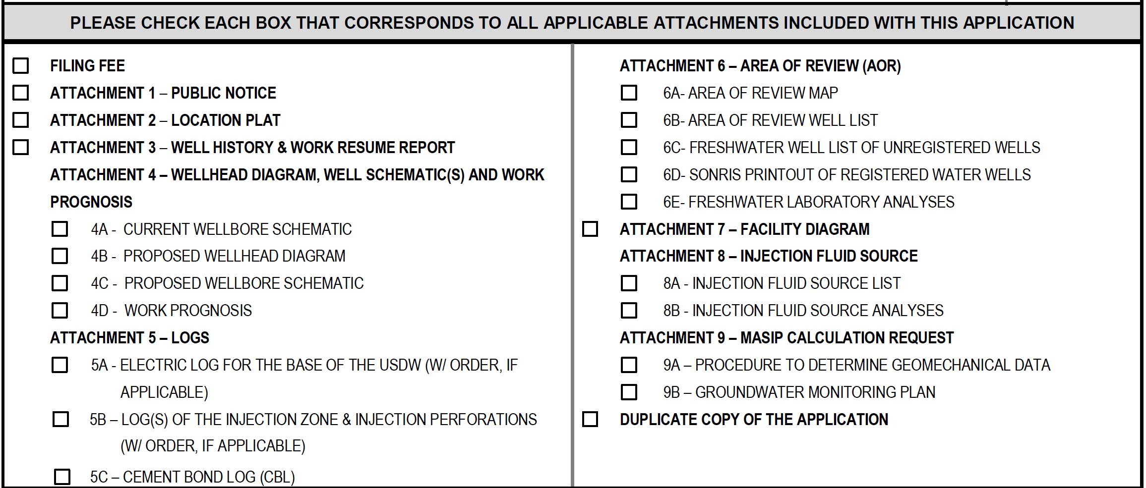
The following section will be found in all the revised forms. By checking each item, the applicant is indicating that each item has been included with the Application.

Slide 75
Additional Attachments Needed to Complete the Application

Slide 76
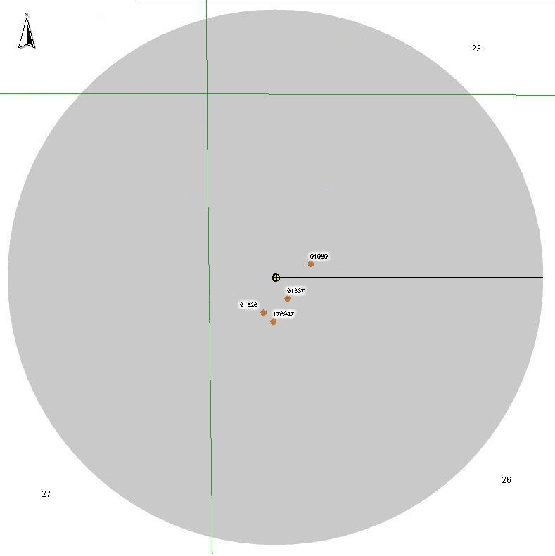
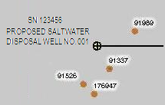
Area of Review Map
Attachment 6A
The AOR map must identify, within a 1,320 ft radius of the proposed injection well, the locations of the following:
1. The proposed injection well
SN 123456
PROPOSED SALTWATER DISPOSAL WELL NO. 001
2. All producing wells
¼ MILE RADIUS
3. All injection wells
4. All shut-in wells
5. All plugged and abandoned wells
6. All dry holes
7. All source water wells (for
enhanced recovery)
LOCATION:
JOE BALL, LLC (J123)
SALTWATER DISPOSAL WELL NO. 001
SN 123456
SECTION 26, TWN 11N, RNG 01W
COLGRADE FIELD
WINN PARISH, LOUISIANA
LEGEND
WELL LOCATION
8. All freshwater wells unless
plotted on the certified plat
CONSULTING CO., LLC
617 N. THIRD STREET
BATON ROUGE, LA 70802
Attachment 6A

Slide 77
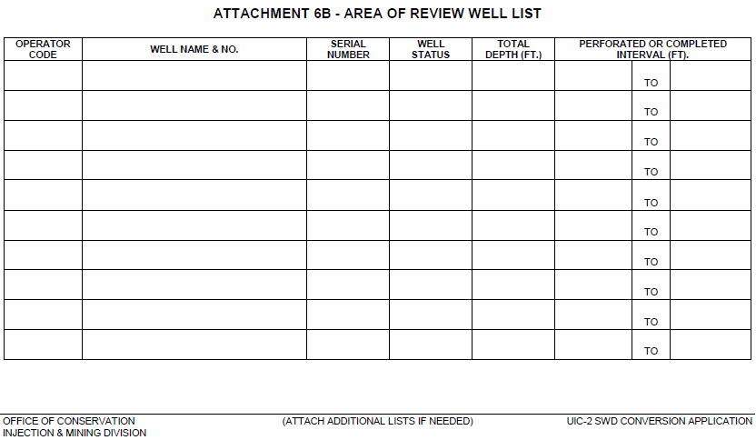
Area of Review Well List
Attachment 6B
Searching SONRIS for wells in the DNR database; and
Researching field maps and company files
J123
OIL AND GAS WELL NO. 002
91989
10
10,900
10,700
10,750
J123
OIL AND GAS WELL NO. 003
176947
30
10,720
10,160
10,250
J123
OIL AND GAS WELL NO. 004
91526
30
10,810
10,200
10,325
J123
OIL AND GAS WELL NO. 006
91337
30
10,900
10,700
10,760

Slide 78
Freshwater Well List
Attachment 6C
The Freshwater Well List, Attachment 6C must identify any unregistered freshwater wells within the AOR. A diligent search must be attempted to locate any unregistered freshwater wells within the AOR of the proposed injection well. The search must include:
Conducting a foot-search of the ¼ mile AOR to identify any unregistered freshwater wells in the field; and
Researching company files for unregistered Rig Supply wells.
IMD will not accept printouts of the DNR SONRIS database search, Attachment 6D in lieu of the Freshwater Well List of Unregistered Wells, Attachment 6C.
All wells listed on the Freshwater Well List, Attachment 6C must be plotted on the Area of Review Map, Attachment 6A, the Location Plat, Attachment 2 or both.

Slide 79
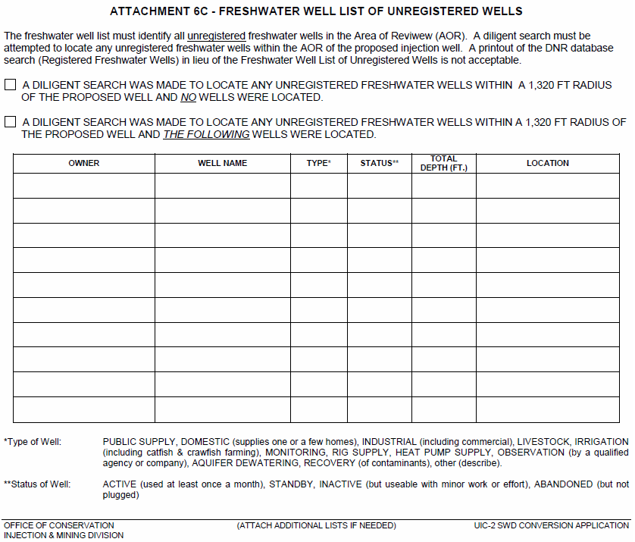
Joe Smith
Joe Smith Freshwater Well
Domestic
Active
324 ft
Longitude: 92º 26’ 51.7”
Latitude: 31º 54’ 37.2”

Slide 80
SONRIS Database Printout of DNR Registered Water Wells
Attachment 6D
A printout of the SONRIS database search for DNR registered water wells within the AOR must be included as part of the Application and labeled as Attachment 6D.
To search the SONRIS database, go to www.dnr.louisiana.gov, click on SONRIS (logo on the upper left side of the page) >> Data Access (on the upper left side of the page) >> Lite (immediately below Data Access) >> Water Wells by Latitude Longitude (under Ground Water Information at the bottom left of the page).
To search for registered water wells in the AOR of the proposed well, enter the Latitude and Longitude (NAD 83) of the proposed injection well and a search radius of 1,320 feet. All wells listed on the SONRIS Database Printout of DNR Registered Water Wells, Attachment 6D must be plotted on the Area of Review Map, Attachment 6A, the Location Plat, Attachment 2, or both.
Please label the printout Attachment 6D and include as part of the Application.

Slide 81
SONRIS Database Printout of DNR Registered Water Wells
Attachment 6D, cont’d.
31.910833333
-
92.448888889
1320
Found
0
Records
Attachment 6D
Note: This search should be conducted using NAD 83 Latitude / Longitude as stated in the Instructions.

Slide 82
Here’s a common problem encountered
during application review…

Slide 83
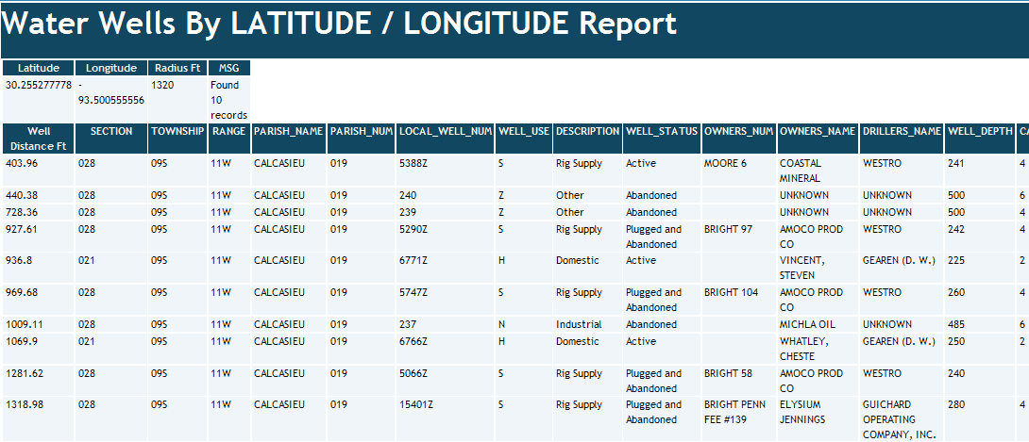
Attachment 6D

Slide 84
Attachment 6D

Slide 85
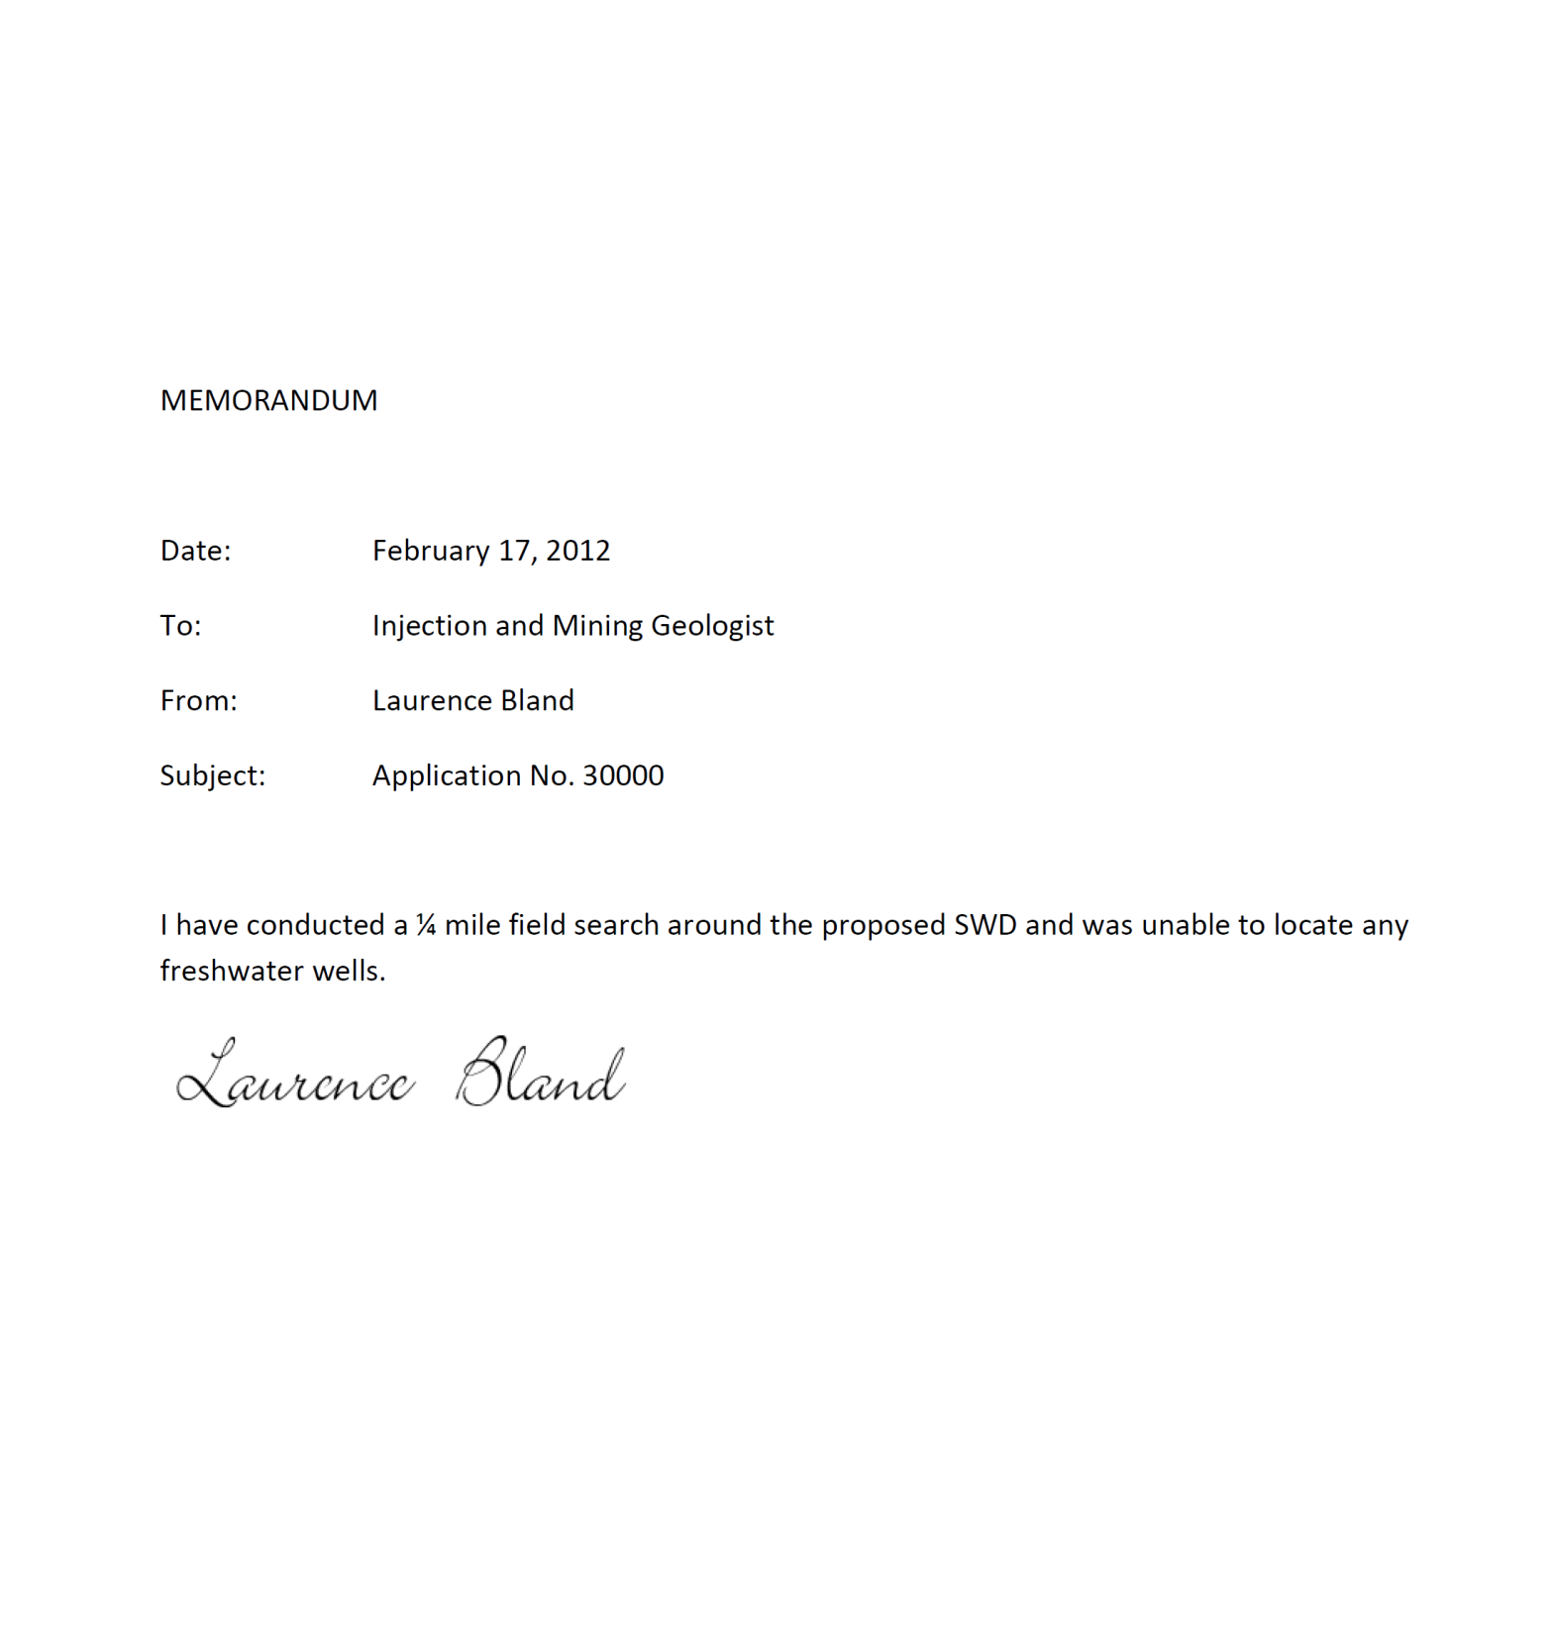
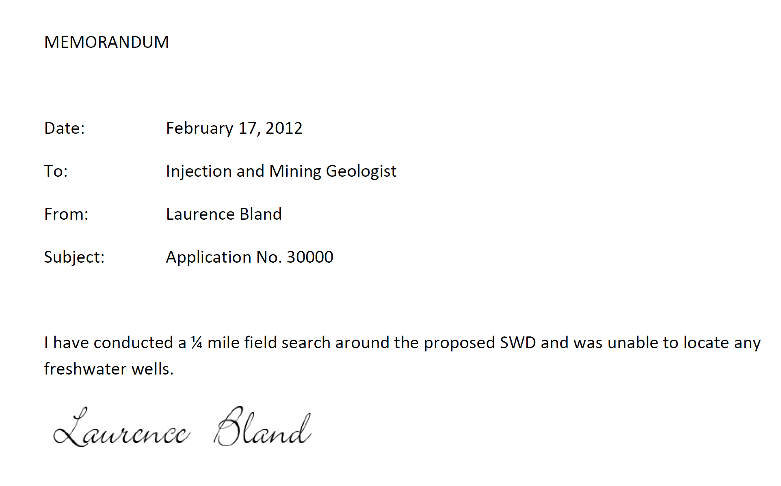
SAMPLE

Slide 86
Freshwater Laboratory Analyses
Attachment 6E
Laboratory analyses of a water sample from each unplugged freshwater well must be provided. Bailers or surface pumps with tubing should be used to sample the wells that no longer have pumps.
A written explanation must be submitted for all unplugged wells on the Freshwater Well List, Attachment 6C and SONRIS printout, Attachment 6D that are not sampled.
The laboratory analyses must be signed originals from a Louisiana Department of Environmental Quality (LDEQ), Louisiana Environmental Laboratory Accreditation Program (LELAP) accredited laboratory.
The analysis sheet(s) must identify the freshwater well sampled, and, at a minimum, include measurements of Chlorides (mg/l) and Total Dissolved Solids (mg/l). A PDF list of Accredited Laboratories can be found on the LDEQ website, www.deq.louisiana.gov, Under Divisions >> Public Participation and Permit Support >> Louisiana Laboratory Accreditation Program (scroll down to the Accredited Laboratories link).

Slide 87
Freshwater Laboratory Analyses cont’d.
Attachment 6E
Please label the analysis sheet(s) Attachment 6E and include as part of the Application.
Please ensure that the Sample Name or Sample Id on the chain-of-custody submitted to the laboratory identifies the location from which the sample was collected and can be correlated to a freshwater well name or DNR number listed on the Freshwater Well list, Attachment 6C or the SONRIS Database Printout of DNR Registered Water Wells, Attachment 6D. This is usually the sample name or sample ID that also appears on the laboratory report.

Slide 88
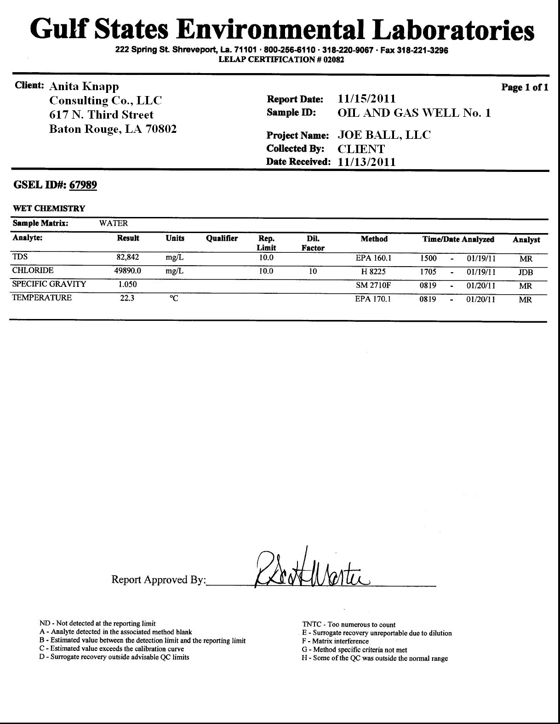
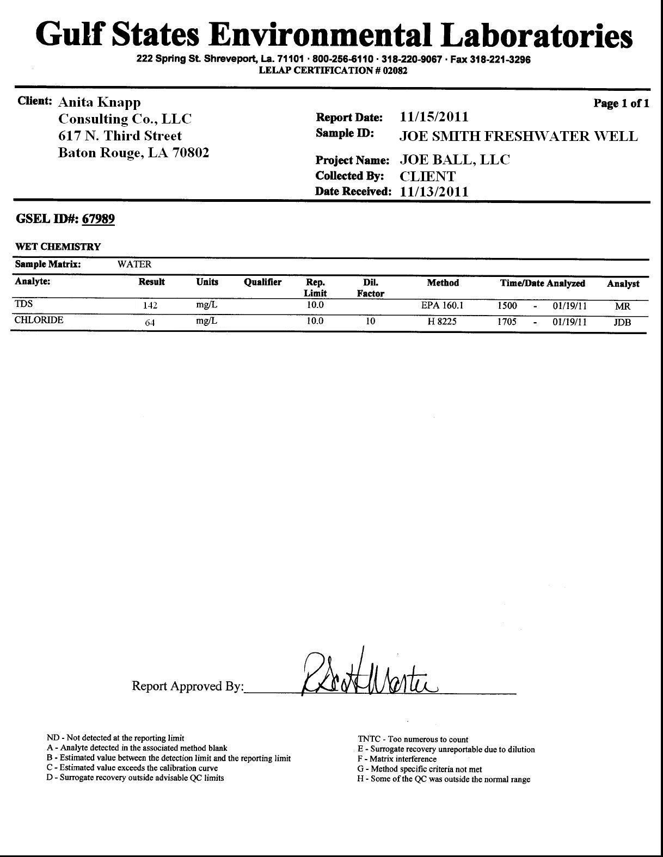
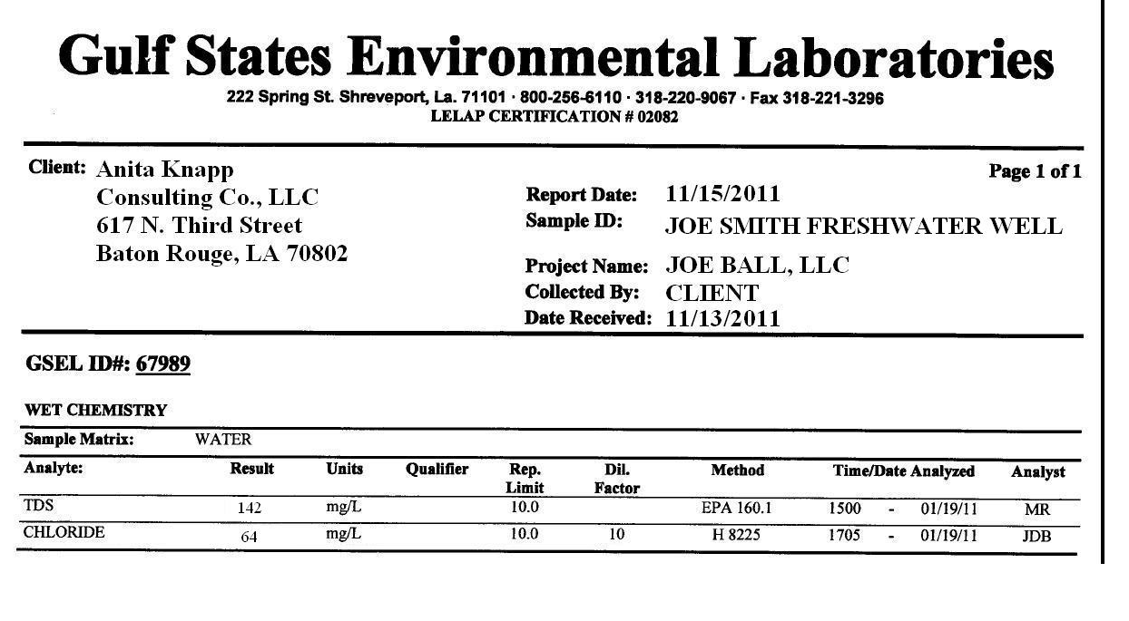
Attachment 6E

Slide 89
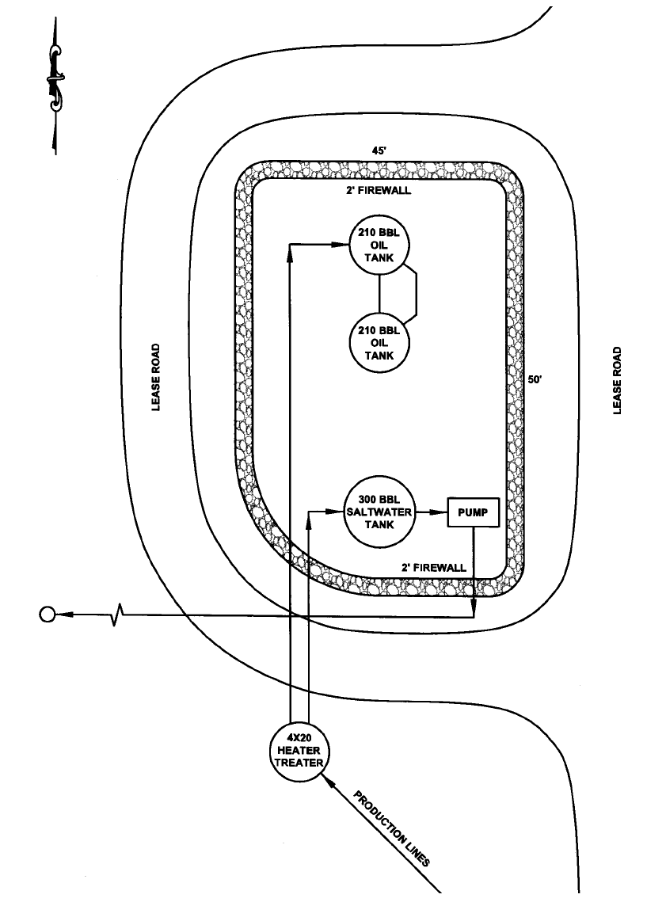
Facility Diagram
Attachment 7
A surface facility diagram must be included as part of the Application and labeled as Attachment 7. The diagram should be drawn to scale (or reasonably close) and should show the following where applicable:
1. Proposed well
2. Tanks
3. Pits
4. Containment levees
5. Flow lines entering and leaving the
facility
6. Rig supply well
7. Producing wells if located within the
area shown
8. Pertinent buildings
9. Landmarks and other significant
structures or features
PROPOSED SALTWATER DISPOSAL WELL NO. 001
Attachment 7

Slide 90
Injection Fluid Source List
ATTACHMENT 8A
The Injection Fluid Source List must include each well that will contribute fluid to the proposed injection well and should only include wells of which the applicant is the registered operator-of-record.
Applicants must complete the Injection Fluid Source List that is included in the Form UIC-2 SWD Conversion Application package labeled as Attachment 8A. Printouts of the SONRIS database search in lieu of the Injection Fluid Source List (Attachment 8A) will not be accepted. Please include Attachment 8A as part of the Application package.
Once a well is permitted for SWD, the operator can apply to add additional wells to their fluid source list to include wells produced by a different operator by submitting a Form UIC-13 Community Saltwater Disposal System Initial Notification.

Slide 91
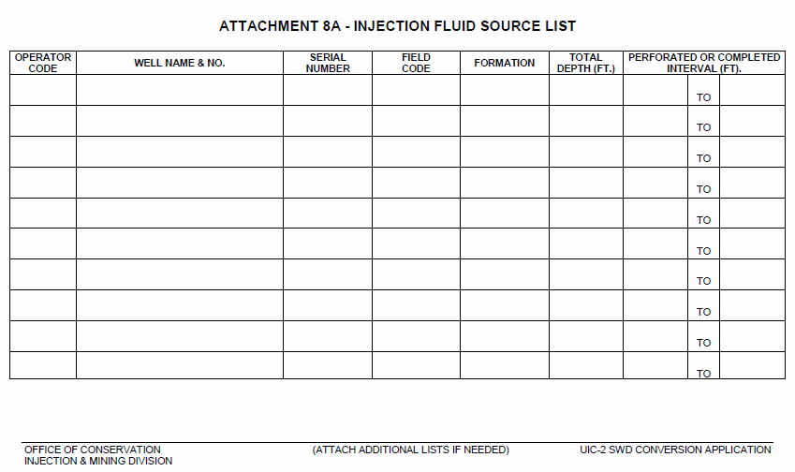
Injection Fluid Source List
ATTACHMENT 8A
J123
OIL AND GAS WELL NO. 006
91337
2768
10,000’ Sand
10,900
10,700
10,760

Slide 92
Injection Fluid Source Analyses
ATTACHMENT 8B
Laboratory analyses of a representative sample of the fluid to be injected in the proposed well should be included as part of the Application. The laboratory analyses must be signed originals from a LDEQ LELAP accredited laboratory. A PDF list of Accredited Laboratories can be found on the LDEQ website, www.deq.louisiana.gov, under Divisions >> Public Participation and Permit Support >> Laboratory Accreditation (scroll down to the Accredited Laboratories link).
The analysis sheet(s) must indicate the source of the sample and at a minimum include measurements of:
1. Chlorides (mg/l)
2. Density (g/cc or ppg) or Specific gravity
3. Total Dissolved Solids (mg/l)
4. Temperature of sample when specific gravity was measured

Slide 93
Injection Fluid Source Analyses
ATTACHMENT 8B cont’d.
The Sample Name or Sample ID on the analyses sheet(s) should identify the location point where the sample was collected and must correlate to a well(s) on the Injection Fluid Source List, Attachment 8A.
If the sample location is a tank battery or common gathering point, then a signed written statement will be needed to associate the fluid source wells with the sample location.
If the fluid source well(s) are not currently producing water, the applicant should submit a signed written statement agreeing to the submittal of the laboratory analyses as soon as fluid is available.
The Approval-to-Construct letter for this well can be issued without the analyses; however, the Permit-to-Inject will not be issued until the analyses have been received by this Office.
Please label the analyses, Attachment 8B or if no fluid is available, label the written statement stating such as Attachment 8B and include as part of the Application.

Slide 94
Attachment 8B

Slide 95
Here’s another common problem encountered
during application review…

Slide 96
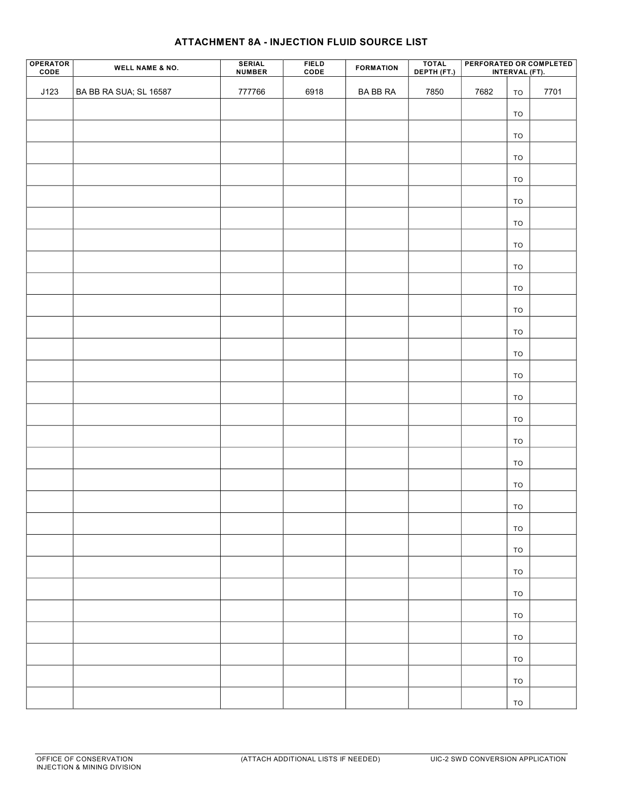

Slide 97
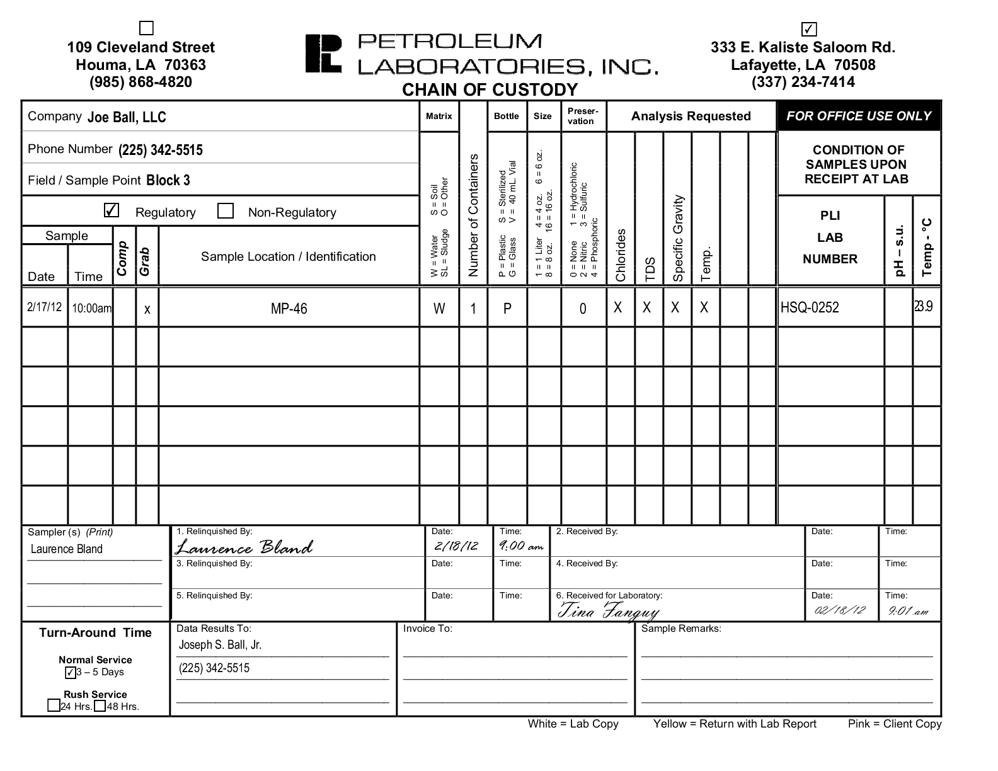

Slide 99
The Fluid Source Analysis cannot be connected to the well on the Fluid Source List

Slide 100
SAMPLE
If required, please include a letter similar to this one which indicates where the sample was collected.

Slide 101
GROUP EXERCISES

Slide 102
Exercise Number 1
Determine the Base of the USDW from the following log
**Remember**
The base of the USDW can be determined from the deep induction curve, generally the dotted curve, on the e-log. Resistivity changes with temperature and depth, therefore the guidelines below are used to approximate the lowermost USDW in sands at the following depths:
1. Ground surface to 1,000 feet: 3 ohms or higher is considered USDW;
2. 1,000 feet to 2,000 feet: 2 ½ ohms or higher is considered USDW; and
3. 2,000 feet and deeper: 2 ohms or higher is considered USDW.
The base of the USDW is typically established at the base of the sand unit that contains the lowermost USDW. Clay or shale intervals with resistivities higher than those listed above are not considered USDW.

Slide 103
Scale 0
5
From ground surface to 1,000 feet ≥ 3 ohms is USDW

Slide 104
Scale 0
5

Slide 105
Scale 0
5

Slide 106
USDW at
675 FEET
≥ 3 ohms
Base of a Sand
Scale 0
5

Slide 107
If your answer is 675 feet, you are correct!

Slide 108
LET’S TRY ANOTHER ONE…

Slide 109
Exercise Number 2
What’s wrong with these sections of the Application?
ANITA KNAPP
AGENT

Slide 110
Exercise Number 3
Determine the following from the following log:
Base of the USDW
Select the Top of the Injection Zone between
3,000 and 3,200 feet
Select the Bottom of the Injection Zone between
4,300 and 4,800 feet

Slide 112
Less than 1,000 feet, ≥ 3 ohms is USDW
Scale 0
20

Slide 113
USDW
1,000 to 2,000 feet, 2 ½ ohms or higher is USDW
Base of a Sand
Scale 0
20
The base of the USDW is at 930 feet

Slide 114
Scale 0
20

Slide 115
Scale 0
20
Find a possible
Top of Injection Zone between the depths of
3,000 and 3,200 feet

Slide 116
Top of the Injection Zone between 3,000 and 3,200 feet
Option 1
SHALE LINE
Option 1
Notice the slight separation on the resistivity curves
And here’s the isolating shale but let’s try another possible top of zone.

Slide 117
Top of the Injection Zone between 3,000 and 3,200 feet
Option 2
SHALE LINE
Option 2
There is less separation on the resistivity curves and sufficient confining shale therefore Option 2 is preferable. The proposed top of zone is
3,050 feet.

Slide 118
Determine a potential Bottom of Injection Zone between the depths of
4,300 and 4,800 feet
Scale 0
20

Slide 119
Bottom of the Injection Zone between 4,300 and 4,800 feet
SHALE LINE
There is sufficient shale to isolate our selection, therefore we should select 4,525 feet as our proposed bottom of zone.

Slide 120
Class II Enhanced Recovery (ER) Wells
(Form UIC -2 ER)

Slide 123
Enhanced Recovery (ER) Wells
Use Form UIC-2 ER
The application process is the same as with Class II UIC-2 SWDs except for the following:
An Order creating a Secondary Recovery or Enhanced Recovery (ER) project, signed by the Commissioner of Conservation must exist before a permit can be issued for an ER well.
ER projects and Orders associated with them are under the jurisdiction of the Engineering and Geological Divisions of Conservation.
Pilot projects must first have approval through the Engineering and Geological Divisions of Conservation before the Injection and Mining Division can approve the permit.

Slide 124
Checklist for Attachments to be included in an ER Application
A copy of the Order creating the Secondary Recovery or Enhanced Recovery (ER) project, signed by the Commissioner of Conservation must be submitted with the ER Application.

Slide 125
Class II Annular Disposal Wells (Form UIC-9)

Slide 128
Class II Annular Disposal Wells
Form UIC-9
SURFACE CASING
BASE OF THE USDW
ANNULAR DISPOSAL ZONE
TUBING AND PACKER
CEMENT
INJECTION CASING (LONG STRING)
The Annular Injection Zone is defined from the surface casing shoe to the top of cement of the long string casing

Slide 129
To qualify for Annular Disposal, economic hardship must be proven
The intent for annular disposal is for marginal wells where disposal costs would be prohibitive.
Annular Class II permits are only valid for 12 months and must be renewed annually.
Only water from the well itself can be disposed into an annular disposal well.
There must be a minimum of 100 feet of net shale between the base of the USDW and the surface casing shoe.
Production reported on the UIC-9 will be compared to production reported to the Production Audit Division during the review process.
An MIPT cannot be performed on an Annular Injection Well. Wells of this type are tested by means of Radioactive Tracer Survey (RTS) only.

Slide 130
Community Saltwater
Disposal Wells
(Form UIC-13)

Slide 131
Community VS. Commercial
Community Saltwater Disposal Well
Saltwater disposal well within an oil or gas field which is operated by one operator of record for disposal of E&P Waste fluids and used by other operators of record in the same field or adjacent fields for noncommercial disposal of their produced water
Such operators share in the costs of operating the well/system
Specific definition for “adjacent fields”
Commercial Saltwater Disposal Well
A legally permitted E&P Waste storage, treatment and/or disposal facility which receives, treats, reclaims, stores, and/or disposes of E&P Waste for a fee or other consideration

Slide 132
Form UIC-13 Community Saltwater Disposal System Application
Instructions
Operator and well information
Fluid Source List Operator of record’s well(s) and other operator’s well(s)
Certification by Operator
Community Disposal Well Working Agreement
Agreement must contain:
Non-profit and non-commercial statement
Pro-rata share of the disposal well’s operating expenses
Pro-rata share calculated and billed monthly
[PRO-RATA SHARE] = [TOTAL MONTLY MAINTENANCE EXPENSES] x [(BBLS DISPOSED BY OTHER OPERATORS EACH MONTH) / (TOTAL BBLS OF SALTWATER DISPOSED OF IN THE SAME MONTH)]

Slide 133
Commercial Class II Applications
(Form UIC-2 COM SWD)

Slide 136
Commercial Class II Applications
(Form UIC-2 COM SWD)
A Commercial Class II Disposal Well is a legally permitted Exploration and Production (E&P) Waste storage, treatment and/or disposal facility which receives, treats, reclaims, stores, and/or disposes of E&P Waste for a fee or other consideration.
Same permitting process as the UIC 2 SWD with the following exceptions:
A representative sample of the fluid proposed to be injected must be submitted with the application.
The operator must provide North – South / East – West geologic cross sections across a 2 mile radius with the Application.
The AOR is ¼ mile. If a deficient well is located within the ¼ mile AOR, corrective action will be necessary.
The MASIP can be calculated based on the fracture gradient of the injection formation or based on the fracture gradient of the confining formation. The AOR becomes ½ mile if the MASIP is to be based on the fracture gradient of the confining formation (IMD-GS-09).
A closure plan for plugging and abandoning the well and a cost estimate to implement the closure plan must be included with the Application.

Slide 137
QUESTIONS?

