Slide 1
Maximizing CRS Points through the PPI
Melissa daigle
LCP meeting ● June 29, 2016 ● Baton Rouge

Slide 2
Brief Overview of the Community Rating System
Sole mechanism for discounting flood insurance rates in communities
Class system
Earn points for selected activities
Points earned determines class ranking
Class level corresponds to increasing discounts
Governed by the 2013 Coordinator’s Manual
In effect until December 31, 2016

Slide 3
Brief Overview of the Community Rating System
Four broad classifications for points activities:
Public Information Activities
Mapping and Regulations
Flood Damage Reduction Activities
Warning and Response
Notes:
Public Information Activities
Elevation certificates Map information service
Outreach projects Hazard disclosure
Flood protection information Flood protection assistance
Flood insurance promotion
Mapping and Regulations
Floodplain mapping Open space preservation
Higher regulatory standards Flood data maintenance
Stormwater management
Flood Damage Reduction Activities
Floodplain management planning
Acquisition and relocation
Flood protection
Drainage system maintenance
Warning and Response
Flood warning and response
Levees
Dams

Slide 4
A Closer Look: Outreach Projects
Communities can earn points for outreach activities completed.
Goal: provide the public with information needed to increase flood hazard awareness and to motivate actions to reduce flood damage, encourage flood insurance coverage, and protect the natural functions of the floodplain.
Two classifications of outreach projects
Outreach projects that are distributed every year, and
Outreach projects that are distributed when a flood occurs, but are prepared in advance and updated each year.
Maximum Points Available: 350

Slide 5
A Closer Look: Outreach Projects
Three factors determine the amount of credit earned:
What and how many messages are conveyed,
What type of project it is,
Informational materials that people pick up
Activities that reach out to people, or
Projects targeted to a specific audience
How often it is delivered.
Outreach projects must be delivered at least once each year.
Multipliers are available
30% multiplier if delivered by another organization
40% multiplier if in a Program for Public Information

Slide 6
A Closer Look: Outreach Projects
Future Considerations
FEMA would like to give additional credit in the future for outreach projects that have impact
Looking for activities that make demonstrated changes in people’s behavior.
Example – increase in the number of resident-installed property protection projects
Look for this in the 2017 version of the Coordinator’s Manual.

Slide 7
A Closer Look: Six Priority Messages
Know your flood hazard | Your property is subject to flooding. You are in a repetitively flooded area.
Insure your property for your flood hazard | You need flood insurance. Renters should buy flood insurance for their contents.
Protect people from the hazard | Turn around, don’t drown. Designate a place where your family can meet after an evacuation is issued.
Protect your property from the hazard | Replace your flooded furnace with one elevated above the flood level. Keep trash out of streams and ditches.
Build responsibly | Get a permit before you build. Know the substantial damage rules and the ICC benefits – visit www…..
Protect natural floodplain functions | Report broken silt fences: Keep our streams clean. No pollutants down the storm drains.

Slide 8
Program for Public Information (PPI)
New activity under the 2013 CRS Coordinator’s Manual
Committee-based, localized approach to community outreach
By having a PPI, communities get a 40% multiplier for outreach activities included in the PPI.
Objective: Provide communities with outreach that is:
Designed to meet local needs, and
Monitored, evaluated, and revised to improve effectiveness.

Slide 9
PPI Steps
Step 1: Establish the PPI Committee
Can be either for a single jurisdiction or multiple jurisdictions.
Must meet at least two times.
Half of the members must be from outside local government.
Step 2: Assess the community’s public information
Step 3: Formulate messages
Step 4: Identify outreach projects to convey the messages

Slide 10
PPI Steps
Step 5: Examine other public information initiatives
Step 6: Prepare the PPI document
Document must be adopted by the community.
Step 7: Implement, monitor, and evaluate the program
An evaluation report must be done each year.

Slide 11
Current Project: Stats
Funding Source: EPA Gulf of Mexico Program
Other Project Team Members:
Niki Pace, MS-AL Sea Grant
Tracie Sempier, MS-AL Sea Grant
Stephen Deal, MS-AL Sea Grant
Wes Shaw, Blue Urchin (web design)
Communities Assisted:
Mississippi: City of Biloxi
Louisiana: Parishes of Cameron, Calcasieu, and Vermillion

Slide 12
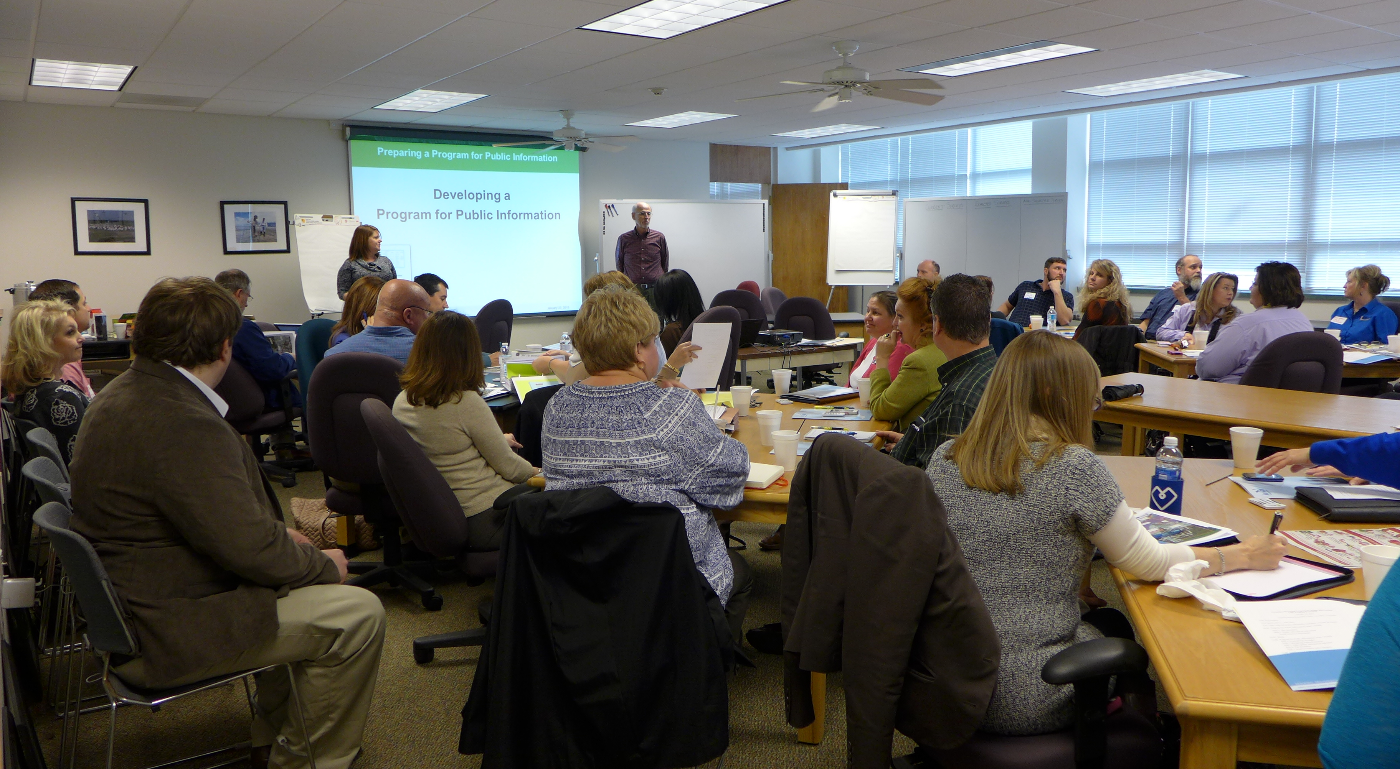
Project Deliverables: PPI Training
Training workshop held on January 22, 2015
Attended by CRS representatives from Louisiana, Mississippi, and Alabama
22 communities represented
Day-long training designed and led by French Wetmore
Workshop was highly reviewed by attendees

Slide 13
Project Deliverables: PPI Documents
Several meetings have been held between project team members and selected communities.
Both PPIs are in draft version and have been submitted to ISO/CRS Specialists for review.
Communities are submitting comments on the draft.
The Project Team is preparing presentations for the city council/parish police juries in the communities.

Slide 14
A Closer Look: PPI Documents
The multi-jurisdictional PPI for Cameron, Calcasieu, and Vermillion contains:
Information on the geography and hazards of each parish,
An overview of the Community Needs Assessment completed by each parish,
Information on flood insurance policies and repetitive loss and severe repetitive loss,
Details on ”Target Areas,” “Target Audiences,” and “Messages and Outcomes” as determined by the committee, and
A strategy for adoption, evaluation, and implementation.
Notes:
Target Areas
Repetitive loss and severe repetitive loss structures that have not been mitigated –
Rental areas – Designated V zones –
Areas protected by a levee – Fastlands (areas above 5 feet) –
Areas that are hydrologically isolated –
Target Audiences
The SWIFT PPI Committee also selected several target audiences for outreach.
Students in driver’s education. First time homeowners
Chambers of Commerce. Business owners.
Repetitive loss property owners. Residents in mobile home parks.
Property surveyors, developers, engineers, and architects.
Insurance Agents. Relator Associations.
Renters and rental property owners.
Subsets of K-12 : (Home economic groups, 4-H, Future Farmers of America (FFA))
Heliport locations
Messages and Outcomes
Protect yourself and your property from hurricanes
How to insure your property for your flood hazard
Understanding elevation regulations Understanding mitigation grant options

Slide 15
Project Deliverables: Online Resources
The project will have a dedicated website that contains several resources for communities, including:
Copies of both PPIs created through the project,
Filmed webinar trainings on how to create a PPI,
Community snapshots describing in detail the steps in getting the PPI created, adopted, and implemented, and
Lessons learned and best practices.

Slide 16
A Closer Look: Lessons Learned
It will take longer than expected.
Be patient and keep moving along.
Single jurisdictions may be easier than multi-jurisdictions.
You likely won’t get everything included on the activity spreadsheet the first go round.
That is ok – you still get outreach points for it. Keep a running list of what to add to the activity spreadsheet the following year.

Slide 17
Questions?
Melissa Daigle
225-578-9968
mtrosc2@lsu.edu

