Slide 1
Oysters and the Oyster Industry:
Enhancing the Resource,
Raising the Lease Moratorium,
And Resolving Coastal User Conflicts
Louisiana Oil and Gas Association CLE
September 16, 2014

Slide 2
Panel Members
Jim Devitt,
  Deputy General Counsel, La. Department of Natural Resources
Larry Marino
  Partner, Oats and Marino
Randy Pausina
  Assistant Secretary, La. Department of Wildlife and Fisheries

Slide 3
Introduction
Comparative timeline of the oyster and oil and gas industries

Slide 4
The Avenal Decision
Avenal v. State, 886 So.2d 1085 (La. 2004)

Slide 5
Oyster Lease Moratorium
History
Why is the moratorium still in place?
Pros and Cons of Lifting the Moratorium
Implementation

Slide 6
State Oyster Initiatives
Oyster Landings
Public seed ground stock assessment
Cultch Plants
Hatchery Raised Larvae
Remote Setting
Alternative Oyster Culture

Slide 7
OYSTER RESTORATION
Randy Pausina | Louisiana Oil & Gas Association CLE | September 16, 2014

Slide 8
Historical Louisiana Oyster Landings
*Preliminary LDWF data
Notes:
Louisiana’s oyster resources are among the largest and most valuable in the United States. LDWF manages approximately 1.7 million acres of public oyster bottoms throughout coastal Louisiana and leases nearly 400,000 acres of water bottom to private individuals for traditional on-bottom cultivation. Louisiana’s public oyster seed grounds are considered to be the backbone of the Louisiana oyster fishery – contributing directly to oyster landings and providing a source of seed oysters for transplanting to private leases.

Slide 9
Historical Louisiana
Seed and Sack Oyster Stocks
Notes:
Since the spill, there have been severe declines in oyster abundance on the public seed grounds in both seed and sack size oysters compared to historical averages, with particular declines in the Pontchartrain basin (east of the river).

Slide 10
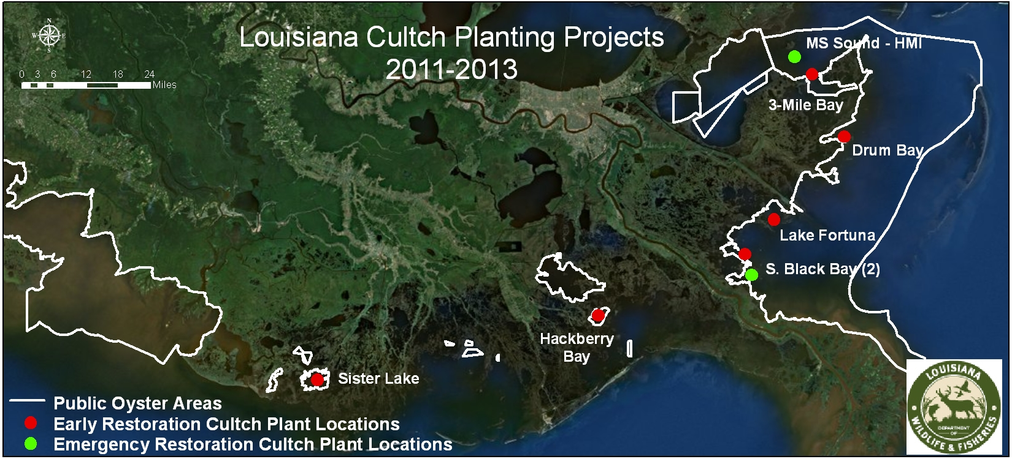
Cultch Plants
Notes:
Given the importance of the resource to the state, LDWF took a proactive approach to oyster rehabilitation. Using LDWF funds, the department constructed two “ emergency restoration” cultch plants in 2011, east of the river. (Shown in green on the map)
LDWF also prioritized the Louisiana Oyster Cultch Project as part of the DWH Natural Resource Damage Assessment (NRDA) Early Restoration Process. This $14 million project funded by BP includes placement of oyster cultch onto public oyster seed grounds and construction of an oyster hatchery facility. (Shown in red on the map.)

Slide 11
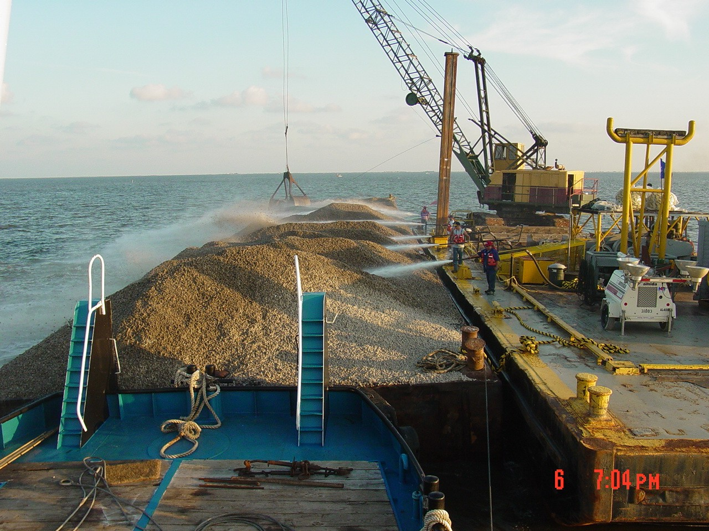
Cultch Plants
Notes:
Cultch plantings provide hard substrate on which free-swimming oyster larvae can attach and grow (Figure 1). The cultch planting approach has been employed by LDWF since 1917 and is a proven oyster management technique. The cultch material can include shell, limestone, crushed concrete and ? and is typically deployed from a barge using high pressure water cannons.
In 2011, 59,295 cubic yards cy of cultch material was placed at 2 locations east of the Mississippi River. These were funded by LDWF.
Between the spring of 2012 and summer of 2013, over 170,000 cubic yards of cultch material was placed at six locations, both east and west of the Mississippi River as part of NRDA Early Restoration.
LDWF biologists continue to monitor these and other oyster reefs throughout coastal Louisiana as part of the LDWF Oyster Management Program.

Slide 12
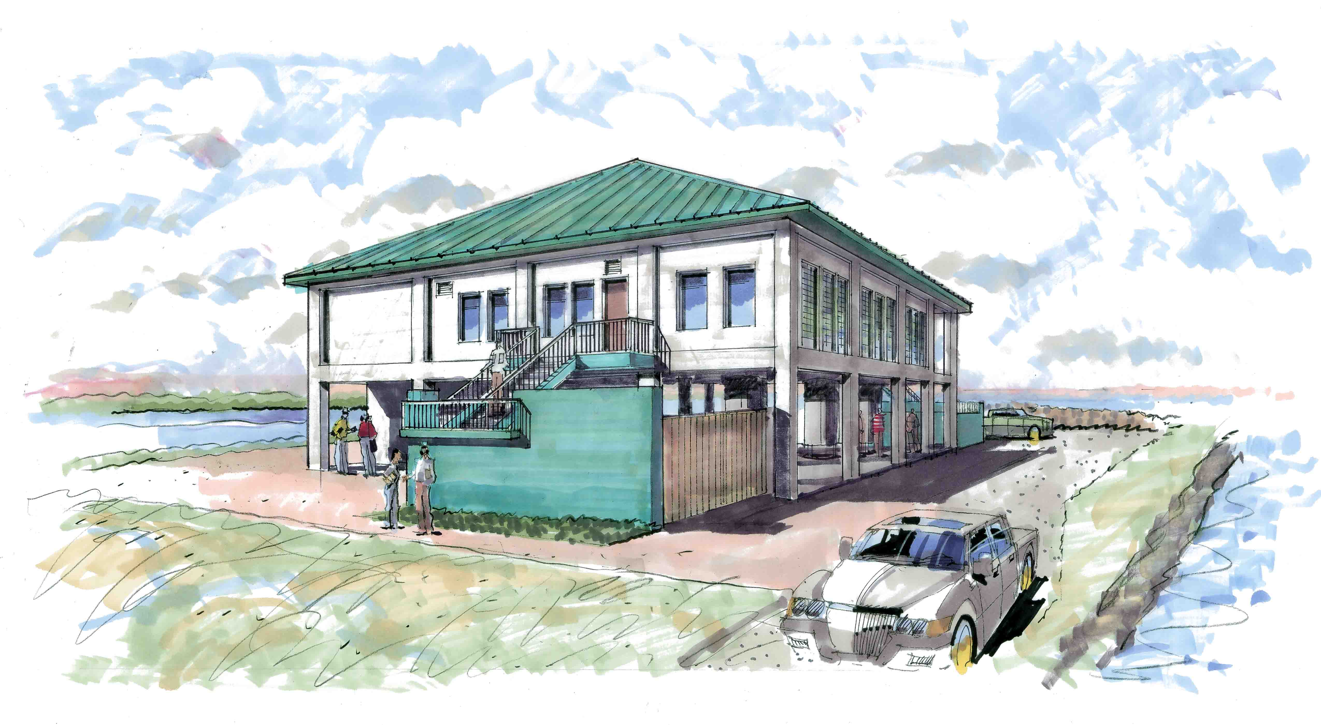
Hatchery Raised Oyster Larvae
Notes:
The oyster hatchery portion of the LA Oyster Cultch project involves constructing a state-of-the-art facility to provide a supplemental source of oyster larvae and seed to help facilitate and expedite the success of NRDA Early Restoration cultch plants. Larvae produced in the hatchery can be used for wider scale oyster restoration where necessary when larvae is available (NRDA is primary).
Oyster hatchery operations will include broodstock maintenance, algal cultivation, larval production, and a nursery system with grow-out capacity. The facility will be capable of producing 1 billion larvae per year.
Larvae produced at the hatchery can be released into the water directly over cultch material or be remotely set on oyster cultch to create oyster seed. Remotely-set oysters can then be deployed directly onto reefs, or further developed in the nursery system prior to deployment in a suitable grow-out area (i.e., public seed grounds).
The new NRDA oyster hatchery is nearing completion and we hope to have it operational next spring.

Slide 13
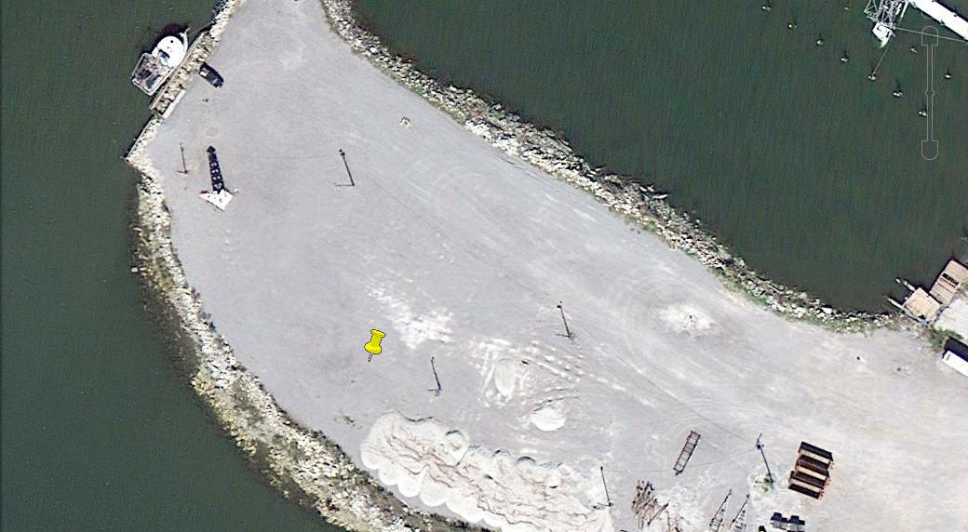
Remote Setting
Notes:
Remote setting is the process of allowing hatchery produced oyster larvae to attach to cultch material in tanks where the larvae set on oyster shell or other cultch material and are allowed to grow-out before they are deployed to oyster reefs.
Currently LSU is operating a small-scale hatchery beneath the LDWF Marine Lab on Grand Isle. This small-scale facility has limited larval production and setting capacities. LDWF and Plaquemines Parish are working cooperatively to develop a remote setting facility in Buras, LA.
Construction is anticipated to begin in late 2014. Six concrete tanks 30ft by 4.5ft will be constructed to for setting larvae on material. A 50ft X 100ft open wall shed will be constructed to provide a work space for cleaning and hauling equipment. A minimum of a 100ft concrete dock will be constructed on the harbor side of the property.
This will allow LDWF to fully utilize the oyster larvae produced at the new hatchery on Grand Isle.
LDWF and CPRA funding of remote setting site in Buras to grow out spat set on cultch in tanks prior to deployment. Construction to begin in late 2014.
The material produced will be of a low volume and is considered very delicate (the more the material is handled, the more oysters die before being deployed), making LDWF’s typical deployment method, larger barges, unsuitable. LDWF has several vessels that could be suitable to deploy this material.

Slide 14
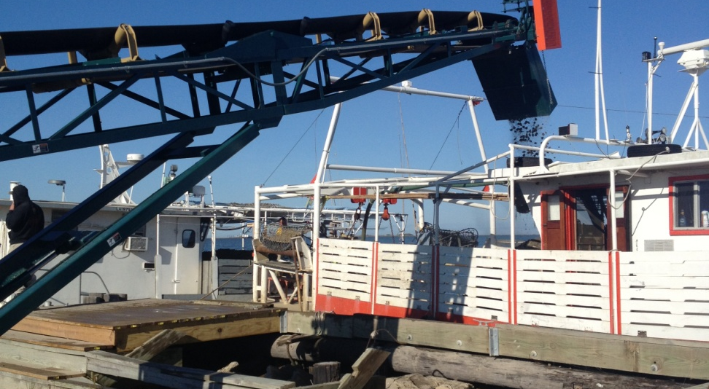
Remote Setting
Notes:
Concurrently LDWF began stockpiling cultch material at the Buras location and testing small-scale material deployment protocol using oyster vessels. A typical deployment involves loading a vessel with aggregate conveyor and having this vessel travel to a pre-designated seed ground area where the material is deployed via water cannon.
In addition to testing the protocol for utilizing oyster vessels LDWF has also been testing alternative methods of cultch planting.
LDWF has traditionally planned oyster cultch plants in excess of 100 acres, which lends itself well to large barge, and tug operations, which have been the traditional bid winners. However, through this program we are examining the efficacy of constructing smaller 1 – 5 acre reefs set geographically and chronologically far apart, and is some cases at shallower depths.

Slide 15
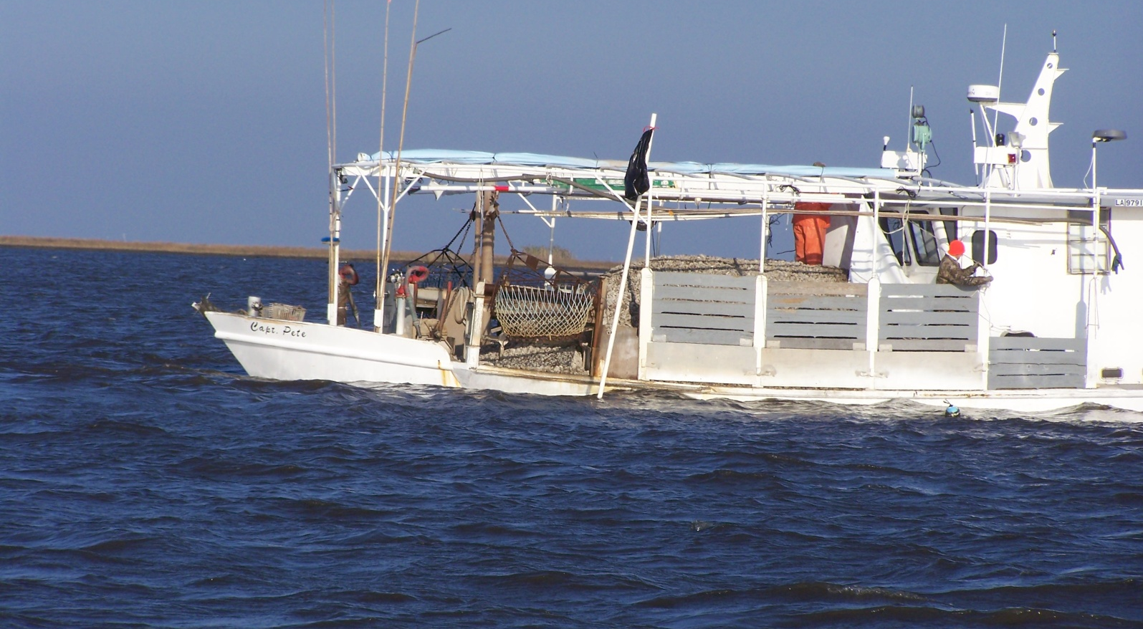
Remote Setting
Notes:
Efforts to date:
Cultch deployment to small plots using oyster vessels in Hackberry Bay and Black Bay

Slide 16
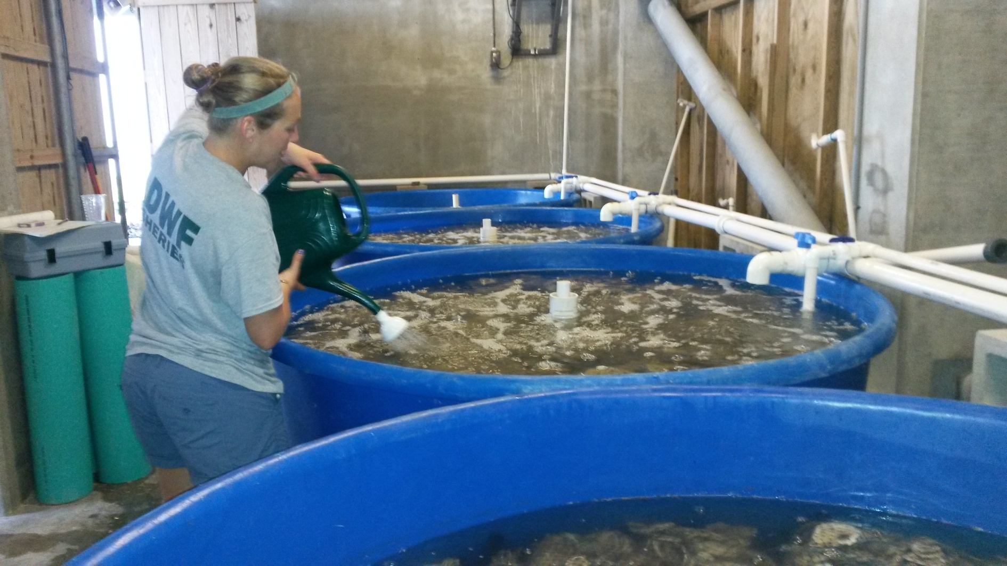
Remote Setting
Notes:
LDWF staff pouring oyster larvae into a tank for the larvae to set on cultch material as part of summer 2014 pilot.
While waiting for the full-scale hatchery and remote setting facilities to be completed, LDWF began testing and implementing several components of the Remote Setting Program. In June 2011, LDWF began testing various small-scale larvae and spat deployment methods including pumping larvae to the bottom in the Lake Calcasieu area and placing remotely set micro cultch on top of existing cultch plants. To date, over 52 million spat and 1.5 billion larvae have been utilized in oyster rehabilitation efforts in Louisiana.”
Summer 2014 Pilot program to test setting of hatchery raised oyster larvae using various methods (shell, concrete, free swimming larvae) with hatchery raised larvae from existing LSU Sea Grant Hatchery located at the LDWF marine lab. Deployment into Hackberry Bay and Black Bay. Biological sampling of the spat-on-shell test plots in Hackberry Bay has shown promising results – good survival and growth of spat. Additional plots have recently been deployed in California Bay (south of Black Bay) and sampling of those plots will begin next month.

Slide 17
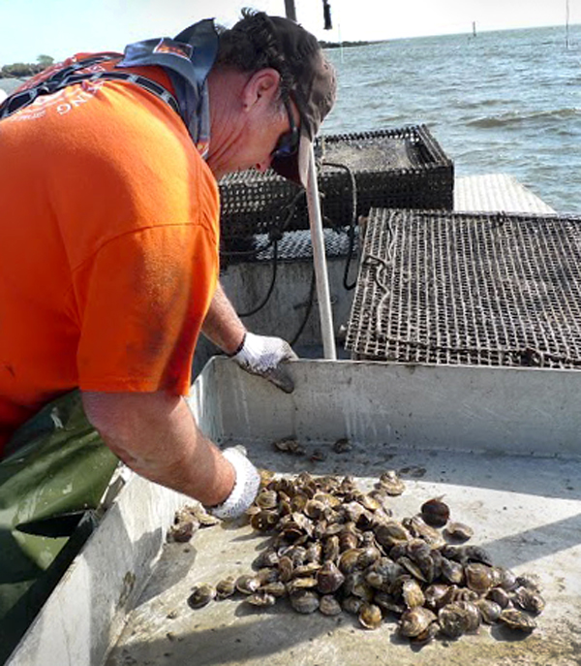
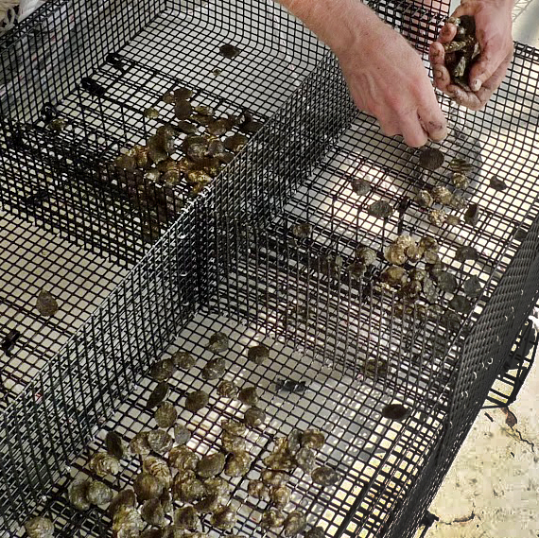
Alternative Oyster Culture
Notes:
Most of the Louisiana oysters are grown and harvested from reefs on the public seed grounds or from oysters cultivated on private leases on water bottoms in the state
Adoption of off-bottom oyster culture can supplement the traditional harvest.
In this process, oysters are grown suspended in the water column in some type of mesh container (basket, bag, cage, etc.) that is held above the seafloor. Oysters grown this way are typically hatchery-reared single set oysters instead of clumps of oysters normally found in the wild. The cages prevent predators from picking off the oysters. The cage is raised to the surface and the farmer can harvest oysters that are the desired size. Oysters have greater access to food because they are suspended in the water, and farmers can control for biofouling and even oyster size.
It typically takes 3 years for a traditional on-bottom oyster to grow to market size. The amount of time required for an oyster to mature into a harvestable size also is cut in half in off-bottom cultivation.
Oysters produced using off-bottom culture techniques are typically sold to the premium half-shell market and bring a higher price than oysters harvested from traditional on-bottom production (from either public oyster reefs or private oyster grounds).
It’s unlikely that off-bottom culture will replace traditional on bottom farming due to the vast quantity of oysters typically harvested from Louisiana’s on bottom reefs, but off-bottom oyster farming may be a viable near-shore domestic aquaculture industry that can provide an economic benefit to coastal communities. It can aid in sustainability and allow for resilience from natural and manmade disasters and is a great product for the niche oyster market.

Slide 18
Alternative Oyster Culture
La. R.S. 56:431.2 et seq.

Slide 19
Resolution of User Conflicts
Oyster Lease Damage Evaluation Board (OLDEB)
Damage to State Seed Grounds
Damage from Integrated Coastal Protection

