Slide 1
Red River Flooding and Weather Briefing
Jeff Graschel – Service Coordination Hydrologist
Suzanne Van Cooten – Hydrologist in Charge
Lower Mississippi River Forecast Center
Cynthia Palmer – Science and Operations Officer
Craig Ross - Hydrologist
National Weather Service – Shreveport

Slide 2
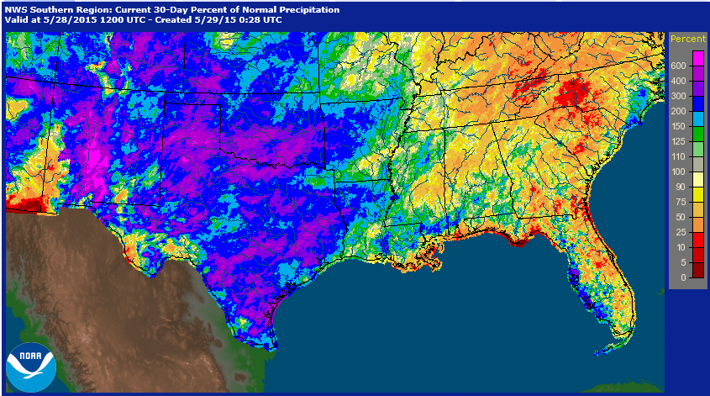
30 Day Percent of Normal

Slide 3
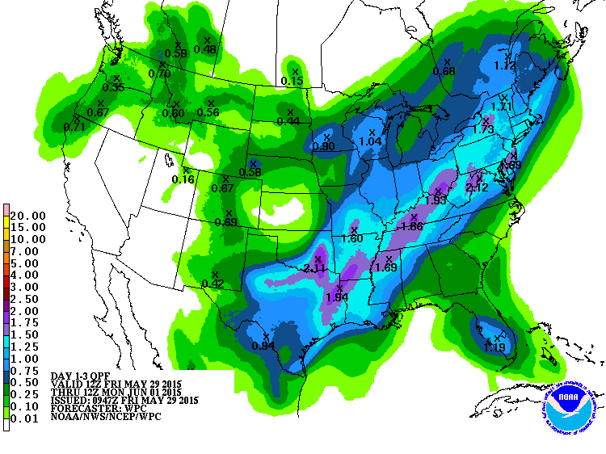
3 Day QFP Outlook:
Today – Monday Morning
The threat of showers and thunderstorm will continue through this weekend as a series over disturbances move across the area.
Heavy rain is likely with the thunderstorms.
Flash Flooding Watch in effect through 7 pm Saturday

Slide 4
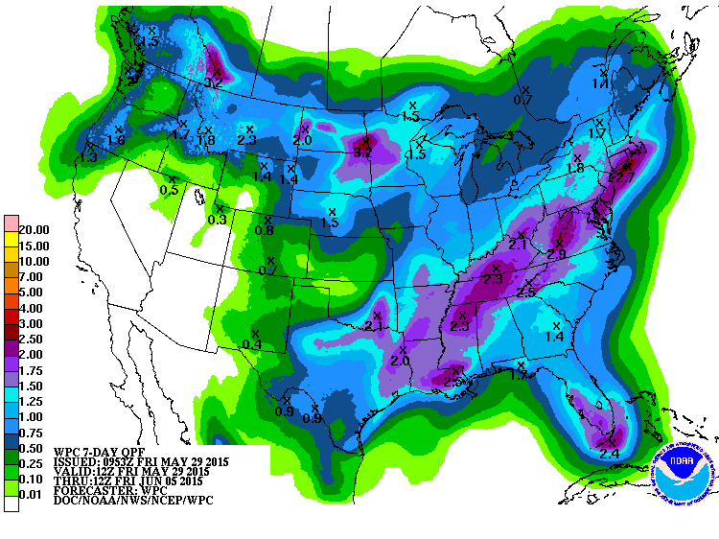
7 Day QFP Outlook:
Today – Friday Morning
The threat of isolated to scattered showers and thunderstorm will continue through next week as an upper level low sets up over Louisiana.
Heavy rain may be possible with the thunderstorms.

Slide 5
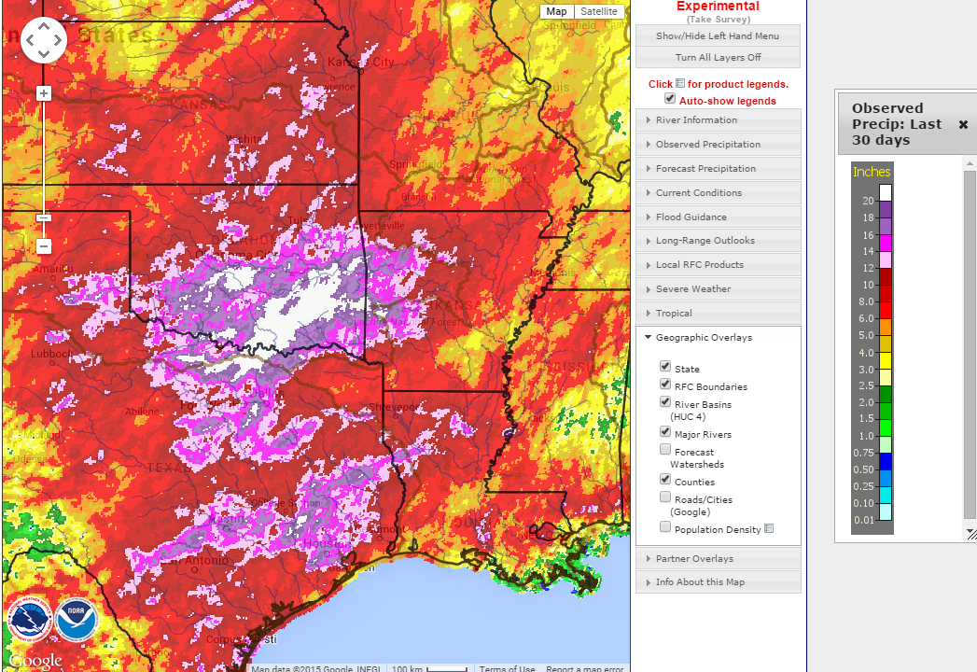
30 day Rainfall Total Ending May 29, 2015

Slide 6
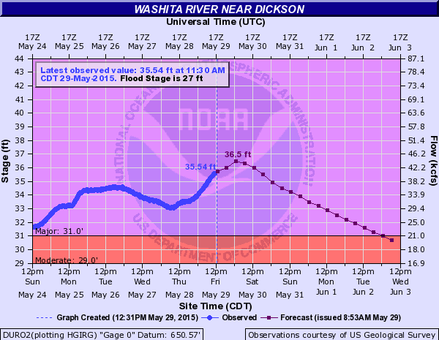
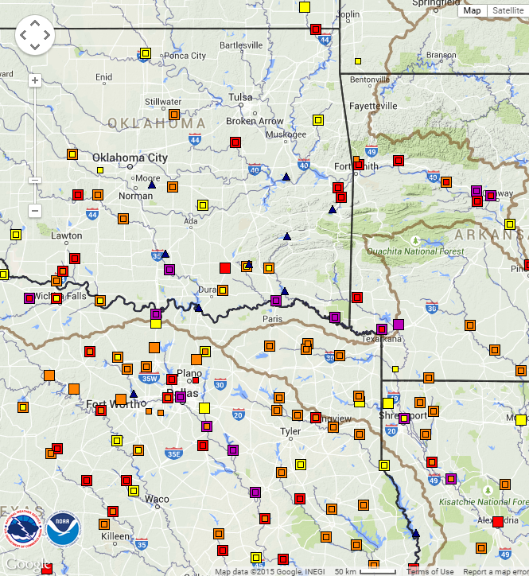
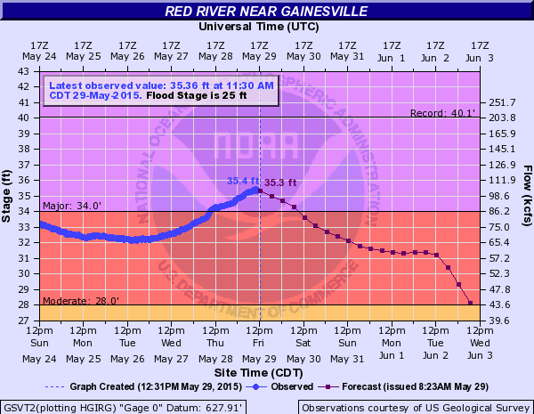
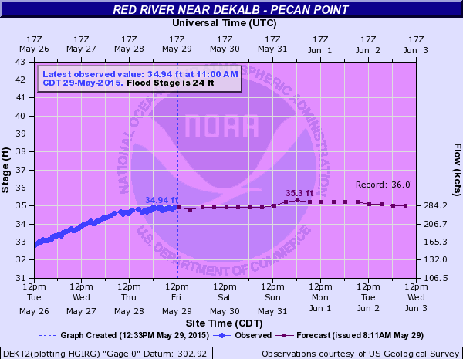
Upstream Conditions

Slide 7
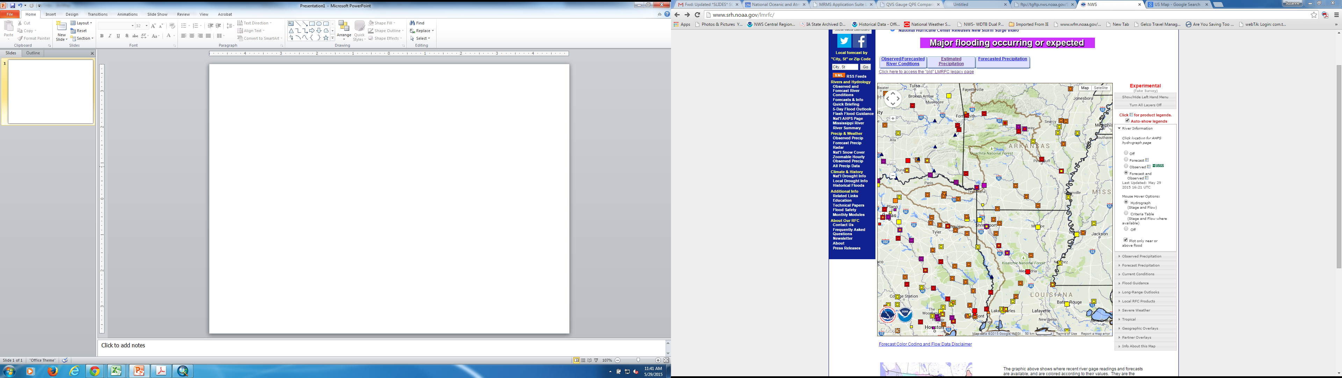
Red River at Index, AR
* Stage 11A May 29: 27.21 FT (0.79 ft blw Major F.S.)
* Rise above Major F.S. early Saturday, May 30
* Crest: 31 ft Tuesday June 2
(Major F.S.= 28ft; Flood of record 34.4 ft on 2/23/1938)
Red River at Fulton, AR
* Stage 10A May 29: 24.44 FT (0.46 ft blw Action Stage)
* Rise above Minor F.S. Saturday May 30
* Rise above Moderate F.S. Monday June 1
* Crest: 33 ft Thursday June 4
(Major F.S.= 32.5ft; Flood of record 37.4 ft on 4/2/1945)
Red River at Shreveport, LA
* Stage 11A May 29: 28.69 FT (1.31 ft blw Minor F.S.)
* Rise above Minor F.S. Sunday May 31
* Rise above Moderate F.S. late Monday June 1
* Rise above Major F.S. Wednesday June 3
* Crest: 34 ft Saturday June 6
(Major F.S.= 33 ft; Flood of Record 45.90 ft on 8/10/1849 )
Red River at Coushatta, LA
* Stage 11A May 29: 31.54 FT (0.54 ft abv Minor F.S.)
* Rise above Moderate F.S. of 33ft early Monday May 31
* Crest: 36.5 ft Sunday June 7
(Major F.S.= 37 ft; Flood of Record 39.90 ft on 04/07/1945)
Red River at Grand Ecore, LA
* Stage 11A May 29: 35.95 FT (0.05 ft blw Moderate F.S.)
* Rise above Major F.S. of 39ft Thursday June 4
* Crest: 40.5 ft Monday June 8
(Major F.S.= 39 ft; Flood of Record = 44.7 ft on 04/10/1945)
Red River at Alexandria, LA
* Stage 11A May 29: 31.52 FT (0.48 ft blw Minor F.S.)
* Rise above Moderate F.S. of 36 ft Friday June 5
* Crest: 38 ft Tuesday June 9
(Major F.S.= 40 ft; Flood of Record = 45.23 ft on 4/17/1945)
F.S = Flood Stage

Slide 8
Red River Forecast
Friday, May 29, 2015 – 7am Morning Update
Point | Current Stage | Flood Stage | Forecast / Crest (*=Additional Rises Possible)
Near De Kalb (Pecan Pt) | *MAJOR 34.84 ft | 24 feet | Rise and crest near 35.3 ft on June 1st.
Index (N of TXK) | *MINOR 26.87 ft | 25 feet | Rise and crest near 31 ft by June 1st.
Fulton | 24.20 ft | 27 feet | Rise and crest near 33 ft by June 4th.
Shreveport | 28.58 ft | 30 feet | Rise and crest near 34 ft by June 6th.
Coushatta | *Moderate 31.46 ft | 31 feet | Rise and crest near 36.5 ft by June 7th.
Grand Ecore | *MODERATE 35.93 ft | 33 feet | Rise to near 40.5 ft by June 8^{th.}

Slide 9
Impacts to the Red River
Severe back water flooding of agriculture land along and adjacent to the river.
Cattle or farm equipment that hasn’t been moved to higher ground may be lost.
Some subdivisions may become cut off from flood waters, with some homes and businesses potentially flooded.
Recreational activities limited through the summer.
Secondary roads may become inundated and cutoff.

Slide 10
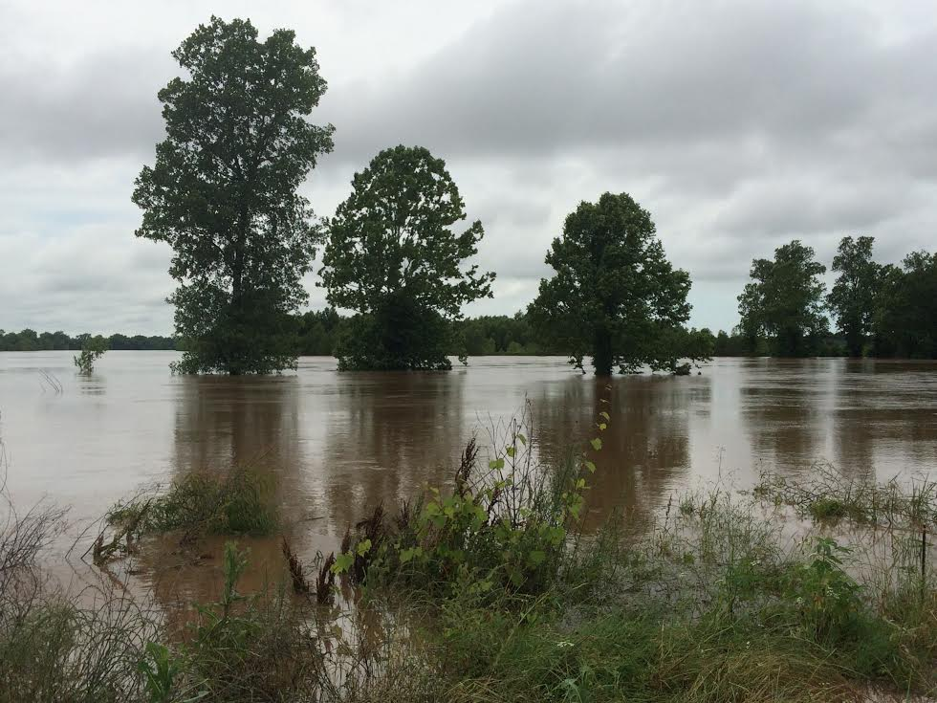




Questions?
Red River in north Bossier City on 05/18/2015
weather.gov/shv
US National Weather Service Shreveport
@NWSShreveport
NWSShreveport

