Slide 1
Assumption Parish Meeting
Tuesday, August 7, 2012

Slide 2
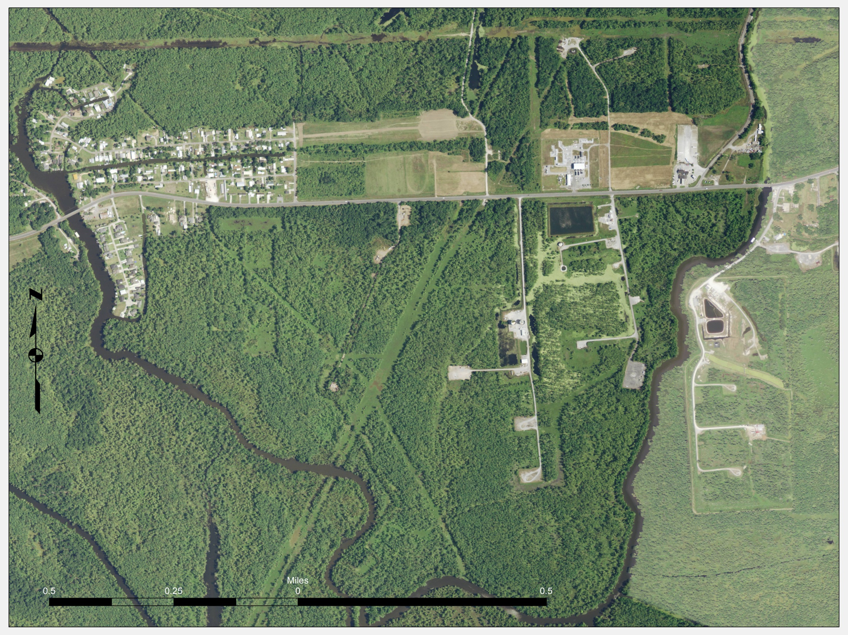

Slide 3
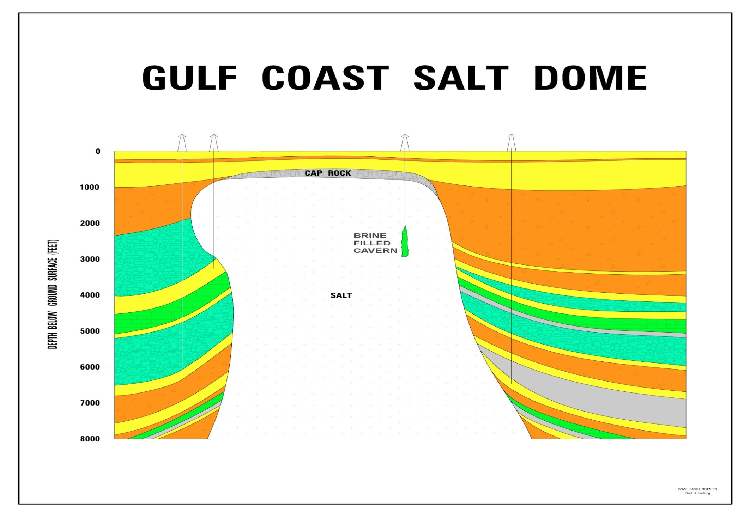
TYPICAL
Louisiana Department of Natural Resources

Slide 4
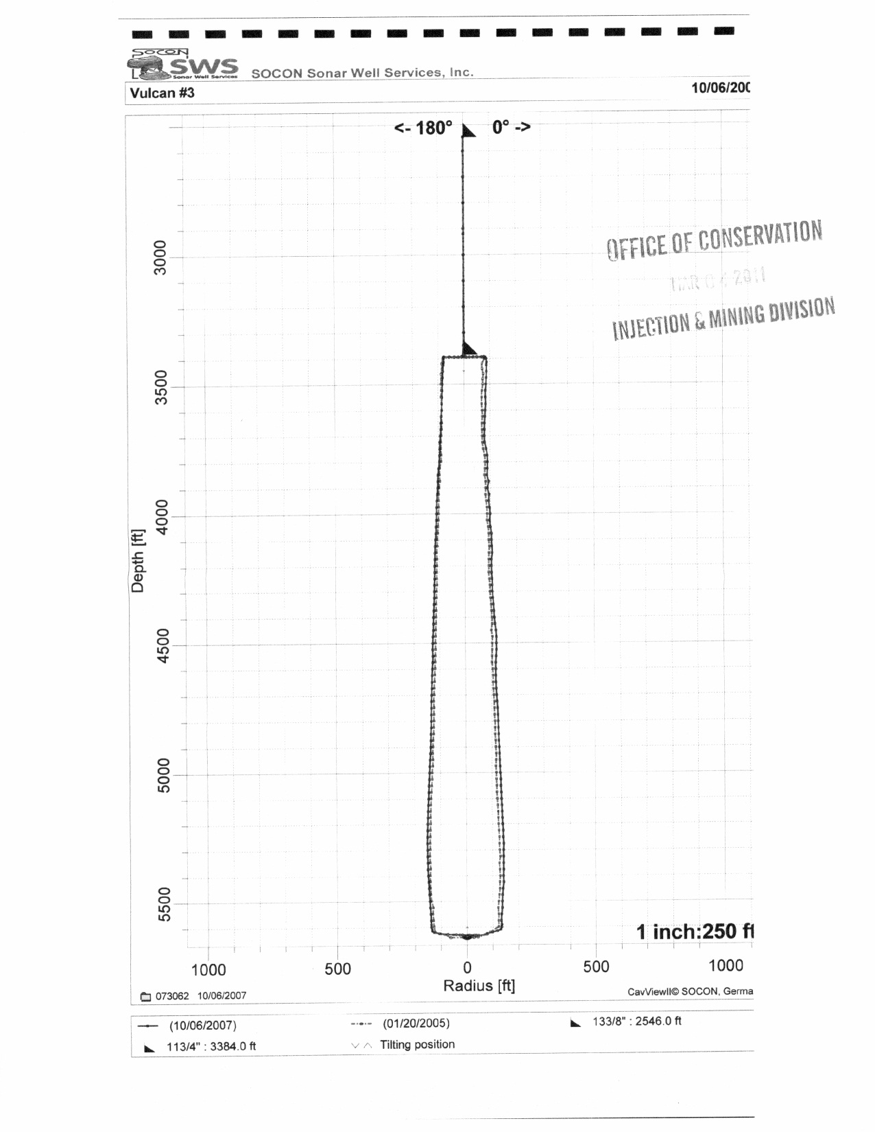

Slide 5
What We Have Done
Parish reported natural gas bubbling to DNR/OOC on June 11
Immediately contacted pipeline companies and gas storage operators
Reviewed pipeline and gas storage cavern integrity tests
Reviewed/inspected oil and natural gas well locations
Coordinated with USGS to place seismographs to document tremors
Executed contract to analyze gas samples for comparison to pipelines
On Aug. 3, day following discovery of sinkhole:
Identified Texas Brine cavern as potential cause
Issued emergency order to Texas Brine to evaluate cavern integrity
Issued orders to pipelines to empty and shut in
Issued notice to cavern gas storage operators to take precautions
DNR/OOC met with other agencies and industry to share available information and current data needs on Aug. 6
Ongoing involvement:
OOC began day-to-day presence at the parish’s command post in July
DNR/OOC has participated in more than 40 conference calls/meetings to date
Louisiana Department of Natural Resources

Slide 6
What We’ve Learned to Date
Pipelines are not the source of the bubbling
No abnormal air quality detected
Sinkhole/slurry area is approximately 372’ in diameter and 422’ deep
400’ of Crosstex pipeline bowed approx. 16’ down and 15’ toward sinkhole
Seismic activity, prior to sinkhole, reported to be shallow
Significant seismic activity ceased hours prior to sinkhole formation
DEQ testing indicates elevated salinity and traces of diesel in sinkhole/slurry
Bubbling continues in Bayou Corne and Grand Bayou
Louisiana Department of Natural Resources

Slide 7
What are We Doing?
Continuing to engage the scientific community
Monitoring investigation of Texas Brine pursuant to the emergency order
Continuing flyovers
Monitoring analytical results provided by DEQ
Monitoring efforts of nearby cavern operators
Requested geotechnical boring on nearby lands
Maintain transparency in response efforts by providing all relevant data to parish/public
Louisiana Department of Natural Resources

Slide 8
Where Do We Go From Here?
Continue to work with the scientific and academic community to:
Review all the data gathered to date
Gather and analyze additional data
Evaluate area for subsidence potential
Hone in on the exact cause of the slurry area
Continue to communicate with all agencies, local government, and the public
Louisiana Department of Natural Resources

Slide 9
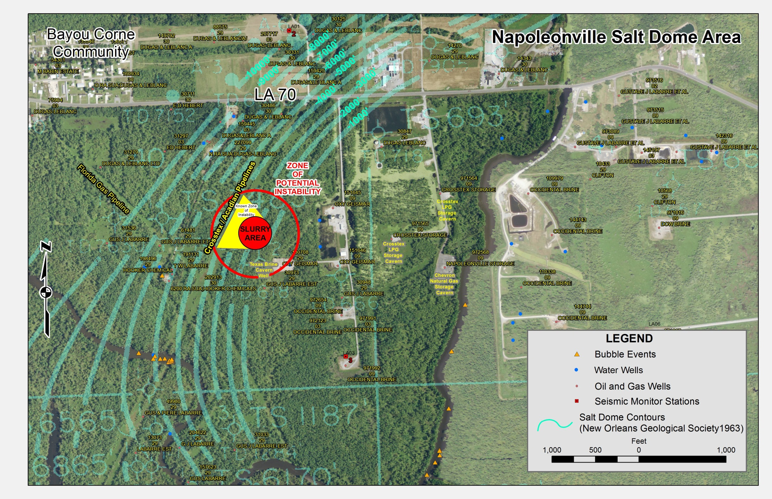
Louisiana Department of Natural Resources

