Slide 1

Louisiana Underground Injection Control Program Workshop Introduction
Joseph S. Ball, Jr.

Slide 2
Underground Injection Control (UIC) Program
March 23, 1982 ― Under provisions of the Safe Drinking Water Act of 1974, the U.S. Environmental Protection Agency (USEPA) delegated Louisiana with full permitting and enforcement authority (primacy) of the state’s UIC Program. Semi-annual USEPA oversight.
Goal is to protect Underground Sources of Drinking Water (USDW) and other state natural resources from endangerment by regulating the subsurface emplacement of fluids through the use of well injection by:
  Processing applications for various subsurface injection projects.
  Conduct field surveillance and enforcement at injection well sites and facilities.
  Test injection wells for mechanical integrity.
  Monitor injection well operations (cradle-to-grave).

Slide 3
Underground Source of Drinking Water
An Underground Source of Drinking Water is defined by the United
States Environmental Protection Agency as:
an aquifer or its portion which supplies any public water system; or
an aquifer or its portion which contains a sufficient quantity of ground water to supply a public water system; and
  currently supplies drinking water for human consumption; or
  contains fewer than 10,000 mg/l total dissolved solids and which is not an exempted aquifer.

Slide 4
Regulatory Classes of Injection Wells
Class I | Industrial (hazardous or nonhazardous) or Municipal Waste
Class II | Oil and Gas Waste, Enhanced Recovery of Hydrocarbons, or Hydrocarbon Storage in a Salt Cavern
Class III | Mineral Solution Mining (salt, sulfur, etc.)
Class IV | Wells injecting Hazardous or Radioactive Waste into or above a USDW. Banned unless authorized as a RCRA or CERCLA cleanup.
Class V | Wells not covered under any other Class (e.g., aquifer remediation, heat pump/ac return flow well, etc.)
Class VI | Carbon Dioxide (CO₂ ) Sequestration

Slide 5
Injection & Mining Division - Regulations
The basic regulations of the Office of Conservation are a series of documents called Statewide Orders. These Orders form the backbone of the regulatory scheme and provide structure for operational requirements. The regulations are lawfully codified in the Louisiana Administrative Code and are prefixed by the letters LAC.
Louisiana Administrative Code | Statewide Order | Subject of Regulation
LAC 43:XIX.Chapter 3 | Statewide Order No. 29-B, Chapter 3 | Onsite storage, treatment and disposal of oilfield waste. Primarily oilfield pit regulations, but also has some general requirements for Class II disposal wells
LAC 43:XIX.Chapter 4 | Statewide Order No. 29-B, Chapter 4 | General regulations for a Class II produced fluids disposal well
LAC 43:XIX.Chapter 5 | Statewide Order No. 29-B, Chapter 5 | Regulations specific to commercial oilfield waste facilities
LAC 43:XVII.Chapter 1 | Statewide Order No. 29-N-1 | Class I Nonhazardous Industrial Waste, Class III Mineral Solution Mining, Class IV, Class V, Class VI
LAC 43:XVII.Chapter 2 | Statewide Order No. 29-N-2 | Class I Hazardous Industrial Waste
LAC 43:XVII.Chapter 3 | Statewide Order No. 29-M | Class II Hydrocarbon Storage in Salt Dome Caverns
LAC 43:XVII.Chapter 31 | Statewide Order No. 29-M-2 | Class II Disposal of Oilfield Waste in Solution-Mined Salt Caverns

Slide 6
Fee Schedule at LAC 43:XIX.Chapter 7
(including application fees)
☑ Commercial Class I | $1,264
☑ Commercial Class II | $ 631
☑ Noncommercial Injection Well | $ 252
☑ Amend Permit to Drill (amend, alter, or change a permit after its issuance) | $ 126
☑ Well Workovers | FREE

Slide 7
Two-Part Permitting Process
  Part I: Permit-to-Construct:
    Public Notice of Application. Usually a Notice of Intent to file. Public hearing is not generally required, but will be held if requested.
    Administrative Review (properly completed forms, required documents, compliance history, financial responsibility, etc.)
    Technical Review to assure that well constructed to prevent movement of fluids into USDW’s. (hydrology, geology, well construction and operation, area-of-review, corrective action, etc.).
    Notice of Application Deficiency if additional data needed.
    Permit-to-Construct issued when the application is administratively complete

Slide 8
APPLICANT PREPARES &
SUBMITS APPLICATION
TO IMD
Regulatory & Technical Review Phase
of Injection Well Application Process
IMD ENTERS APPL. INTO SONRIS, ASSIGNS APPL. NO., & SENDS RECEIPT LETTER
CONDUCT AREA OF REVIEW SEARCH
SUBMISSION COMPLETE?
GEOLOGY REVIEW COMPLETE?
ENGINEERING REVIEW COMPLETE?
YES
YES
YES
APPLICANT RESPONDS TO NOTICE OF DEFICIENCIES
APPLICANT RESPONDS TO NOTICE OF DEFICIENCIES
APPLICANT RESPONDS TO NOTICE OF DEFICIENCIES
NO
NO
NO
SEND ADMINISTRATIVE
NOTICE OF DEFICIENCIES TO APPLICANT
SEND GEOLOGICAL’S
NOTICE OF DEFICIENCIES TO APPLICANT
SEND ENGINEERING’S
NOTICE OF DEFICIENCIES TO APPLICANT
UNABLE TO ADDRESS NOD DENY APPLICATION
UNABLE TO ADDRESS NOD DENY APPLICATION
UNABLE TO ADDRESS NOD DENY APPLICATION

Slide 9
APPLICANT PREPARES &
SUBMITS APPLICATION
TO IMD
Regulatory & Technical Review Phase
of Injection Well Application Process
IMD ENTERS APPL. INTO SONRIS, ASSIGNS APPL. NO., & SENDS RECEIPT LETTER
CONDUCT AREA OF REVIEW SEARCH
SUBMISSION COMPLETE?
YES
GEOLOGY REVIEW COMPLETE?
YES
ENGINEERING REVIEW COMPLETE?
YES
Public Review Phase
of Injection Well Application Process
NO
APPLICANT RESPONDS TO NOTICE OF DEFICIENCIES
NO
APPLICANT RESPONDS TO NOTICE OF DEFICIENCIES
NO
APPLICANT RESPONDS TO NOTICE OF DEFICIENCIES
SEND ADMINISTRATIVE
NOTICE OF DEFICIENCIES TO APPLICANT
SEND GEOLOGICAL’S
NOTICE OF DEFICIENCIES TO APPLICANT
SEND ENGINEERING’S
NOTICE OF DEFICIENCIES TO APPLICANT
UNABLE TO ADDRESS NOD DENY APPLICATION
UNABLE TO ADDRESS NOD DENY APPLICATION
UNABLE TO ADDRESS NOD DENY APPLICATION
PUBLIC HEARING?
GIVE PUBLIC NOTICE AND HOLD PUBLIC HEARING
PERMITTABLE CONSIDERING PUBLIC COMMENTS?
YES
YES
NO
NO
DENY APPLCATION
ISSUE APPROVAL-TO-CONSTRUCT

Slide 10
Two-Part Permitting Process
  Part II: Permit-to-Inject:
    Technical evaluation of well construction and completion report. Was the well completed as permitted?
    Well or reservoir tests.
    Field inspection reports, well mechanical integrity tests.
    If needed, well operator performs corrective action.
    Permit-to-Inject issued with operational restrictions as Maximum Authorized Surface Injection Pressure (MASIP), injection rate/volume, frequency for well or reservoir testing, etc.

Slide 11
When to Publish a Public Notice
Well Type | Timing of Public Notice
Class I Noncommercial | Injection and Mining Division (IMD) publishes after application deemed complete
Class II Saltwater Disposal for oil and gas operations | Applicant publishes Notice of Intent at least 15 days prior to filing application
Class II Saltwater Disposal for salt cavern operations | Applicant publishes notice of application filing within 30 days from the date of receipt of the application by IMD (after receipt of application number)
Class II Enhanced Recovery | Public notice not required. Public hearing is required for Office of Conservation’s approval of an enhanced recovery project. Only approves project, not UIC well.

Slide 12
When to Publish a Public Notice
Well Type | Timing of Public Notice
Class II Commercial Exploration & Production Waste Refer to LAC 43:XIX.519.B and 529.B for details | New Facility: Notice of Intent at least 30 days prior to filing the application Existing Facility: Notice of Intent at least 15 days prior to filing an application
Class II Hydrocarbon Storage in Salt Dome | Applicant publishes Notice of Intent at least 30 days but no more than 180 days before filing application
Class III Solution Mining | Applicant publishes Notice of Intent at least 30 days but no more than 180 days before filing application
Class V | Not required
Class VI CO₂ Sequestration | Injection and Mining Division publishes after application deemed complete

Slide 13
UIC Well Application Forms
Well Type | UIC Form
Class I | UIC-1
CLASS II Saltwater Disposal | UIC-2 SWD Conversion UIC-2 SWD New Drill UIC-2 SWD Re-Entry
Class II Enhanced Recovery | UIC-2 ER Conversion UIC-2 ER New Drill UIC-2 ER Re-Entry
Class II Commercial Injection Well | UIC-2 COM
Class II Hydrocarbon Storage | UIC-2 HSW
Class II Slurry Fracture Injection | UIC-2 SFI
Class II Annular | UIC-9
Class II Change of Zone | UIC-32
Class II E&P Waste Disposal in a Cavern | UIC-43
Class III Solution Mining | UIC-3 BR
Class V | UIC-25

Slide 14
WHERE CAN I FIND UIC-RELATED FORMS?

Slide 15
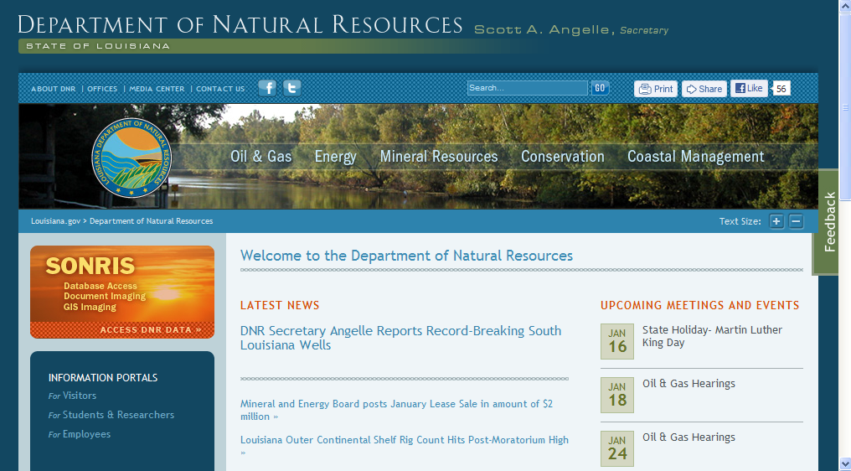
Step 1: Go to the DNR Homepage at http://dnr.louisiana.gov/
and Click on the Conservation option

Slide 16
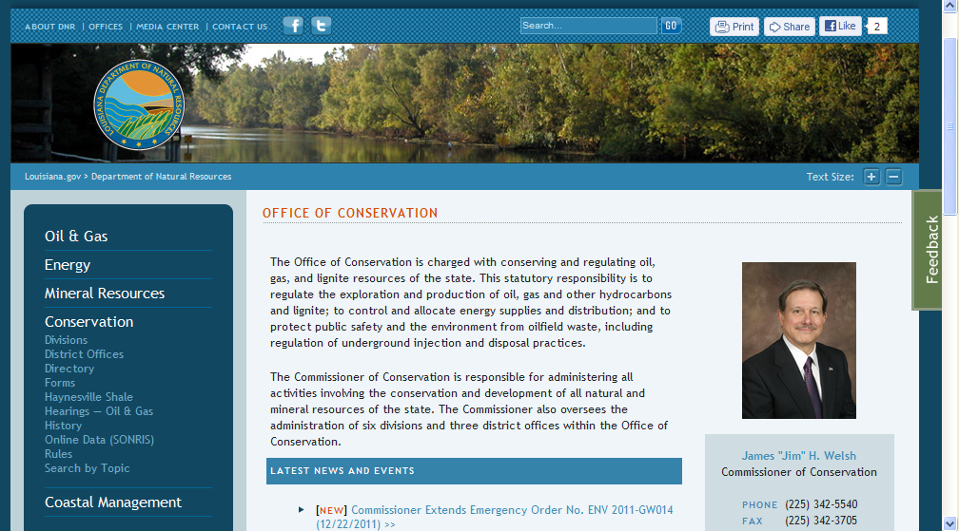
Step 2: Click on Forms

Slide 17
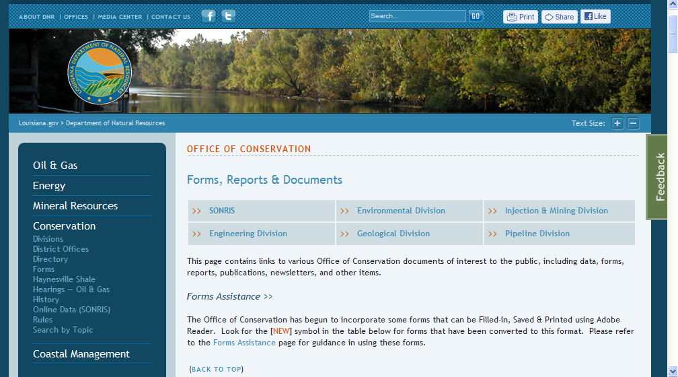
Step 3: Under Forms, Reports & Documents, Click Injection & Mining

Slide 18
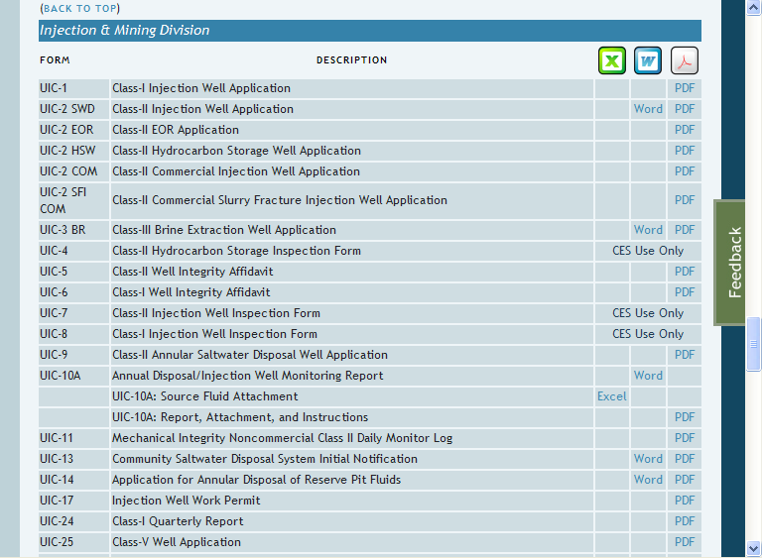
List of Forms Used by the Injection and Mining Division

Slide 19
How Do I Check the Status of an Application

Slide 20
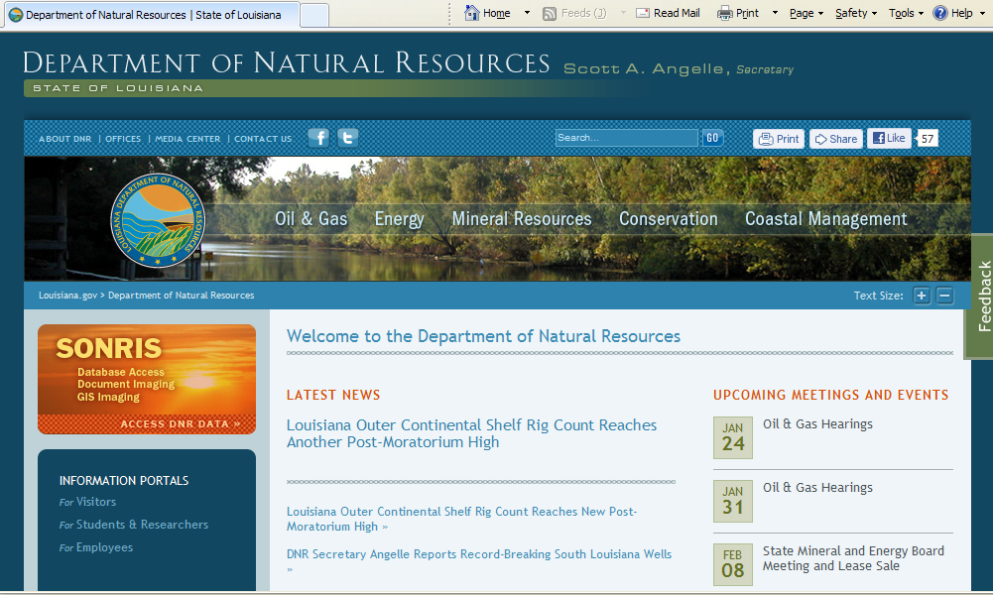
Step 1: Go To DNR Homepage &
Click within the Orange SONRIS Rectangle

Slide 21
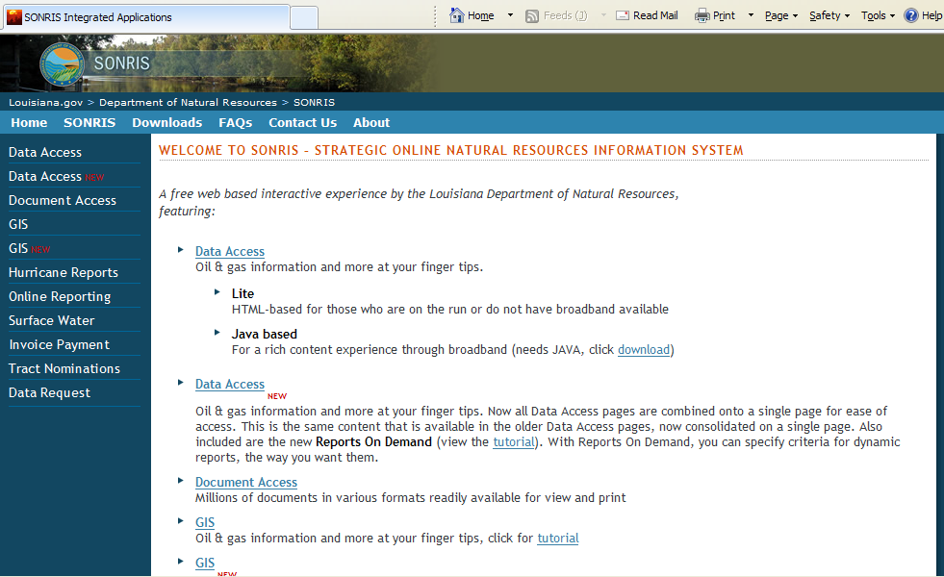
Step 2: Click DATA ACCESS

Slide 22
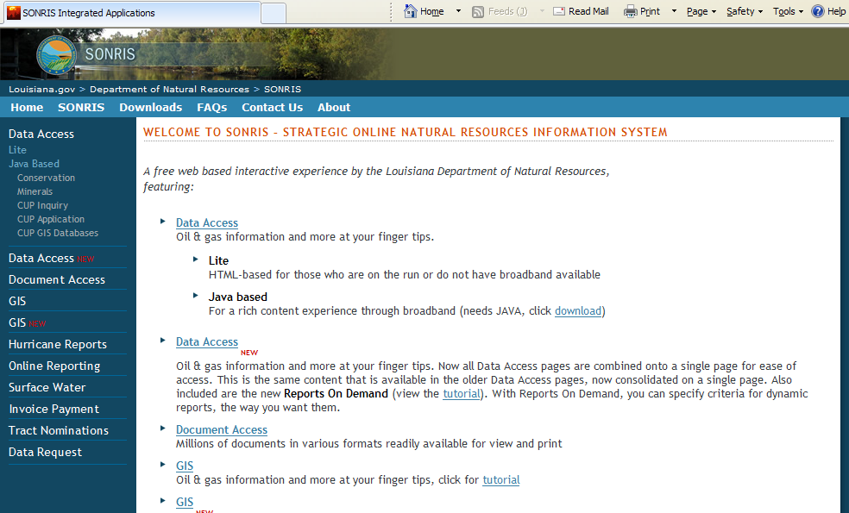
Step 3: Under Java Based, Click CONSERVATION

Slide 23
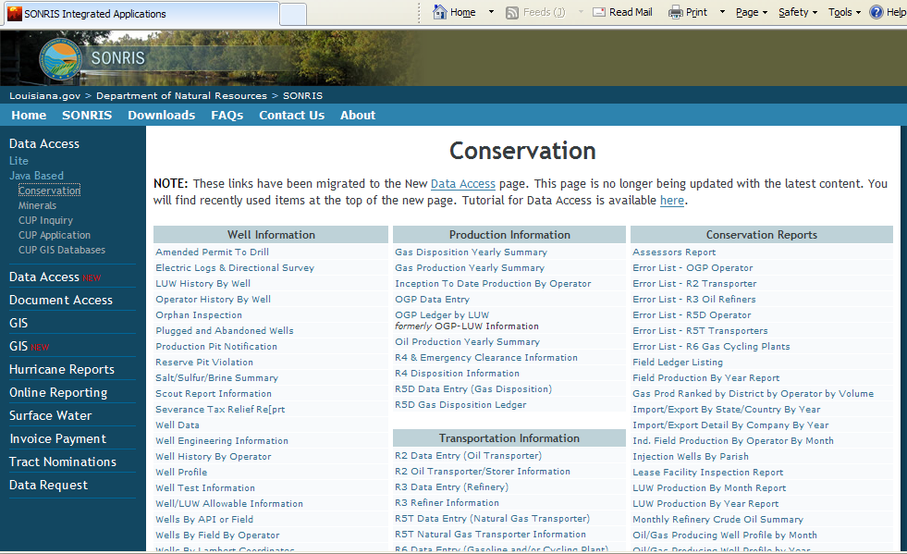
This Page is Similar in Java-Based or Lite

Slide 24
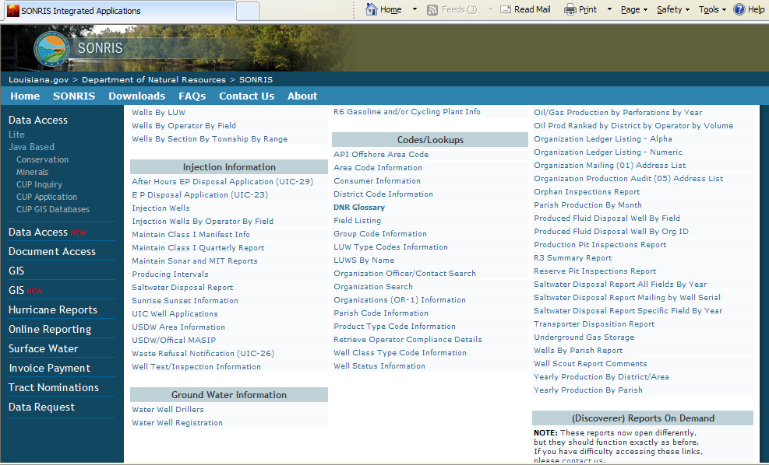
Step 4: Scroll to Injection Information, click UIC WELL APPLICATIONS

Slide 25
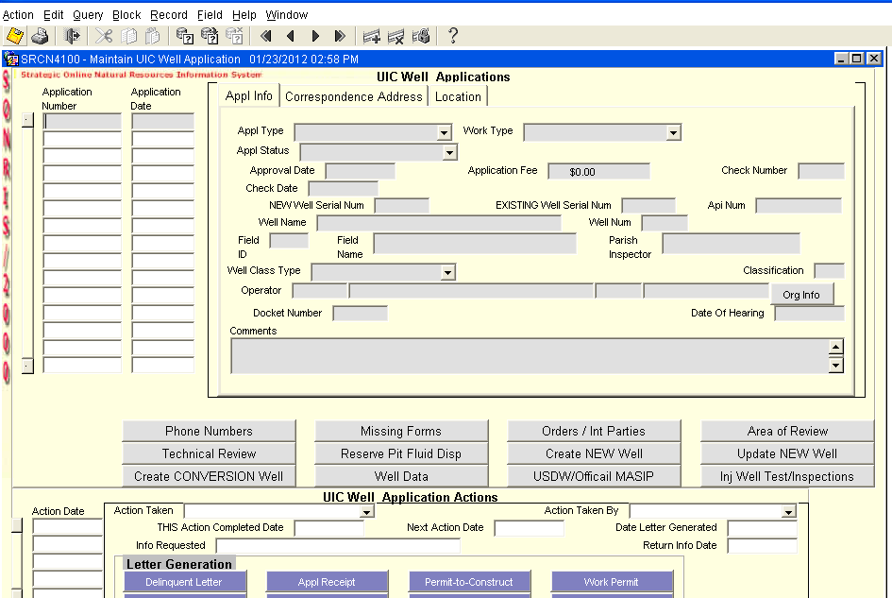
Step 5: Click QUERY or Hit Function 7 Key

Slide 26
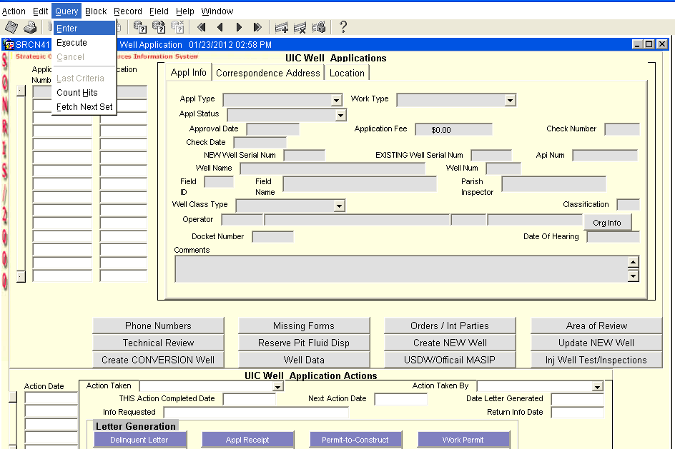
Step 6: Click ENTER

Slide 27
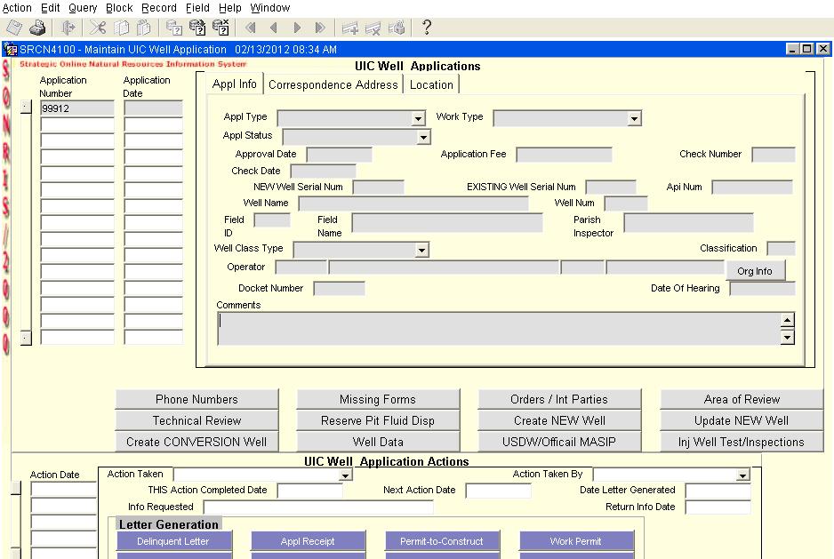
Step 7: Enter APPLICATION NUMBER

Slide 28
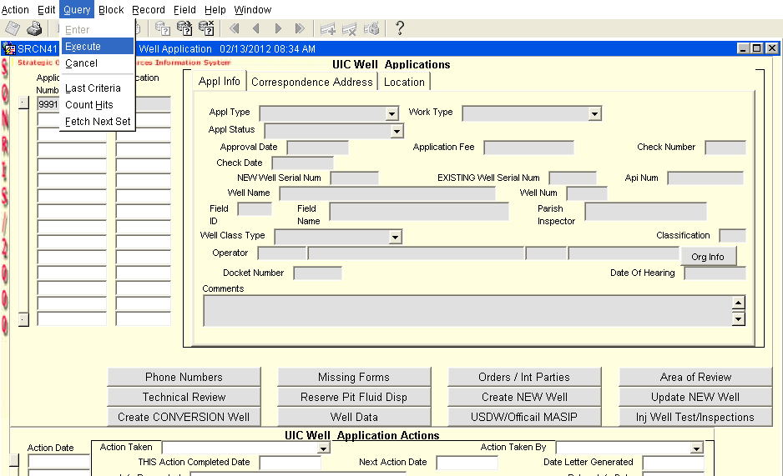
Step 8: Click QUERY, then Click EXECUTE.
As an alternate, Hit Function 8 Key

Slide 29
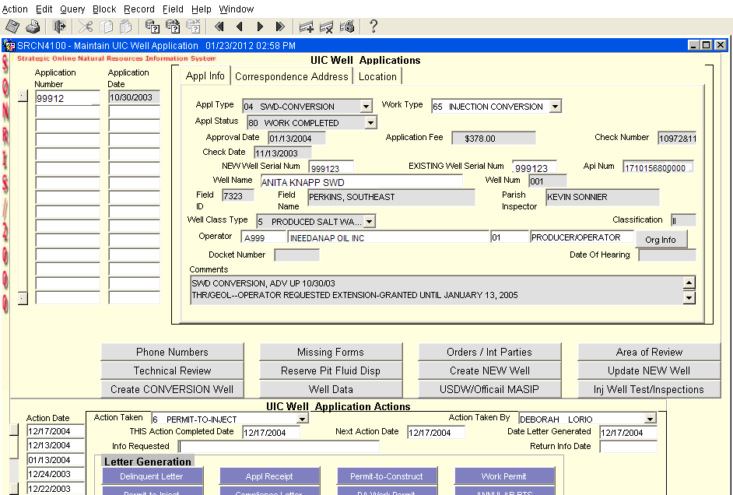
View Application Details Using Application Number

Slide 30
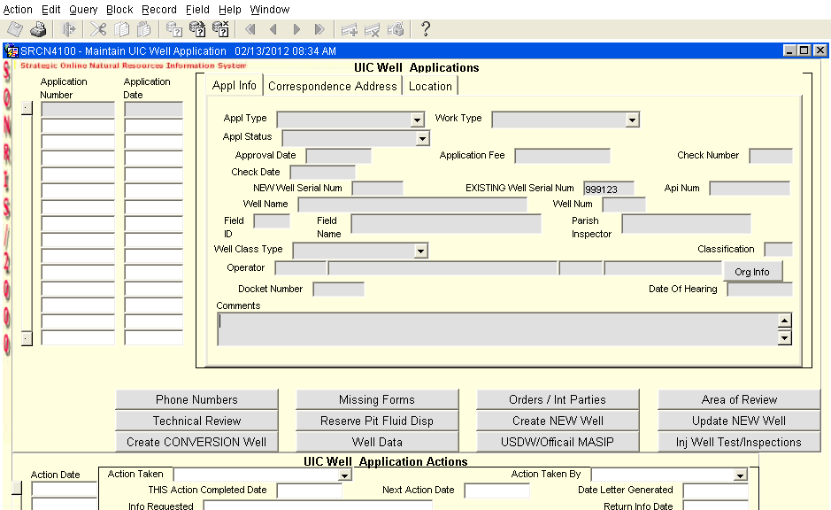
Step 7 alternate: Enter EXISTING WELL SERIAL NUMBER

Slide 31
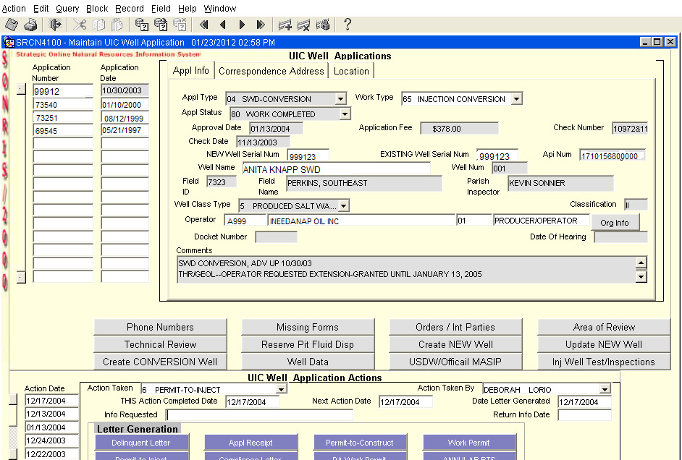
View Application Details using Well Serial Number

Slide 32
Upcoming Changes
  UIC application forms are being revised. There will be new forms created for each well type; i.e. UIC-2 SWD Conversion, UIC-2 SWD New Drill, UIC-2 SWD Re-entry.
  Check the Injection & Mining Division’s forms page for up-to-date forms.
  There will be changes common to all application forms.
  Do not submit a copy of the instructions with the application.
  The Form MD-10-R (yellow card) is no longer required with a UIC application. The Form MD-10-R-A (pink card) will still be required to amend permits.
  New Form UIC-WH-1 replaces the Form WH-1 for injection wells only.

Slide 33
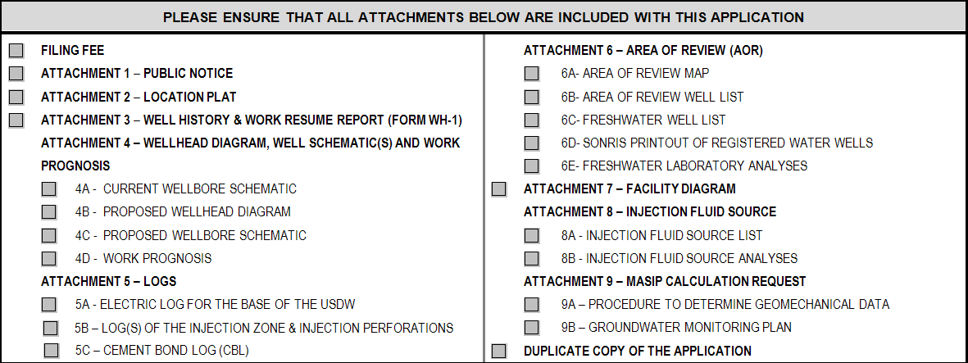
The following section is included on all the revised forms. By checking each item, the applicant is attesting that each item has been included with the application.

Slide 34
Things to Remember
You are responsible.
Respond to all correspondences before the specified due date.
If an extension of the expiration date for a Permit-to-Construct is needed, submit a written request and a $126 Amend Permit-to-Drill fee to the Injection and Mining Division before the permit expiration date.
All matters regarding injection wells are administered by the Injection and Mining Division in Baton Rouge. Do Not Contact A Conservation District Office.

Slide 35
Injection & Mining Division
Contact Information
Telephone: 225-342-5515
Fax: 225-342-3094, or
225-242-3441
Email: Injection-Mining@LA.Gov

Slide 36
Websites of Interest
Louisiana Department of Natural Resources:
  www.dnr.louisiana.gov/
Louisiana Office of the State Register:
  www.doa.louisiana.gov/osr/osr.htm
United States Environmental Protection Agency:
  www.epa.gov
  www.epa.gov/region6/water
  www.epa.gov/region6/water/swp/uic/index.htm

Slide 37
