Slide 1

Location Plats
Area of Reviews
Migration Potentials
UIC TRAINING WORKSHOP | Injection and Mining Division
Presented by
Teresa Rougon
Luzma Mata de Leder
Angela Howard
March 6-7, 2012

Slide 2
Location Plats
Notes:
For this portion of my talk, we’d like to offer some guidance for when you are putting your application together.

Slide 3
Policy No. IMD-GS-10
Location Plat Requirements for Injection & Mining Permits
Purpose and Intent
  Improve the accuracy
  Increase the effectiveness
  Address potential environmental threats
  Improve the reliability of location descriptions and coordinates
Copy of Policy
  www.dnr.louisiana.gov >>
  Conservation (TOP MENU) >>
  Divisions (LEFT MENU) >>
  Injection & Mining (LEFT MENU) >>
  Injection & Mining Policy Statements (SCROLL DOWN) >>
  IMD-GS-10 (CLICK)

Slide 4
Application Requirements
NEW Location Plats Required
  Applies to most applications for New Drill and Re-Drill wells
  Can apply to some Permitted IMD wells
EXISTING Location Plats Accepted
  Applies to most applications for Conversion wells, as long as the following is met:
    If the proposed well was surveyed BEFORE November 1, 2010:
      An existing Location Plat must have been previously accepted by the Office of Conservation, and
      The correct X/Y Coordinates must be available in the SONRIS database.
    If the proposed well was surveyed AFTER November 1, 2010:
      An existing Location Plat must have been previously accepted by the Office of Conservation, and
      The Location Plat meets the survey and location plat requirements of this policy.

Slide 5
Survey Requirements
Minimum Requirements for Surveys Conducted in the Field
Field Investigation
  Performed by a Professional Land Surveyor (or under their supervision)
  Marked with steady marker
    At least 1/2 inch width/diameter
    At least 18 inches in length
    Marker must be distinguishable from surroundings
Location Determination
  Section Lines
  Historical or Government Surveyed Monuments
  Protracted Section Plat
Global Positioning System (GPS)

Slide 6
Location Plat Requirements
Minimum Requirements for Location Plats
Dimensions of 8.5 x 10.5 inches
Scaled to 1,000 feet to an inch
  A smaller scale may be used as long as the applicable features are represented
  Required Format
  Legend, North Arrow, Bar Scale, Well Name, Operator Name, etc.
  Legal Description
  Geographic Coordinates
  Required Features
  Section Lines, Property Lines, Water Bodies, (when applicable, Oil & Gas Wells), etc.
  Seals, Signatures, and Certifications

Slide 7
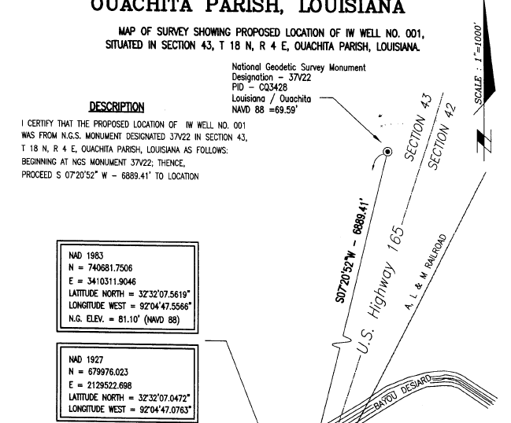
WELL LOCATION PLAT
MAP OF SURVEY SHOWING PROPOSED LOCATION OF JOE BALL SWD WELL NO. 001,
SITUATED IN SECTION 43, T 18 N, R 4 E, OUACHITA PARISH, LOUISINA.
PARISH
SECTION, TOWNSHIP, RANGE
MONUMENT DESCRIPTION
I CERTIFY THAT THE PROPOSED LOCATION OF THE JOE BALL SWD WELL No. 001 WAS FROM N.G.S. MONUMENT DESIGNATED 37V22 IN SECTION 43, T18 N, R 4 E, OUACHITA PARISH, LOUISIANA AS FOLLOWS: BEGINNING AT NGS MONUMENT 37V22, THENCE, PROCEED S 07º20’52” W – 6889.41’ TO LOCATION
LOCATION DESCRIPTION
NORTH ARROW AND SCALE
Proposed location of
JOE BALL SWD WELL NO. 001
WELL NAME
GEOGRAPHIC COORDINATES
IN LAT/LONG & X/Y,
NAD 1983 & 1927
ROADWAY
ELEVATION & REFERENCE
BEARING & DISTANCE
WATER BODY

Slide 8
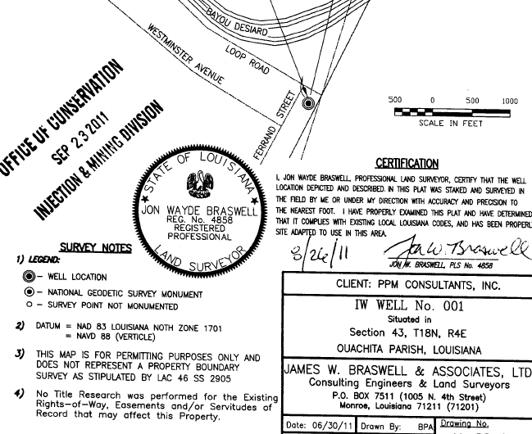
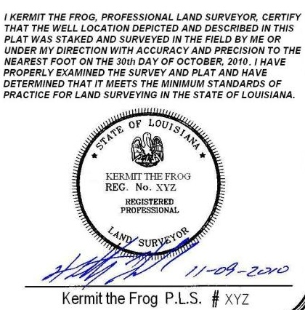

WATERWAY
CERTIFICATION STATEMENT
DATE OF SURVEY
PLS SEAL
BAR SCALE
ORIGINAL SIGNATURE AND DATE IN CONTRASTING INK
OPERATOR: JOE BALL, LLC
JOE BALL SWD WELL NO. 001 Situated in Section 43, T18N, R4E Ouachita Parish, Louisiana
Kermit & Associates, LTD Consulting Engineers & Land Surveyors P.O. Box 10001 Monroe, LA 71211 (71201)
Date: 12/19/2011 | Drawn by: KMG | Drawing No. 12-0001-01
Scale: 1” = 1000’ | Checked by: JSB
OPERATOR’S NAME
LEGEND
WELL NAME
DRAWING DATE

Slide 9
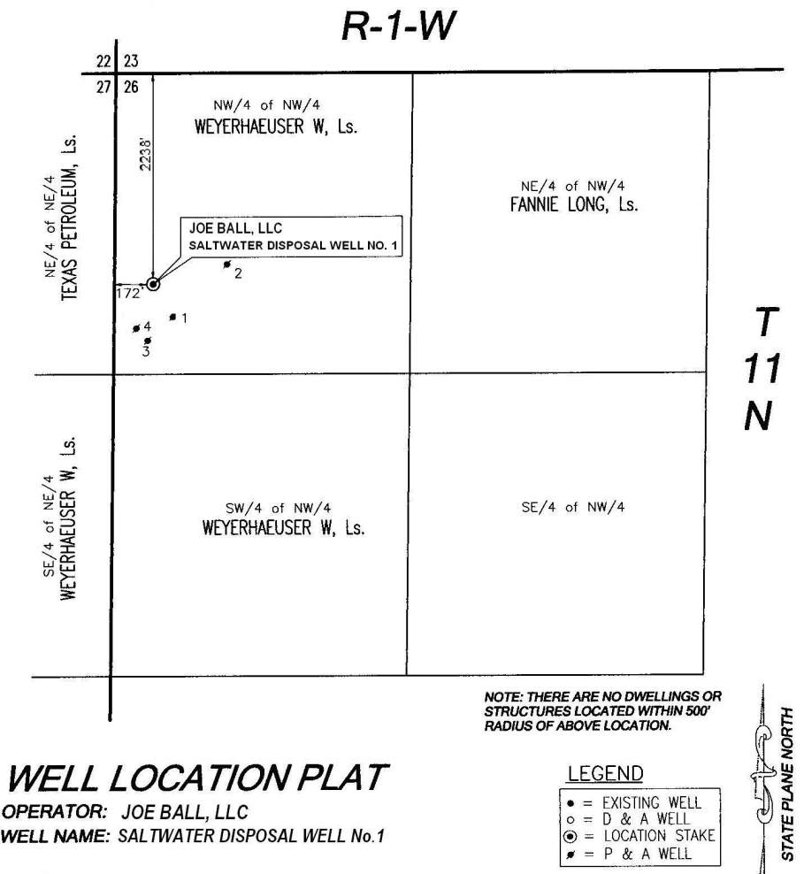
SN 888888
5
ADJACENT WELLS
AS DRILLED
, SN 888888
WATER WELL

Slide 10
Location Plat Requirements
Legal Description
Description must include:
  Field measured distances to the section lines, OR
  Distance and bearing to a historical or governmental monument, OR
  Footages on a protracted section plat.
If the description is not based on the most recent survey, then the plat must include a statement phrased as follows:
“This description is based on the survey and plat made by [insert licensee’s name], Professional Land Surveyor, dated [insert date].”

Slide 11
Location Plat Requirements
Geographic Coordinates
Latitude and Longitude
  In Degrees, Minutes, Seconds
  Minimum accuracy and precision of two decimals of a second
  Provide coordinate referenced from NAD 1927 and 1983
  Will NOT accept values scaled from a map
  If GPS is used to determine coordinates, then the GPS data must meet the policy
State Plane X,Y Coordinates
  Provide coordinate referenced from NAD 1927 and 1983
  Lambert Zone (North or South)

Slide 12
Location Plat Requirements
Seal, Signatures, and Certifications
Seal
  Of the licensed Professional Land Surveyor who assumes responsibility for survey and plat
  Rubber Stamp or Computer Generated seals
  Computer generated seals must be signed and dated
Signatures
  Licensee’s original, handwritten, pen to paper, signature and date
  Contrasting ink

Slide 13
Location Plat Requirements
Seal, Signatures, and Certifications (Continued)
Certification Statement
  The following statement is acceptable:
  “ I [insert licensee’s name], Professional Land Surveyor, certify that the well location depicted and described in this plat was [staked or located] and surveyed in the field by me or under by direction with accuracy and precision to the nearest foot. I have properly examined the survey and plat and have determined that it meets the minimum standards of practice for land surveying in the State of Louisiana.”

Slide 14
Applying the Location Plat Policy to the Following Wells
Class V Wells
Area Permits for Class III Wells
Horizontal and Directional Drilled Wells

Slide 15
Challenges Due to Irregular Sections

Slide 16
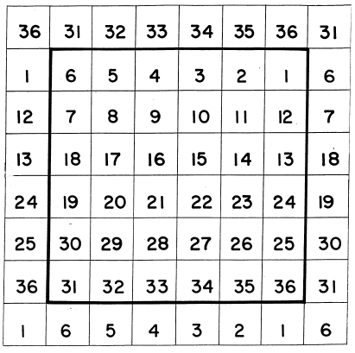
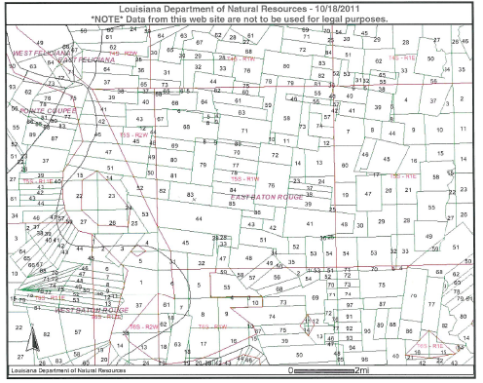
Challenges Due to Irregular Sections (Continued)
IS THERE A GRID PATTERN?
WHERE IS SECTION 83 ?

Slide 17
Challenges Due to Irregular Sections (Continued)

Slide 18
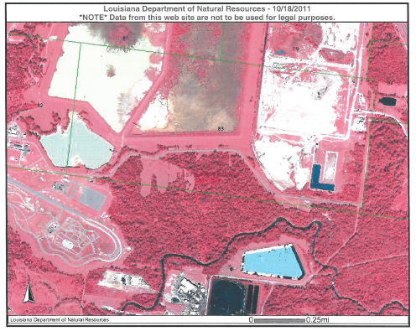
Class V Wells
Challenges Due to Irregular Sections (Continued)
83
44

Slide 19
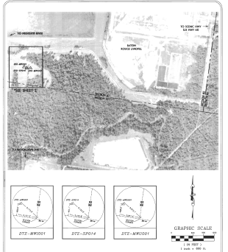
Class V Wells
Challenges Due to Irregular Sections (Continued)
83
44

Slide 20
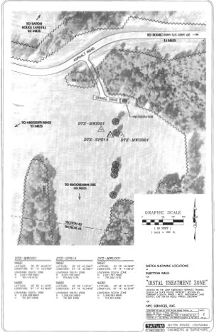
Class V Wells
Challenges Due to Irregular Sections (Continued)
83
44

Slide 21
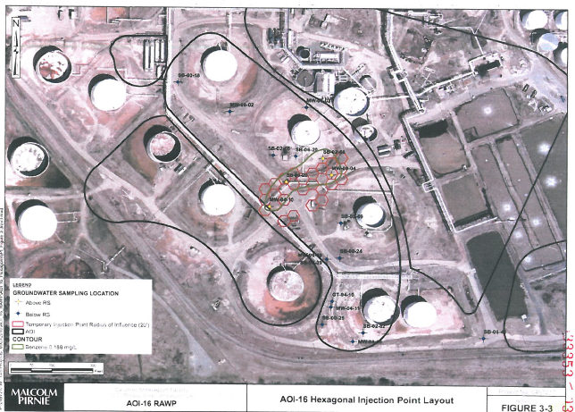
Class V Wells
Class V Wells Installed to Monitor or Remediate Sites
Class V wells are typically installed in tight clusters and in close proximity to industrial structures, which makes conducting the field survey difficult.

Slide 22
Class V Wells
Example of a Location Plat for six Class V wells

Slide 23
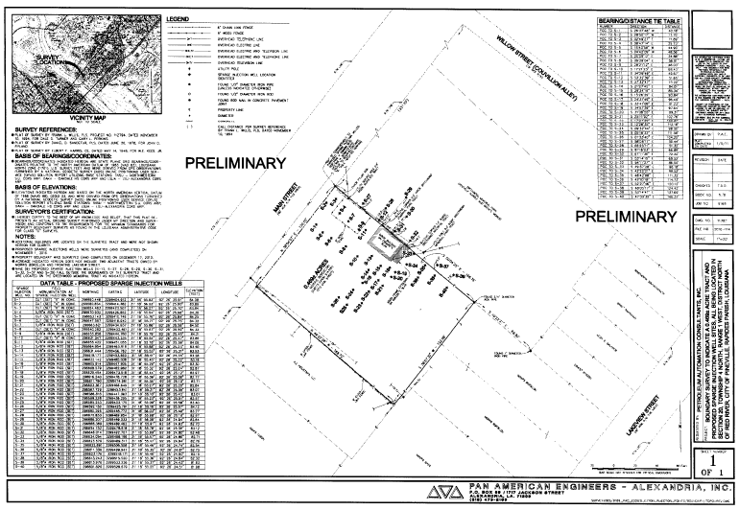
Class V Wells
Another example of a Location Plat for multiple Class V wells

Slide 24
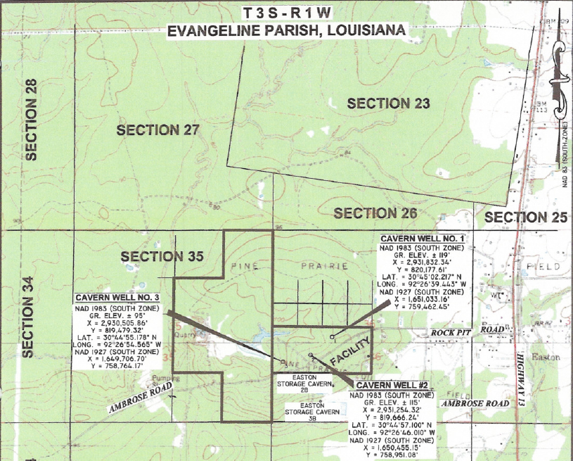
Single Class III Well within an Area Permit
Survey of Individual Wells within Area Permit Boundary

Slide 25
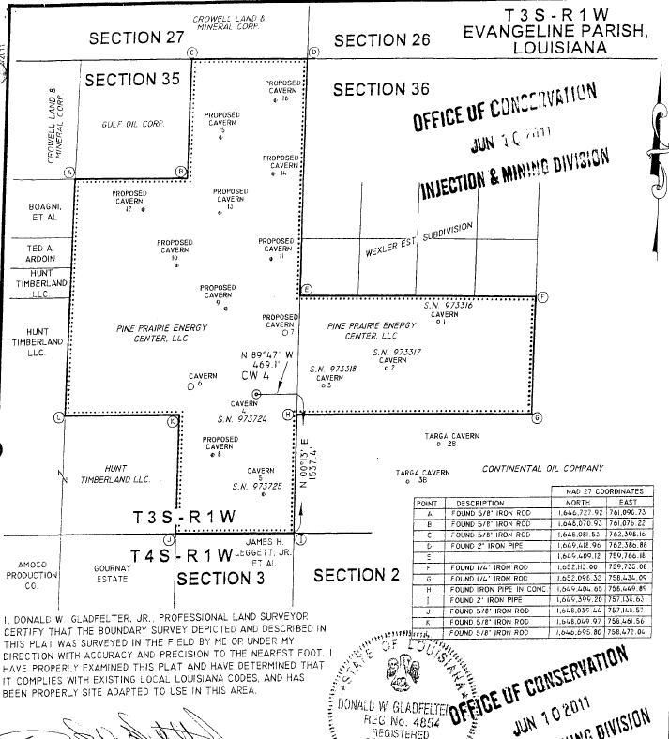
Area Permits for Class III Wells
Survey Includes Multiple Points that Define the Area

Slide 26
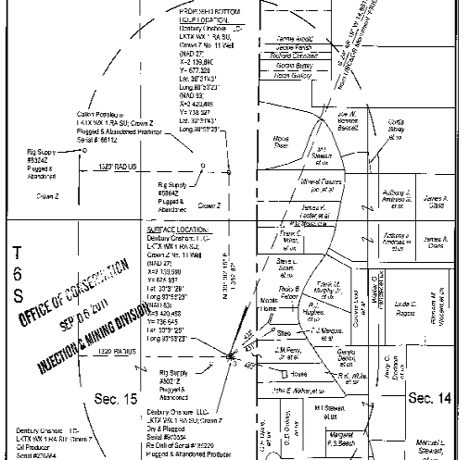
Directional & Horizontal Wells
Surface and Bottom Hole Locations

Slide 27
What is wrong with this plat?

Slide 28
NO SIGNATURE

Slide 29
Area of Review (AOR)

Slide 30
Area of Review (AOR)
Conducting a Search of the AOR
For Class II applications, the AOR is evaluated for wells within a ¼ mile radius of the well to be permitted.
The AOR search must include:
  Searching SONRIS for wells in the DNR database; AND
  Researching field maps and company files.
Applicants must complete the AOR Well List that is included in the Form UIC-2 SWD Application package. This Attachment must be labeled Attachment 6B.

Slide 31
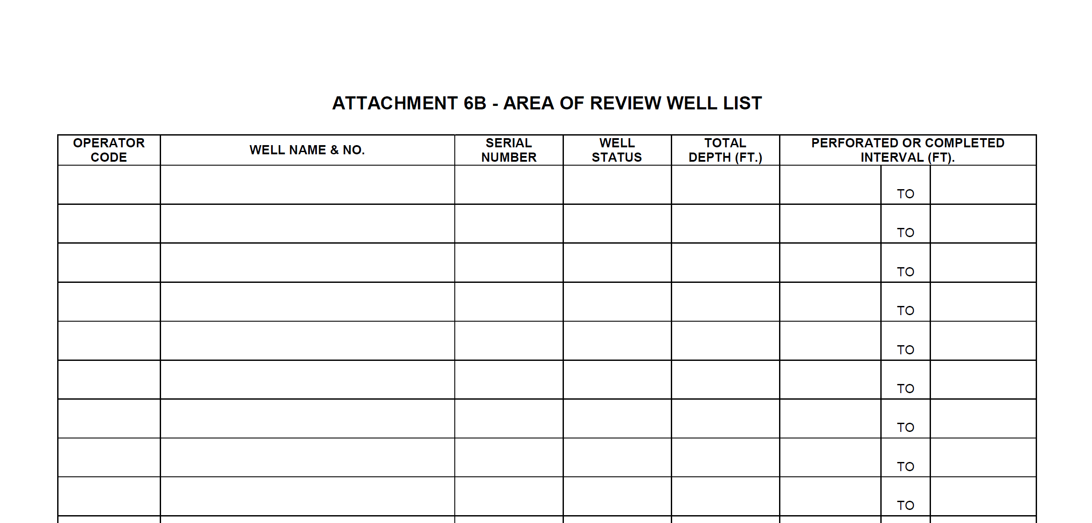
Area of Review Well List
Attachment 6B

Slide 32
AOR Detailed Report
Identifying an Existing Well’s
Lambert Coordinates
Notes:
For this portion of my talk, we’d like to offer some guidance for when you are putting your application together.

Slide 33
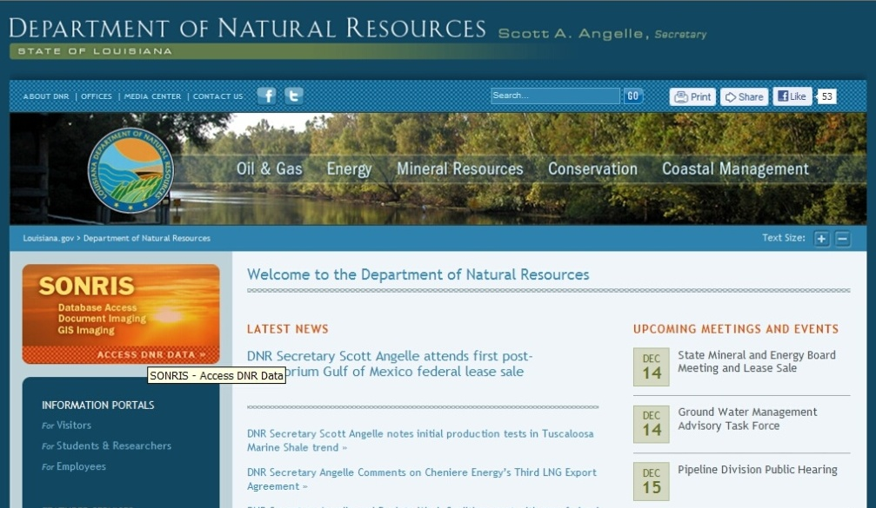

Go to www.dnr.louisiana.gov & click on the SONRIS logo

Slide 34
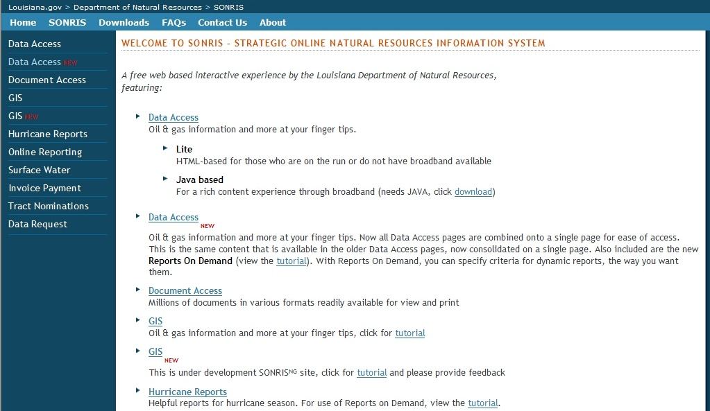
Select Data Access (NEW) from Left Menu

Slide 35
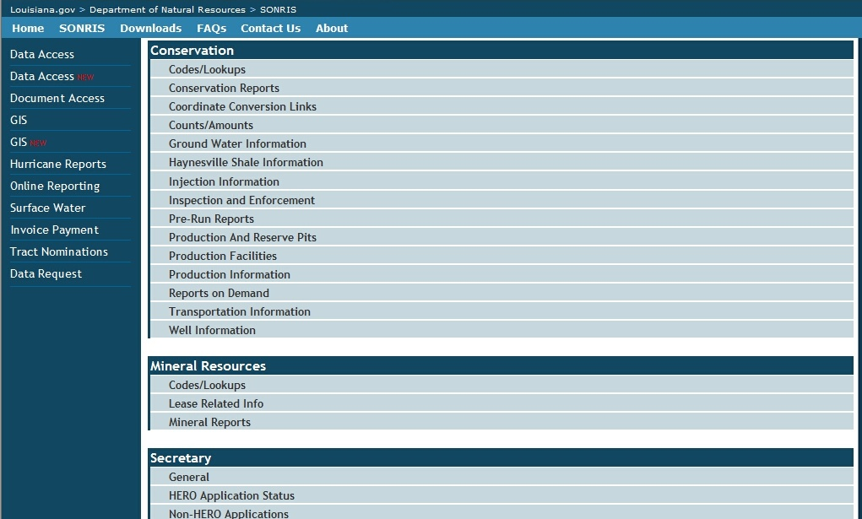
Scroll down to Conservation and select Well Information

Slide 36
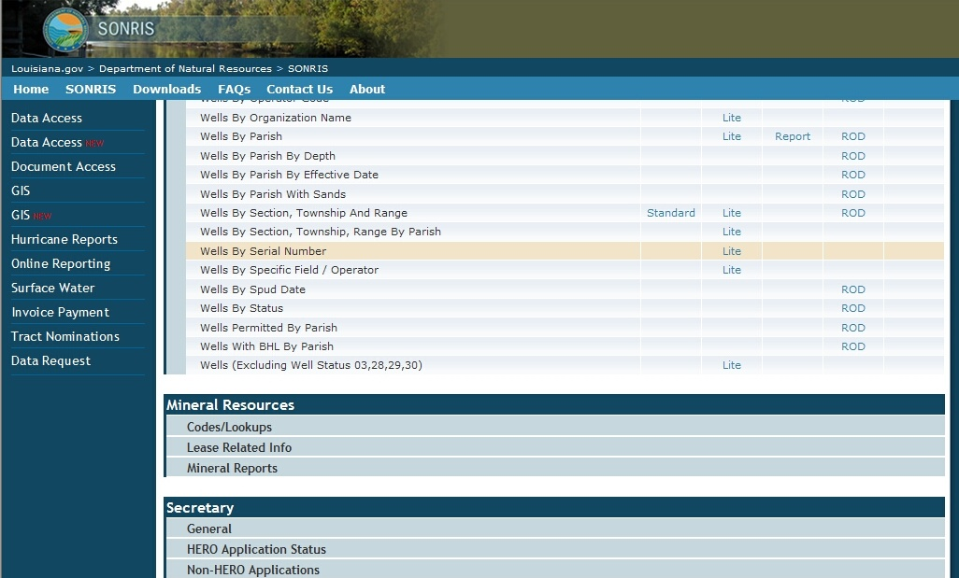
Scroll down to Wells by Serial Number and select the Lite link

Slide 37
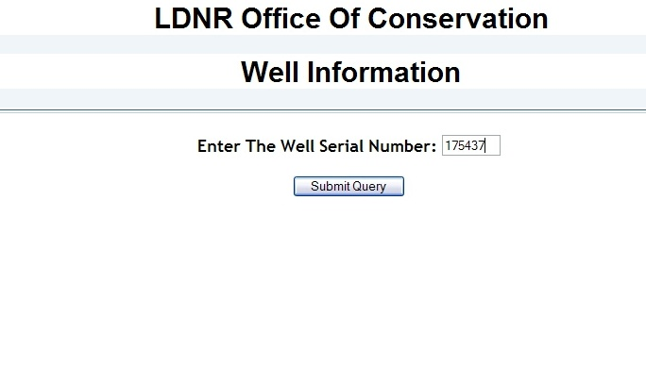
Enter the Serial Number of the well & click Submit Query

Slide 38
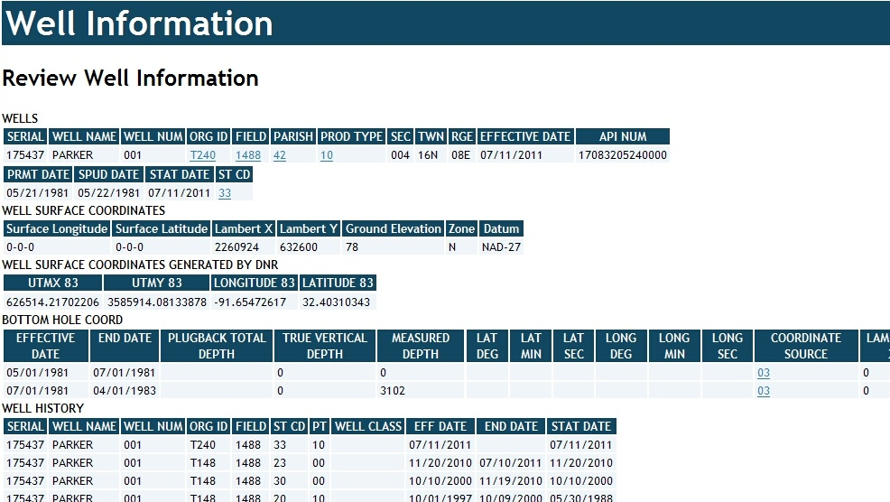
Scroll down to WELL SURFACE COORDINATES &
Locate the Lambert X, Lambert Y, Zone, and Datum fields

Slide 39
AOR Detailed Report
Generating the Detailed Report
Notes:
For this portion of my talk, we’d like to offer some guidance for when you are putting your application together.

Slide 40
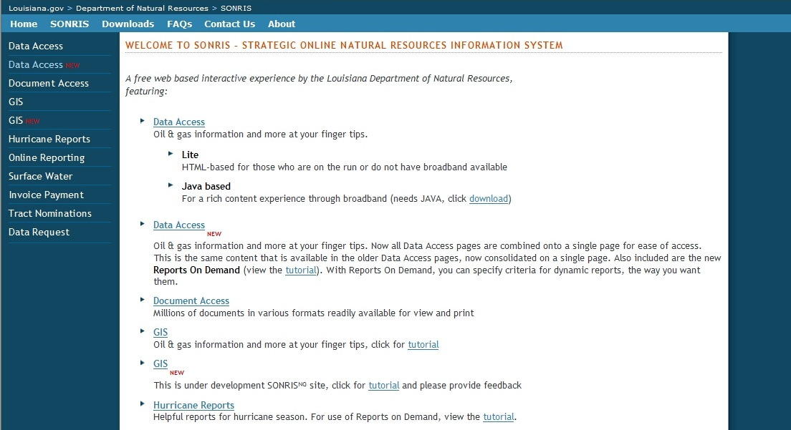
Return to SONRIS and Select
Data Access (NEW) from Left Menu

Slide 41
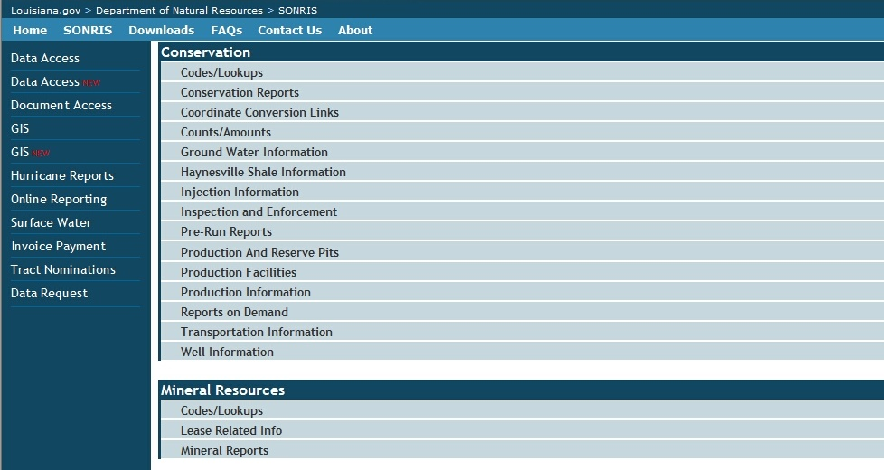
Scroll down to Conservation and select Injection Information

Slide 42
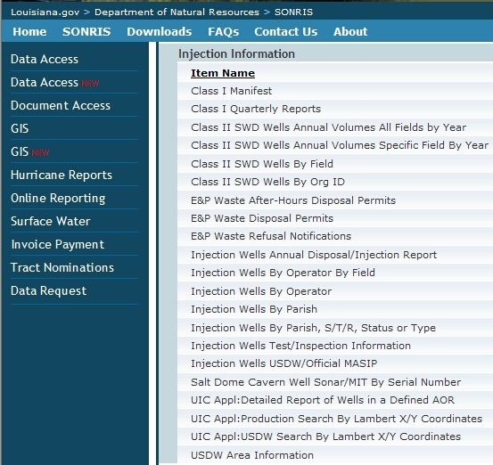
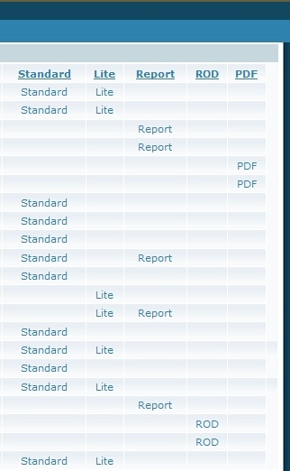
Scroll down to UIC Appl: Detailed Report Of Wells in a Defined AOR and select the Report link

Slide 43
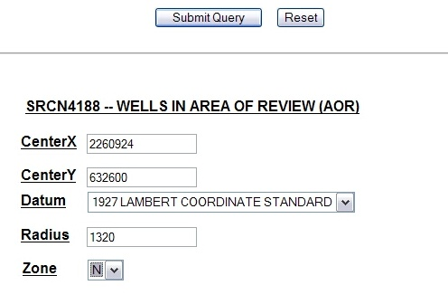
Enter the location’s X/Y Coordinates, Datum (NAD 1927), modify the default Radius (if necessary),
& enter the Zone. Select Submit Query

Slide 44
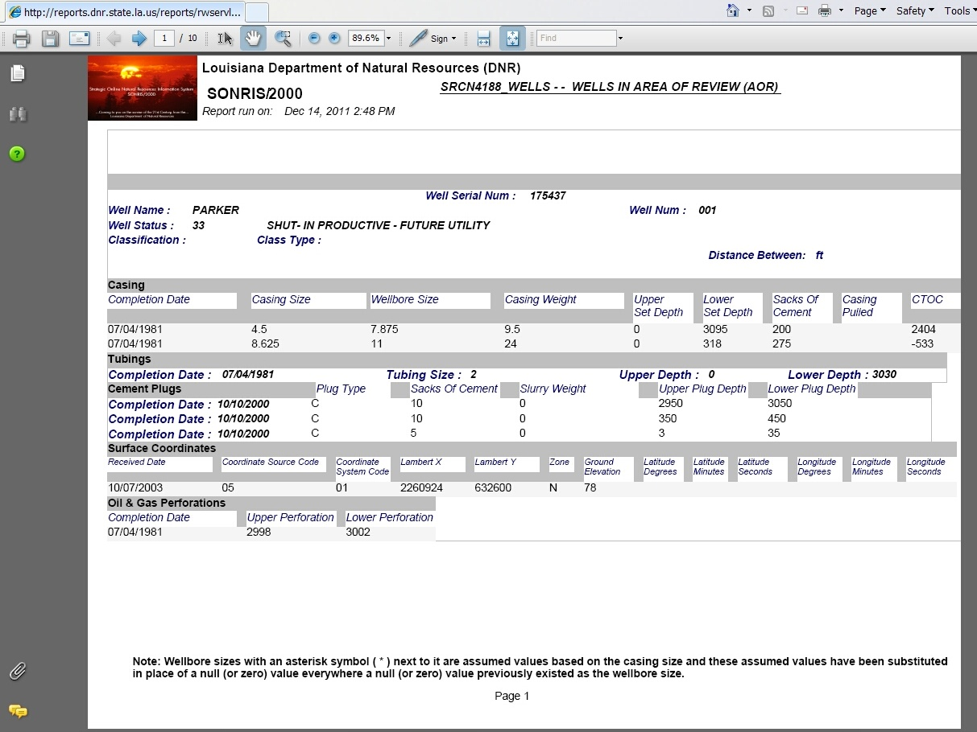
The Distance Between value is “0” because the information is for the proposed well.
0 ft

Slide 45
Identifying Deficient
Wells in an AOR
Cement Isolation in Offset Wells

Slide 46
Cement Isolation
Determining Cement Isolation in an Offset Well
Adequate cement isolation in an offset well in the AOR is defined as:
  Top of cement (calculated or CBL) located between the base of the USDW and the top of the proposed injection zone behind each string of casing which penetrates the proposed injection zone; OR
  An open-hole plug set between the base of the USDW and the proposed injection zone.

Slide 47
USDW: 860 feet Injection Zone: 1,570 – 2,470 feet
Let’s practice applying the criteria on the information for the well itself.
Is the calculated top of cement of the long string above the proposed injection zone?
Is the surface casing set and cemented through the base of the USDW?
X
X
Is there an open-hole plug set between the base of the USDW and the proposed injection zone ?

Slide 48




Sufficient Cement Isolation of USDW
Offset well that penetrates the USDW and ZONE
SUBJECT WELL
OFFSET WELL
SURFACE
CASING
BASE OF THE USDW
SHALE
INJECTION PERFORATIONS
TOP OF ZONE
BOTTOM OF ZONE
INJECTION CASING
(LONG STRING)

Slide 49
Sufficient Cement Isolation of USDW
Offset well that does NOT penetrate the ZONE
SUBJECT WELL
OFFSET WELL
SURFACE
CASING
BASE OF THE USDW
SHALE
INJECTION PERFORATIONS
TOP OF ZONE
BOTTOM OF ZONE
INJECTION CASING
(LONG STRING)

Slide 50
Insufficient Cement Isolation of USDW
Offset well in the ¼-mile Area of Review
SUBJECT WELL
OFFSET WELL
SURFACE
CASING
BASE OF THE USDW
SHALE
TOP OF ZONE
INJECTION PERFORATIONS
BOTTOM OF ZONE
INJECTION CASING
(LONG STRING)

Slide 51
AOR Exercise
Identify the Deficient Wells in the ¼ mile AOR using the following information:
    1. SN 175437 is the Proposed SWD well.
    2. The Base of the USDW was identified at 860 feet.
    3. The Proposed Injection Zone is from 1,570 – 2,470 feet.
    Remember, to verify sufficient cement isolation in the offset wells, the following must exist:
    Top of cement (calculated or CBL) located between the base of the USDW and the top of the proposed injection zone behind each string of casing which penetrates the proposed injection zone; OR
    An open-hole plug set between the base of the USDW and the proposed injection zone.

Slide 52
Migration Potential Determination (MIGPOT)
Determining the Potential for Fluids to Migrate from an Injection Zone to a Deficient Offset Well

Slide 53
Migration Potential
Theory and Determination of Potential
    Theory
    When a pathway exists, the potential for flow into the USDW exists regardless of the distance from the disposal well to another well. This is even true if no fluid (or no additional fluid) is injected into the disposal well.
    Factors for Consideration
    Are there deficient wells in the AOR of the proposed injection well?
    How far away is the nearest deficient wellbore?
    Will proposed injection interval induce sufficient pressure to cause flow into USDW?
Determination
    If a deficient wells is located within the ¼ mile AOR, corrective action is required to be performed in order for the well to be permitted. This is to ensure that injected fluid will not migrate from the injection zone into the USDW by way of channels which may be present in the deficient well bores.

Slide 54
Corrective Actions
    Provide Documentation
    Provide additional documentation which shows that sufficient cement isolation of the USDW from the injection zone exists in each of the offset deficient wells. This proof may consist of logs, documents from the Office of Conservation District Office files, or other records acceptable to the Commissioner; or
    Re-enter for Isolation
    Re-enter the offset wells and isolate the injection zone from the USDW with a cement squeeze or plug. All remedial work must be properly permitted by the District Office; or
    Migration Potential Calculation (MIGPOT)
    Provide the Injection and Mining Division with data necessary to perform a MIGPOT. If it can be shown that injection will not cause fluid migration in the offset wells, the proposed disposal well may be permitted without further corrective action required on the offset wells. If you wish to have a MIGPOT calculation performed, a signed letter must be submitted to the Injection and Mining Division stating such.

Slide 55
Calculating the MIGPOT
Fluid and Formation Properties Needed for Calculation
    A signed letter must be submitted to the IMD if the corrective action is to request a MIGPOT calculation be performed. A sample MIGPOT letter can be found in your handout.
    Daily Injection Rate (bbls/Day)
    Injection Fluid Density (ppg)
    Injection Fluid Viscosity (cp)
    Formation Permeability (millidarcies)
    Formation Porosity (%)
    Static Fluid Level (To be measured after receiving “Approval to Construct” letter)

Slide 56
Monitoring the Migration Potential
Annual Static Fluid Level Measurement and MIGPOT Calculation
Static fluid level of the subject well must be obtained annually and witnessed by a Conservation Enforcement Specialist.
The well cannot be on a vacuum at the time of the test.
The CES will report the static fluid level to IMD and an Engineer will recalculate the MIGPOT.

Slide 57
Questions?

