Slide 1
Class I, Salt Cavern & Class V Wells
Louisiana Department of Natural Resources
Office of Conservation
Injection and Mining Division

Slide 2
CLASS I, SALT CAVERN & CLASS V Wells
 | Class I Non-Hazardous Waste Injection | Class I Hazardous Waste Injection | Class II Hydrocarbon Storage | Class II E&P Waste Disposal in a Salt Cavern | Class III Solution Mining | Class V
Statewide Order | 29-N-1 | 29-N-2 | 29-M | 29-M-2 | 29-N-1 | 29-N-1
 | LAC 43: XVII.103 Chapter 1 | LAC 43: XVII.201 Chapter 2 | LAC 43: XVII.301 Chapter 3 | LAC 43: XVII.3101 Chapter 31 | LAC 43: XVII.103 Chapter 1 | LAC 43: XVII.103 Chapter 1
Permit Application Form | UIC-1 | UIC-1 | UIC-2 HSW | UIC-43 | UIC-3BR | UIC-25
The Application should only refer to the regulations of the specific Class of well for which you are applying.

Slide 3
Note: Class V wells will be discussed separately towards the end of the presentation.

Slide 4
OVERVIEW OF WELL CLASS COMPARISONS

Slide 5
Permit Application content common to Class I wells and Salt Caverns
Certified Plat
Regional Geology
Local Geology
  Base of USDW
  Freshwater Aquifers
  Stratigraphy (Cross-Sections)
  Structure Maps
  Injection Zone
  Seismic Activity
  Flood Areas
Technical Report
Monitoring, Testing & Reporting
Contingency Plans
Closure & Post-Closure Plans
Financial Responsibility
IT Questions
Adjacent Property Owners’ Names & Addresses

Slide 6
Regional and Local Geology Section

Slide 7
CROSS SECTION PROFILES
Should include information from literature, seismic data, and facility records.
Must be prepared to professional geological standards (vertical and horizontal scales, orientation, legend, preparer’s name and date of preparation)
Include an index map to show the cross sections lines
If logs are available, include the closest wells to the proposed well
The Operator’s name, Well Name and Number, Well Serial Number, and Well Status should be identified above each one of the wells used to construct the cross section s
Distance between the wells
Electrical log copies scaled and included in the cross sections

Slide 8
CROSS SECTION PROFILES
(Continued)
Indicate the extent of the AOR and property lines
Indicate the USDW, Aquifer Systems, Age of Major geological units
Stratigraphic correlations based on particular stratigraphic units should be marked clearly throughout the cross sections
Proposed perforated interval needs to be marked
The proposed top and bottom of the injection zone should be marked clearly
The Confining zone should be marked clearly
Indicate the horizontal extent of major surface features
For a complete list of features to include on cross sections, please see the “cross section standards” list.

Slide 9
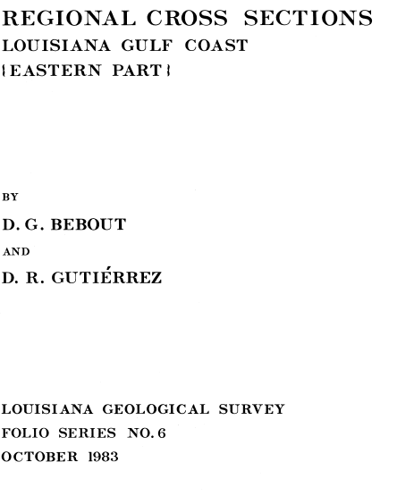
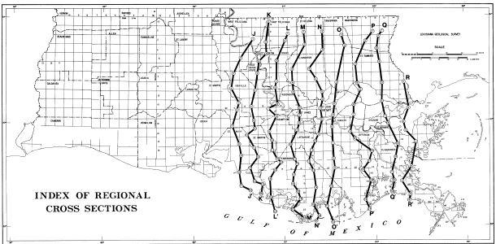

Slide 10
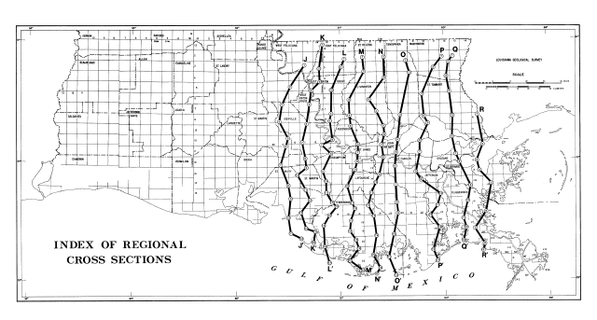

Slide 11
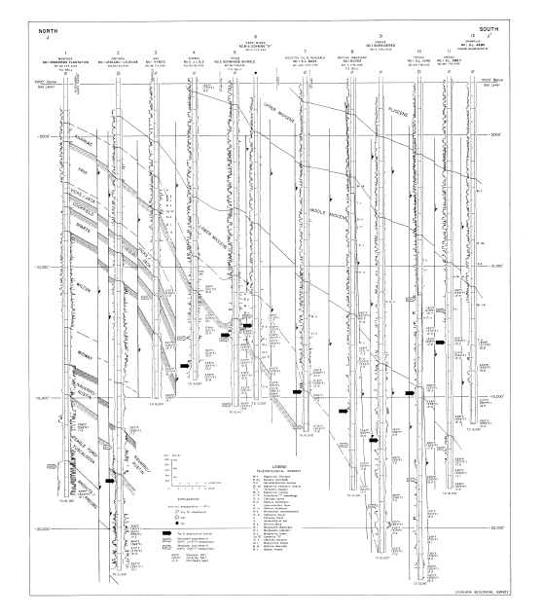
Well information
Legend

Slide 12
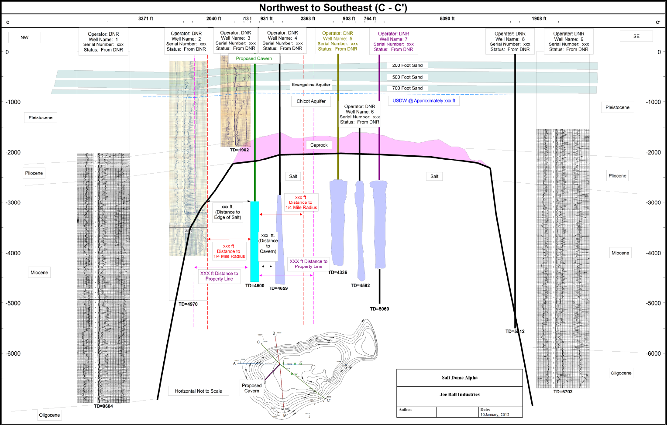
LOCAL GEOLOGY – INDEX MAP FOR CROSS-SECTIONS

Slide 13
Some areas of Discussion that are specific to each Class of well

Slide 14
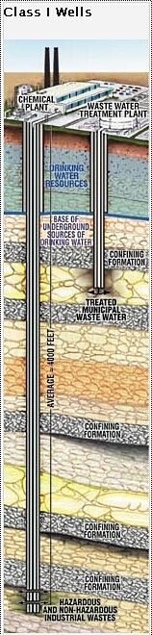
Class I Injection Wells
isolate hazardous, industrial and municipal,
or radioactive wastes from the lowermost formation containing, within ¼ mile radius of the well bore, an underground source of drinking water.

Slide 15
CLASS I NON-HAZARDOUS
AREA OF REVIEW OF ARTIFICIAL PENETRATION WELLS
  No less than 2-Miles
AREA OF REVIEW FOR FRESH WATER WELLS
¼ Mile radius
INJECTION ZONE RESERVOIR PROPERTIES
  Porosity and Permeability
  Lithology of the Injection Formation
  Bottomhole Temperature and Pressure
  Formation Fracture Pressure
WASTE STREAM CHARACTERIZATION
  Chemical and Physical properties of the injection fluid
  Compatibility with Formation
PERIODIC MECHANICAL TEST
  RTS
  Temperature Logs
  Oxygen Activation Logs

Slide 16
CLASS I HAZARDOUS
Essentially the same requirements as Class I Non-Hazardous wells with the addition of the following:
The following must be proven through modeling:
  That the injection zone has sufficient permeability, porosity, thickness & areal extent to prevent migration of fluids into USDWs or outside of the injection zone.
  That the confining zone is laterally continuous and free of transecting, transmissive faults or fractures over an area sufficient to prevent the movement of fluids into USDW or outside the injection zone; and
  Contains at least one formation of sufficient thickness and with lithological and stress characteristics capable of preventing vertical propagation of fractures.

Slide 17
CLASS I HAZARDOUS
(continued)
Area of Review of Artificial Penetration Wells
2-Miles around the well OR the calculated cone of influence of the well, whichever is greater
For wells within ½ Mile radius of injection well, include:
  Copies of casing and cementing records (including cementing affidavits)
  Copies of plugging and completion records; and
  Schematic diagrams of each well

Slide 18
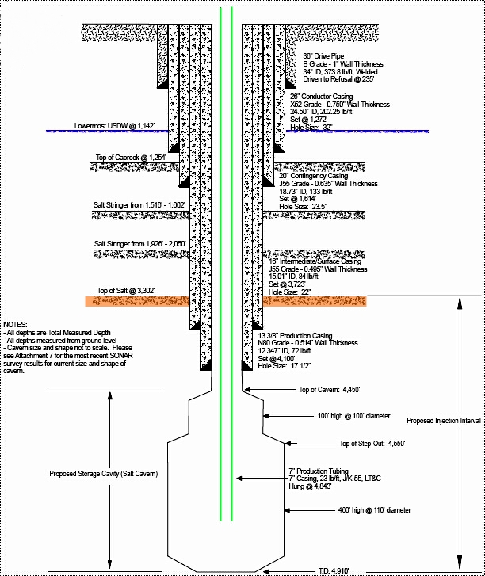
Class II Hydrocarbon Storage Wells inject hydrocarbons in underground formations (such as salt caverns) where they are stored.

Slide 19
Class II Hydrocarbon Storage
Structure map showing Top of Salt
Well Construction Requirements
  Two strings of casing cemented into the salt
  Deepest cemented casing at least 300 feet into the salt
Storage Cavern Location and Geometry
  Maximum development diameter of the storage chamber shall be no less than 100 feet from property lines
  Distance separation between cavern walls shall be no less than 200 feet as measured in any direction
  Distance of the cavern to the edge of the salt shall be no less than 300 feet

Slide 20
Class II Hydrocarbon Storage
Geomechanical Studies and Modeling
  To determine maximum and minimum operating pressure of the storage chamber
Subsidence Program including semi-annual subsidence surveys for gas storage or annual subsidence surveys for liquid storage
Sonar Survey Reports of the mined cavern (every 5 years)
MITs – typically Nitrogen/Brine Tests (every 5 years)
  Must include 60-minute casing test and at a minimum a 24-hour cavern system test.

Slide 21
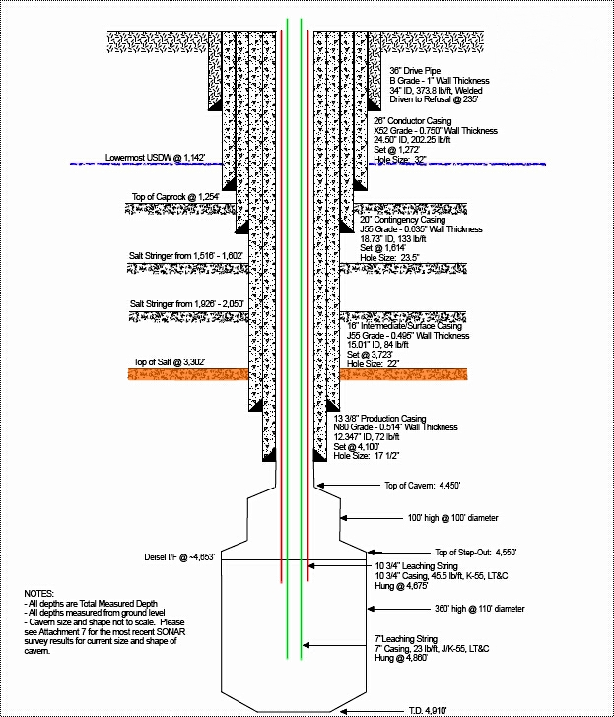
Class III wells inject fluids for extraction of minerals or energy. Currently, all permitted Class III wells in Louisiana are salt solution mining wells.

Slide 22
Class III Solution Mining
Structure map showing Top of Salt
Evaluation of Groundwater (typically freshwater) Pumpage for Cavern Development
  Number of wells to be installed
  Projected volume of water needed
  Expected volume of cavern
  Time required to complete the project
  Contact the Environmental Division of the Office of Conservation
Groundwater analysis of the source of mining water
  The analysis sheet(s) must identify the freshwater well sampled
  At minimum include measurements of: Chloride and TDS.
Sonar Survey Reports of the mined cavern (every 5 years)
MITs – typically Nitrogen/Brine Tests (every 5 years)
  Must include 60-minute casing test and at a minimum a 24-hour cavern system test.
NOTE: Class III applications should not refer to regulations in 29-M or 29-M-2 even if the cavern is being developed for storage or E & P Waste Disposal purposes.

Slide 23
Technical Report

Slide 24
Technical Report
The purpose of the Technical Report is to describe the proposed project as a whole and must explain:
Regional and Local Geology
overall well operating ranges,
system monitoring,
safety procedures and equipment,
financial responsibility,
Closure and post closure plans, etc.
The bulk of these application packages is located in the Technical Report. Each Class well is required to include certain content within the Technical report. We will discuss content that is specific for the Engineering and Geological reviews for each type well.

Slide 25
Components to include in the Technical Report for Class I Non-Hazardous
(Non-Haz) Wells

Slide 26
Technical Report for Class I Non-Haz Wells
Proposed operating data: average & maximum daily rate & volume of the injection fluid; average & maximum injection pressure; source & analysis of the chemical, physical & biological characteristics of the injection fluid;
Proposed formation testing program: to obtain an analysis of the physical & chemical characteristics of the receiving formation;
Proposed stimulation program;
Proposed injection procedures: including storage & pre-injection treatment of the waste stream, and well use schedule;

Slide 27
Technical Report (for Class I Non-Haz Wells) - continued
Plans (including maps): for meeting the monitoring requirements of Lac 43:XVII.109.A.7 (209.I.1 for Class I Hazardous Wells);
Construction procedures: including a cementing & casing program, logging procedures, deviation checks & a drilling, testing & coring program;
Contingency plans: to cope with all shut-ins or well failures to prevent the migration of the contaminating fluids into underground sources of drinking water (USDW);

Slide 28
Technical Report (for Class I Non-Haz Wells) - continued
Calculation of the pressure increase: in the proposed injection zone for a time period equal to the expected life of the well. You may use Matthews and Russell, 1967 Pressure Buildup and Flow Tests in Wells, American Institute of Mining, Met. Eng. Monograph, Vol. 1;
Calculation of expected waste front travel: a conservative value can be calculated by using the following formula (see next slide).

Slide 29
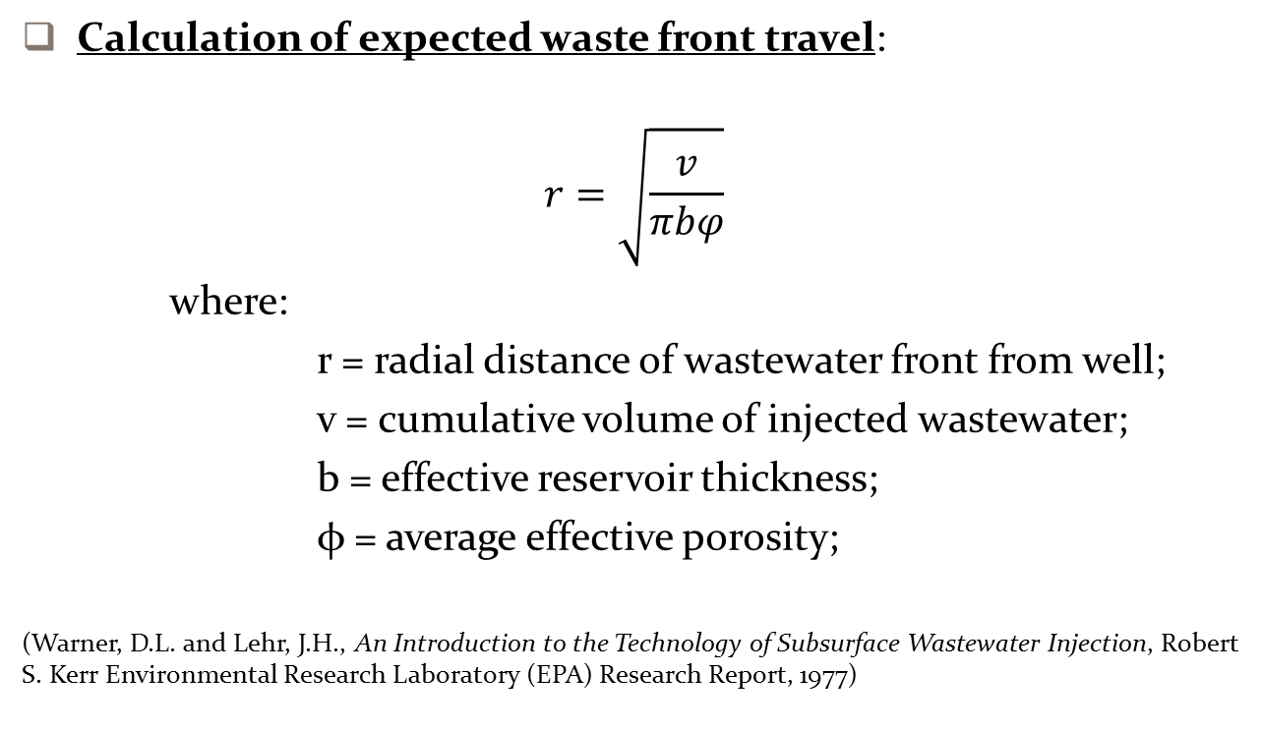
Technical Report (for Class I Non-Haz Wells)
- continued
Calculation of expected waste front travel:
$$r=\sqrt{\frac{v}{πbφ}}$$
where:
r = radial distance of wastewater front from well;
v = cumulative volume of injected wastewater;
b = effective reservoir thickness;
φ = average effective porosity;
(Warner, D.L. and Lehr, J.H., An Introduction to the Technology of Subsurface Wastewater Injection, Robert S. Kerr Environmental Research Laboratory (EPA) Research Report, 1977)

Slide 30
Components to include in the Technical Report for Class I Hazardous
(Haz) Wells

Slide 31
Technical Report (for Class I Haz Wells)
Essentially, the same requirements as Class I Non-Haz wells with the addition of the following:
  Table of data on all wells which penetrate the proposed zone within a 2-mile Area of Review (AOR) or the calculated cone of influence of the well, whichever is greater - for wells within a ½-mile radius of the injection well - you must also include:
      Copies of casing & cementing records (including cementing affidavits);
      Copies of plugging &/or completion records; and
      Schematic diagrams of each well.

Slide 32
Technical Report (for Class I Haz Wells)
- continued
  Proposed formation testing program: to obtain an analysis of the chemical, physical & radiological characteristics of & other information on both the injection zone and the confining zone;
  Construction procedures: should include a cementing and casing program (include cementer’s recommendation), well material specifications & their life expectancy, logging procedures, deviation checks and a drilling, testing & coring program;
  Financial assurance: through a performance bond or other appropriate means, the resources necessary to close, P&A the well & for post-closure care as required under LAC 43:XVII.207.C & 209.O;
  Applicant’s plans for closure (P&A) and post-closure care of the well (information required under LAC 43:XVII.209.L.1 & M.1).

Slide 33
Components to include in the Technical Report for Class II Hydrocarbon Storage (HSW) Wells

Slide 34
Technical Report (for Class II HSW wells)
Information on manmade structures within the salt stock regardless of use, depth of penetration, or distance to the salt cavern well or salt cavern being the subject of the application:
    A tabular listing of all salt caverns to include:
        Operator name, well name & number, state serial number & well location;
        Current or previous use of the salt cavern (waste disposal, hydrocarbon storage, solution mining), current status of the salt cavern (active, shut-in, P&A’d), date the salt cavern well was drilled, & the date the current salt cavern status was assigned;
        Salt cavern depth, construction, completion (including completion depths), P&A data;

Slide 35
Technical Report (for Class II HSW wells) - continued
    A tabular listing of all conventional (dry or room and pillar) mining activities, whether active or abandoned. The list must include the following minimum items:
        Owner or operator name & address;
        Current mine status (active, abandoned);
        Depth & boundaries of mined levels;
        The closest distance of the mine in any direction to the salt cavern well & salt cavern.
Corrective action plan: for wells or other manmade structures within the AOR that penetrate the salt stock but are not properly constructed, completed or P&A’d;

Slide 36
Technical Report (for Class II HSW wells) - continued
Surface site diagram(s): drawn to scale to include details & locations of the entire salt cavern hydrocarbon storage facility layout (surface pumps, piping & instrumentation, controlled access roads, fenced boundaries, hydrocarbon offloading, storage, treatment & processing areas, field office, monitoring & safety equipment & location of such equipment, required curbed or other retaining wall heights, etc.;
Detailed plans & procedures to operate the salt cavern well, salt cavern & related surface facilities in accordance with the following requirements:

Slide 37
Technical Report (for Class II HSW wells) - continued
    Cavern & surface facility design requirements: including but not limited to cavern spacing requirements & cavern coalescence;
    Operating requirements: including but not limited to cavern roof restrictions, blanket material, remedial work, well recompletion, multiple well caverns, cavern allowable operating pressure & rates and cavern displacement fluid management;

Slide 38
Technical Report (for Class II HSW wells) - continued
    Safety requirements: including but not limited to an emergency action plan, controlled site access, facility identification, personnel, wellhead protection & identification, valves & flowlines, alarm systems, emergency shutdown valves, vapor monitoring & leak detection, gaseous vapor control, fire detection & suppression, systems test & inspections & surface facility retaining walls & spill containment, as well as contingency plans to cope with all shut-ins or well failures to prevent the migration of contaminating fluids into underground sources of drinking water;

Slide 39
Technical Report (for Class II HSW wells) - continued
    Monitoring requirements including but not limited to equipment requirements such as pressure gauges, pressure sensors and flow sensors, continuous recording instruments, leak detection, subsidence monitoring, as well as a description of methods that will be undertaken to monitor salt cavern growth due to under-saturated fluid injection;
    Pre-operating requirements specifically the submission of a completion report & the information required therein, prior to accepting, storing or otherwise initiating storage activities;

Slide 40
Technical Report (for Class II HSW wells) - continued
    Mechanical integrity pressure and leak test requirements including but not limited to frequency of tests, test methods, submission of pressure & leak test results, notification of test failures;
    Cavern configuration & capacity measurement procedures including but not limited to sonar caliper surveys, frequency of surveys & submission of survey results;

Slide 41
Technical Report (for Class II HSW wells) - continued
    Requirements for inactive caverns;
    Closure requirements including but not limited to closure plan requirements, standards for closure; and,
    Any other information pertinent to operation of the salt cavern storage facility.

Slide 42
Components to include in the Technical Report for Class III Wells

Slide 43
Technical Report (for Class III wells)
Proposed operating data: average & maximum daily rate & volume of fluid to be injected; average & maximum injection pressure; and qualitative analysis & ranges in concentrations of all constituents of injected fluids;
Proposed formation testing program: to obtain the info required by LAC 43:XVII.109.B.4.c & d;
Proposed stimulation program;
Proposed injection procedure;

Slide 44
Technical Report (for Class III wells)
- continued
Plans (including maps): for meeting the monitoring requirements of LAC 43:XVII.109.B.7;
Expected changes in pressure, native fluid displacement and the direction of movement of injection fluid;
Financial assurance: through a performance bond or other appropriate means, the resources necessary to close or P&A the well as required by LAC 43:XVII.109.B.10 & 107.C; and,
Corrective action proposed to be taken under 109.B.3: for wells within the AOR which penetrate the injection zone but are not properly completed or plugged.

Slide 45
A Brief Discussion on Class V Wells

Slide 46
Safe Drinking Water Act
Underground Injection Control (UIC) Program
Protecting Public Health and Drinking Water Resources
Class V wells
Manage the shallow injection
of all other fluids to prevent contamination of drinking water resources
In March 23, 1982 EPA delegated the State of Louisiana with full permitting and enforcement authority of the State’s UIC Program

Slide 47
Class V Permitting
Class V
Statewide Order | 29-N-1
 | LAC 43: XVII.103 Chapter 1
Permit Application Form | UIC-25

Slide 48
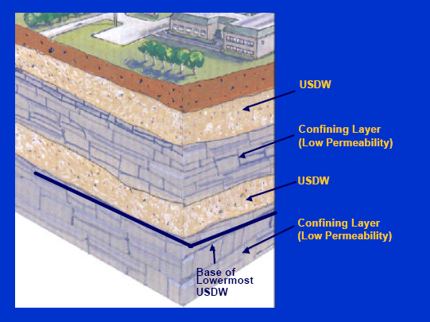
USDW MUST BE PROTECTED

Slide 49
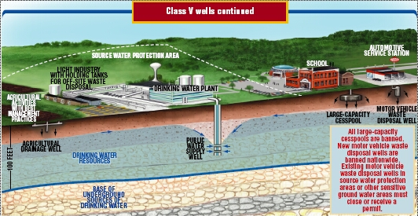
Safe Drinking Water Act
Underground Injection Control (UIC) Program
Protecting Public Health and Drinking Water Resources
There are over 20 subtypes of Class V Wells , nationwide
In Louisiana, most Class V wells are permitted to inject non-hazardous fluids to remediate soil and/or groundwater conditions

Slide 50
Class V Well Applications Should Include:
LOCATION PLAT FOR A SINGLE WELL OR GROUP OF WELLS
WELL CONSTRUCTION DETAILS
DESCRIPTION OF INJECTION FLUIDS
(i.e.,Ozone, OxyTek-L®, Organicide®, etc.)
PROOF THAT THE REMEDIATION SITE IS UNDER MANAGEMENT OF LDEQ AGENCY

Slide 51
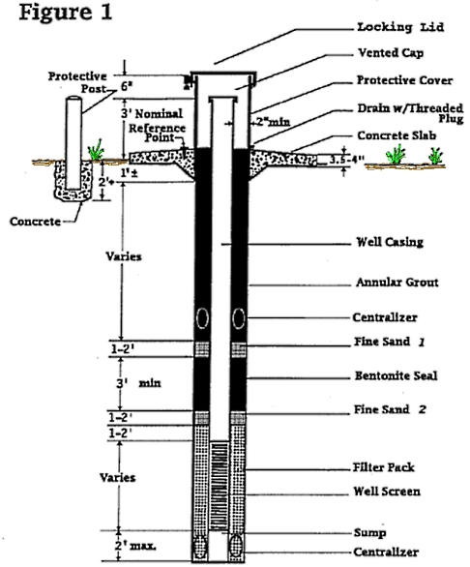
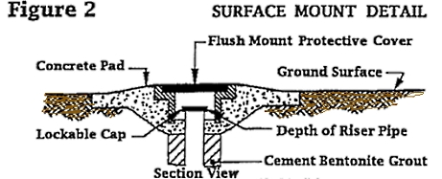
CLASS V – Well Construction
Well Casing above OR below ground with flush mount protective cover
Well Depth between 2 to 40 feet below ground

Slide 52
CLASS V REQUIREMENTS
Injection without a permit is a violation of Statewide Order No. 29-N-1, and is subject to enforcement action and fines
Operator Name, Serial Number and Well Name should be inscribed, stamped or otherwise permanently affixed to the well
An original signed completed Well History & Work Resume Report (FORM UIC-42) must be submitted after completing the injection well
A work permit (FORM UIC-17) must be approved before any work is performed on the well

