Slide 1

UIC APPLICATIONS:
UIC-14s,UIC-17s,
UIC-P&As,UIC-32s, and UIC-WH1s
Presented by
Kay Smothers and Greg France
Injection and Mining Division

Slide 2
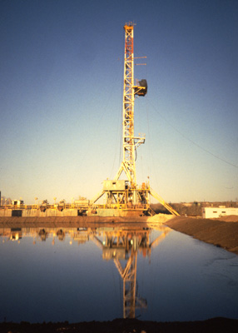
Form UIC-14:
Application for Subsurface Disposal of Reserve Pit Fluids

Slide 3
Intended for the purpose of subsurface injection of drilling and workover waste fluids (including reserve pit fluids) that were generated in the drilling, stimulation, or workover of the specific well for which authorization is requested

Slide 4
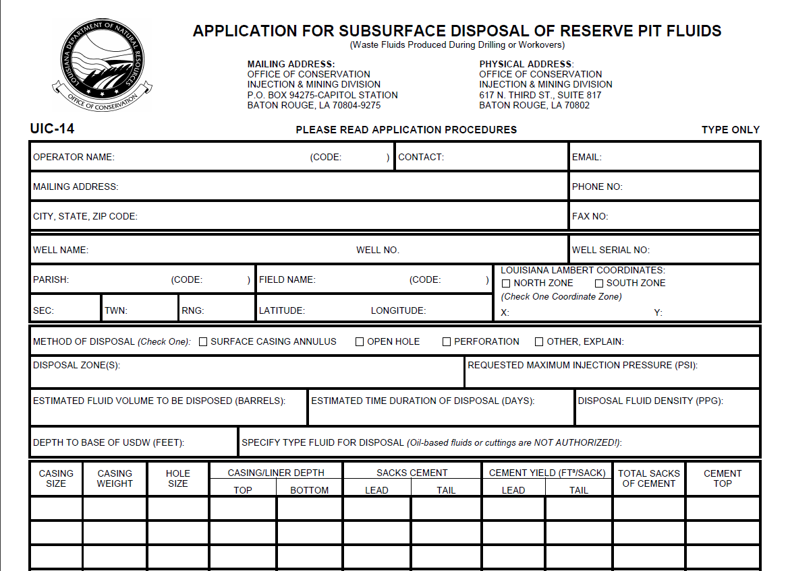
Form UIC-14 Application

Slide 5
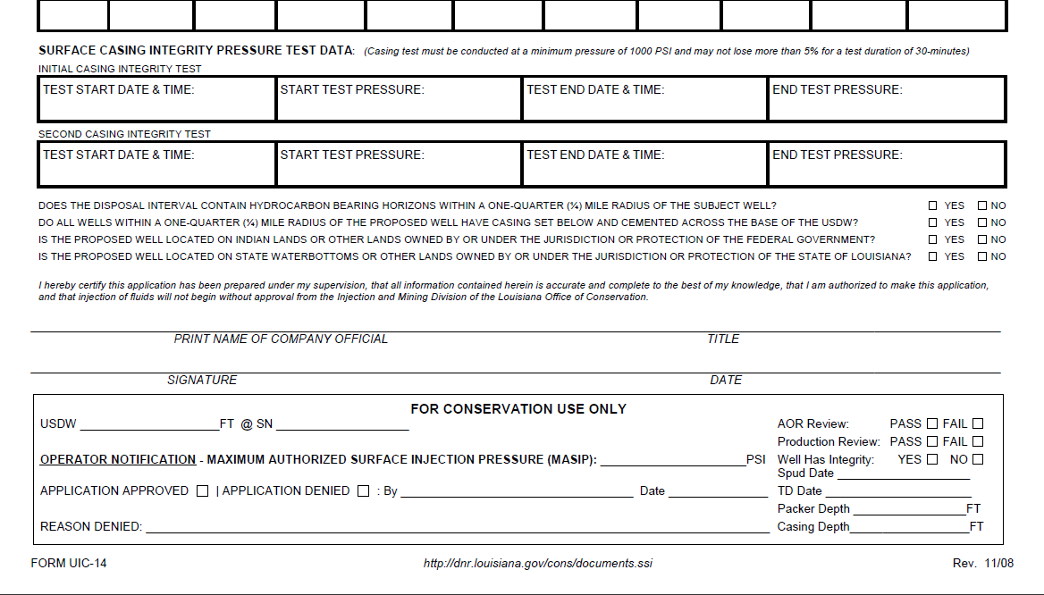

Slide 6
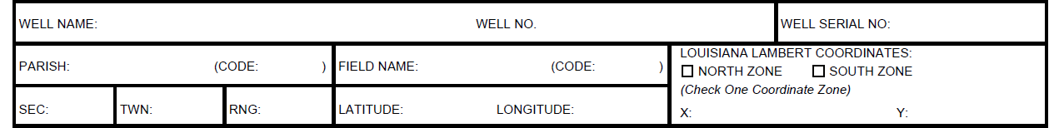
  Well Information
    The information in this section must match the information on Sonris and the Location Plat exactly. The data entered for the coordinates must be the NAD-27 Louisiana Lambert X- & Y- coordinates for the surface hole location.

Slide 7
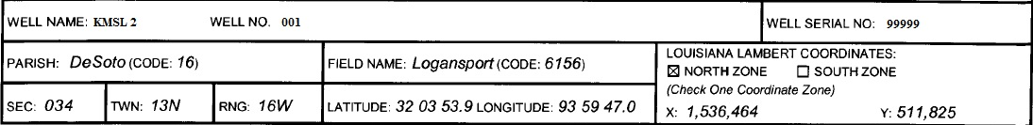
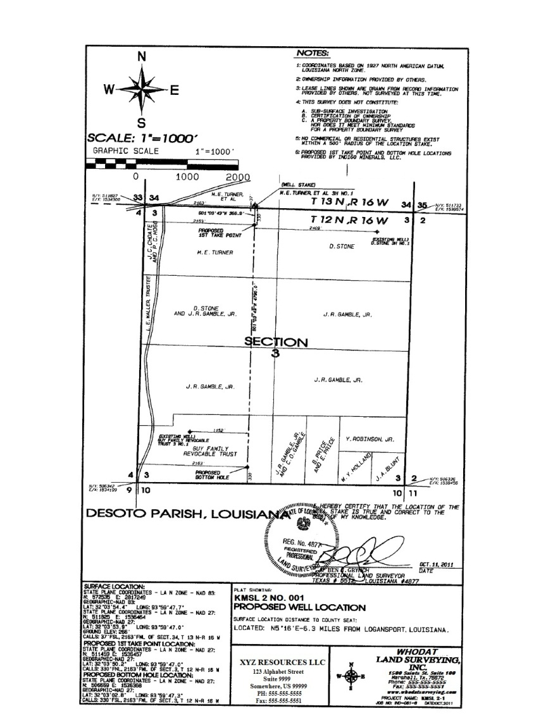
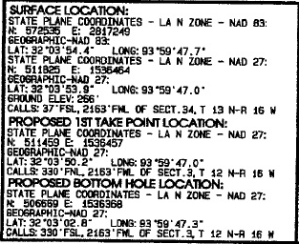

Slide 8
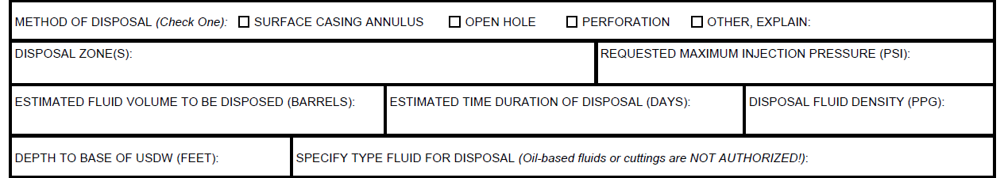
Disposal Information
Note: Injection of drilling and workover waste fluids (including reserve pit fluids) shall be limited to injection of only those fluids generated in the drilling, stimulation or workover of the specific well for which authorization is requested as per LAC 43:XIX.315.A.3

Slide 9




Disposal Method: Surface Casing Annulus
  Disposal Zone
    The interval from the base of the injection casing to the top of cement of the next cemented casing
  Criteria for Approval
    Surface casing must be set at least 200 feet below the base of the USDW and cemented to surface
    Surface casing must pass the second casing integrity pressure test or Radioactive Tracer Survey (RTS)
    Injection must be within intervals that do not contain hydrocarbon bearing horizons
    May only dispose of water-based fluids
200 feet
Disposal
Zone

Slide 10
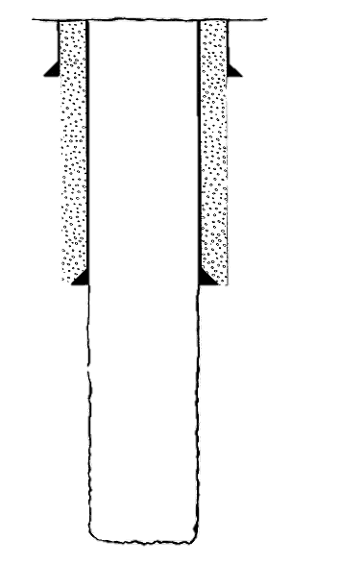
Disposal Method: Open-Hole
Disposal Zone
    Interval from the base of the injection casing to the Total Depth
Criteria for Approval
    Surface casing must be set at least 200 feet below the base of the USDW and cemented to surface
    Surface casing must pass the second casing integrity pressure test or Radioactive Tracer Survey (RTS)
    Injection must be within intervals that do not contain hydrocarbon bearing horizons
    May only dispose of water-based fluids
200 feet
Disposal Zone

Slide 11
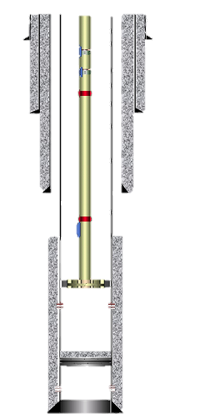
Disposal Method: Perforations
Disposal zone
  Interval from the uppermost injection perforation to the lowermost injection perforation
Criteria for Approval
  Surface casing must be set at least 200 feet below the base of the USDW and cemented to surface
  A cement bond log (CBL) must be submitted showing adequate cement isolation above the perforations
  The casing must be pressure tested prior to perforating (or with a bridge plug if already perforated)
  A radioactive tracer survey (RTS) may be required if IMD deems it necessary
  May only dispose of water-based fluids
200 feet
Disposal Zone

Slide 12
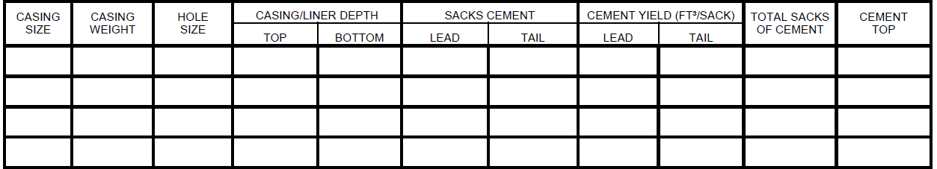
  Well Construction Information
    The information in this section must reflect the well completion information and must match the Schematic diagram of the well

Slide 13
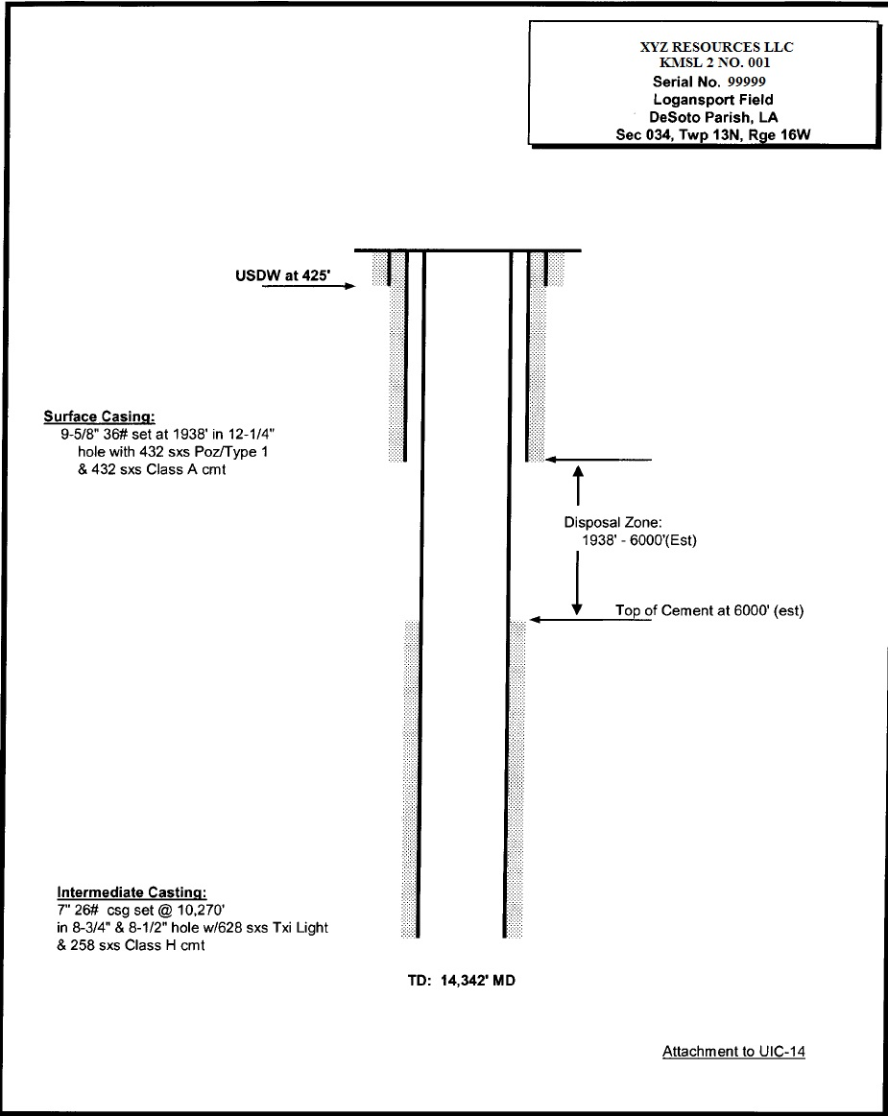
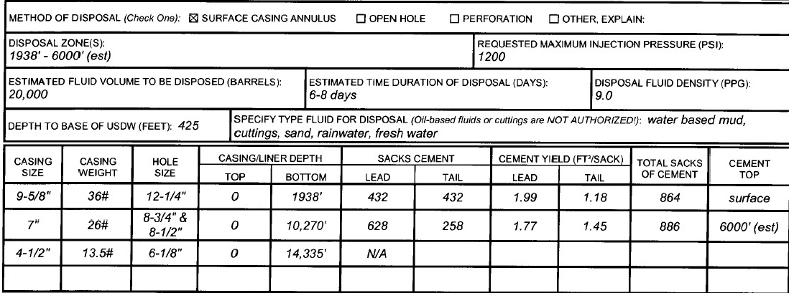

Slide 14
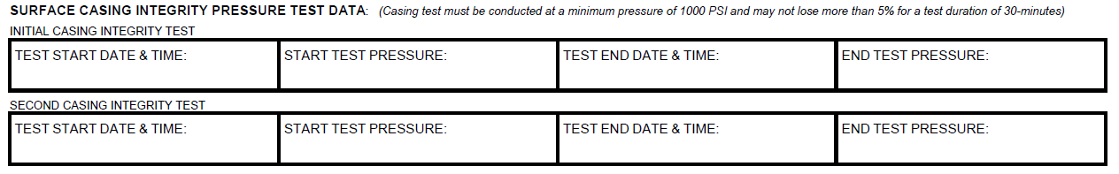
Surface Casing Integrity Pressure Test Data
    The information in this section must match the information provided on Form-CSG T or properly documented pressure chart recordings (if applicable) for both the first and second casing pressure tests.

Slide 15
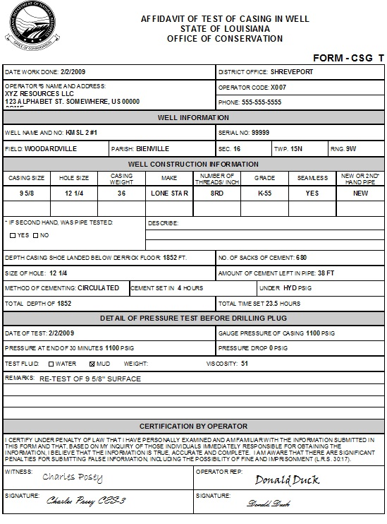
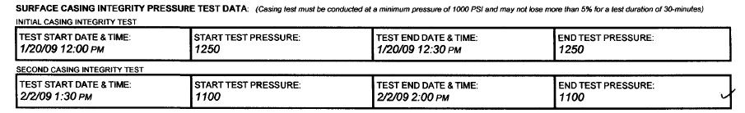
This is an example of a Form-CSG T submitted for the second casing test. If the pressure test was witnessed by a Conservation Enforcement Field Inspector then his signature will be in the witness field.

Slide 16
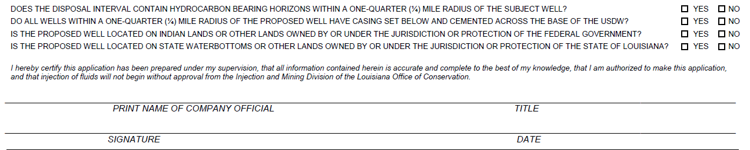
In order for the application to be considered complete, these questions must be answered and the form must be signed and dated.

Slide 17
Attachments

Slide 18
Application Fee
As per LAC 43:XIX.Chapter 7, a non-refundable fee of $252 must be submitted before the application is processed.
  A check may be mailed to: Office of Conservation
  Injection and Mining Division
  P.O. Box 94275-Capitol Station
  Baton Rouge, LA 70804-9275
  An online payment may be submitted after an invoice is created upon the operator’s request or due to failure to submit payment with the application.

Slide 19
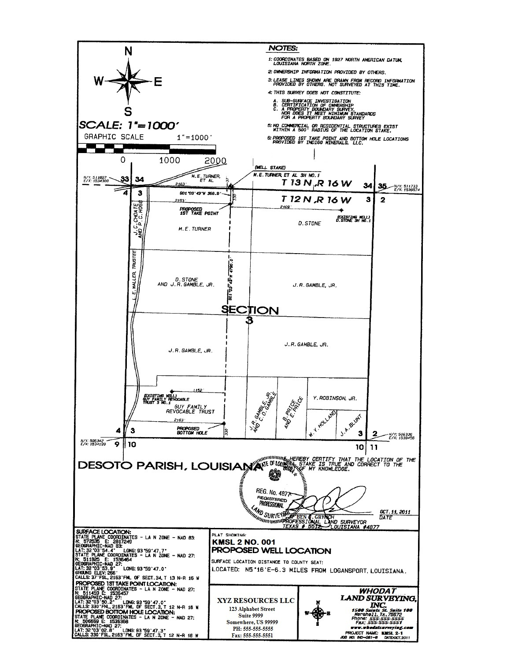

The well location plat must specify the X- & Y- coordinates for the surface hole location based on the Louisiana State Plane coordinate system, NAD 1927 and 1983.
Certified Well Location Plat

Slide 20
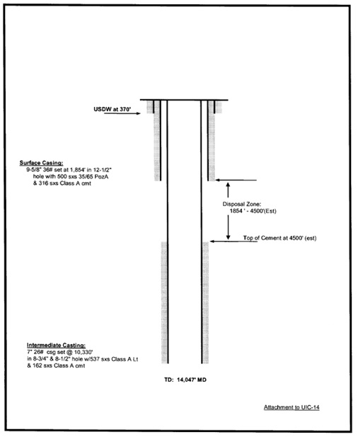
Schematic diagram
All diagrams must include:
Drilled hole diameters, depths, and sizes of all casing strings
Depth of disposal zone
Total well depth
Depth of cemented tops of all casing strings
Depth of the lowermost underground source of drinking water (USDW)

Slide 21
Documentation of First and Second Casing Integrity Tests
If the inspector does not witness the required second test, a properly documented pressure chart recording must be provided.

Slide 22
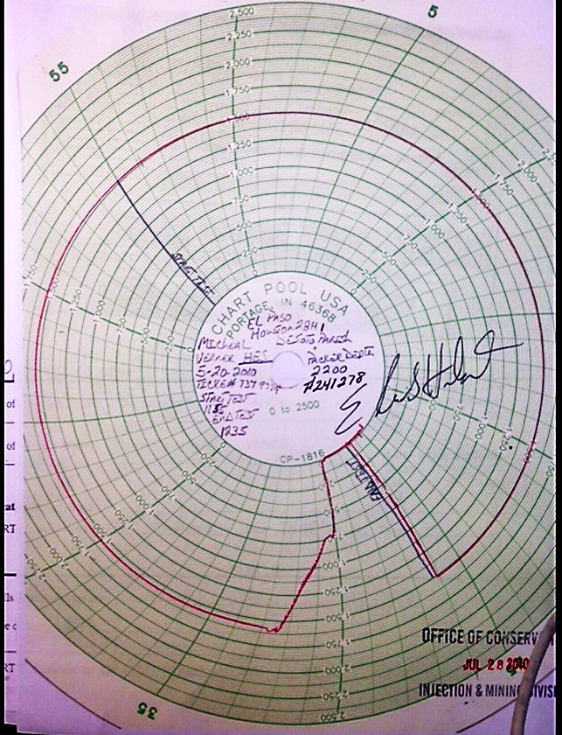
The pressure chart recording must be clearly labeled with the well name, well serial number, casing size, packer depth, test start time and stop time, test date, and signature. This data must reflect the Form-CSG T information (if submitted) and the UIC-14 application form.

Slide 23
Criteria for Approval
Pressure must be held at 1000 psi or greater for a minimum duration of 30 minutes and must not drop more than 5%
Packer must be set within 50 feet of the casing shoe
  If greater than 50 feet, a morning report showing the makeup of the casing shoe must be submitted for review
Must have been performed within a year of submittal
An inspector witnessed Radioactive Tracer Survey (RTS) with a time drive supplement may be performed in lieu of the second pressure test

Slide 24
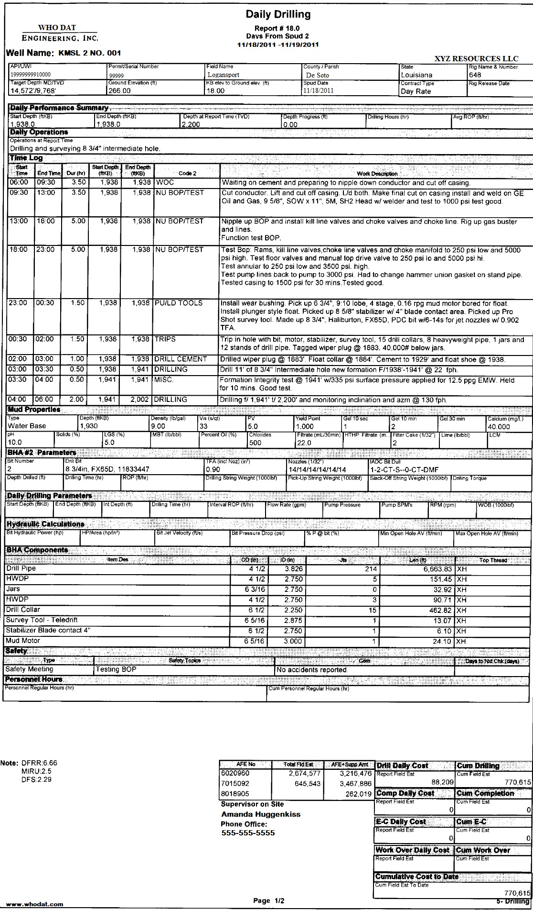
Morning Reports
The first morning report must prove that a jug test was conducted in which the surface casing shoe held pressure to an Equivalent Mud Weight (EMW) that comes within 15% of the Eaton 9# curve.

Slide 25
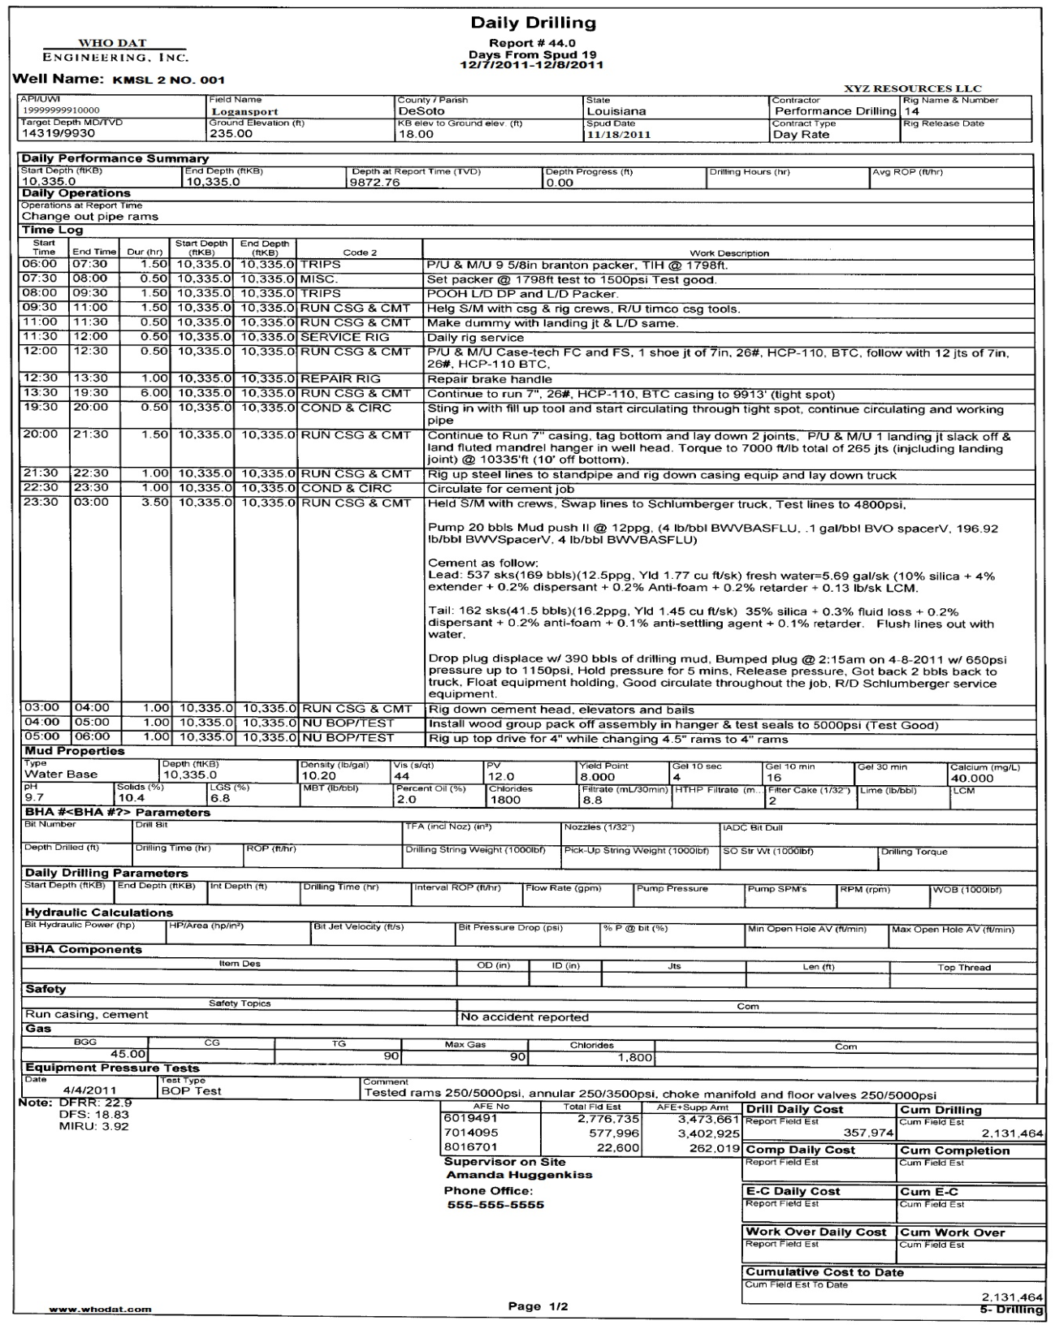
The second morning report must indicate when the long string casing was run

Slide 26
¼ mile radius search
Area of Review (AOR)
Disposal into hydrocarbon bearing horizons is prohibited
All wells must have proof of cement isolation between the USDW and top of the injection zone of the subject well by one of the following:
Casing set and cemented through the USDW
Open hole plugs
Perforate and squeeze cement
Drilled shallower than injection zone

Slide 27
Group Activity

Slide 28
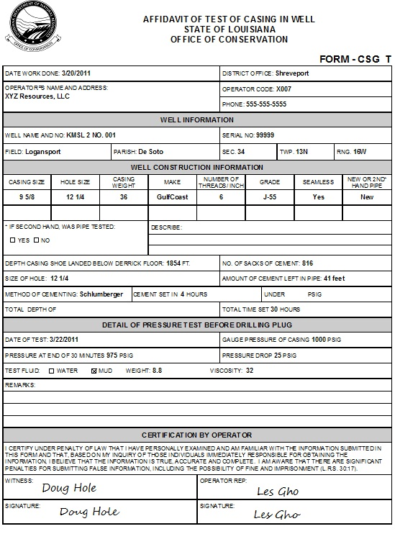
What is wrong with this affidavit?
There was a drop in pressure which fell below the minimum required 1000 psi
Retest 9 5/8 casing. Packer set at 1805’ (Test Good) Charted.
The test was not witnessed by a Conservation Enforcement Agent

Slide 29
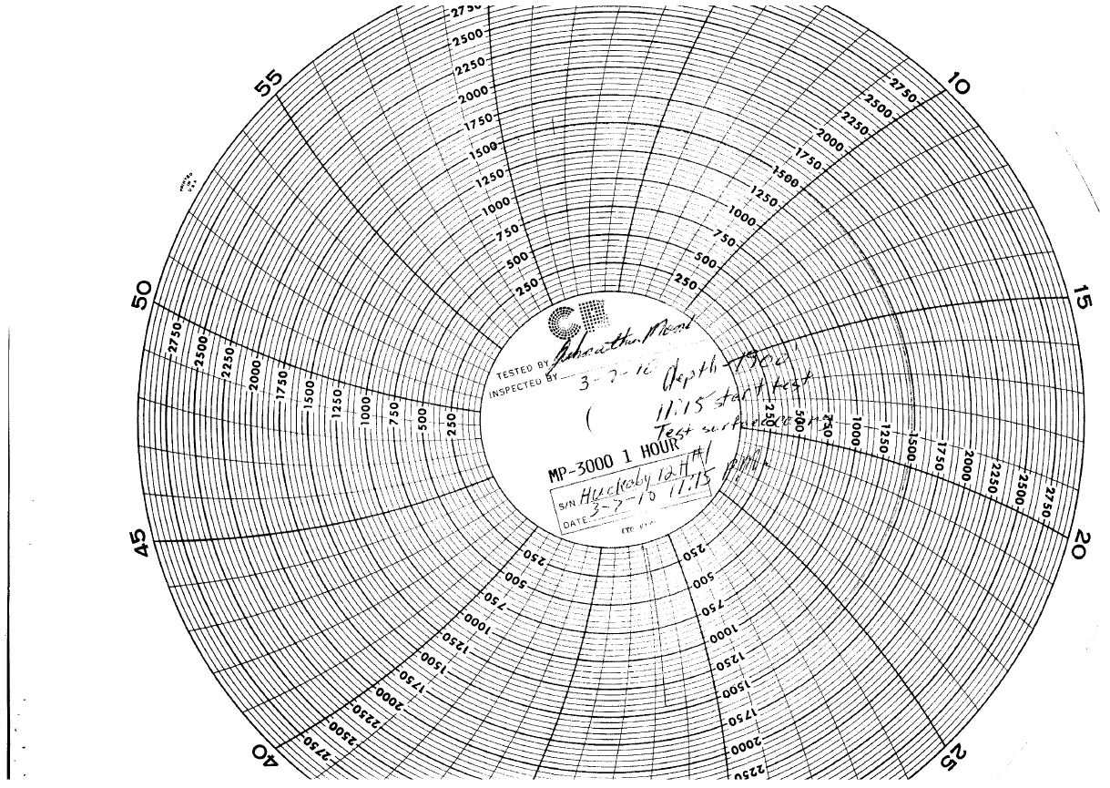
What’s missing on this pressure chart recording?
* Well serial number
* Test stop time

Slide 30
Permit

Slide 31
If approved,
MASIP will be calculated, however, the permitted MASIP will be limited to no more than the pressure applied during the casing pressure test.
The permit is valid for six (6) calendar months from the date of approval
  Injection after the expiration date or closing of the application will require submission of a new application.
The permit will be issued via email along with the following attachments:

Slide 32
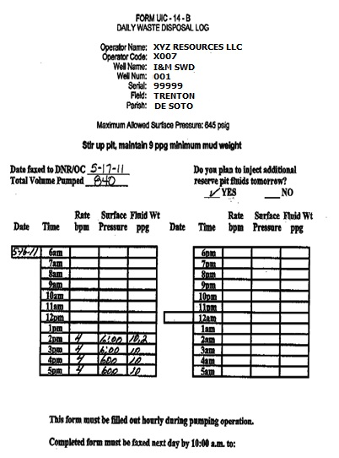
  Form UIC-14-B—Daily Waste Disposal Log
  Records daily injected volume, hourly injection rate, mud weight and injection pressure (Must maintain minimum 9 ppg mud weight)
    Indicates intent for subsequent injection
    Must be faxed daily to 225-342-3094. May be submitted along with a copy of the corresponding pressure chart recording or charts may be mailed to this office within 3 days of the conclusion of the disposal operation

Slide 33
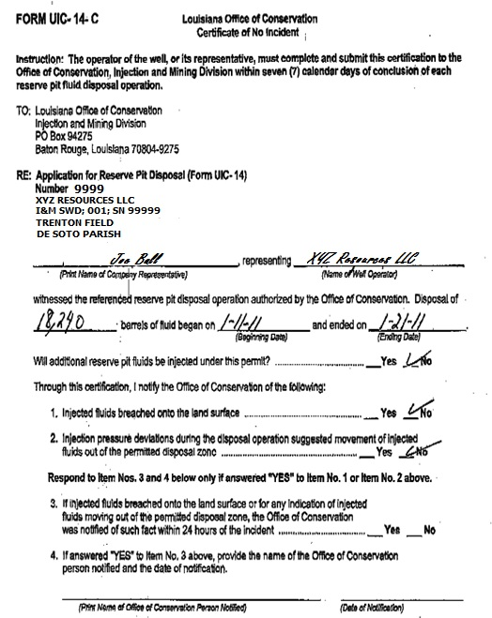
Form UIC-14-C—Certificate of No Incident
  Records total volume injected and duration of disposal operation
Submit within 7 days of the conclusion of each disposal operation
  If activity is suspended for a short period of time and operation will resume at a later time, you must indicate that additional fluids will be injected under the approved permit by selecting “YES”
  If disposal is complete, you must indicate that additional fluids will not be injected under the approved permit by selecting “NO”.

Slide 34

If denied,
A denial letter will be mailed to the Operator of Record

Slide 35
Questions?

Slide 36
Injection Well Work Permit
Form UIC-17

Slide 37
This form should be submitted to IMD for permitted injection wells when a work over is required.

Slide 38
To be evaluated by Injection and Mining for approval to perform major repairs or modifications which require the use of a rig. Examples of this work are listed below:
Plug and Abandon (Must provide Well Schematic)
Deepen
Perforate
Squeeze
Plugback
Pull Tubing/Packer
Back Wash or Other Well Stimulation (Class I Wells)
Pull Casing
Replace Wellhead
Acidize (Class I Wells Only)
Other

Slide 39
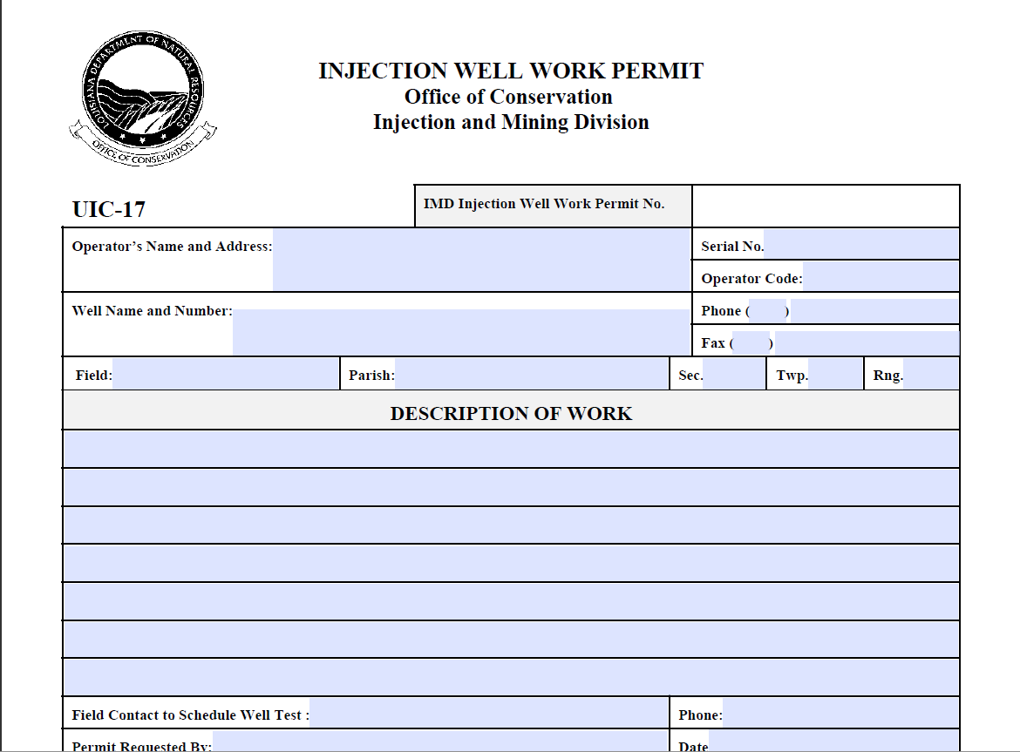
Form UIC-17

Slide 40
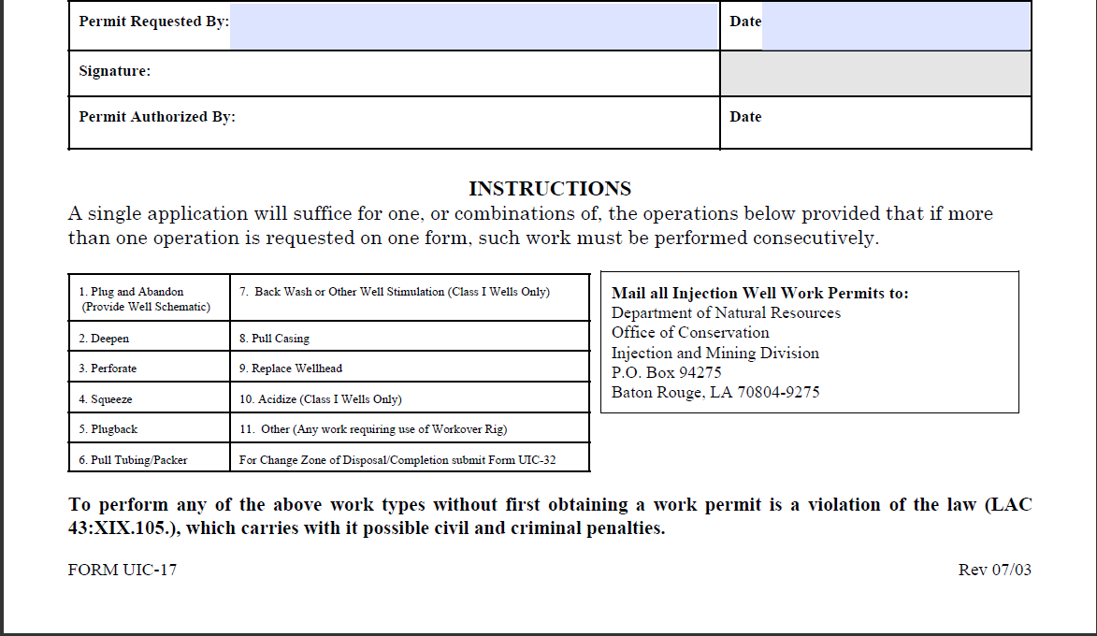

Slide 41
Keynotes for Completing the Form
The description of work must include any and all work to be performed on the well.
The description of work must include the current packer depth. If the tubing and packer will be pulled, the depth at which they will be reset must be included.
A witnessed Mechanical Integrity Pressure Test (MIPT) must be included in the work activity after the work is completed.
The form submitted must include a signature and a date.
A separate sheet may be included for permits to plug and abandon if needed.
  Please state on the form that the work procedure is attached

Slide 42
Group Activity

Slide 43
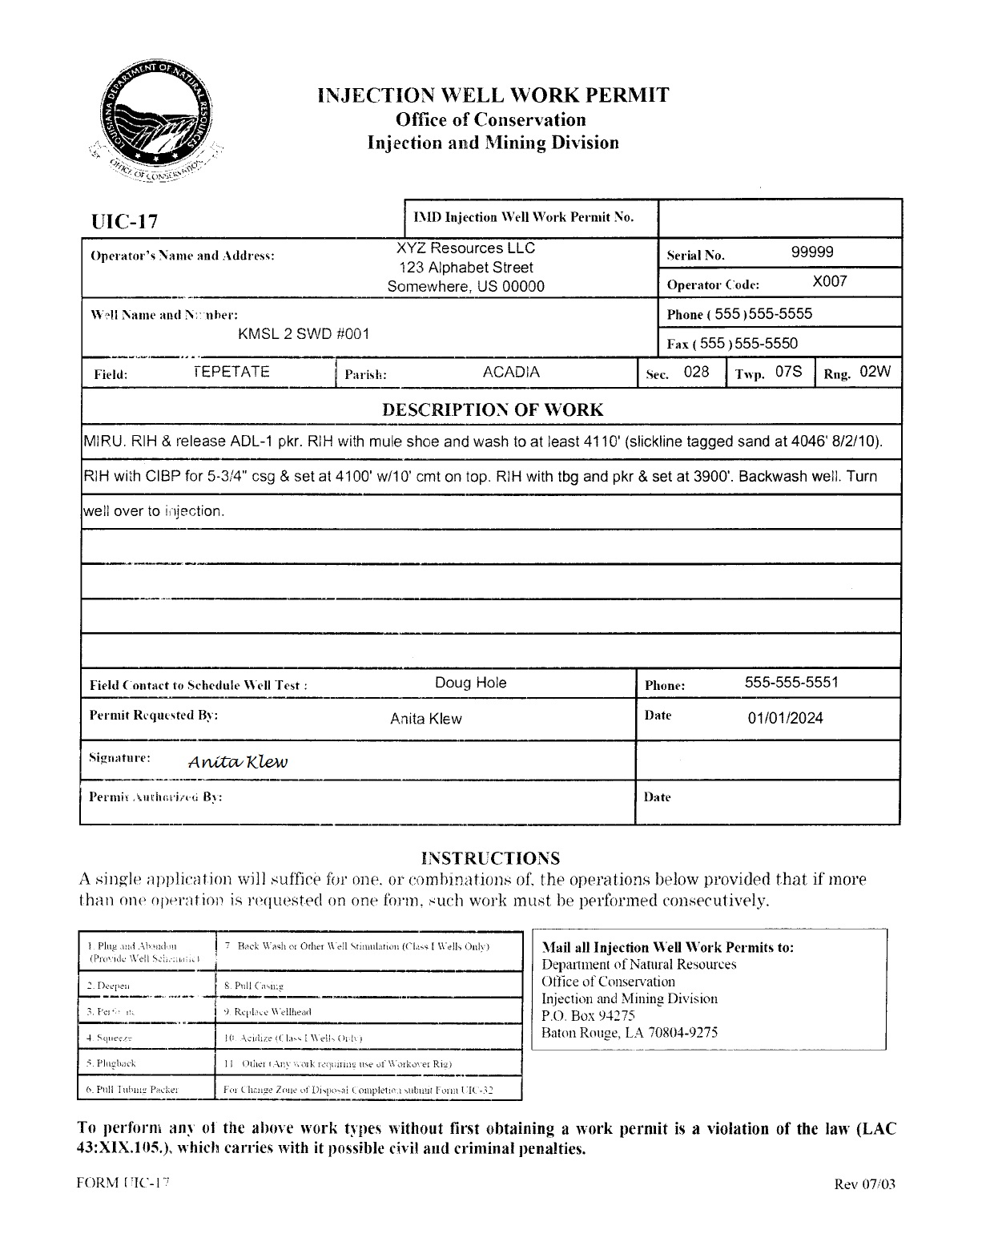
What vital information is missing in the description of work?
*The operator failed to include a witnessed MIPT

Slide 44
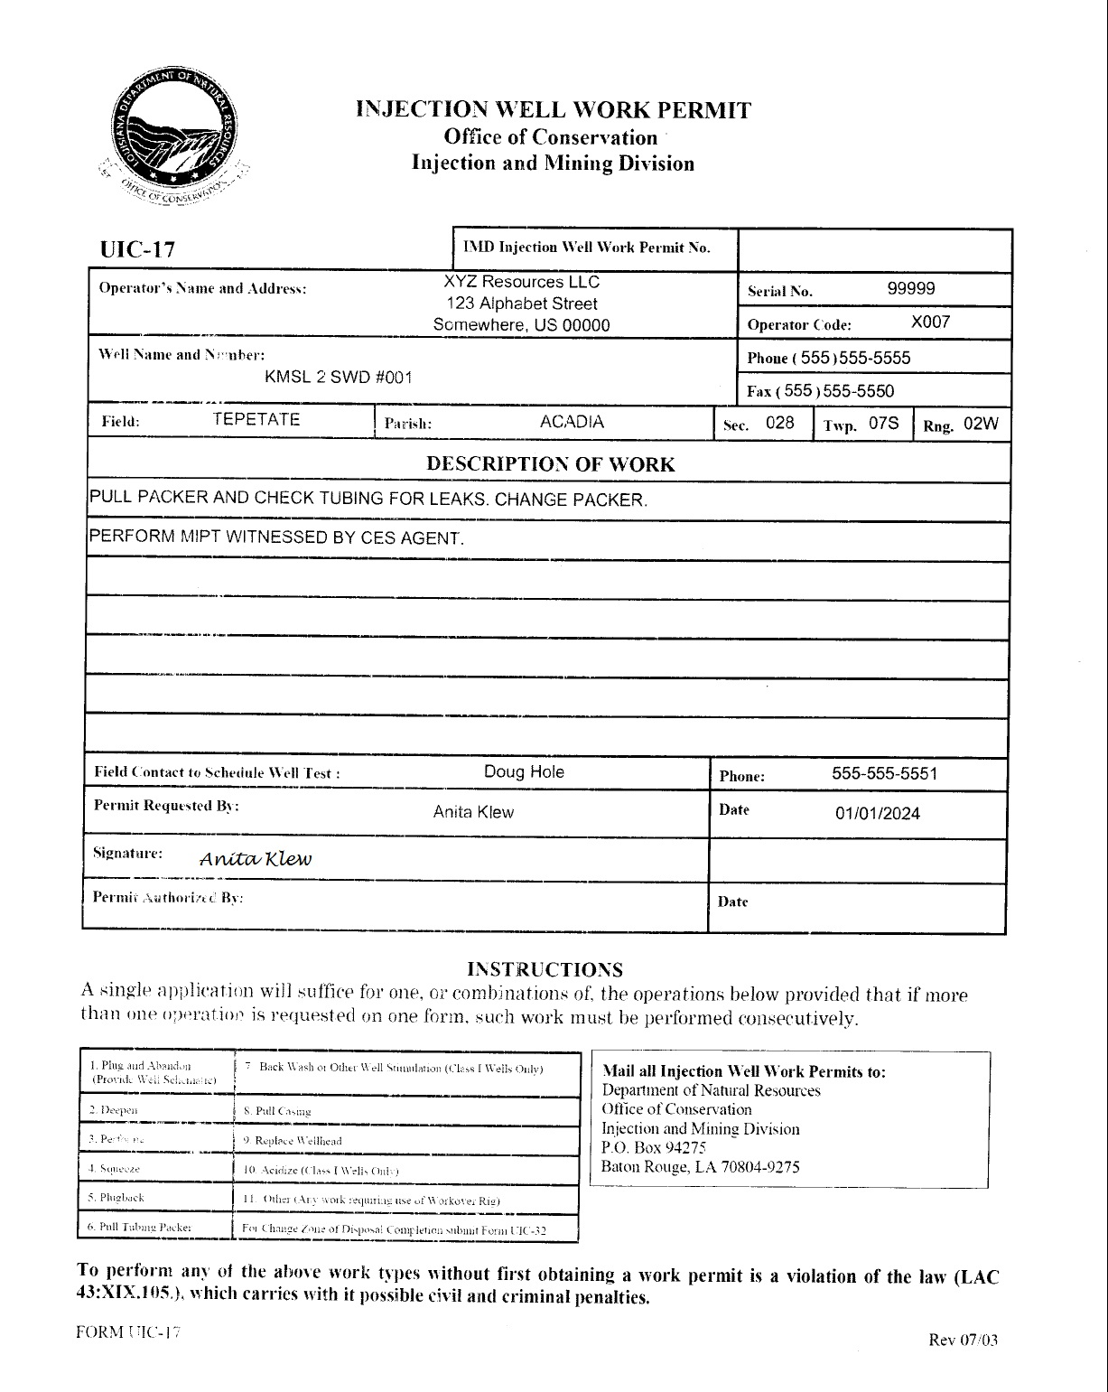
What vital information is missing in the description of work?
*The operator did not include the packer setting depth.

Slide 45
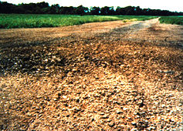
Plug & Abandon (P&A)

Slide 46
GUIDELINES
Cement used must be either class A or class H with a minimum slurry weight of 15 ppg and must be specified in work procedure
The number of sacks of cement for each plug must be provided
There must be a minimum 9 ppg mud or 9 ppg inhibited brine placed between plugs
Each existing set of perforations must be isolated from one another by a permissible plug and each plug must be pressure tested to a minimum of 300 psi for at least 30 minutes
If cement isolation cannot be verified across the USDW either by CBL or calculated cement, the proposed work must include a plan to perforate and squeeze cement at a depth of 50 ft below the base of the USDW such that calculated cement comes up to 50 ft above the USDW for an external plug of at least 100 ft
    A pressure test is not necessary for the USDW plug but it must be tagged to verify the top of cement!

Slide 47
Land Locations
  Must cut all casing strings at least 5 feet below ground level and leave a surface cement plug of at least 30 feet
  Must weld a ½ inch thick steel plate across all annuli and include well serial number and date
Water Locations
  Must cut all casing strings at least 15 feet below mud line and leave a surface cement plug of at least 100 feet.

Slide 48
A 90 day permit will be issued unless remedial action is deemed necessary following a review of the well file. In that case a 30 day permit will be issued.
Once approved,
The reporting requirements will be included with the permit providing a time table and detailed instructions for submitting follow-up documentation.

Slide 49
Questions?

Slide 50
Form uic-p&a: injection well plug and abandonment report

Slide 51
This form is now used in lieu of Form WH-1 and will only be used to document the plugging and abandonment of an injection well. Temporary abandonment should not be submitted on this form but should be reported on Form UIC-WH1.
Upon plugging a well, a complete record must be provided on form UIC-P&A and filed in duplicate in the Injection and Mining Division within 20 days.

Slide 52
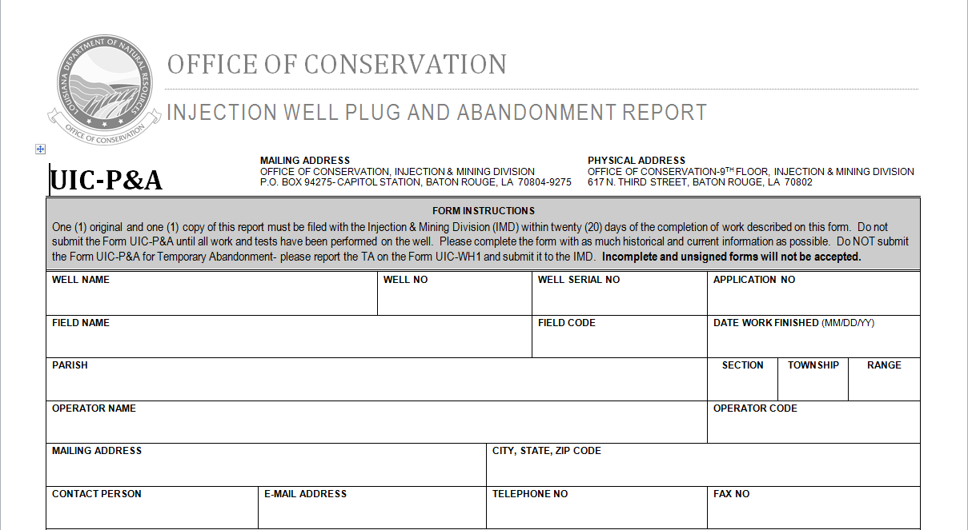
Well Data

Slide 53
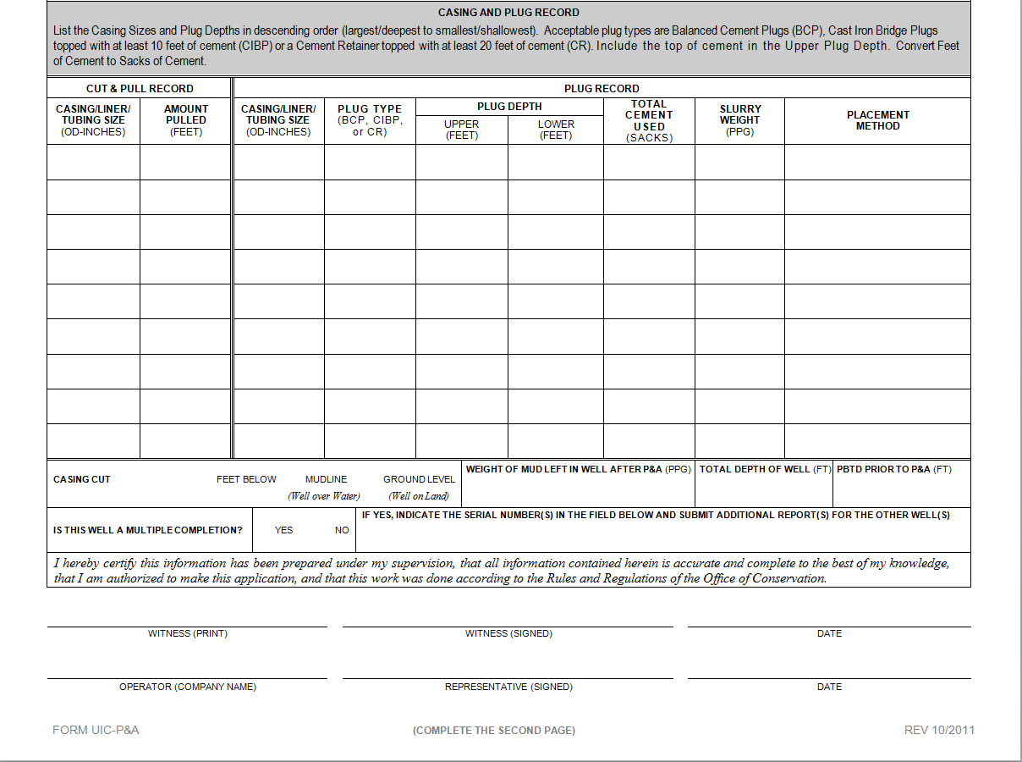

Slide 54
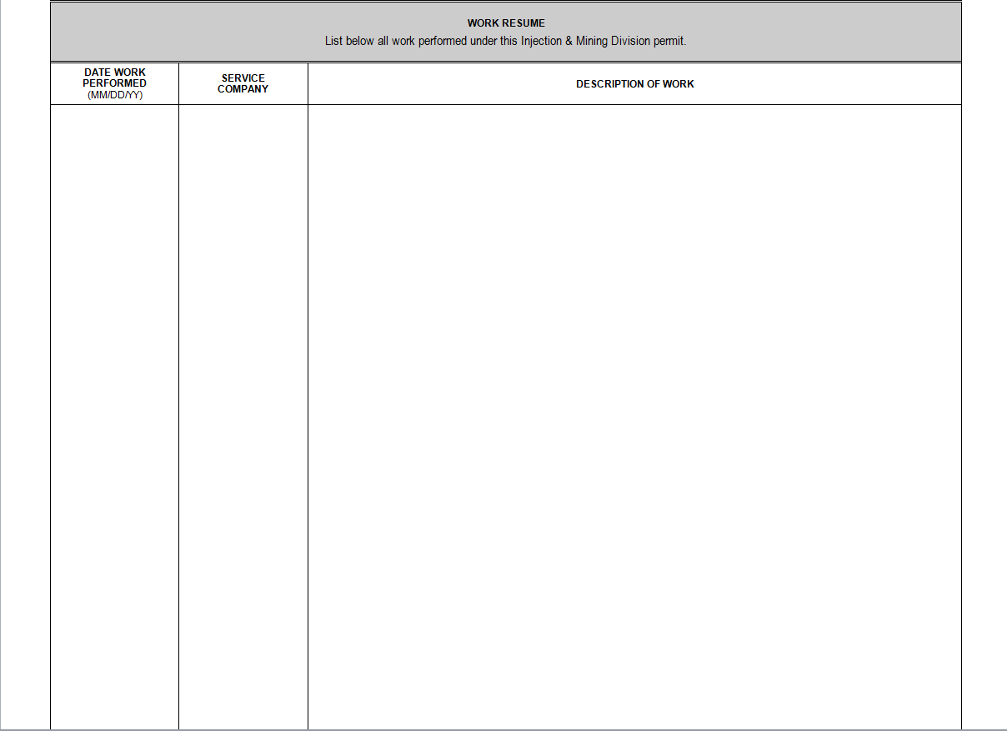

Slide 55
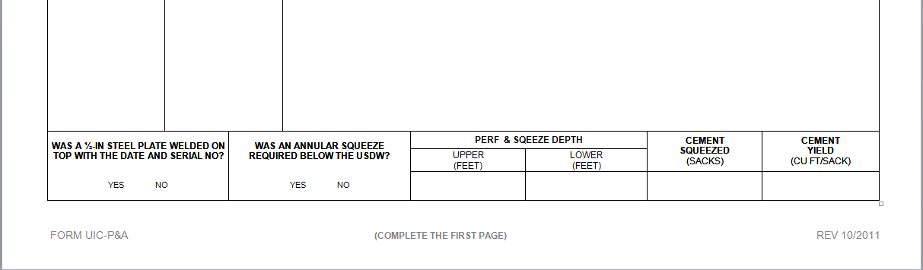

Slide 56
Questions?

Slide 57
UIC-32: Application to Change Disposal / Injection Zone

Slide 58
If an operator wishes to perforate outside of the current permitted zone, a Form UIC-32 must be submitted for a Change in Disposal/Injection zone.

Slide 59
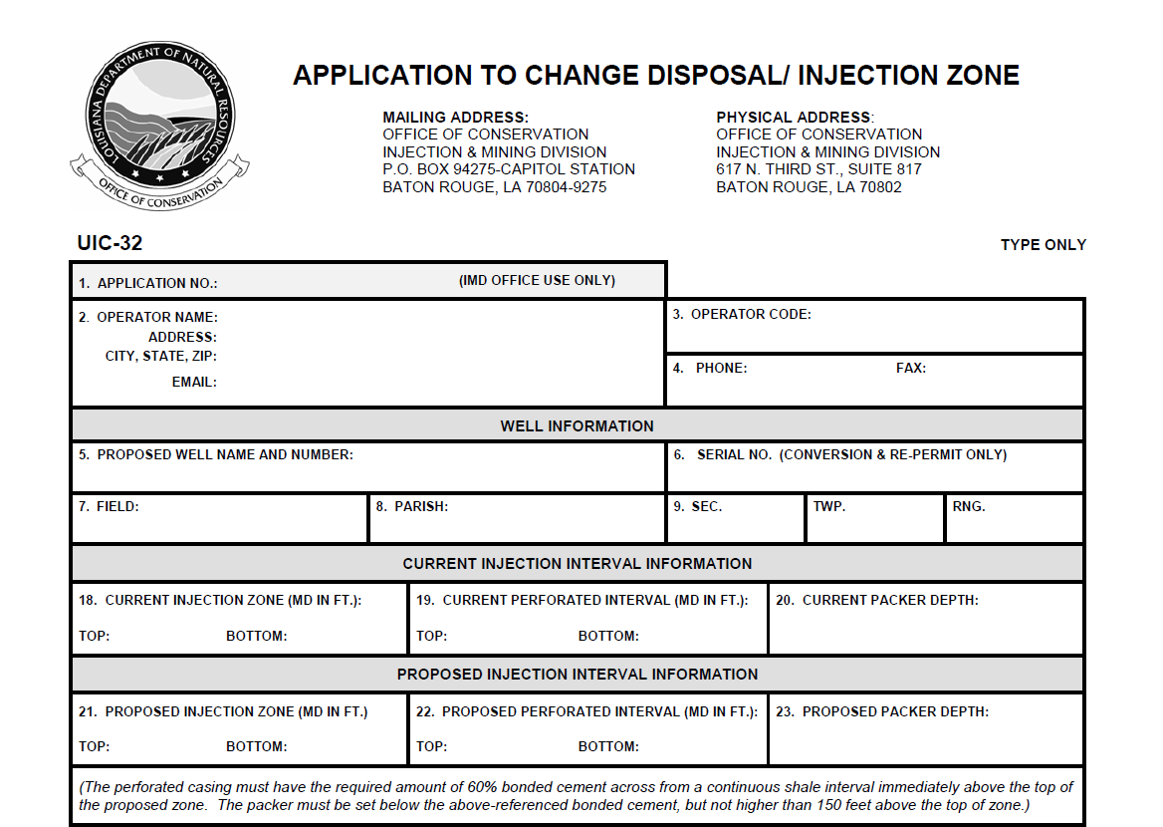
Form UIC-32 Application

Slide 60
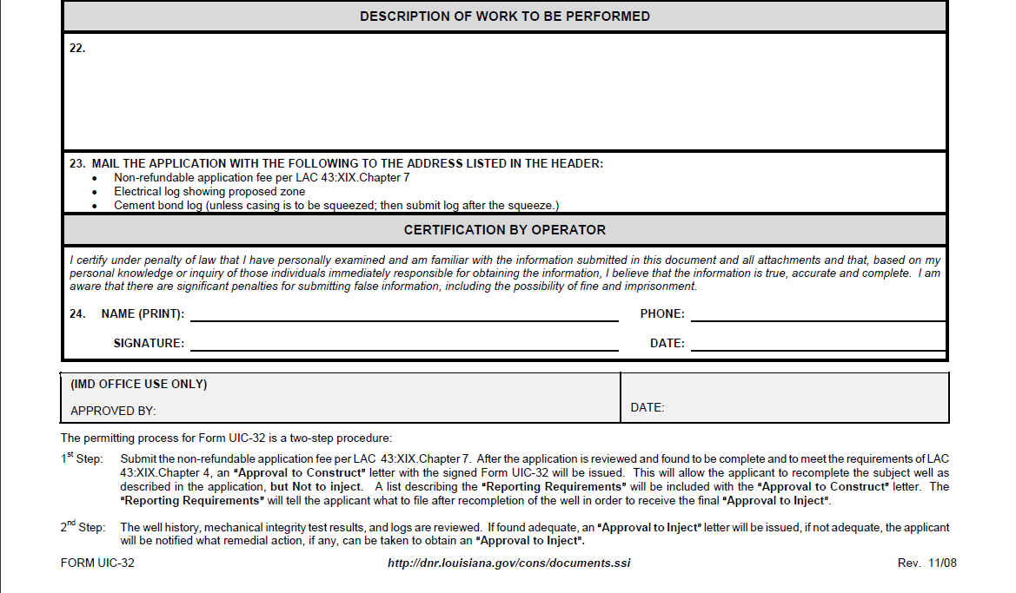

Slide 61

  Current Injection Interval Information
The data entered in these fields may be obtained from historical well information and should reflect the information in Sonris Lite.

Slide 62

Proposed Injection Interval Information
An electrical log must be submitted showing the proposed zone
A proposed well bore diagram should be submitted along with the application and should reflect the proposed injection information.

Slide 63
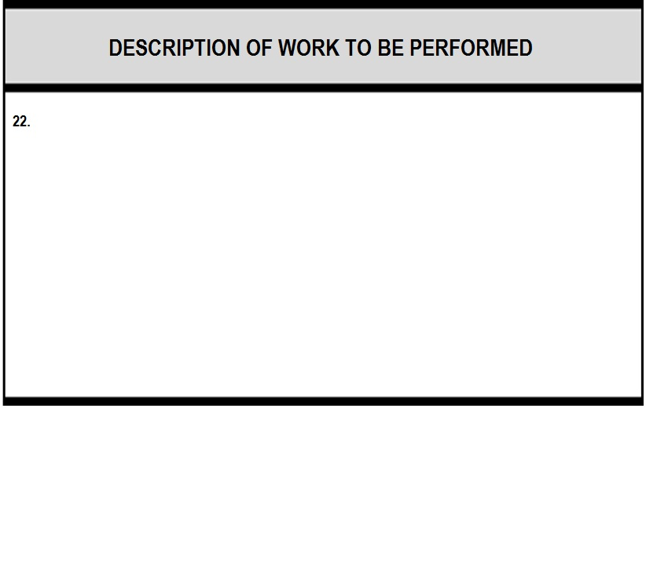
The description of work to be performed must include any and all work that will be performed on the well.
A change in the permitted zone is treated as a new permit, thus the well will be expected to meet all current injection well requirements (meaning it will lose any “grandfathered” status it may have on these requirements).
A witnessed MIPT after the work is completed must also be included.

Slide 64
The application will undergo
Area of Review
Geological Review
Engineering Review

Slide 65
Attachments

Slide 66
Application Fee
As per LAC 43:XIX.Chapter 7, a non-refundable fee of $126 must be submitted before the application is processed.
  A check may be mailed to: Office of Conservation
  Injection and Mining Division
  P.O. Box 94275-Capitol Station
  Baton Rouge, LA 70804-9275
  An online payment may be submitted after an invoice is created upon the operators request or due to failure to submit payment with the application.

Slide 67
Electric Log
The serial number must be written on the log attached to the application.
Must include the header with scale and at least 1,000 feet below the bottom of the proposed injection zone. (Photocopies of the logs are acceptable)
Must identify the proposed injection zone and perforated interval.

Slide 68
Wellbore Diagram
Should include all of the details provided on the application regarding the proposed injection zone and any proposed work that needs to be performed in order to obtain approval.
A diagram of the current wellbore construction may also be submitted at the operator’s discretion.

Slide 69
After the application is reviewed and found to be complete and to meet the requirements of LAC43:XIX.Chapter 4, an Approval to Recomplete letter with the signed Form UIC-32 will be issued.
Once field activities are completed and all reporting requirements are met, a Part II: Final Review for the Permit-to-Inject will be conducted. Injection into the well cannot occur until the Permit-to-Inject is received.

Slide 70
Questions?

Slide 71
Form UIC-WH1 for Injection Wells: Well History and Work Resume Report

Slide 72
This form is used to document the drilling and completion of an injection well, the conversion and completion of an existing well to an injection well, recompletion of an existing injection well involving a change of zone, and the completion of a workover procedure of an injection well. This form must be filed with the Injection and Mining Division within twenty (20) days of completing the authorized work.

Slide 73
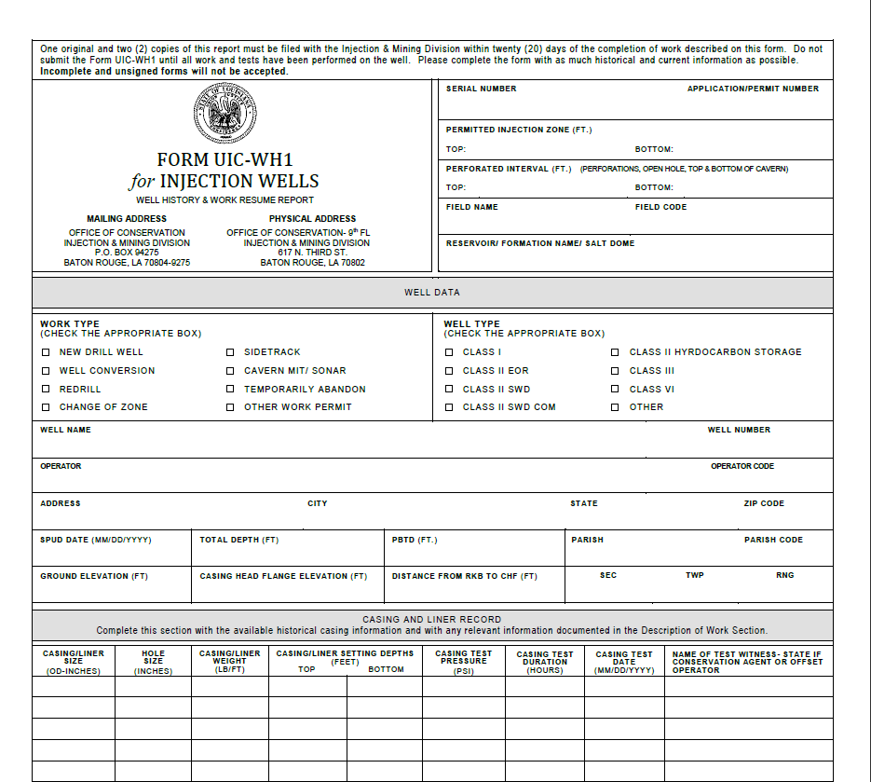
Form UIC-WH1

Slide 74
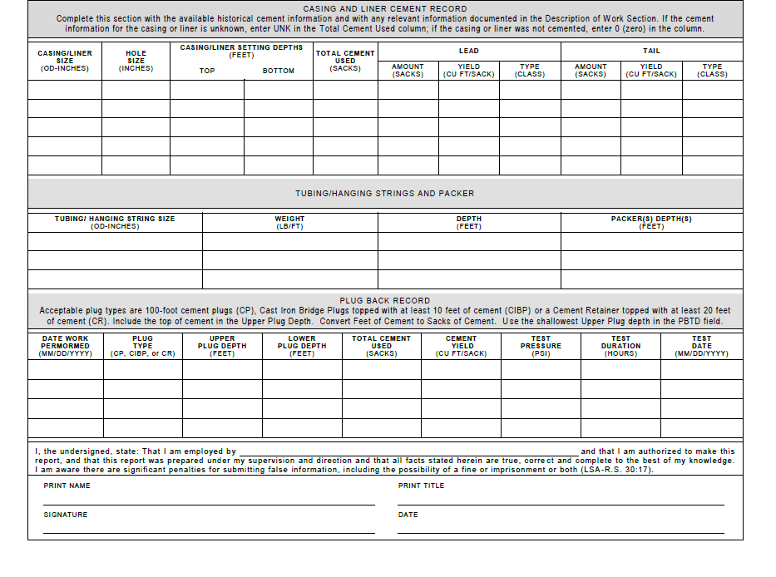

Slide 75
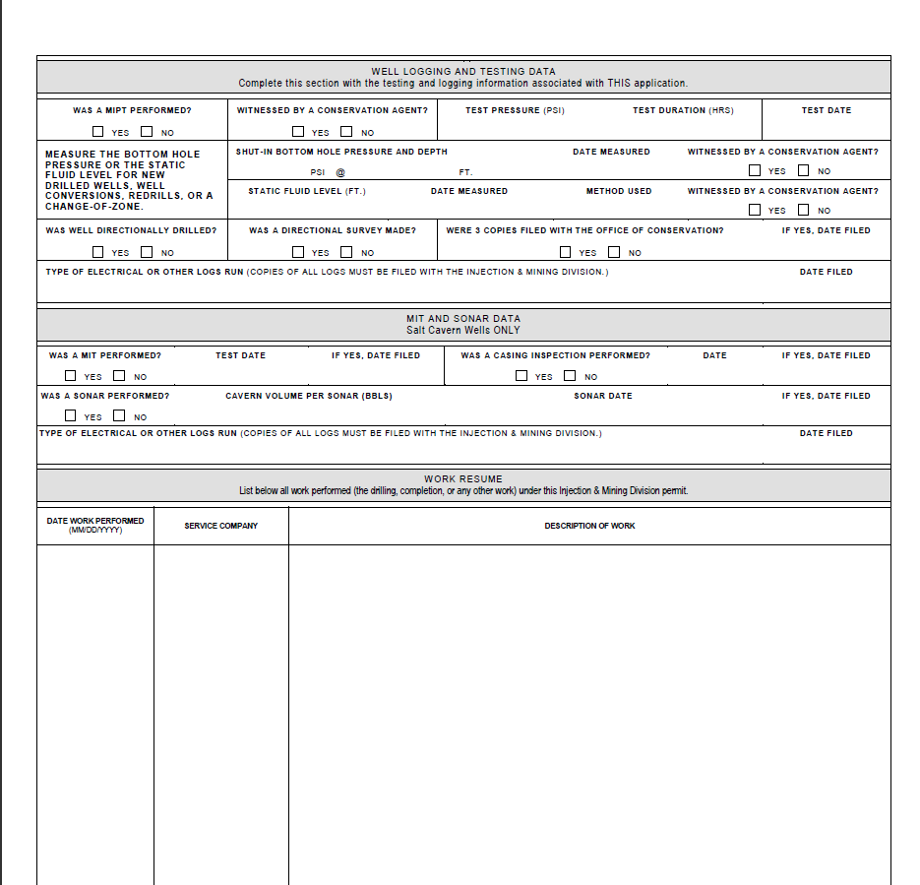

Slide 76
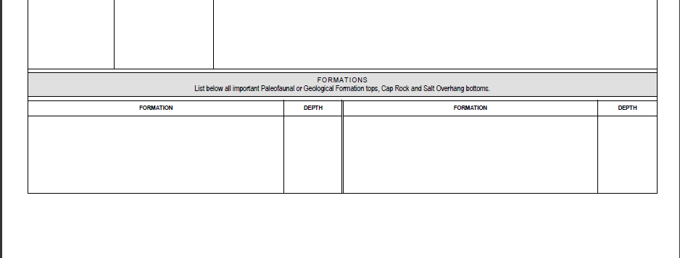

Slide 77
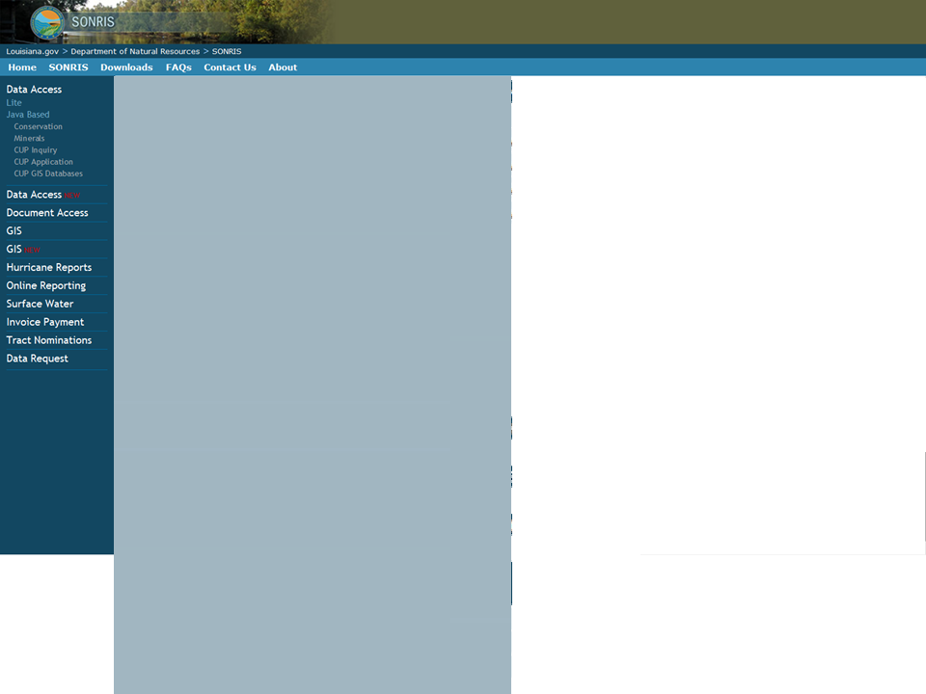
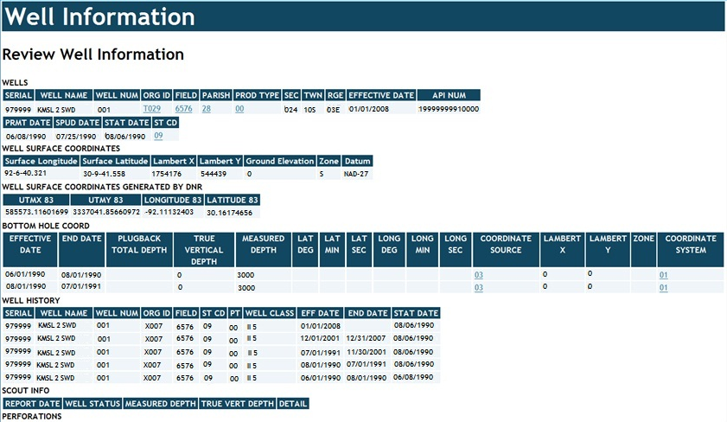
Completion of this form will be based on available historical well information and will include any changes that occur during the permitted work. Sonris Lite may be used to aid in completion of the form.

Slide 78
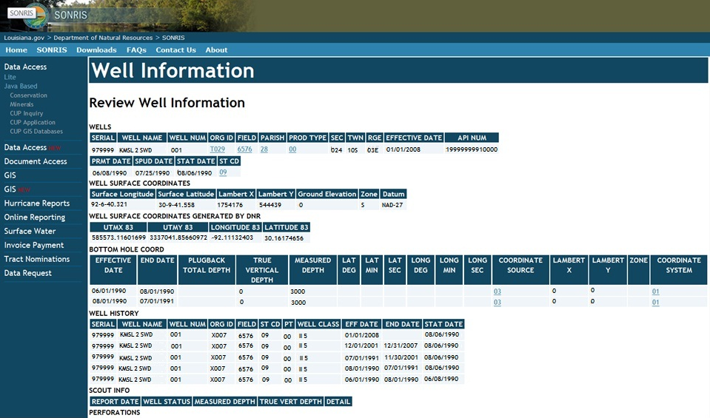
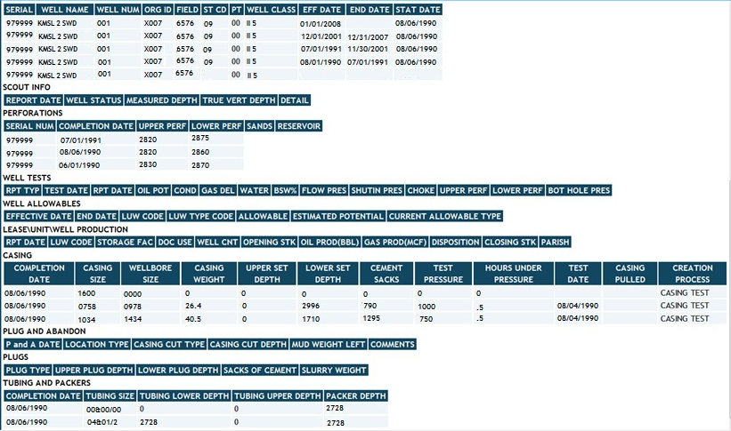

Slide 79
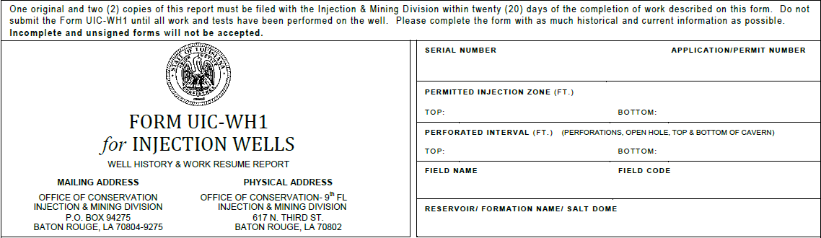
Injection Information

Slide 80
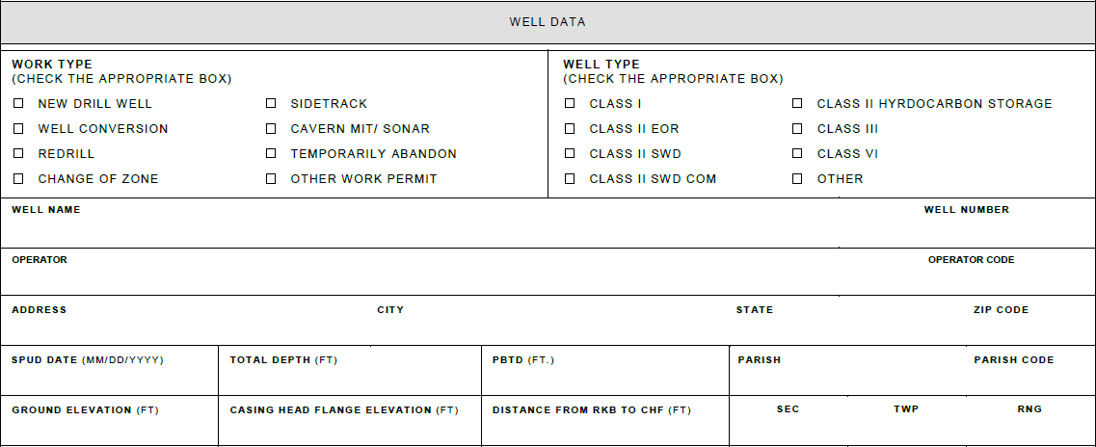
  Well Data
    The information in this section should reflect previous well history reports, if any, unless there has been a change in ownership, well name, or plugged-back depth.

Slide 81
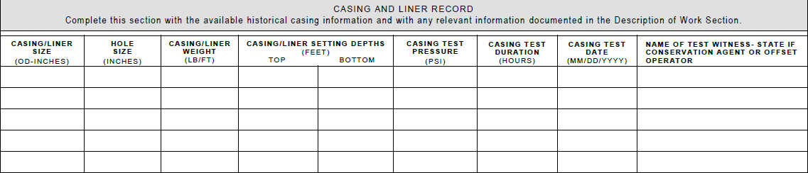
  Casing and Liner Record

Slide 82
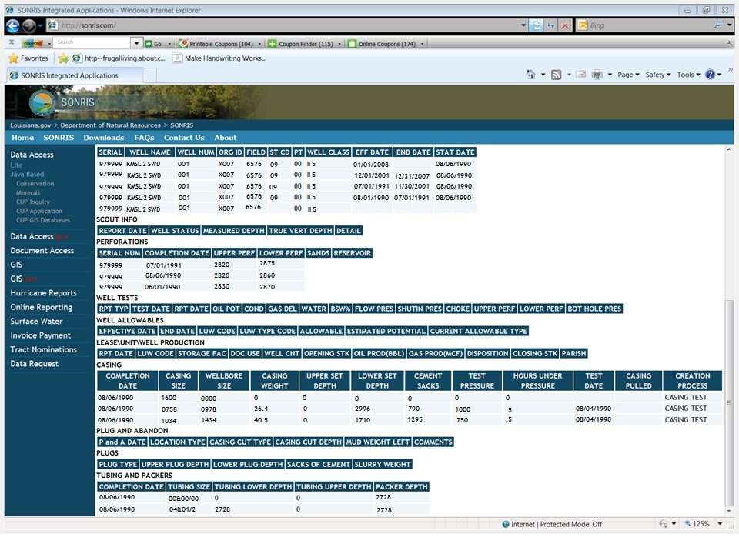
To compare the historical records against the data in SONRIS, scroll down to the section labeled “Casing”

Slide 83

Casing and Liner CEMENT Record
This data may be verified on the same screen as the casing and liner records on Sonris with the exception of the lead and tail cement type and yield.

Slide 84

Tubing/Hanging Strings and Packer
The existing tubing, hanging string and packer information should be entered here.

Slide 85

  Plug Back Record
To verify existing plugs in Sonris, scroll down some more

Slide 87

Well Logging and Testing Data
This section must include ALL logs and tests performed under the approved permit

Slide 88

MIT and SONAR data

Slide 89

ALL work completed under the approved permit must be provided in this section
The work is considered complete when a successful MIPT has been performed

Slide 90

Formations

Slide 91
Questions?

