Slide 1

Reporting , Monitoring,
Inspection & Compliance
UIC TRAINING WORKSHOP | Injection and Mining Division
Presented by
Pierre Catrou
Kaycee Garrett
April 3-4, 2012

Slide 2
Reporting
Notes:
For this portion of my talk, we’d like to offer some guidance for when you are putting your application together.

Slide 3
Form UIC-10
Annual Disposal/ Injection Well Monitoring Report
Annual Submission Required for all Unplugged Injection Wells
  Forms are sent to operators in February of the year following the reporting year (ie: Sent out in February 2012 for the 2011 reporting year)
  Forms must be filled in and submitted to IMD by May 31st
Plugged and Abandoned or Transferred Wells
  Download the Form UIC-10A when the P&A or transfer occurs
  Complete the form for the portion of the year that the well was operated
  www.dnr.louisiana.gov >> Conservation >> Forms/Reports/Documents >> Injection & Mining Division >> Form UIC-10A

Slide 4
Form UIC-10 Instructions
Form UIC-10
  Organization Information
  Injection Pressure, Annulus Pressure, Injection Rate, and Volume Injected each month
  Well Information
  Community or Individual Well
Community Saltwater Disposal Well/System Notification/Certification
  Replaces the need to file a FORM UIC-13 annually, after the initial FORM UIC-13 is on record

Slide 5
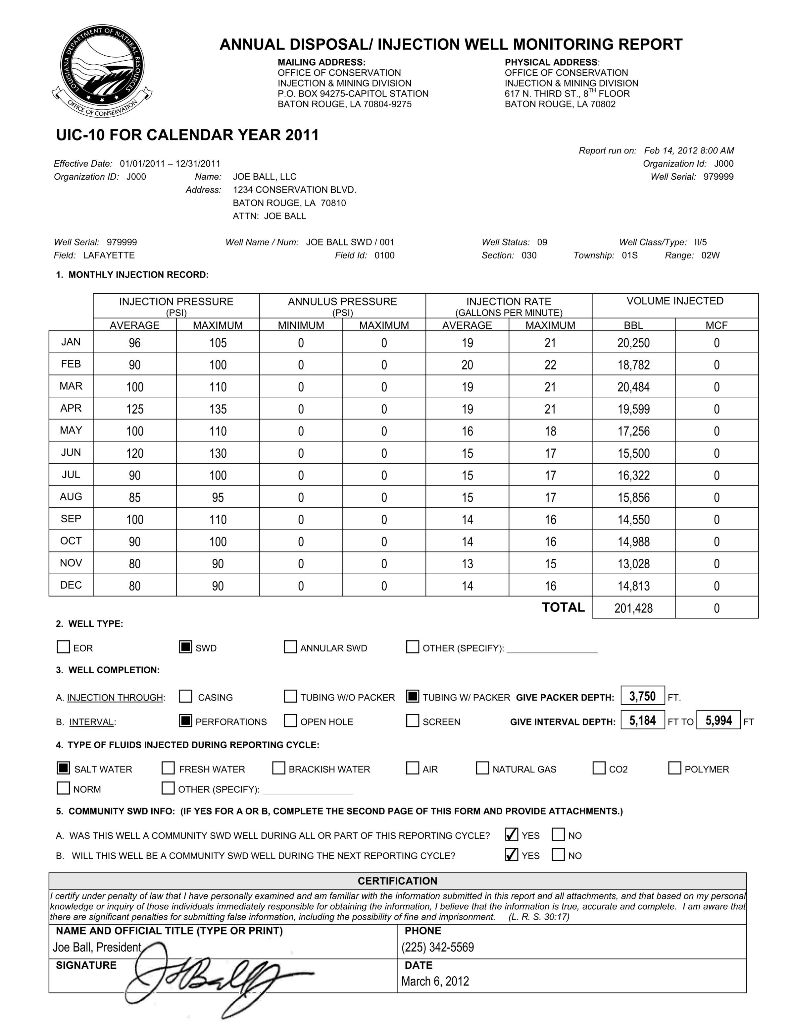

Slide 7
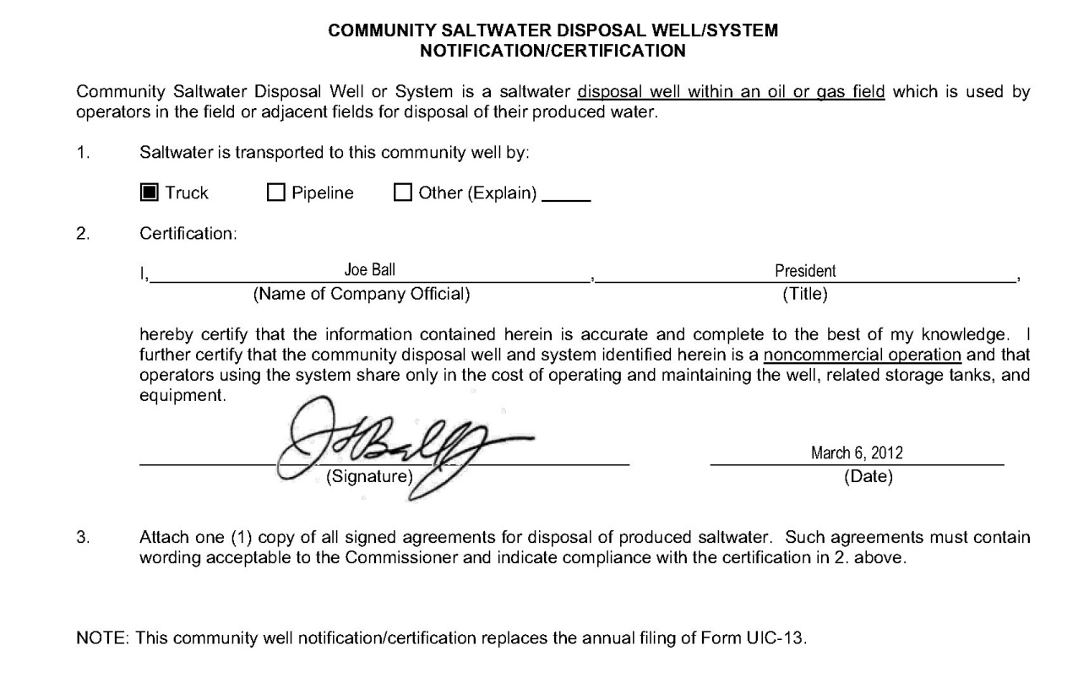

Slide 8
Instructions Continued
Source Fluid Attachment
  Must be completed for each Class II Disposal/Injection well and submitted with the Form UIC-10 or Form UIC-10A. All sources of fluid injected into these wells must be reported using this attachment sheet.
  Commercial SWD facilities are not required to complete the Source Fluid Attachment sheet of manifested fluids, however, this sheet must be completed for any non-manifested fluids such as fluids received by pipeline.

Slide 9
Instructions Continued
Source Fluid Attachment- Source Types
    Source Type A
    Produced fluids from oil and gas production wells operated by your organization located within the field in which the subject injection well is located
      Group all Source Type A Fluids LUW Code.
      Complete each column where “A” is marked in the header

Slide 10
Instructions Continued
    Source Type B
    Produced fluids from oil and gas production wells operated by your organization located in fields other than the field in which the subject injection well is located
      Group all Source Type B Fluids by Serial Number
      Complete each column where “B” is marked in the header
    Source Type C
    Produced fluids from oil and gas production wells operated by organizations other than yours.
      Group all Source Type C Fluids by Serial Number
      Complete each column where “C” is marked in the header

Slide 11
Instructions Continued
    Source Type D
    Fluids from wells and other sources that cannot be identified by an Office of Conservation LUW code. These fluids include but are not limited to gas plant waste waters not classified as hazardous, brine produced from hydrocarbon storage and brine wells in salt domes, out of state oil and gas production wells, offshore-federal oil and gas production wells, etc.
      Group all Source Type D Fluids by Organization
      Complete each column where “D” is marked in the header

Slide 12
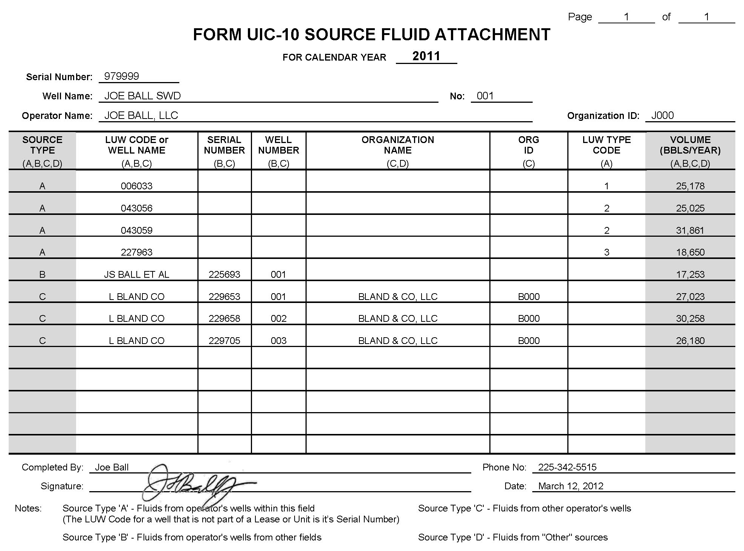
LUW for LEASE wells operated by the operator in the field
LUWs for UNIT wells operated by the operator in the field
SN (LUW) for individual well operated by the operator in the field
Well operated by the operator in a different field
Community Wells

Slide 13
Form UIC-WH1
Work History/ Resume Report for Injection Wells
Submit a Form UIC-WH1 to IMD within 20 days of the completion of work activities on the well, along with any other reporting requirements.
The only exception is for work permits issued to plug and abandon a well; this activity should be reported on the Form UIC-P&A
Failure to submit a Form UIC-WH1 will result in IMD issuing a Notice of Violation to the operator.

Slide 14
Form UIC-P&A
Injection Well Plugging and Abandonment Report
Submit a Form UIC-P&A to IMD within 20 days of the completion of work activities on the well, along with any other reporting requirements.
Form UIC-P&A is one form that combined the information required in the Form UIC-WH1 and the Plug & Abandon Report
Failure to submit a Form UIC-WH1 will result in IMD issuing a Notice of Violation to the operator.

Slide 15
Monitoring

Slide 16
Mechanical Integrity
Definition
A well has Mechanical Integrity if:
  Internal Integrity
  There is no significant leak in the casing, tubing, or packer; and
  External Integrity
  There is no significant fluid movement into an underground source of drinking water (USDW) through vertical channels adjacent to the injection wellbore.

Slide 17
Mechanical Integrity
Failure
The Mechanical Integrity Failure occurs when:
  A gauge pressure loss of 5% or greater occurs during an MIPT (or a pressure loss greater than 5 psi in Class I wells);
  The annulus of the well cannot be completely filled with water;
  The annulus of the well cannot maintain pressure;
  While injecting, water flows from the casing valve when it is open, thus indicating a communication problem in the well;
  There is a vacuum on the annulus when the casing valve is opened;
  An inspector arrives at the well for a scheduled test, but the operator is absent or unprepared for the test.

Slide 18
Mechanical Integrity
Reporting a Failure
If a mechanical failure or down-hole problem indicates that the injection well is not, or may not be directing the injected fluid into the permitted or authorized zone, then the operator must comply with the following:
  The well must be shut-in; and
  The operator must call the appropriate CES or IMD within 24 hours and verbally notify them of the failure.

Slide 19
Mechanical Integrity
Repairing a Failure
When the operator notifies the CES or IMD of the failure, a Work Permit Application Number and Notice of Violation will be issued to the operator, which will allow the operator to pull the tubing and packer and repair the well. The operator will have 30 days to repair the well under that work permit.
If additional work is necessary to repair the well, the operator must submit a Form UIC-17 Work Permit Application to IMD within 30 days of the well failure. The Form UIC-17 should detail the additional work necessary to repair the well, and if approved, the operator will have 90 to repair the well.
If the operator is unable to repair the well within required timeframe, then the operator must comply with the following:
  Submit a letter or email requesting an extension to repair the well;
  Provide a financial instrument in an amount determined by IMD; and,
  If the well is not repaired within one (1) year, then the well must be plugged and abandoned.

Slide 20
Test & Inspections

Slide 21
Inspectors
Areas of Enforcement
The Injection and Mining Division (IMD) employs seven (7) Conservation Enforcement Specialists (CES) to administer the inspection and enforcement activities for injection wells.
Pete Bradford (Area 1)
Bossier, Caddo, Webster
Rex Darden (Area 2)
Bienville, Caldwell, East Carroll, West Carroll, Claiborne, Franklin, Lincoln, Madison, Morehouse, Ouachita, Richland, Union
Bill Jones (Area 3)
Avoyelles, Catahoula , Concordia, LaSalle, Tensas

Slide 22
Inspectors
Continued
Jackie Hebert (Area 4)
Allen, Beauregard, DeSoto, Evangeline, Grant, Natchitoches, Rapides, Red River, Sabine, Vernon, Winn
Vacant (Area 5)
Acadia, Ascension, East Baton Rouge, West Baton Rouge, East Feliciana, West Feliciana, Iberia, Lafayette, Livingston, St. Helena, St. Landry, St. Martin, St. Tammany, Tangipahoa, Washington
Kevin Sonnier (Area 6)
Calcasieu, Cameron, Jefferson Davis, Vermilion
Billy Carnes (Area 7)
Assumption, Lafourche, Orleans, Plaquemines, St. Bernard, St. Charles, St. James, St. John the Baptist, St. Mary, Terrebonne

Slide 23
Inspectors
Responsibilities
The IMD CES are responsible for:
Witnessing Mechanical Integrity Pressure Test (MIPT);
Witnessing any other mechanical integrity tests approved by IMD;
Performing site and well inspections;
Responding to injection well emergencies, and
Investigating complaints

Slide 24
Mechanical Integrity Pressure Tests (MIPT)
Types of Witnessed MIPT
The following MIPTs must be witnessed by a CES, unless otherwise noted by IMD:
Initial MIPT
MIPT performed on a new drill or converted injection well. The test should be performed after the well is perforated and the tubing and packer is set in the well. A successful MIPT must be witnessed by a Conservation Enforcement Specialist (CES/Inspector) before the well will be issued a Permit-to-Inject.
Compliance MIPT
MIPT performed when an operator has completed remedial work on a well. An MIPT must be performed before the well is returned to service.

Slide 25
Mechanical Integrity Pressure Tests (MIPT)
Types of Witnessed MIPT Continued
Periodic MIPT
A scheduled MIPT that is witnessed by a CES at least once every five (5) years.
  If a well requires additional mechanical integrity monitoring, then a more frequent test schedule may be assigned to the well. Notice of the revised schedule will be stated in the Permit-to-Inject.
  IMD will notify the operator when it is time to schedule a test; however, it is the responsibility of the operator to ensure that a witnessed test is performed according to the well’s prescribed schedule.

Slide 26
Mechanical Integrity Pressure Tests (MIPT)
Unwitnessed MIPT
Depending on the schedule and availability of the CES, IMD may give permission for a Class II Injection well operator to perform an unwitnessed MIPT and static fluid level measurement on their well.
Form UIC-5: Class II Well Integrity Test Affidavit
The results on the test/measurement must be reported on the From UIC-5, Class II Well Integrity Test Affidavit, and must comply with the following:
  The ORIGINAL Form UIC-5 must be submitted to the Injection and Mining Division within seven (7) days of performing the test.
  All MIPTs reported on Form UIC-5 must be performed by the operator and witnessed by a third party who is not an employee of the operator.

Slide 27
Mechanical Integrity Pressure Tests (MIPT)
Criteria for Performing a MIPT
The following are the simplified criteria for performing a MIPT:
A minimum of 300 psi fluid pressure must be applied to the casing annulus if the existing pressure on the casing annulus is not sufficient.
A differential of approximately 100 psi shall be maintained between the casing annulus test pressure and any existing formation pressure or injection pressure in the tubing during the test.
The test pressure shall be monitored for a period of no less than 30 minutes.
A test pressure loss of 5% (or 5 psi for Class I wells) is the maximum allowable loss during the test period.

Slide 28
Inspections
Types
The following inspection types are performed by the CES:
Periodic Inspection
Inspection performed in conjunction with all MIPTs and initial facility inspections. The principal items that are addressed include well site identification, special operational provisions, well head conditions, and well site conditions.
Compliance Inspection
Inspection performed when the operator has completed remedial work as prescribed by a Compliance Notice, Notice of Violation, or Compliance Order.

Slide 29
Inspections
Types Continued
Plugging and Abandonment Activities
Field activity performed to visually observe activities involved in the plugging and abandonment activities approved by a work permit.
Emergency Responses
Response to a noncompliance action that causes an immediate threat to damage private property, the environment or is a threat to public safety.
Complaint Investigation
Field activity to investigate a complaint concerning the operation of a specific injection well. The compliant may have been initiated by a concerned citizen or by representatives of other State or Federal regulatory agencies.

Slide 30
Compliance

Slide 31
Orphaned Wells
Taken over by an Active Operator
  If permit has NOT been expired, then IMD will conduct a file review and require the new operator to address any deficiencies in the following areas:
    MIPT compliance status
    Construction compliance
    Cement record review
    Reporting compliance
    If permit has been EXPIRED, the new operator will be required to meet the following:
      Submit a UIC-2 SWD Application within 1 YEAR of the status being changed to 08, Inactive
      If a UIC-2 SWD Application is not submitted within 1 YEAR, then the operator will have 60 days to plug and abandon the well

Slide 32
Types of Violations
    Compliance Notices
      Letters sent to inform Operator of actions to be taken to remain compliant
      Examples: UIC-10, MIPT Test Reminders
    Notice of Violation
      Letters sent to inform Operators they are out of compliance and the required corrective actions
      Examples: Failure to submit WH-1, Failure to pass MIPT
    Compliance Orders
      Order sent for failure to properly respond to a Notice of Violation
      Requires Operator to P&A and may assess a Civil Penalty

