Slide 1
LOUISIANA DEPARTMENT OF NATURAL RESOURCES
Office of Conservation
TUSCALOOSA MARINE SHALE DEVELOPMENT
REGULATORY ASPECTS: AN OVERVIEW
By
Madhurendu B. Kumar, Ph.D., P.G.
Director, Geological Oil and Gas Division
Emerging U.S. Shale Plays 2012
March 21-22, 2012
Houston, Texas
American Business Conferences

Slide 2
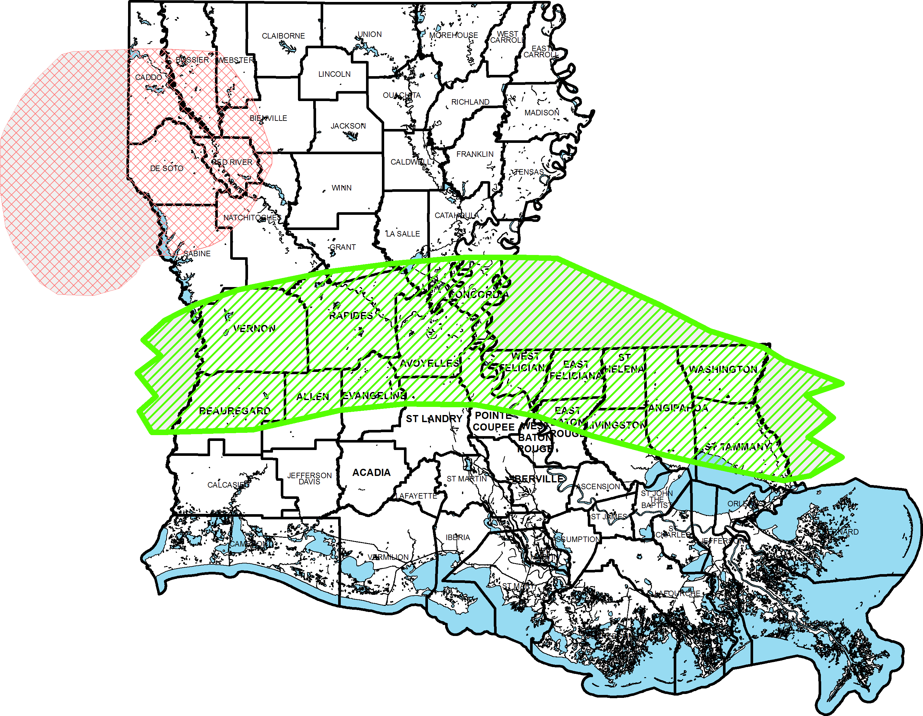
Eagle Ford/Tuscaloosa Marine Shale Play
Lower Smackover “Brown Dense” and Haynesville Shale Plays
BROWN DENSE
Haynesville Shale
Tuscaloosa Marine Shale

Slide 3
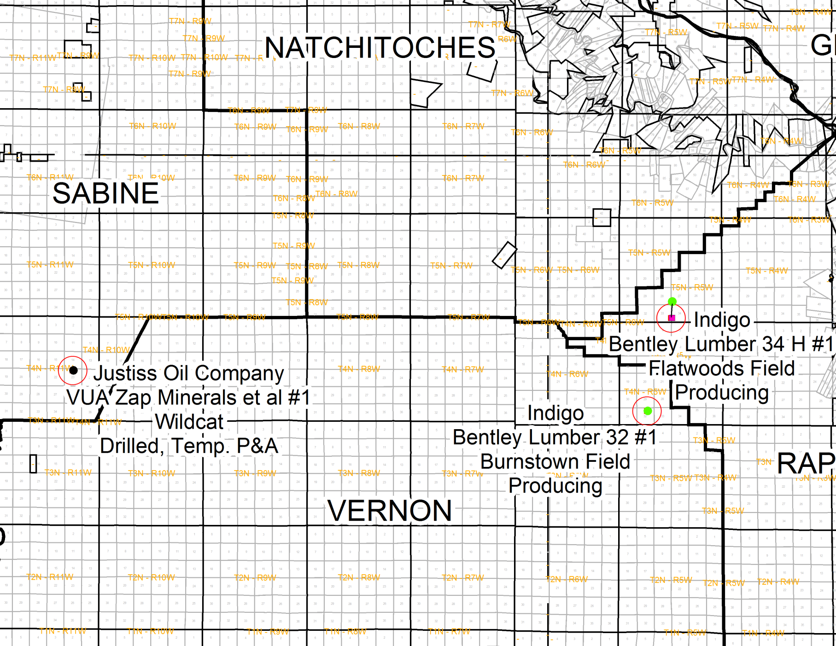
TMS ACTIVITY

Slide 4
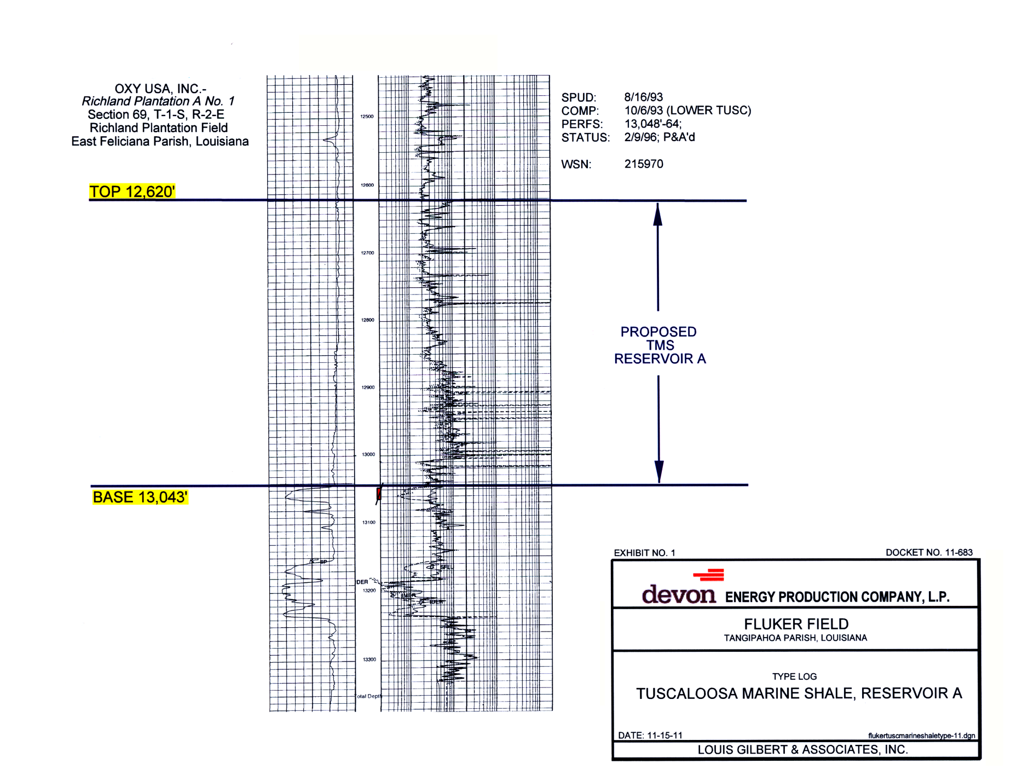
TMS TARGET ZONE IDENTIFICATION LOG

Slide 5
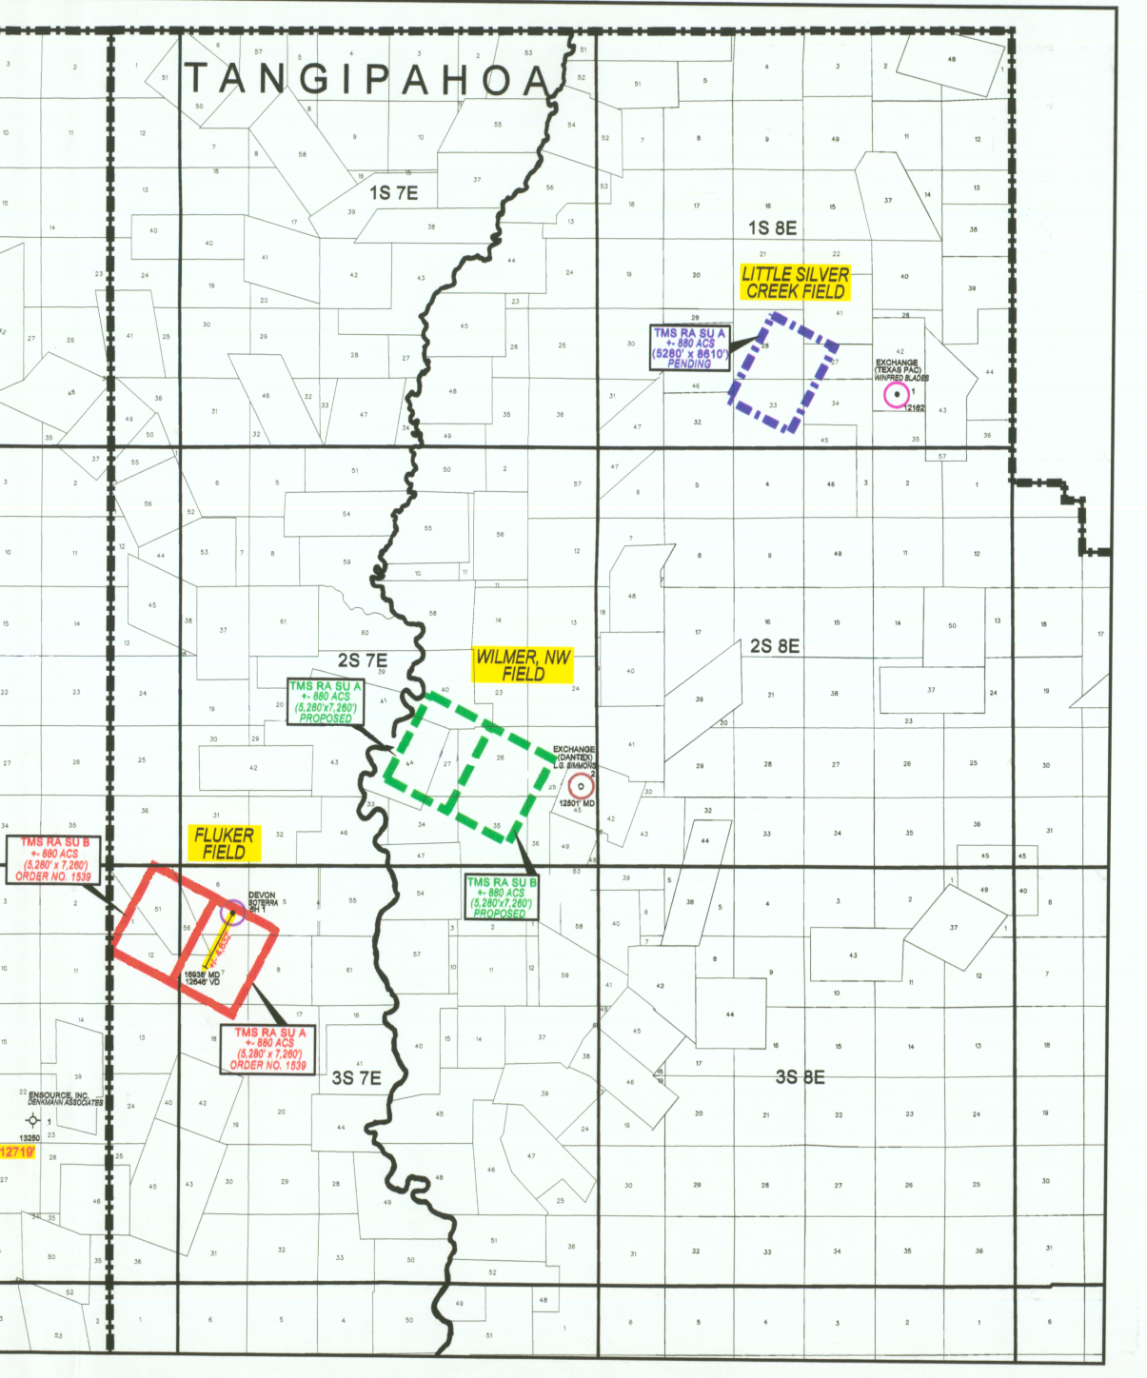
TMS ACTIVITY

Slide 6
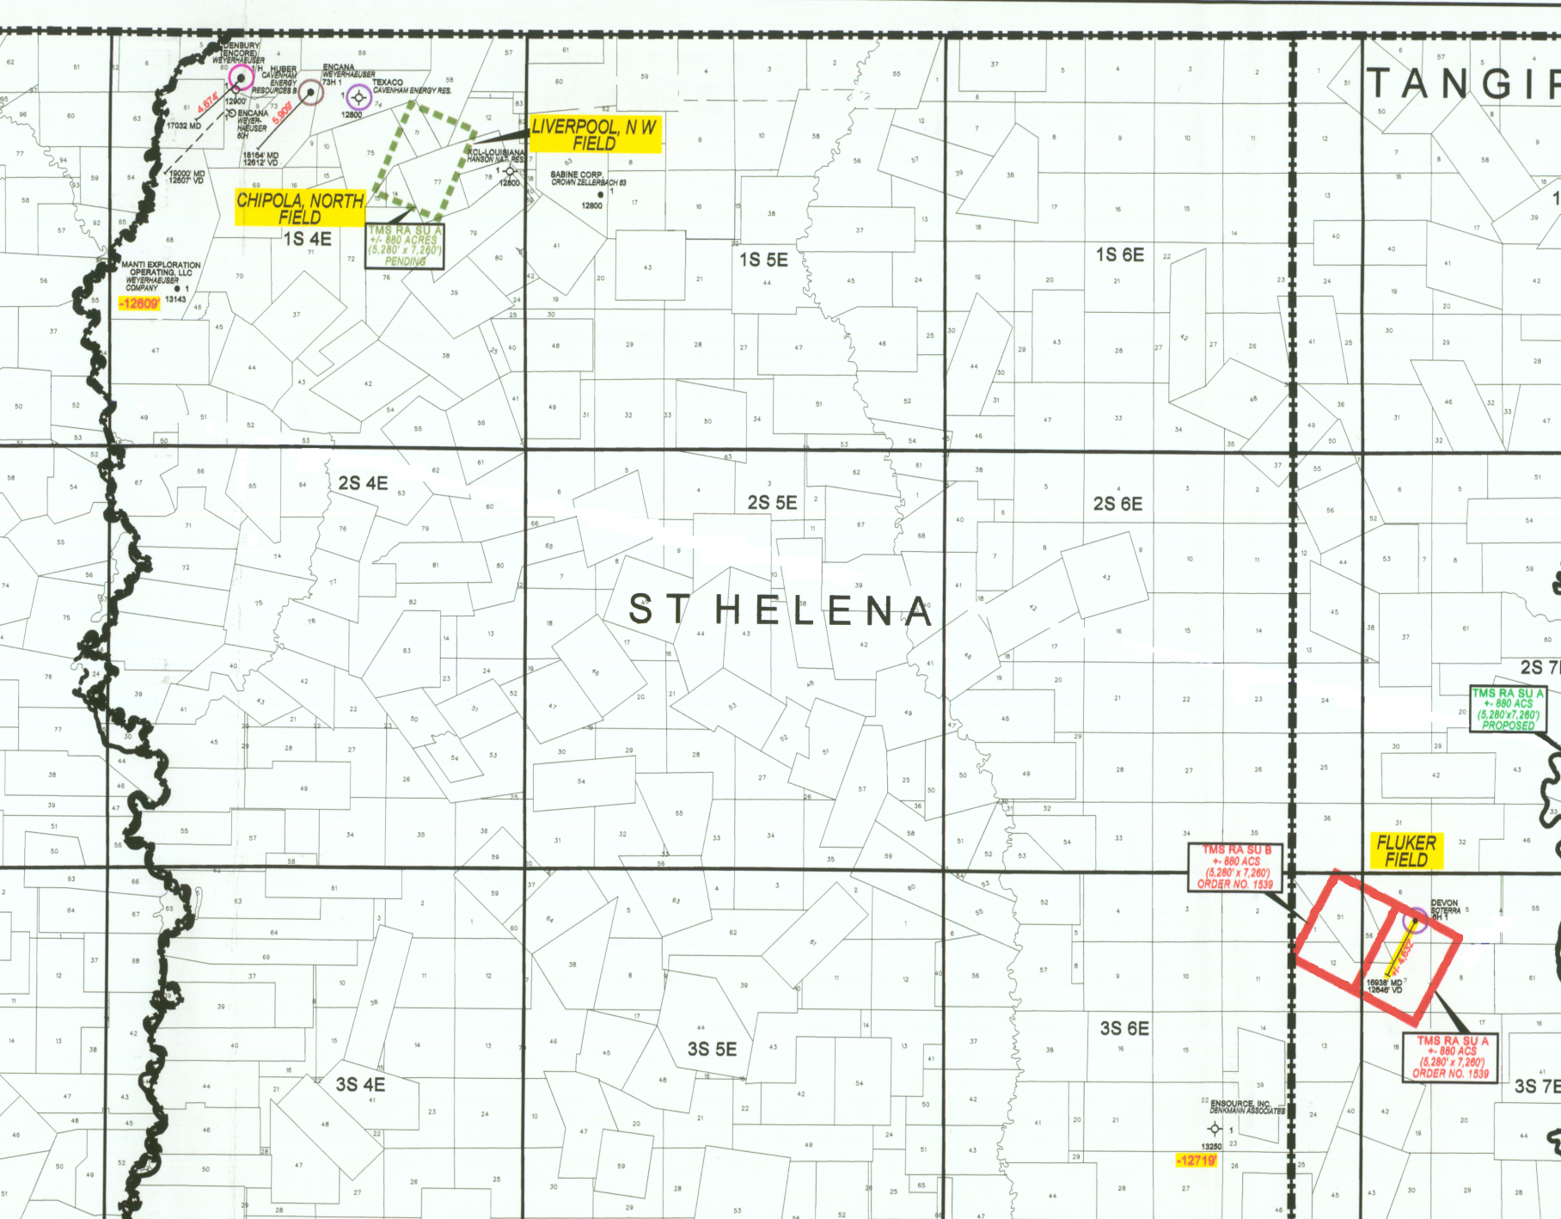
TMS ACTIVITY

Slide 7
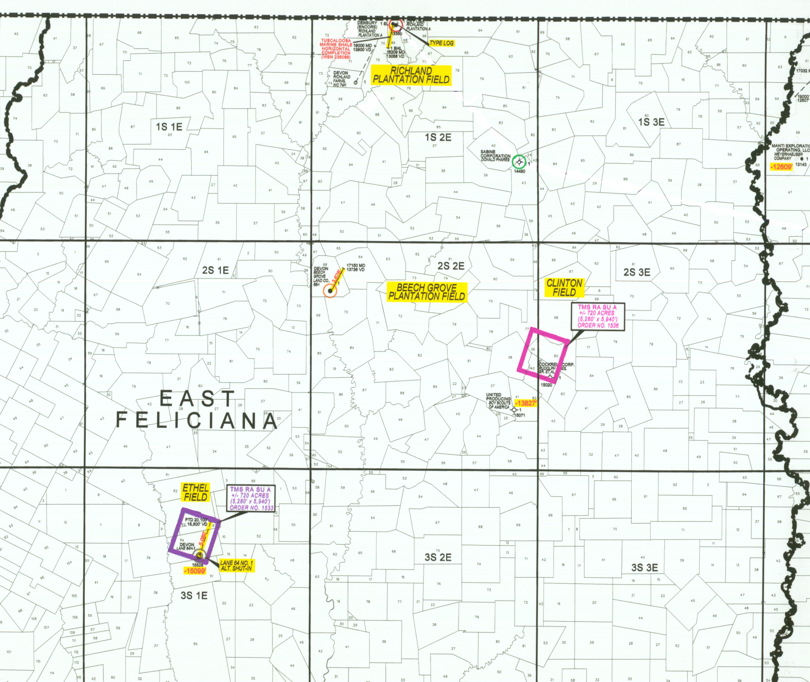
TMS ACTIVITY

Slide 8
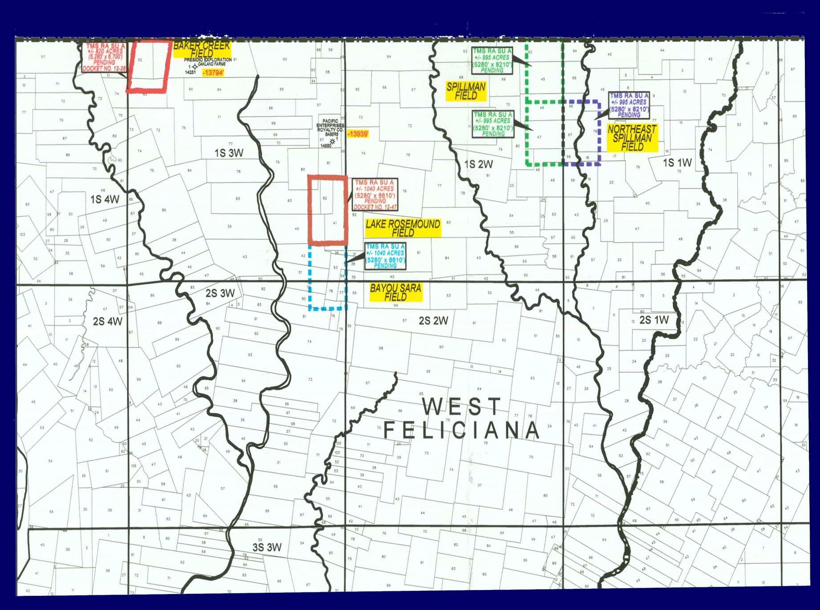
TMS ACTIVITY

Slide 9
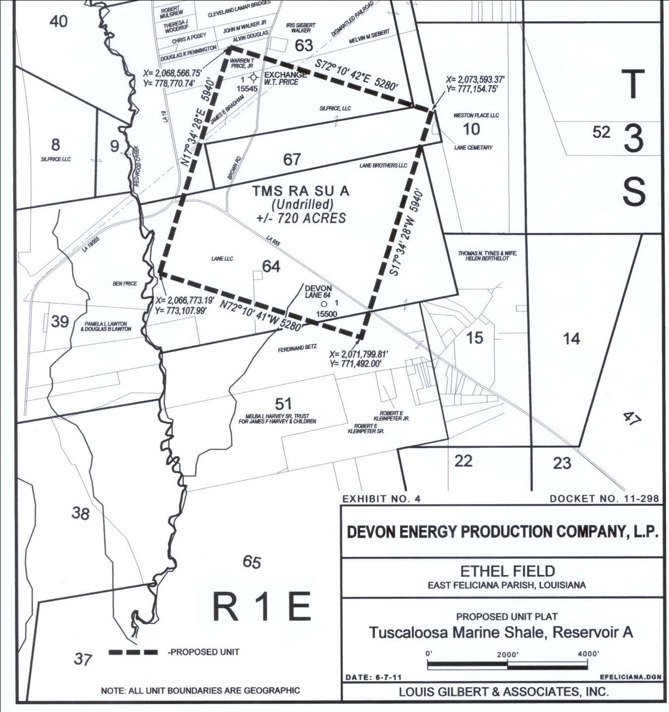
TMS Unitization Ethel Field

Slide 10
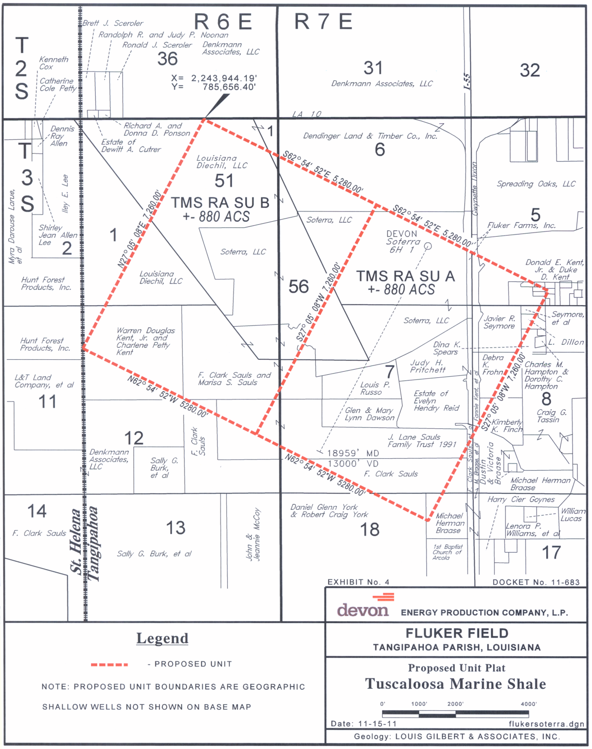
TMS Unitization Fluker Field

Slide 11
Well Permitting & Reporting
Permit process ensures wells are drilled at legal locations.
  Prevents drilling of unnecessary wells.
  Protects correlative rights of mineral owners.
Reporting requirements ensure transparency
  Inclination or directional surveys confirm well bottom hole location
  Production reporting serves as the basis for severance tax calculations and is used by mineral owners to confirm proper payment of royalties.

Slide 12
Water Resources Management
Water well permitting and aquifer evaluation
Licensing of water well drillers
Well construction requirements
Resource use reporting and monitoring

Slide 13
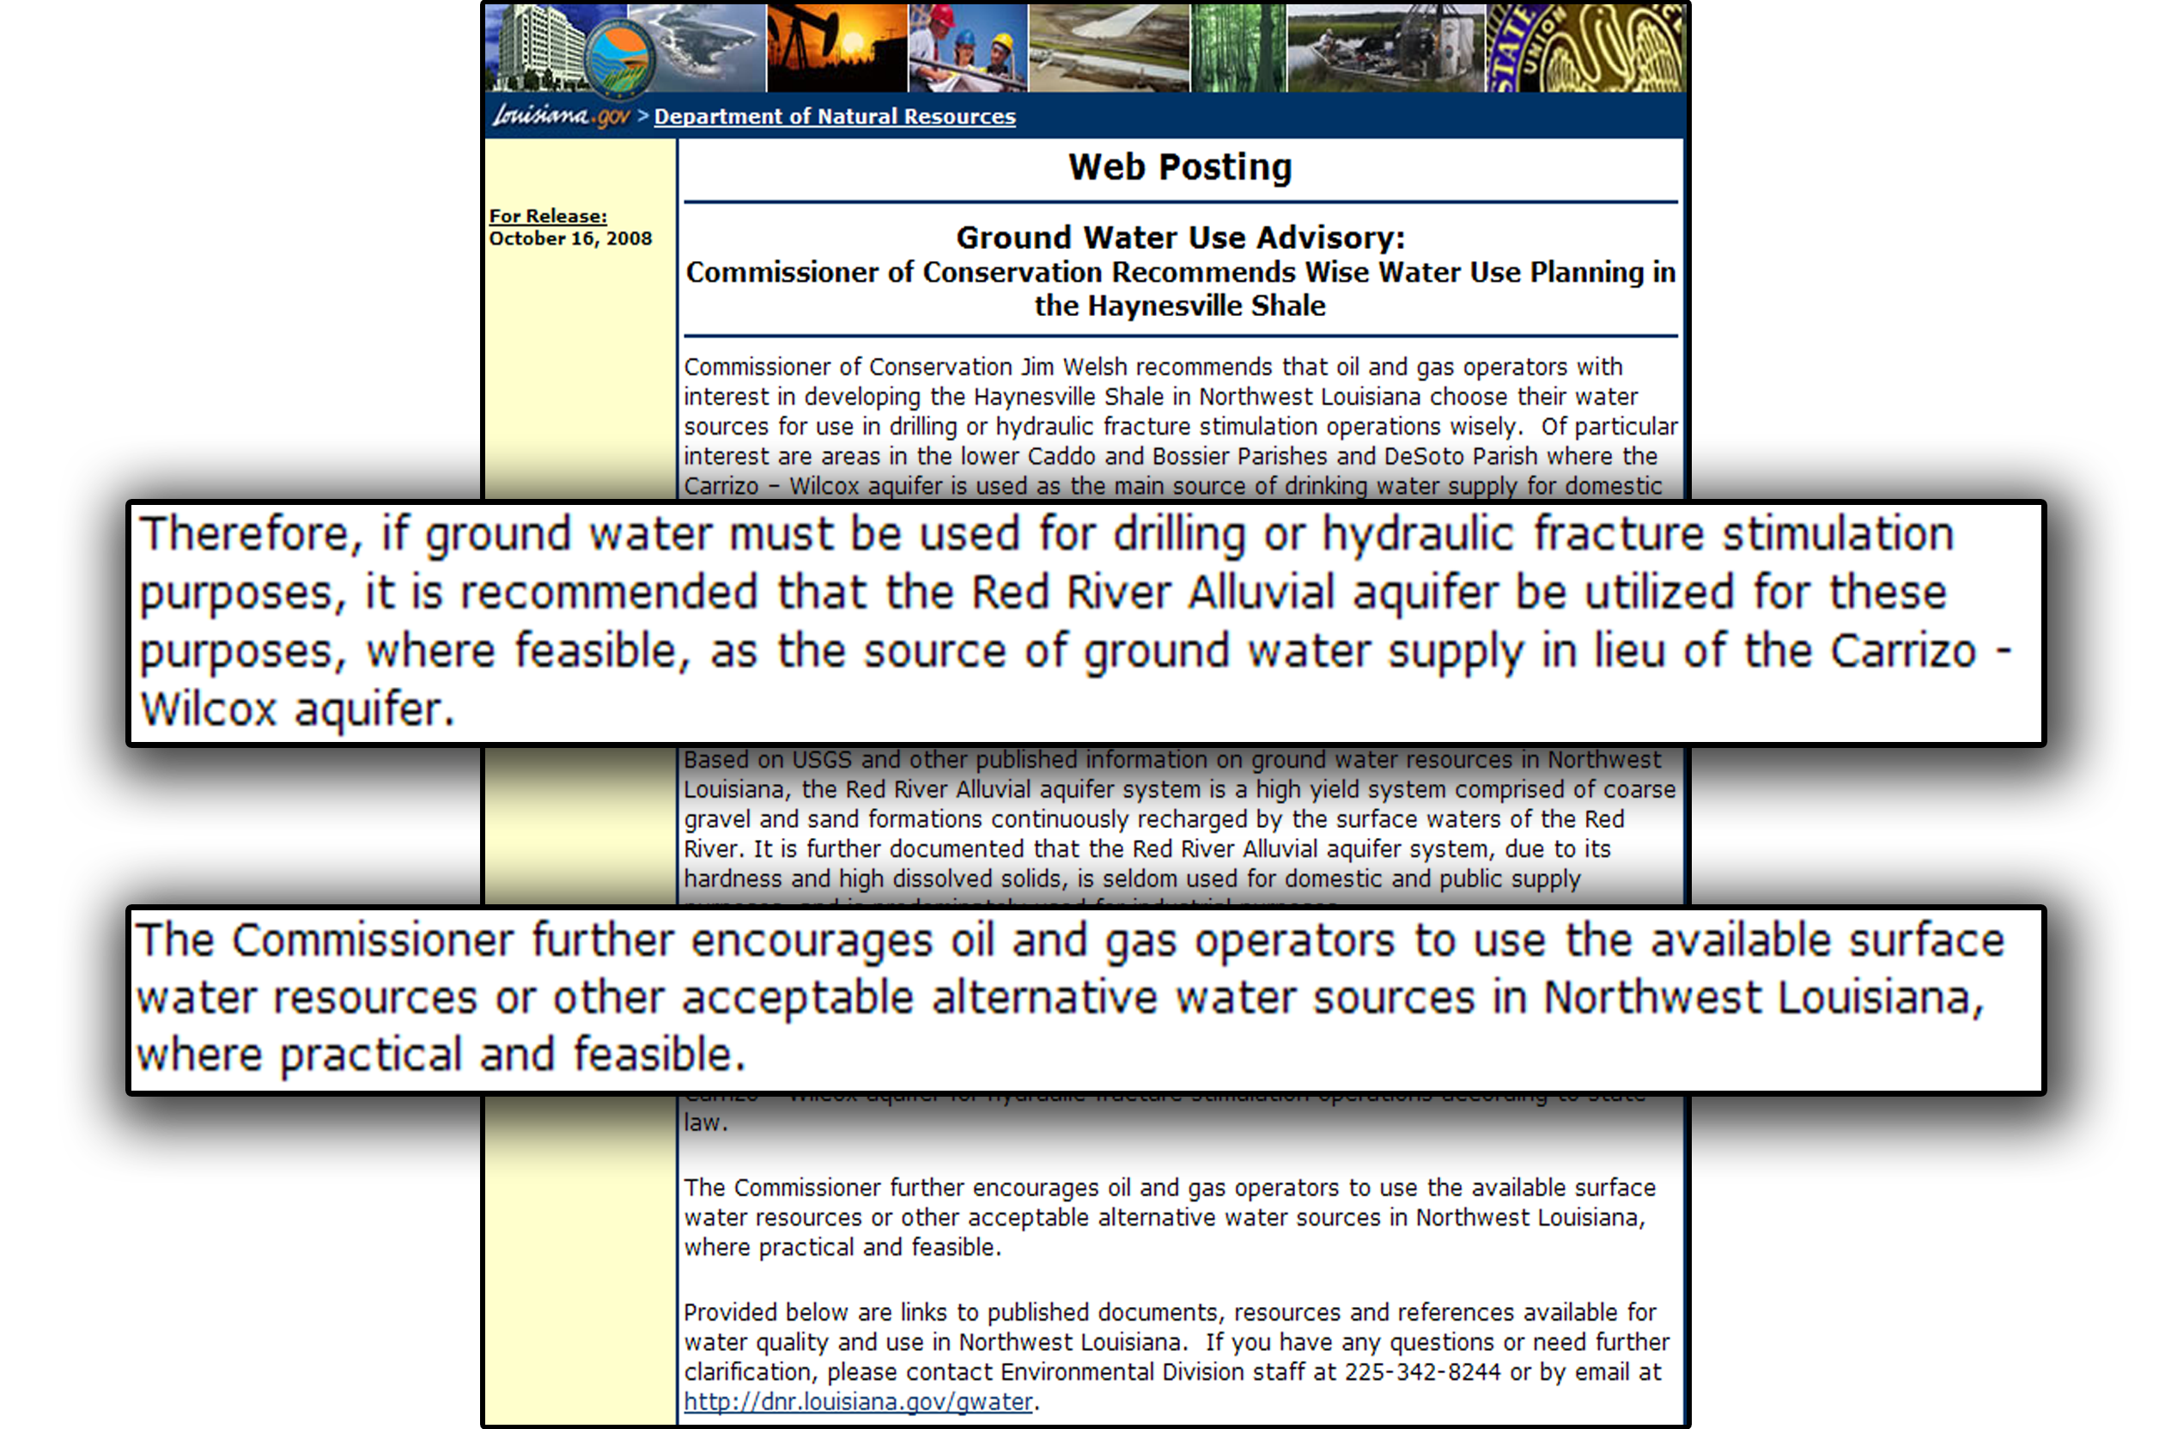
Ground Water Use Advisory

Slide 14
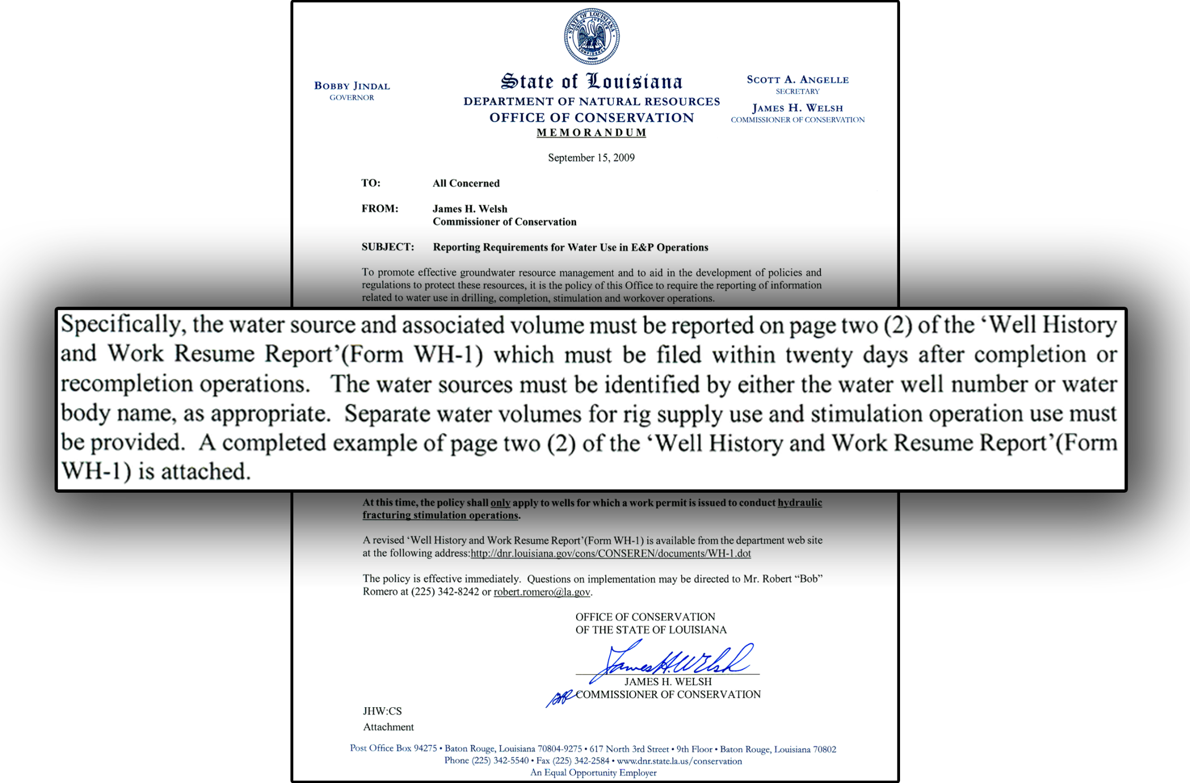
Directive for Frac Water Reporting
Due to revisions of the WH-1 form, water source and associated volumes are now reported on page 3.

Slide 15
Protection of Groundwater Through Well Construction
Construction requirements result in protection of USDW and isolation of hydrocarbon bearing zones.
  Multiple casing strings
  Minimum setting depth
  Cement requirements
  Pressure testing
5 in.
Production
7 ⅝ in.
Intermediate
10 ¾ in.
Surface

Slide 16
Waste Management
Exploration & Production (E&P) Wastes primarily include:
  Drilling fluids
  Flowback water
  Produced water
E&P Waste regulations ensure proper disposal to minimize environmental impacts of resource development.
Manifest and reporting systems ensure transparency and accountability.
Waste Management options include:
  Onsite disposal using conservative limiting criteria
  Well injection
  Commercial disposal
  Recycling in limited cases

Slide 17
Inspection & Rule Enforcement
38 inspectors conduct periodic visual inspections of wells and associated facilities during all phases of development (drilling, completion, production, and abandonment)
Rule violations result in the issuance of Compliance Orders to the responsible party requiring corrective actions.
Compliance Order enforcement may involve the progressive issuance of Civil Penalties, suspension of authority to sell oil, withholding of permits or a declaration preventing continued operation in Louisiana.

Slide 18
Hydraulic Fracturing Rule
LAC 43:XIX.118
Effective as of October 20, 2011
Must file application with and receive work permit to hydraulically frack from the appropriate district office (Lafayette, Shreveport, & Monroe) prior to beginning fracking operations. Sec. 118.B.
Following completion of hydraulic fracturing the operator must file a Well History and Work Resume Report (Form WH-1) in accordance with Sec. 105 & Sec. 118.C.
LAC 43:XIX.105 requires:
  At least 12 hours prior notice must be given to the manager of the appropriate district office, so that a Conservation representative may have a chance to witness the fracturing operations.
  Within 20 days of completing work under the work permit, the work must be described on the Well History and Work Resume Report and submitted to the appropriate district office.

Slide 19
What Must Be Reported?
With the Well History and Work Resume Report (Form WH-1), the following information must be reported:
  Types and volumes (in gal.) of hydraulic fracturing fluid used in the operation.
  A list by type of all additives used during hydraulic fracturing operations. Specifically list the following for each type:
    Specific trade name and suppliers.
  List of chemical ingredients in fracturing fluid subject to requirements of 29 CFR 1910.1200(g)(2) and their associated CAS numbers. Also specify for each chemical ingredient:
    Maximum ingredient concentration within the additive expressed as a chemical by mass of each chemical ingredient;
    Maximum concentration of each chemical ingredient expressed as a percentage by mass of the total volume of hydraulic frac fluid used.

Slide 20
Confidential Information
Like similar statutes or regulations in other jurisdictions, the new fracturing information reporting requirements provide that specific chemical ingredient identity and CAS numbers entitled to trade secret designation pursuant to 29 CFR Sec. 1910.1200(i), do not need to be reported.
When a trade secret is claimed by the party entitled to make such a claim, then the following information must be provided:
  The chemical family of the trade secret ingredient; and
  A statement claiming that trade secret protection is being made.
    Statement may be as simple as stating that the ingredient is “privileged”, “proprietary” or a “trade secret.”
Despite this protection, no party can withhold trade secret information from a health care professional when such disclosure is required by state or federal law.

Slide 21
How to Report?
On the Work History/Well Resume Report (Form WH-1) submitted to the appropriate district office within 20 days of completion of the hydraulic fracturing operations.
Frac Focus Chemical Disclosure Registry – online accessible registry sponsored by Groundwater Protection Council and the Interstate Oil & Gas Compact Commission.
  Fracfocus.org
  Search for specific well information by location, operator, well name, etc.
  Under new reporting requirements, must report within 20 days of completion of hydraulic fracturing operations.
  Reporting on Frac Focus does not fully replace WH-1 Requirement.
Similar Publicly Available Websites.

Slide 22
Public Information
The majority of information collected by the Office of Conservation is available to the public free of charge through the DNR website – SONRIS (www.sonris.com)
  Access to the DNR Database
  Access to map-based (GIS) information (Geographic Information System (GIS)
  Access to images of documents on file

