Slide 2
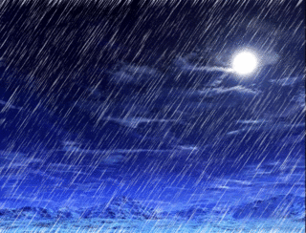
The prefix “hydro” means water in Latin.
The hydrosphere includes all the water on the planet.
Notes:
For vocabulary development give the students other examples of words that start with hydro. Hydrologist studies water. Hydropower generates electricity from water such as a dam.

Slide 3
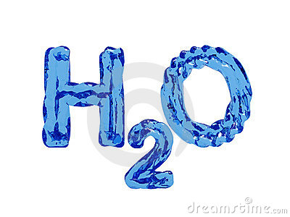
H₂O is how we write the formula for a molecule of water. This formula shows that the “recipe” for water is 2 atoms of hydrogen for every atom of oxygen.
Notes:
Elements in water are hydrogen and oxygen. The number 2 is called a subscript in a molecular formula. This number cannot change or it will be different compound. For example H2O2 is hydrogen peroxide.

Slide 4
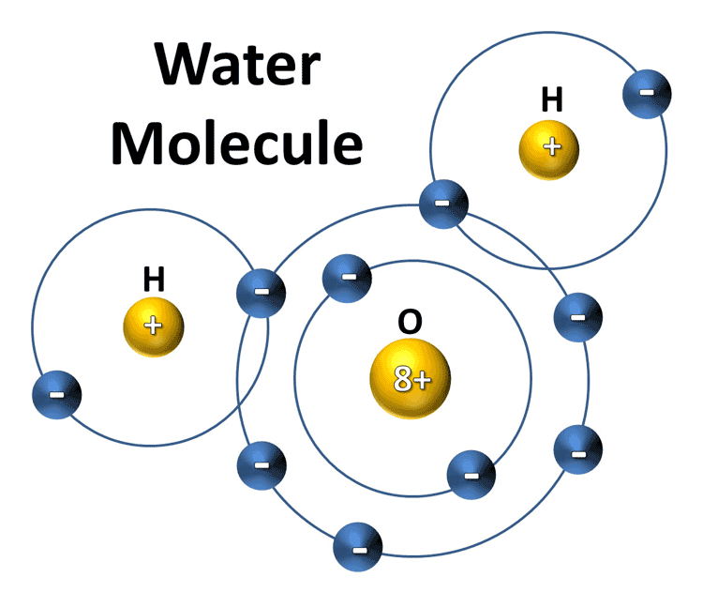
Two atoms of hydrogen and one atom of oxygen
Notes:
Teacher can review the parts of the atom – positive protons, neutrons (not illustrated here) and negative electrons. Compare the numbers of protons and electrons of oxygen (8) with hydrogen (1)

Slide 5
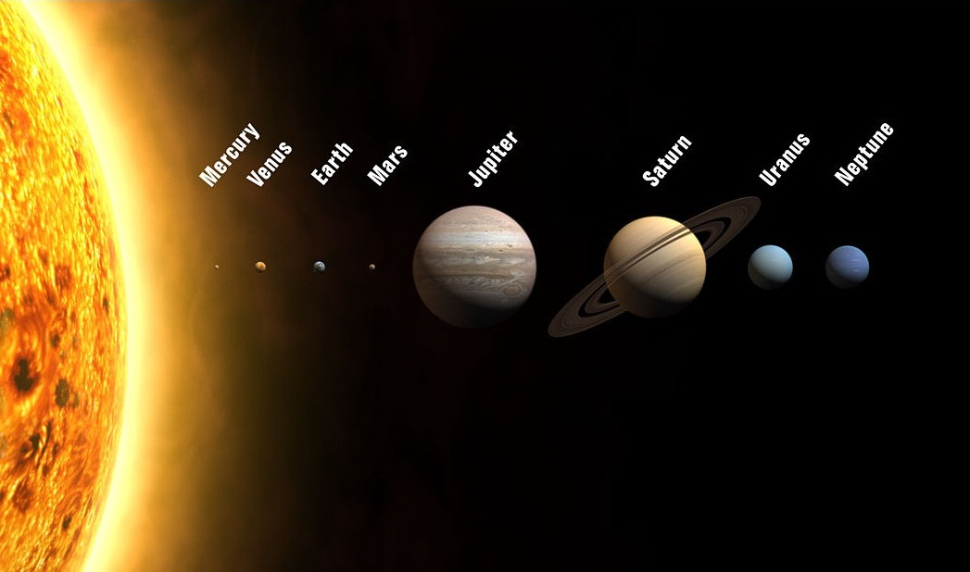
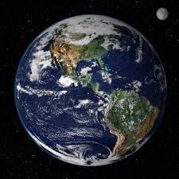
Within our Solar System
Liquid water makes Earth a very special place.
Notes:
Water is abundant on Earth so that we take it for granted. The following slide shows why Earth is unique in the Solar System to have liquid water which sustains life as we know it.

Slide 6
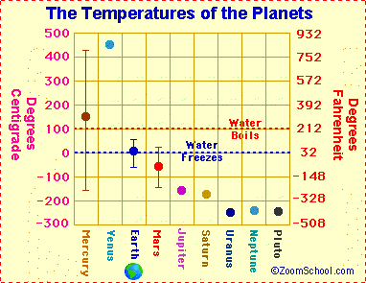
Earth is the right temperature for lots of liquid water.
Notes:
The temperature range on Earth allows most of its water to remain in the liquid state. If we were a colder object like Pluto, all water would be frozen. On the other hand, if we were on a very hot planet, like Mercury, all the water would be in a gaseous state. (Interesting note: Mercury is not as not as Venus because it has no atmosphere to trap heat)

Slide 7
Notes:
In order to help students understand why there is so much ocean water compared to freshwater – have the students look at the surface of a globe and tell them that about 70% of the Earth’s surface is ocean.

Slide 8
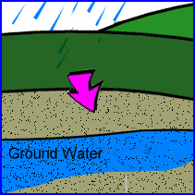
Where do we get our water?
Surface water (lakes or rivers) - About 75% of water use in Louisiana
Groundwater wells – About 25% of water use in Louisiana
Surface Water
Notes:
New Orleans uses river water for their public supply.

Slide 9
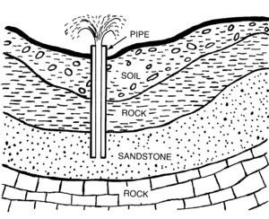
The water comes from very deep in the ground in regions called aquifers.
Water is found in the layer with sand. Screens located at the bottom of the pipe keep the sand out while pumping.
Notes:
This is a diagram of one confined aquifer layer. Below Baton Rouge are 10 layers of aquifers from 400 – 2800 feet below the surface.

Slide 10
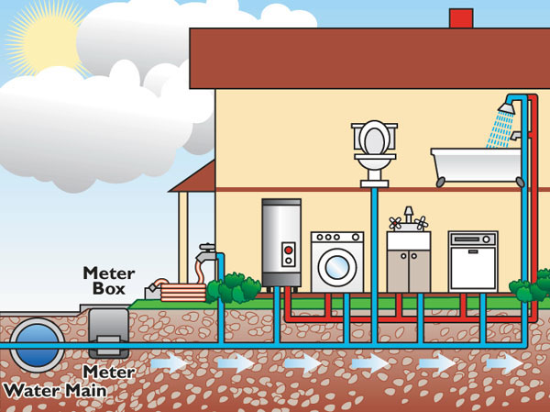
Baton Rouge Water Company pumps water out of the ground and sends it in pipes to your home.
Notes:
Ask who knows where their water meter is for their home and can they describe it for the class. The red pipes on this diagram are illustrating the hot water line from the hot water heater.

Slide 11
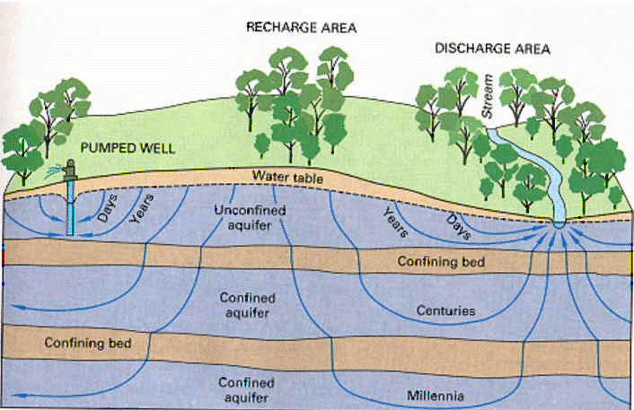
Water in aquifers deep below the surface took a very long time to get there – naturally filtered as it travels through the ground.
Notes:
The deeper the water is filtered through the ground, the purer it is. Baton Rouge drinking water comes from 1500 feet or more below the surface. It is some of the purest water in the world – but it took a very long time to get there.

Slide 12
All water moves around Earth in the water cycle - also called the hydrologic cycle.

Slide 13
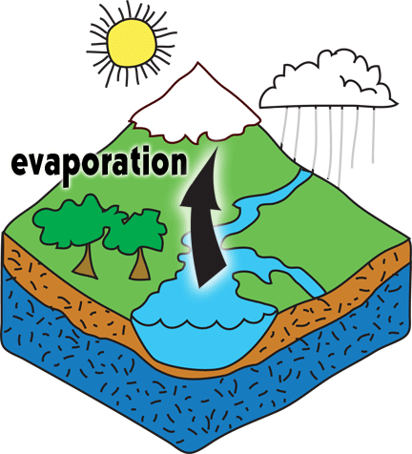
The energy to move the water comes from the sun.
Notes:
Most students know the basics of the water cycle. Review with students what they know and tell them that they are going to learn how their personal water use is linked to the water cycle.

Slide 14
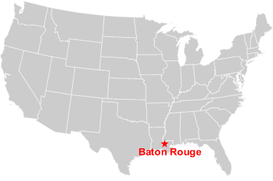
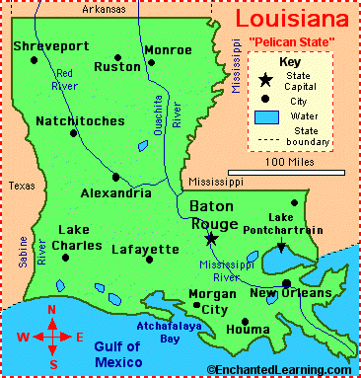
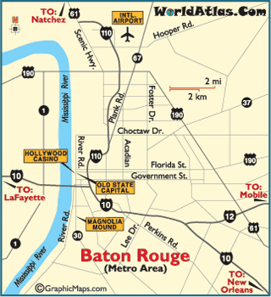
How does Baton Rouge fit into the water cycle?
How do you fit into the water cycle?
Notes:
Generate ideas from the students about where the water in their house comes from and where does it go. Most students know the basics of the water cycle, but have very little knowledge of personal water use.

Slide 15
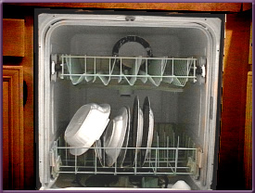
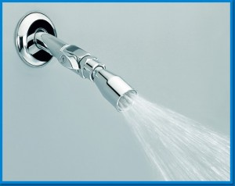
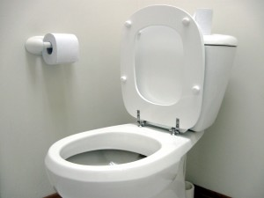
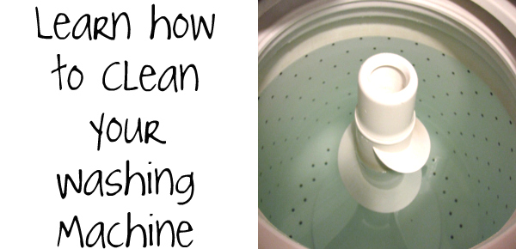
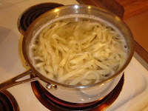
Your Personal Water Uses are an important part of the water cycle
Notes:
Discuss the multitude of ways in which we rely on the personal use of water in our homes.

Slide 16
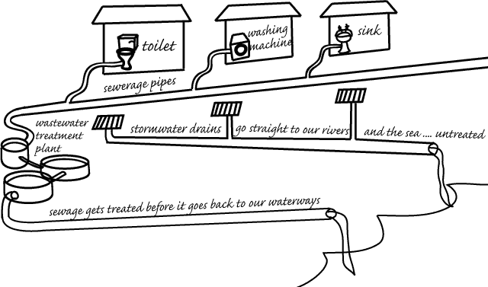
Your wastewater (sewage) and storm water drains are also part of the water cycle.
Notes:
Talk with your students about the importance of keeping stormwater drains clean. They need to remain clear to prevent flooding. Do not dispose of wastes in storm drains because these go directly to the river.

Slide 17
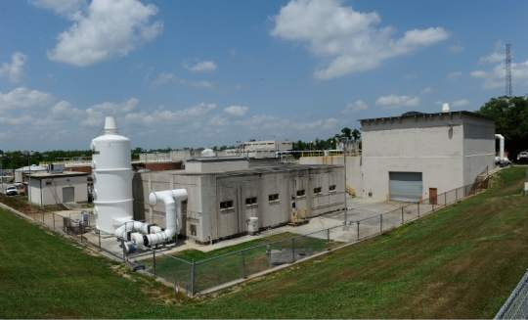
Your sewage travels underground to wastewater treatment plants where it is treated before released into local rivers.
Notes:
Sewage treatment is an interesting process that your students may want to read more about. The treatment includes physical separation of wastes as well as chemical and biological treatments.

Slide 18
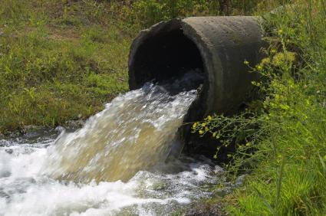
Wastewater discharge pipe – treated sewage goes into the river.
Notes:
Tell the students that in some parts of our country, the treated water goes back into public supply. The water is safe to drink, but not as desirable as our groundwater – motivation to protect our groundwater for future generations to enjoy.

Slide 19
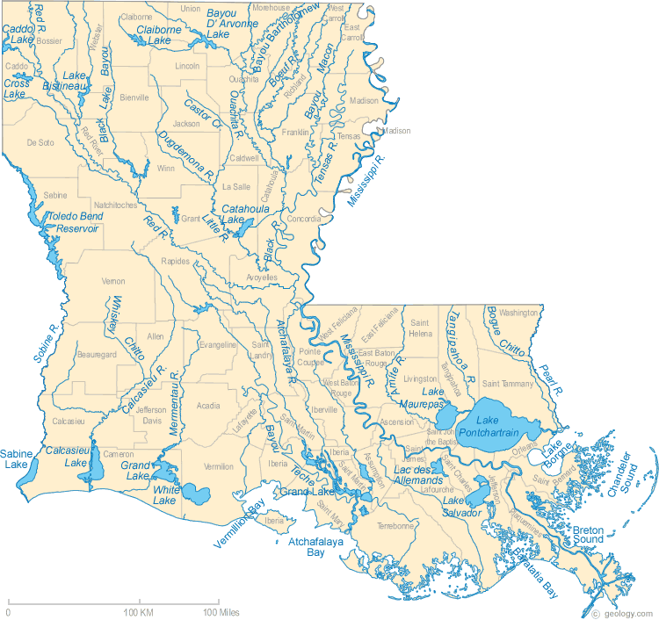
Rivers of Louisiana: Where does the water go?
Water follows the pull of gravity and flows downhill. Generally – that is towards the coast into the Gulf of Mexico
Gulf of Mexico
Notes:
Ask: What determines how or where a river flows? Elicit from students that ultimately gravity—which is impacted by elevation, topography, and geology—determines where a river flows, and since the areas of lowest elevation are where the land meets the ocean, that’s where the rivers flow.

Slide 20
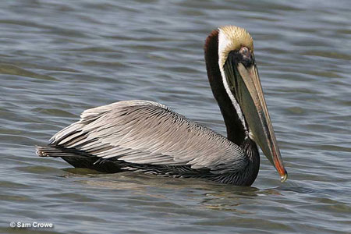
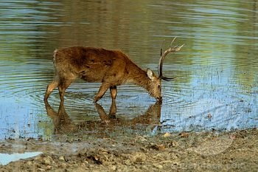
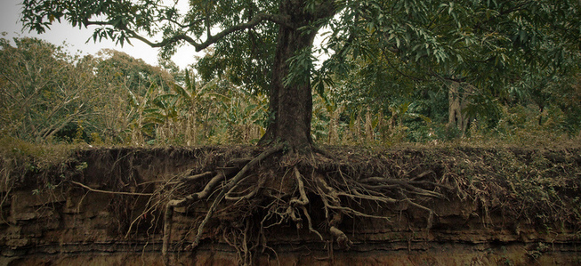
Plants and Animals are part of the water cycle too.
Notes:
Organisms all over the Earth need water to survive. Although it's a small amount when compared to oceans, every living creature is filled with water. Our cells are mainly composed of water. The human body is 60% water.

Slide 21
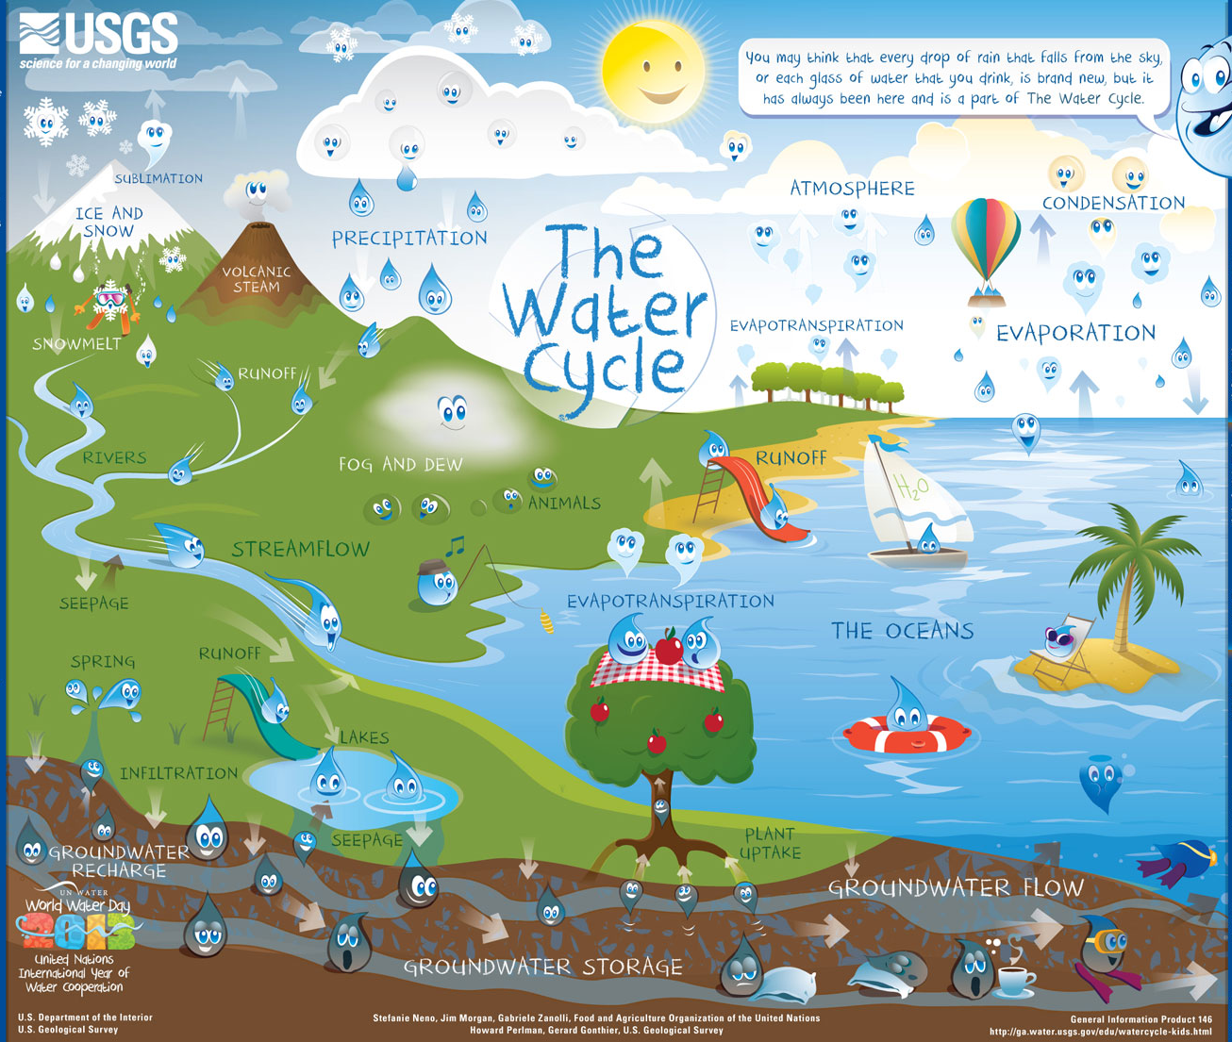
Notes:
Facilitate class discussion and conclude that the hydrosphere (water) connects all humans to all other ecosystems and organisms on Earth.

Slide 22
How long does the water cycle take?
Many variables
A water drop in the ocean may spend 3,000 years in the ocean.
A water drop in a cloud may spend 10 days in the cloud.
Groundwater may be months to 10,000 years!
Notes:
Challenge students to guess how long it takes for parts of the water cycle they can easily visualize. (rain, puddle, evaporate, water vapor condenses on a glass, evaporate, in cloud, rain…..) Emphasize after evaporation, the water is an invisible gas in the air before it becomes part of a cloud.

Slide 23
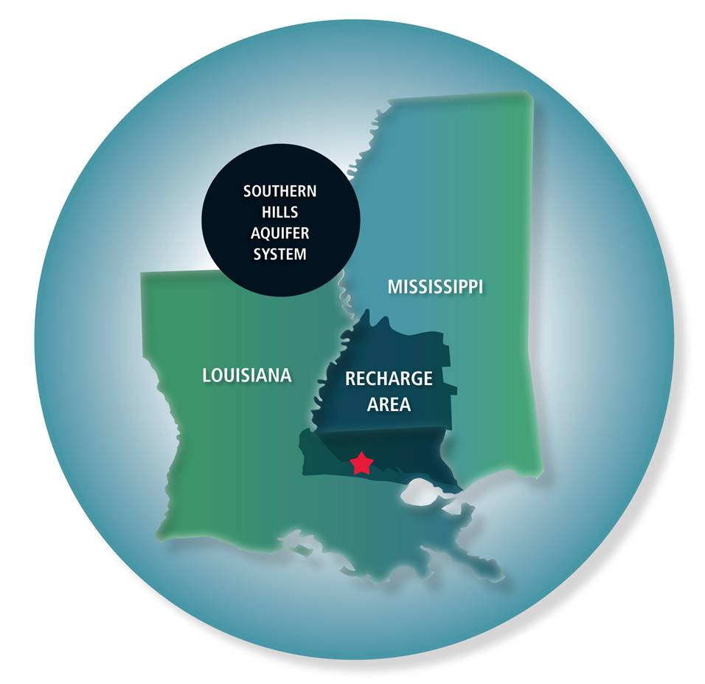
Groundwater is a very slow part of the hydrologic cycle.
The aquifers that we use below Baton Rouge get new water from the recharge area. (where surface water is absorbed into the ground)
Hundreds or thousands of years may pass before the water has drifted through many layers of soil and rock to reach the deep aquifers we use for our drinking water.
Notes:
The red star is Baton Rouge. Most of our groundwater entered the ground in Southern Mississippi. (called the recharge area)

Slide 24
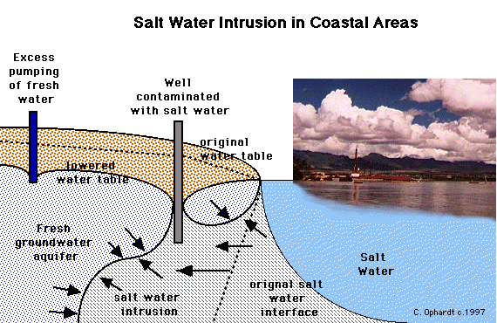
In some areas, people have taken too much freshwater out of the ground which causes saltwater to move through the ground and contaminate the freshwater wells.
Notes:
Explain to the students that water flows downhill – or from high pressure to low pressure. Excess pumping of fresh water creates a lowered water table with lower pressure. Therefore, salt water moves in.

Slide 25
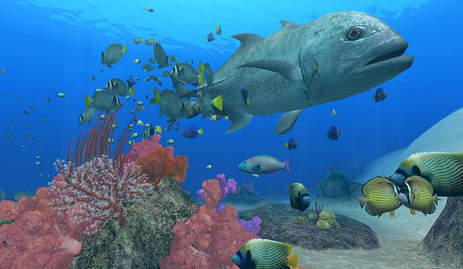
Salty seawater is perfect for all the plants and animals that live in the ocean.
Notes:
Explain that organisms that live in seawater have special adaptations that enable them to live in salt water and that they could not live in freshwater.

Slide 26
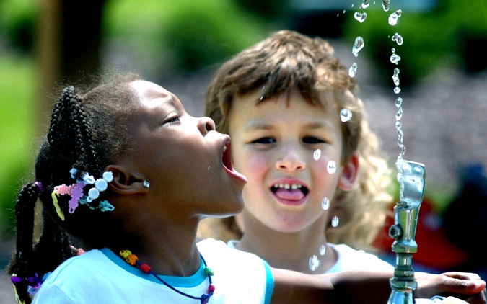
But all the rest of life on Earth depends on freshwater.

Slide 27
How salty is seawater?
Seawater is about 3.5% salt, Freshwater has less than 0.1% salt.
Notes:
Although we commonly only refer to the salt in seawater (sodium chloride) there are actually many other elements dissolved in seawater in very small quantities.

Slide 28
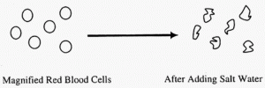
Why can’t we drink seawater?
Drinking water as salty as the sea would make you sick, because it would create an imbalance of your body fluids. For the same reason we cannot water our plants with seawater.
Your cells actually shrivel in salt water!

Slide 29
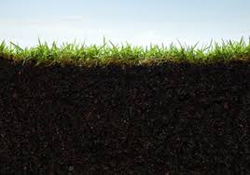
It is important to treat our groundwater as a valuable resource and manage its use responsibly.
Water cycles around and around, but needs our protection for future use.

Slide 30
References
Allen, Rebekah., The Advocate. August 12, 2011. “Home Buyouts Discussed”. http://theadvocate.com/home/571583-79/home-buyouts-discussed.html Waste water treatment plant. (April 20, 2014).
Climate Science Investigations . “Water molecule”. http://www.ces.fau.edu/nasa/module- 3/why-does-temperature-vary/land-and-water.php diagram. (April 20, 2014).
Cooperative Extension, University of Georgia. “Home water use”. http://spock.fcs.uga.edu/ext/housing/water_use.php. (May 15, 2014).
Elmhurst College General Education. Chemistry and Issues in the Environment, “Saltwater intrusion in coastal areas”. http://www.elmhurst.edu/~chm/onlcourse/chm110/outlines/saltintrusion.h tml . (April 20, 2014).
Enchanted Learning. “Temperature on the planets”. http://www.enchantedlearning.com/subjects/astronomy/planets/. (April 20, 2014).

Slide 31
References
Earth Form: Houston Museum of Natural Science. “Distribution of World’s Water”. http://earth.rice.edu/mtpe/hydro/hydrosphere/hot/freshwater/0water_cha rt.html. (April 20, 2014).
Geology.Com. “Rivers of Louisiana”. http://geology.com/lakes-rivers- water/louisiana.shtml. (April 20, 2014.)
Mount Isa City Council, “From Drains to Drinking Water”. http://www.mountisa.qld.gov.au/drains2drinking (May 20, 2014).
Peakwater.org. “Groundwater report: Regional approach is better than state mandates.” Photo retrieved from www.scipeeps.com http://peakwater.org/2011/04/groundwater-report-regional-approach-is-better- than-statewide-mandates/ (June 15, 2014).
Science Class AIPCV. “Hydrosphere”. http://cacaballero.blogspot.com/2010_09_01_archive.html. (April 20, 2014).

Slide 32
References
USGS: Water Cycle – Water Science for Schools. http://water.usgs.gov/edu/watercyclegwdischarge.html . (January 10, 2013).
Wikipedia. “Sea water salts”. http://en.wikipedia.org/wiki/Seawater (May 15, 2014)
Wikipedia. “Solar System”. http://en.wikipedia.org/wiki/Solar_System (April 20, 2014).

