Slide 1
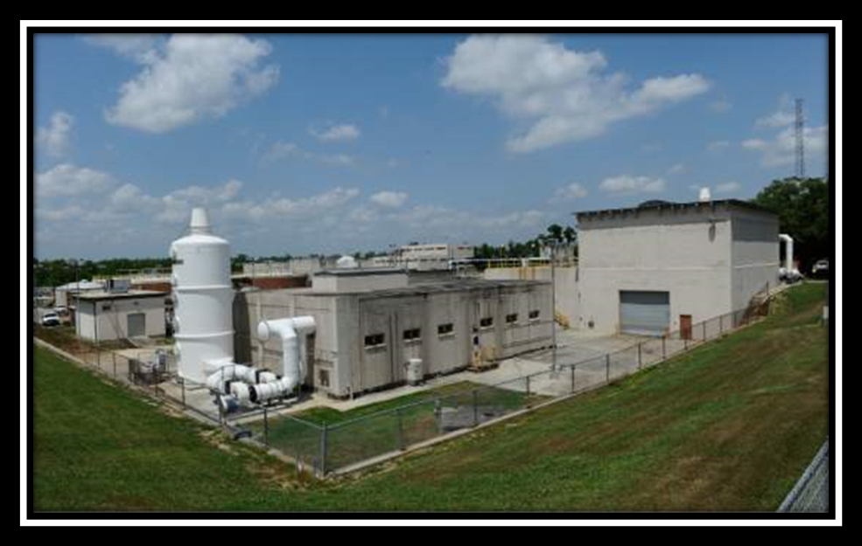
Sewage Treatment
Notes:
Public supply water goes to sewage treatment after use. Following a series of treatments, the water is released into the Mississippi River.

Slide 2
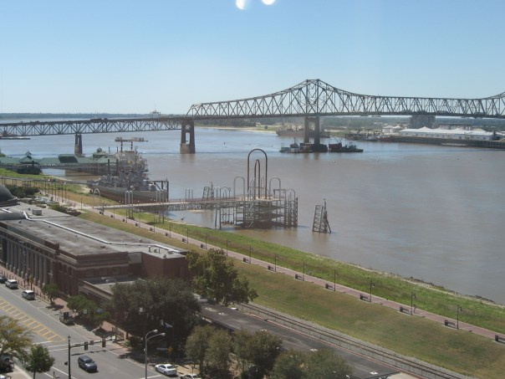
River
Notes:
Mississippi River drains water from 41% of the continental United States. It flows into the Gulf of Mexico

Slide 3
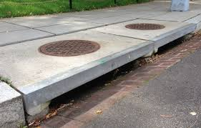
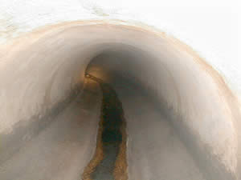
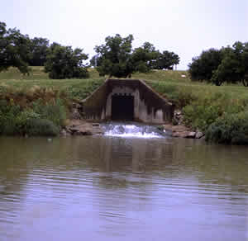
Drainage Ditch
Notes:
Storm drains in the streets help to control flooding in heavy rainfall. Pipes from street drains flow to drainage ditches or canals which will eventually lead into a bayou or river. Important to point out to students that this water does NOT go to wastewater treatment before release into the environment, so they should not dump trash here!

Slide 4
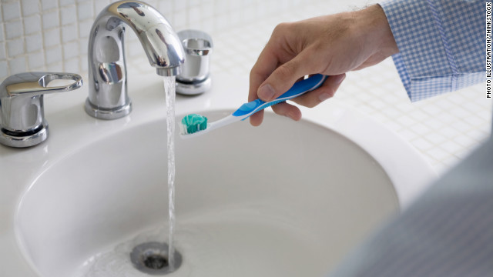
Public Water Supply
Notes:
Baton Rouge public supply water comes from deep in the ground. Most of our groundwater would have come from rainwater in the Southern Hills recharge area in southern Mississippi. Water down the drain will go to wastewater treatment.

Slide 5
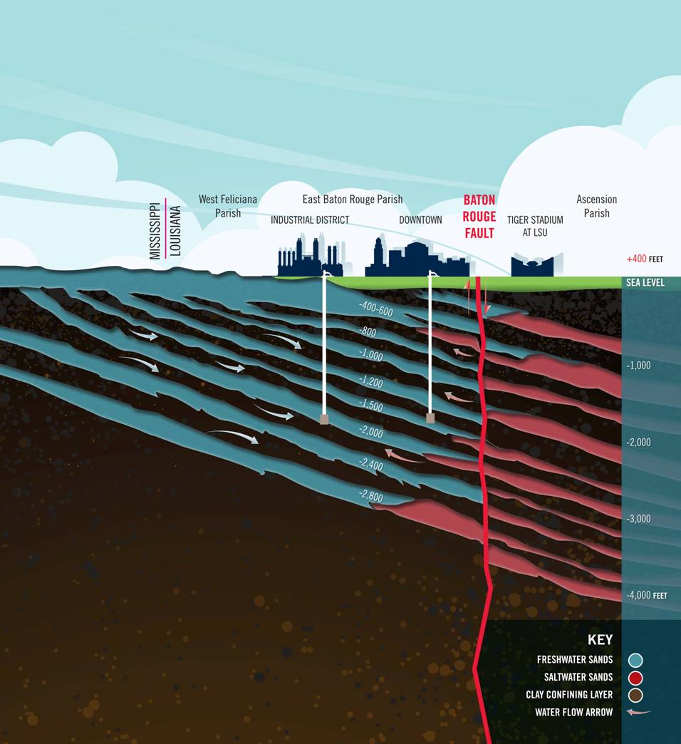
Groundwater
Notes:
Groundwater comes from rain or surface water. It is pumped out of the ground for industrial or public use.

Slide 6
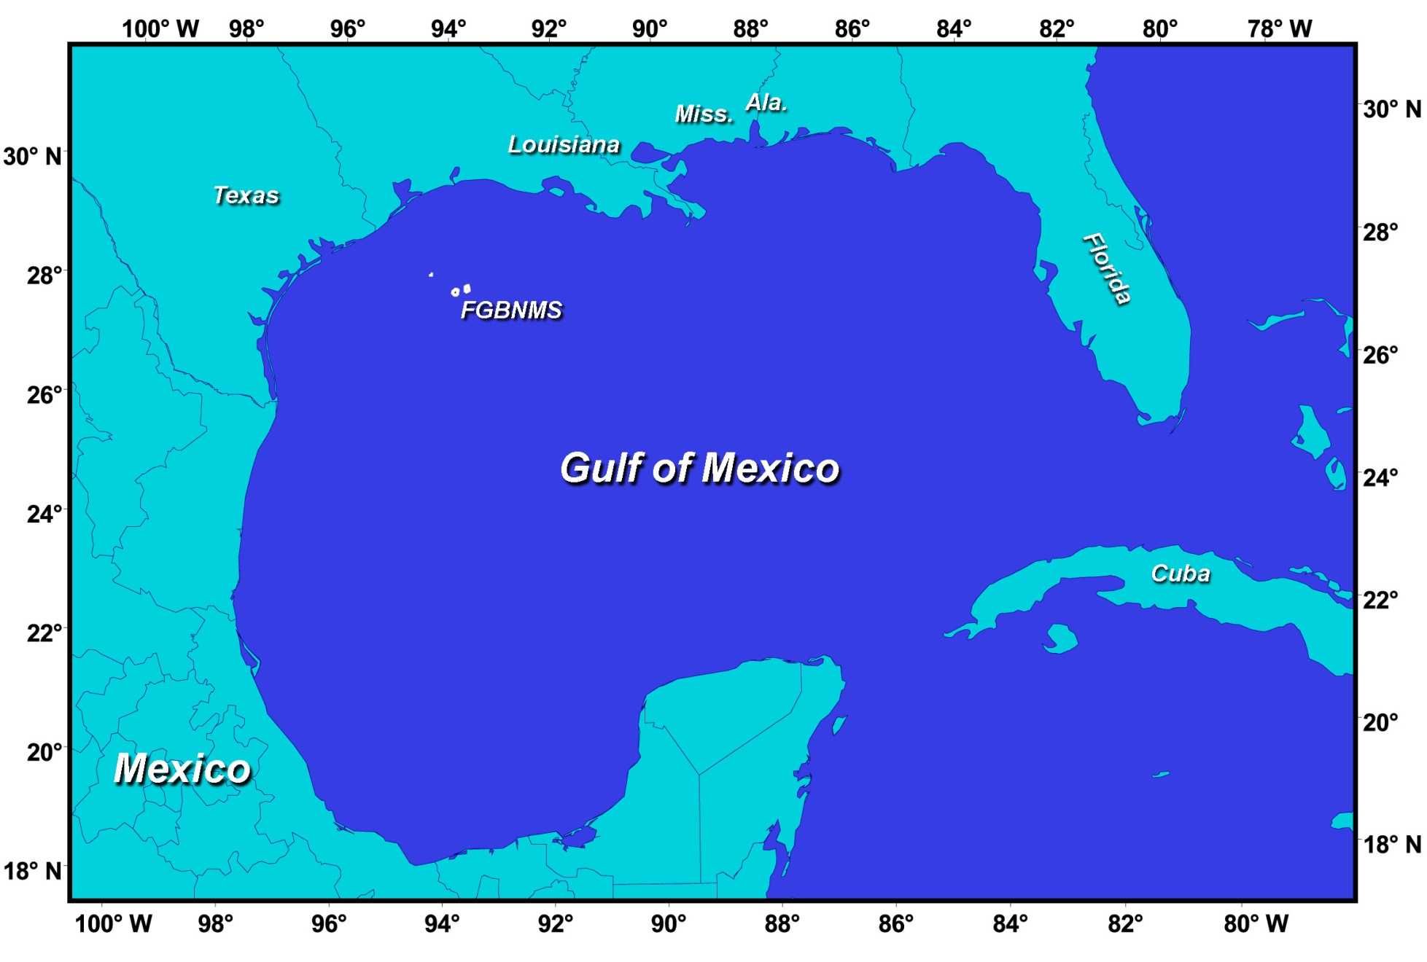
Ocean
Notes:
Oceans receive water from rivers or rain. Since desalination (removal of salt for drinking or irrigation) is a very expensive process, ocean water is not used by people. The water evaporates to the clouds. (Just the H2O: the salt largely stays behind)

Slide 7
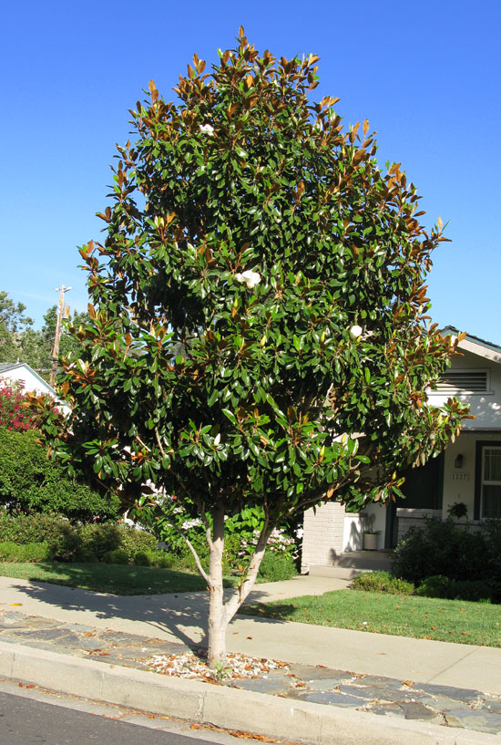
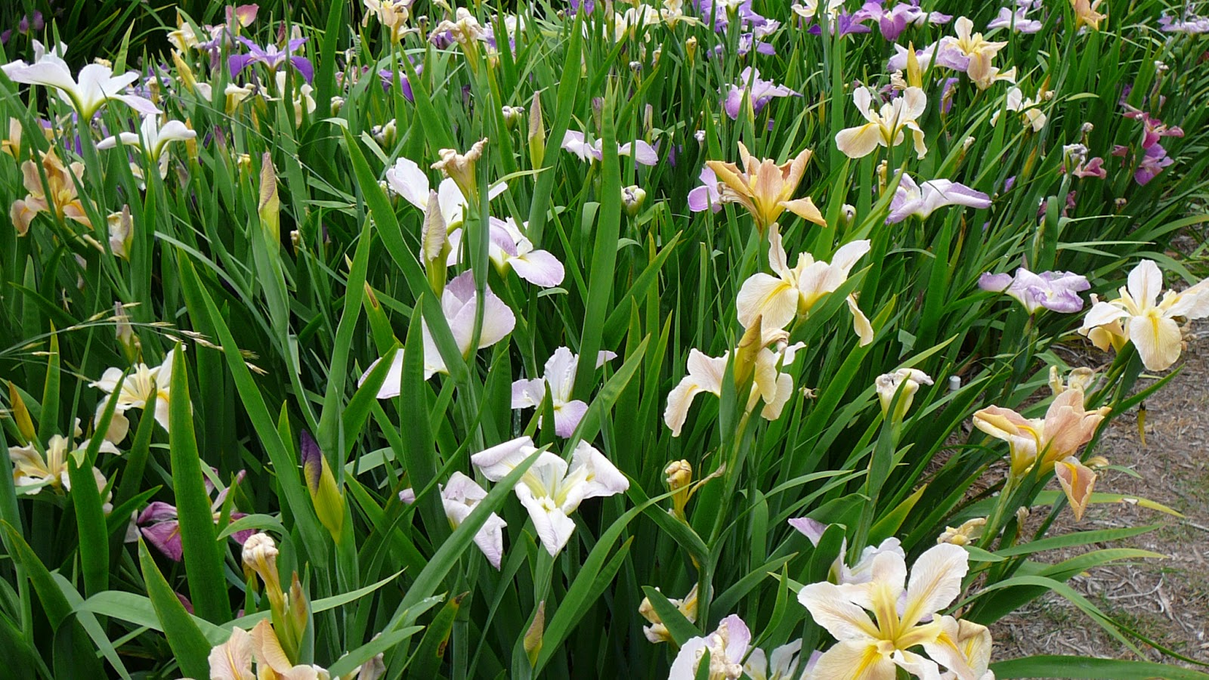
Plants
Notes:
Plants take water in through their roots and lose water through transpiration in their leaves. Animals often eat plants as a source of water – especially in the desert.

Slide 8
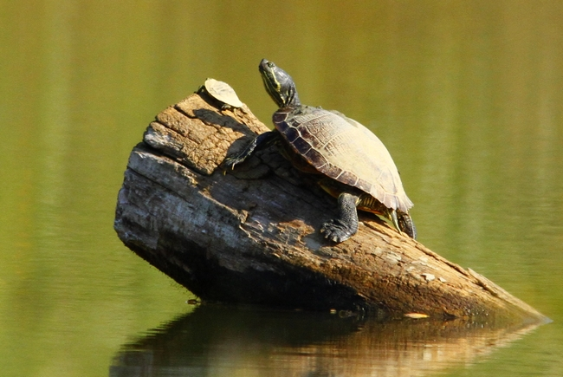
People and Animals
Notes:
People and animals drink water and lose some water through their skin. After our bodies have used the water, the leftovers are removed with urine. We get some water by eating plants and other animals.

Slide 9
Clouds
Notes:
Water evaporates into the air forming water vapor which we usually can’t see. When the water condenses, we see the water as clouds. When the water droplets become heavy enough, they fall as rain.

