Slide 1
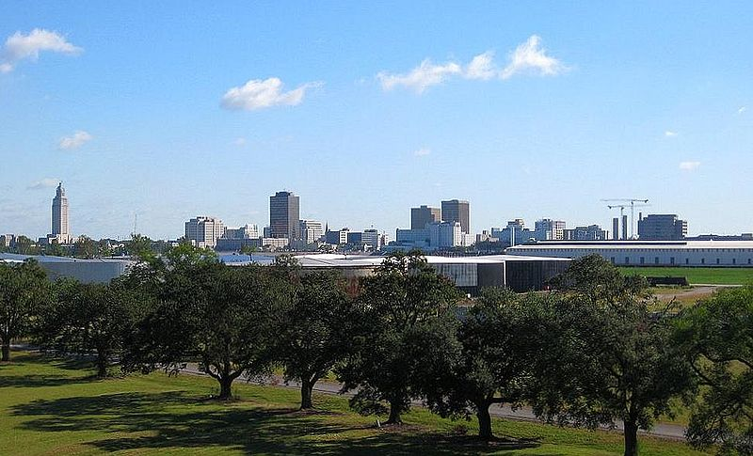
Our Groundwater in Baton Rouge, La.
UrbanPlanet, BR

Slide 2
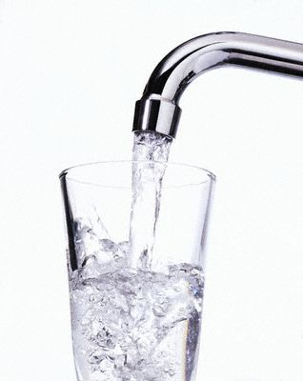
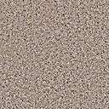
Do you ever think about the clean drinking water that comes out of your faucet?

Slide 3

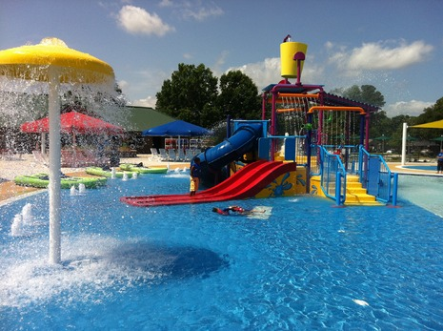
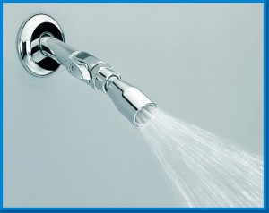

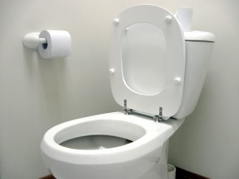
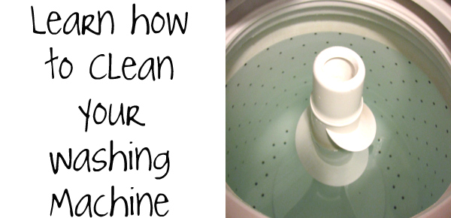
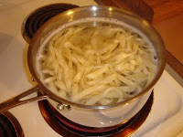
Your Personal Water Uses
NBC33 Photographer Doug Fain
Notes:
Discuss the multitude of ways in which we rely on the personal use of water in our homes.

Slide 4
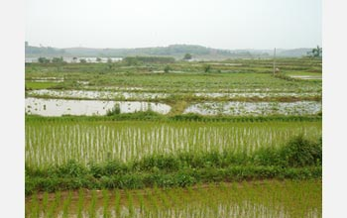
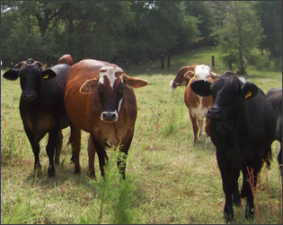
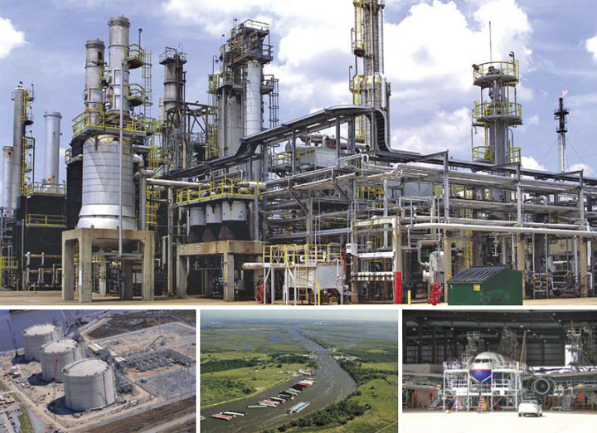
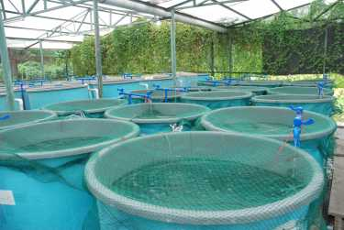
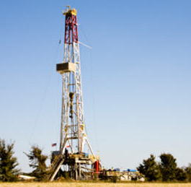
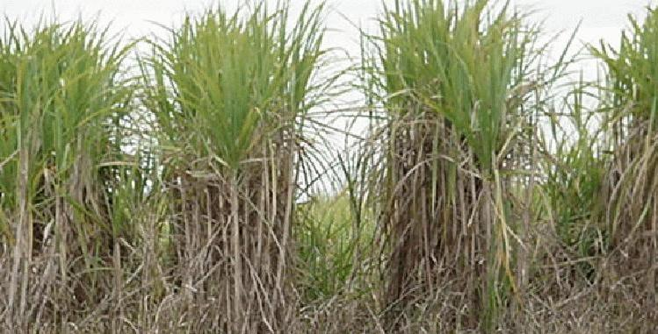
Business and Industrial Uses of Water
Notes:
Discuss other uses of public water (from left to right) – crawfish farming, livestock. industry, aquaculture, hydraulic fracture, sugarcane

Slide 5
Why does BR water taste so good?
Individual comments from area residents (quotesTigerDroppings.com,2009)
Baton Rouge has something like the 2nd best rated public water supply in the US
My dad used to bottle (his brother’s in BR) water to bring home to Shreveport . That stuff is good!
Tap water in every other city in Louisiana is not even drinkable...tap water here tastes like Dasani
Baton Rouge water is super filtered and absolutely dead soft. The soft part is pretty important. Not many places in the world can say this.
Notes:
Ask the students to share some of their own stories about what water tastes like in other areas.

Slide 6
Levels of Word Knowledge
 | I’ve never seen or heard the word before | I’ve heard or seen the word, but don’t know the meaning | I vaguely know the meaning and can assoc. it with the concept. | I know the word well, and can explain it and use it
Aquifer
Hydrologic Cycle
Groundwater
Recharge Area
Cone of depression
Saltwater intrusion or encroachment
Fault
Notes:
Students may record their individual answers, or teacher may choose to quickly poll the class with hand votes.

Slide 7
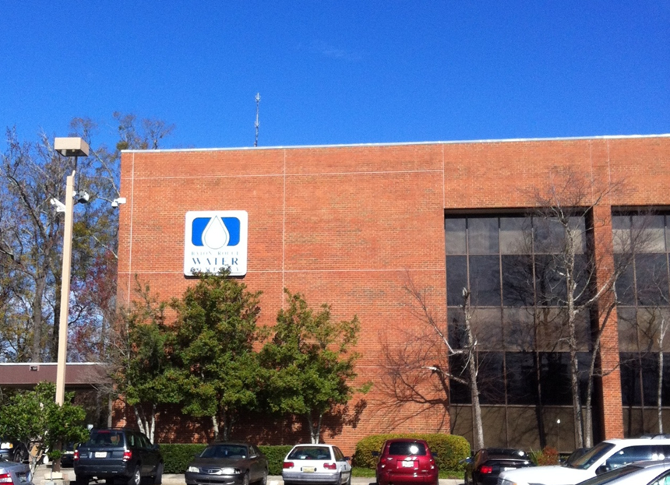
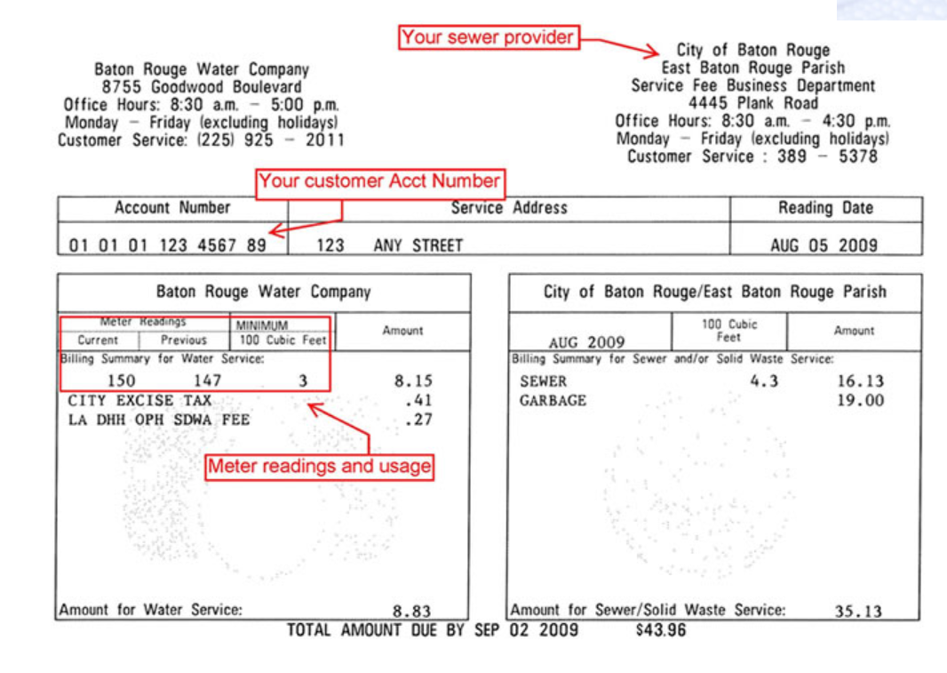
When most of us think about BR Water… we think about the company where we pay our water bill.
Notes:
Baton Rouge Water Company provides our water and the City of Baton Rouge provides sewage service – two separate companies although billed together.

Slide 8
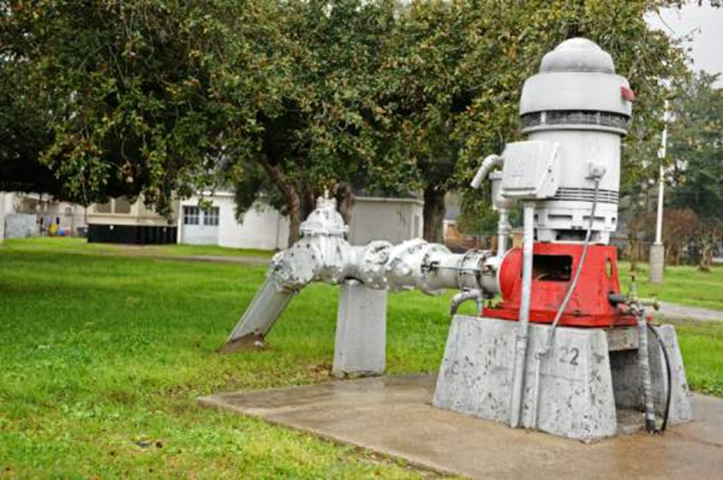
The real work of the Baton Rouge Water Co. takes place at pumps such as this one.
The Advocate
Notes:
A well at Lula Pump Station brings water from a natural source hundreds of feet underground to a treatment center in the background before the water is sent to a distribution center.

Slide 9
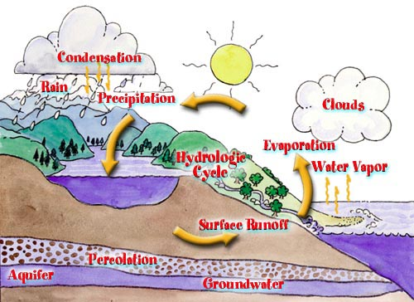
The rest of the story of the water we drink occurs far underground.
Notes:
Review the hydrologic cycle, emphasizing groundwater.

Slide 10
Groundwater stored in Aquifers
aqua = “water” + fer = “bearing”
an underground layer of rock, sediment or soil that is filled with water and allows the flow of groundwater
water is held in spaces between the rock or soil particles

Slide 11
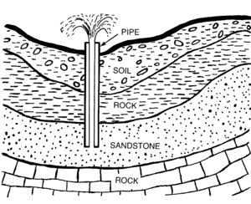
Southern Hills aquifers are composed of unconsolidated sands confined between layers of clay and silt.
Water is found in the layer with sand. Screens located at the bottom of the pipe keep the sand out while pumping.

Slide 13
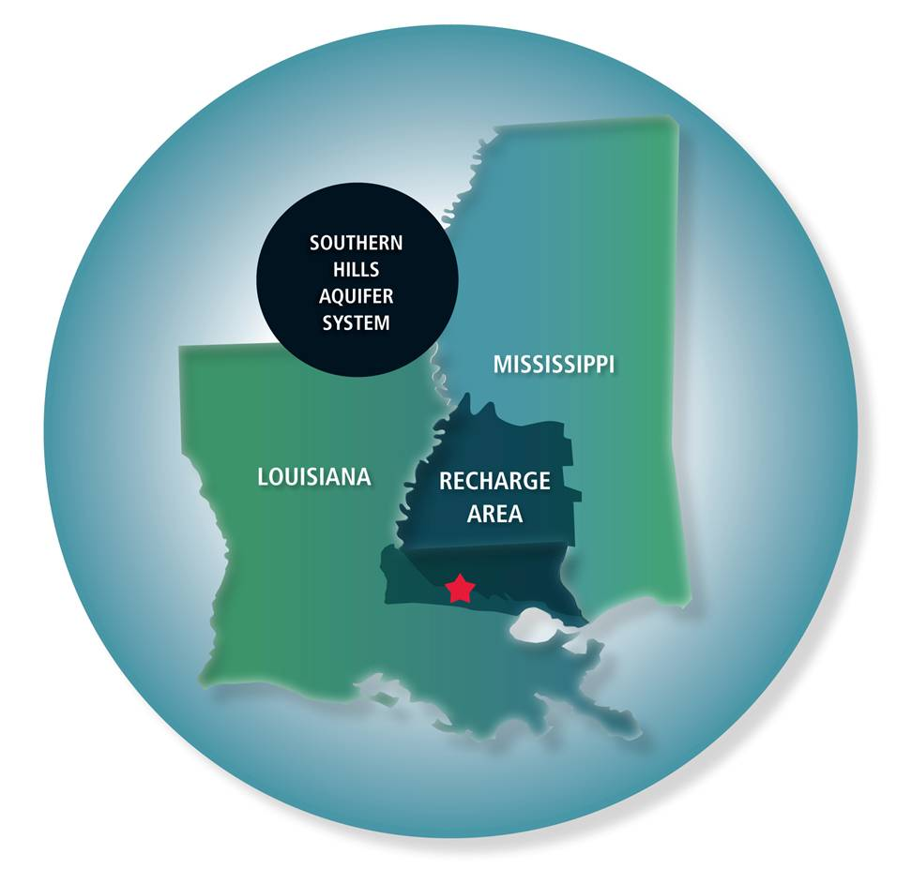
The recharge area is the area on the land which supplies the aquifer.

Slide 14
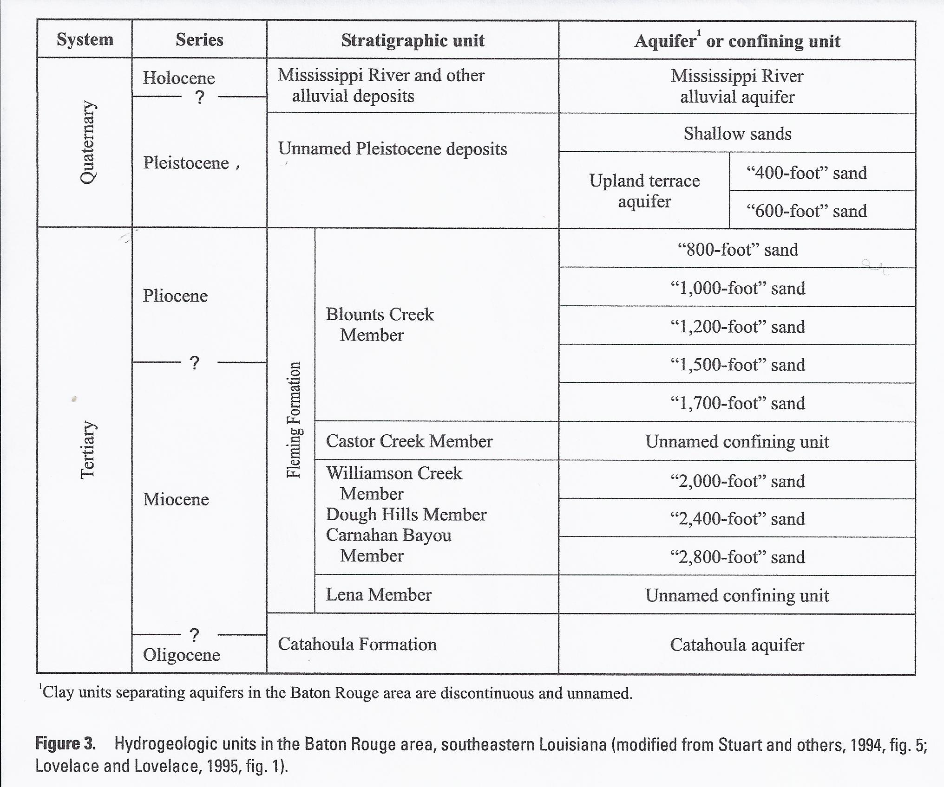
Notes:
Aquifers below Baton Rouge are named according to their depths. Point out to students the references to units of Geologic Time. (System = Period, Series = Epoch)
Older deposits are deeper and younger deposits are on top. (Law of Superposition). Have the students look at the Geologic Time Scale in their textbook in order to place these times in perspective. A stratigraphic unit is a stratum of rock or a body of strata classified as a unit on the basis of character, property, or attribute.

Slide 15
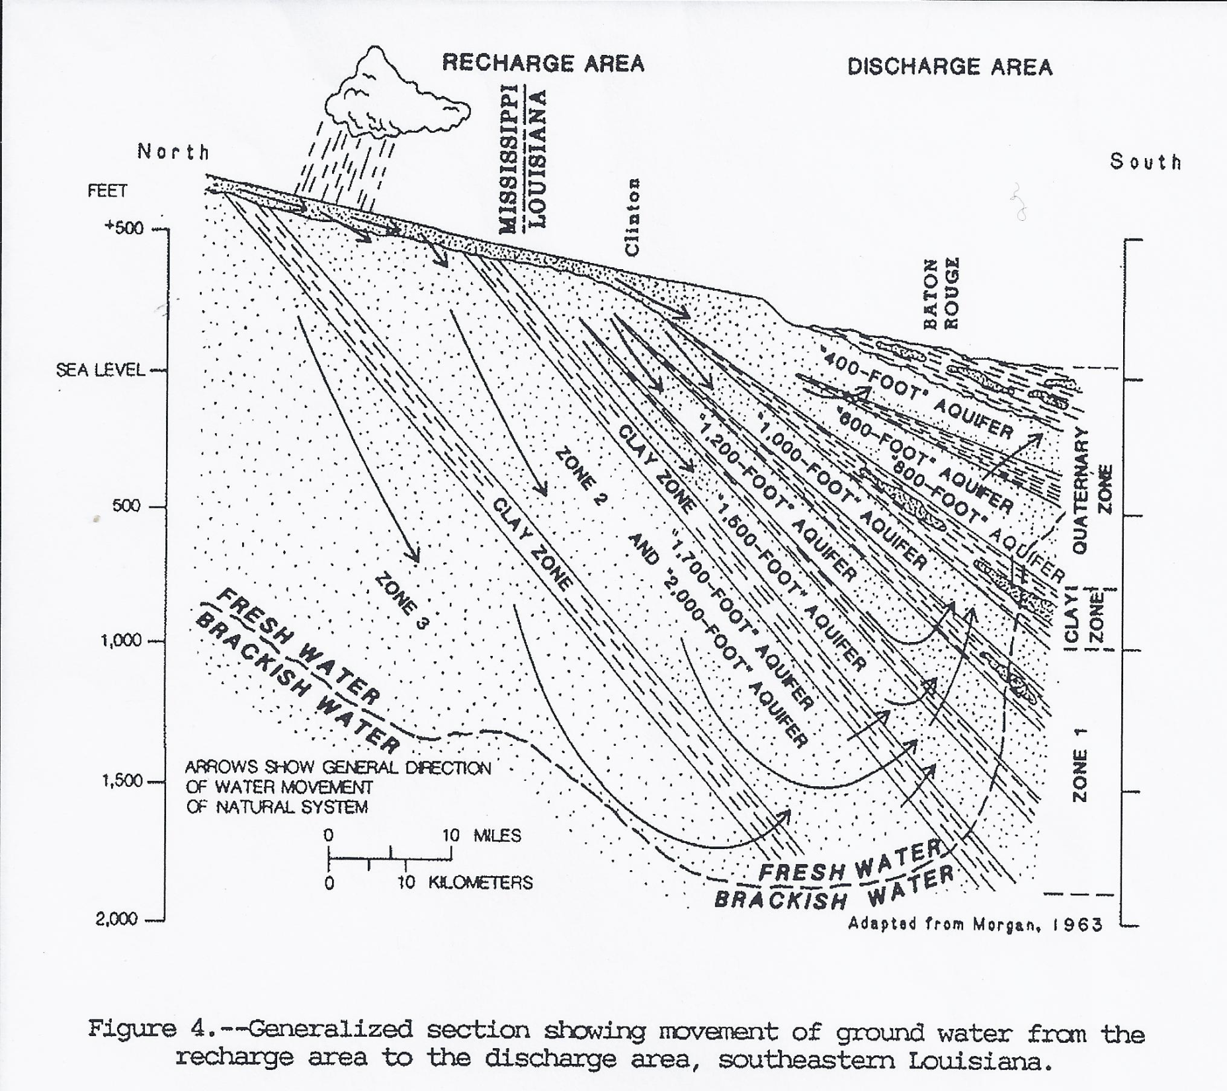
Notes:
The horizontal distance is extremely exaggerated in this diagram in order to illustrate where our aquifers are recharged and discharged. Point out to students that the aquifer slopes only appear to be very steep.

Slide 16
Groundwater Flow Rates
Groundwater movement is slow relative to surface water.
Typical rates of flow:
Ocean current = 2 miles per hour
Mississippi River = 1 - 3 miles per hour
Groundwater = ranges from tens of feet per day to one foot per year

Slide 17

Activity!
How fast is groundwater (.00002 km per hour?)
Notes:
Instructions for math calculations are included in a word file on this CD from La. Dept. of Resources.

Slide 18
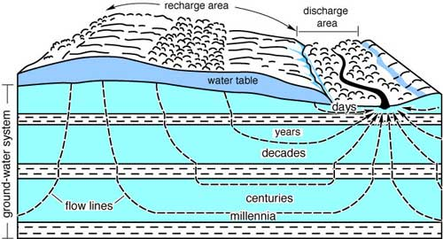
The groundwater we access today may have fallen as rain 2000 years ago!
Notes:
Groundwater flow is variable – dependent on the hydrologic gradient, the permeability, and porosity of the ground components.

Slide 19
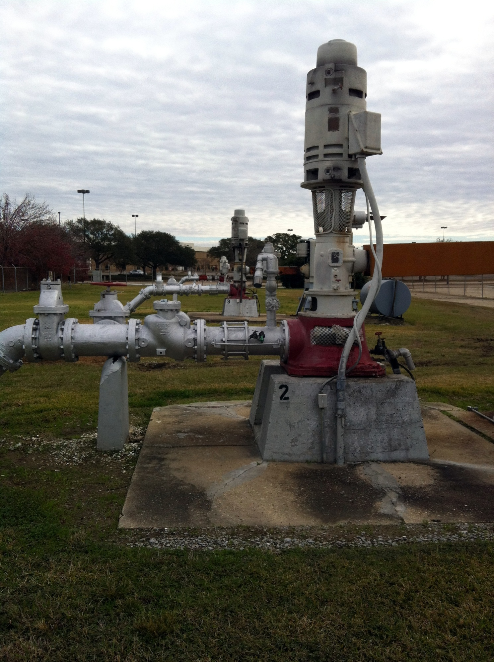
Each of these water pumps are bringing up water from the aquifers below Baton Rouge – some go as deep as 2800 feet.

Slide 20
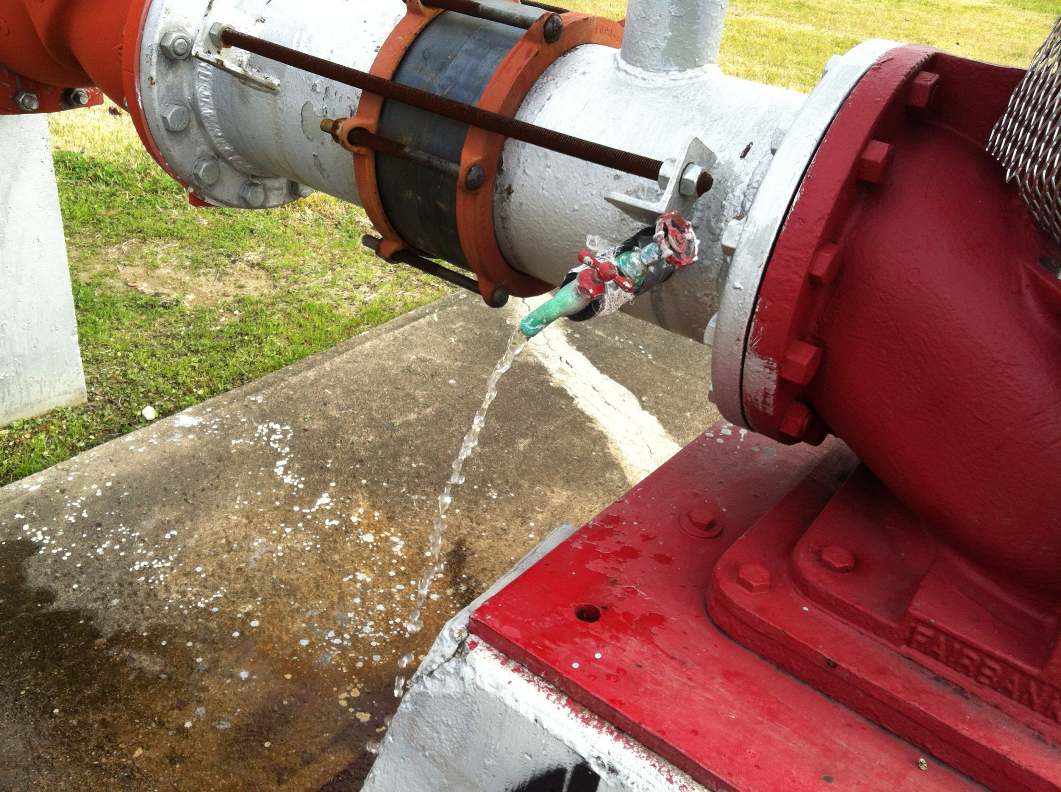
What would you guess is the temperature of the water coming straight out of the ground from 2000 feet below?
Warm!
Average 85 degrees F.

Slide 21
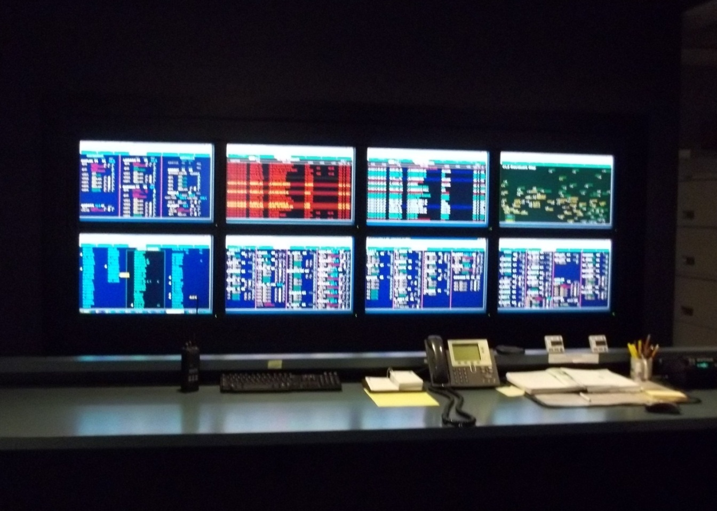
Baton Rouge Water Co. operates 97 groundwater wells in EBR Parish.
Technicians in the control room monitor a variety of pump information for all wells – 24 hours a day.
Notes:
Encourage your students to explore the Baton Rouge Water Company’s web site. They will find reports about our water as well as employment opportunities.

Slide 22
What if we are using groundwater faster than it is replaced?
When an aquifer is pumped faster than it can be replenished, a cone of depression is formed.
The cone of depression describes a three-dimensional inverted cone surrounding the well that represents the volume of water removed as a result of pumping.
Notes:
Cones of depression play a large roll in saltwater intrusion which is introduced later in this power point, so it is important for students to grasp this concept.

Slide 23
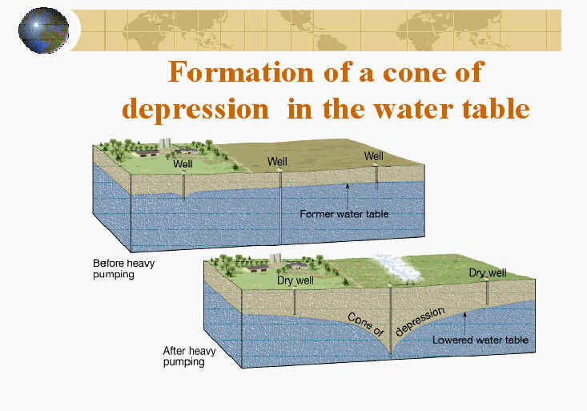
The cone of depression is like a “valley” in the water table with a vertical drop in the height between the water level in the well prior to pumping and the water level in the well during pumping.

Slide 24
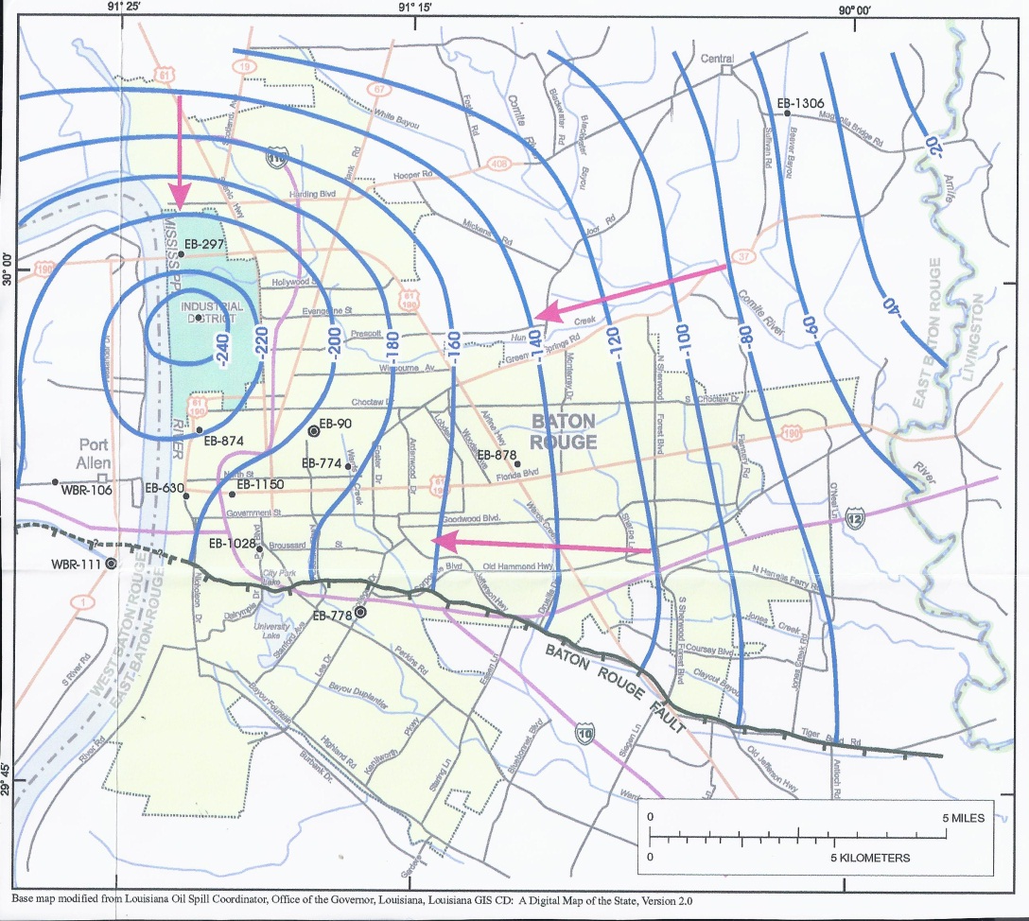
2000 foot aquifer
Lowest water level
A cone of depression on a static water level map. The lowest water levels are in the circular contour line marked -240 feet.
Notes:
Emphasize to students that this is a map of water levels in one aquifer. Blue lines (Potentiometic Contour) show the water level within the 2000 ft aquifer “sinks” to -240 ft in the Baton Rouge Industrial District. Reference the topographic contour lines that students are familiar with to assist in their understanding that these lines represent slope. Topographic contour lines represent slope of the terrain and potentiometric contour lines represent water level. As on land, water will flow from high pressure to low pressure and in response to gravity (“downhill”)

Slide 25
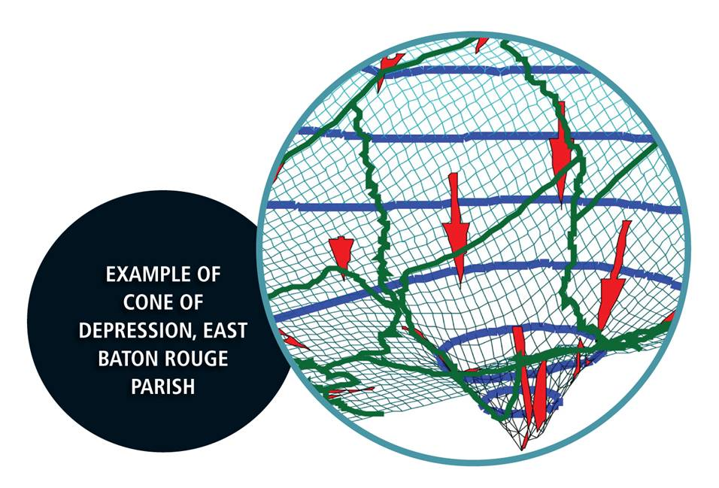

Slide 26
There are two substantial cones of depression in Baton Rouge
1500 foot sands – water level has dropped approximately 175 feet since 1945
2000 foot sands – water level has dropped approximately 240 feet since 1945
Managing Louisiana’s Groundwater Resources, Louisiana Groundwater Resources Commission, March 2012

Slide 27
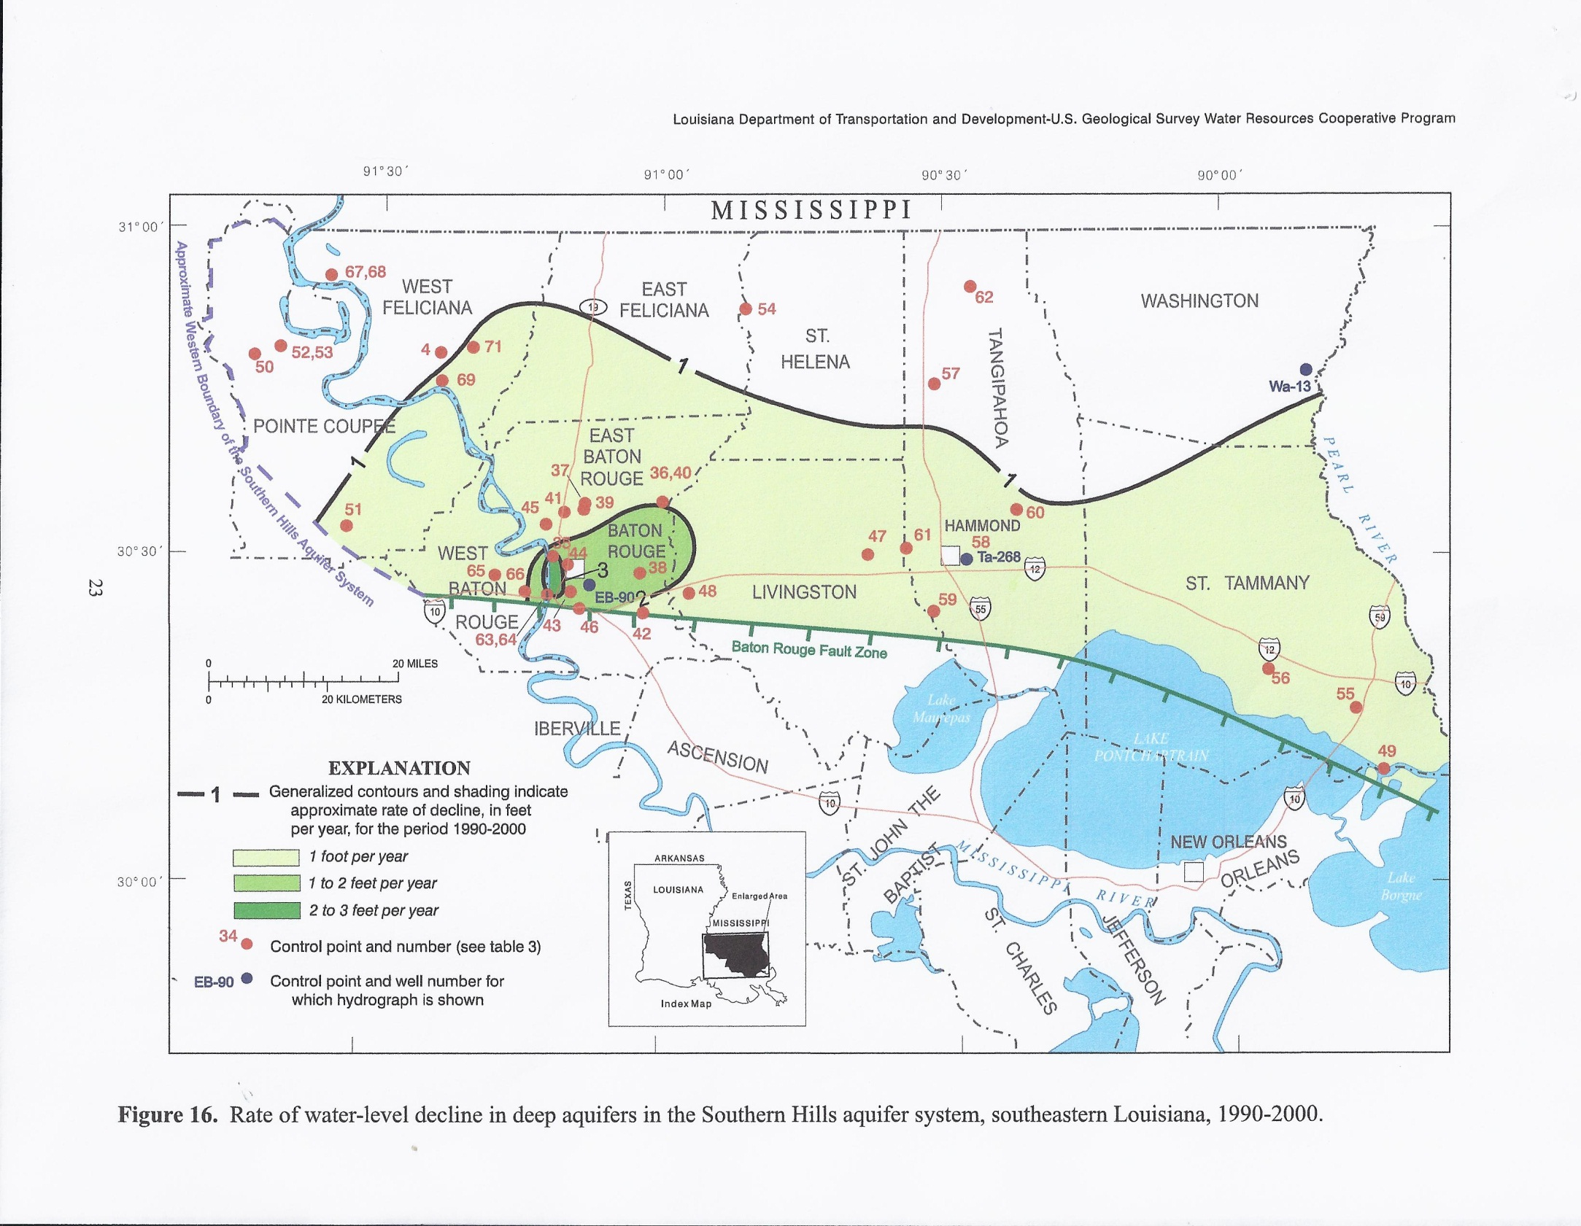
Darker green areas indicate regions with the greatest groundwater level declines.
Tomaszewski, 2002

Slide 28
Activity!
Draw a static water level map from a model of a cone of depression.
How do static water level maps compare with topographic maps?
Notes:
Instructions and hand-outs are included on the CD provided by the La. Department of Resources.

Slide 29
Is our groundwater clean?
Groundwater contamination occurs when products such as gasoline, oil, road salts and chemicals get into the groundwater and cause it to become unsafe and unfit for human use.
Some of the major sources of these products are storage tanks, septic systems, hazardous waste sites, landfills, and the widespread use of road salts, fertilizers, pesticides and other chemicals.

Slide 30
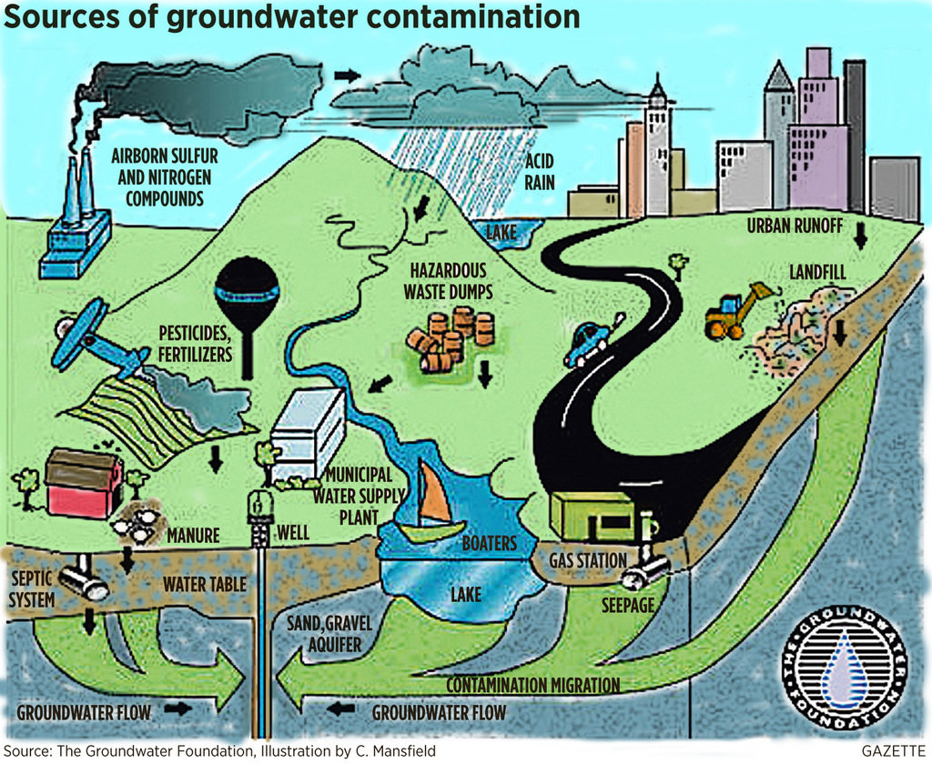
Notes:
Use this diagram to review point and non-point pollution sources.

Slide 31
Drinking Water Guidelines
There are many federal guidelines that must be followed to ensure safe drinking water supplies.
Water quality data for community water systems throughout the United States is available at:
www.epa.gov/safewater
Baton Rouge data is also found:
www.batonrougewater.com

Slide 32
Saltwater threat to BR Water
“Saltwater encroachment has been detected in six aquifers, including the “1,500-foot” and “2,000-foot” sands, north of the Baton Rouge fault in East Baton Rouge Parish. The encroachment is in response to ground-water
withdrawals, primarily for public supply and industrial uses, in Baton Rouge.”
USGS Louisiana Water Science Center (LAWSC)

Slide 33
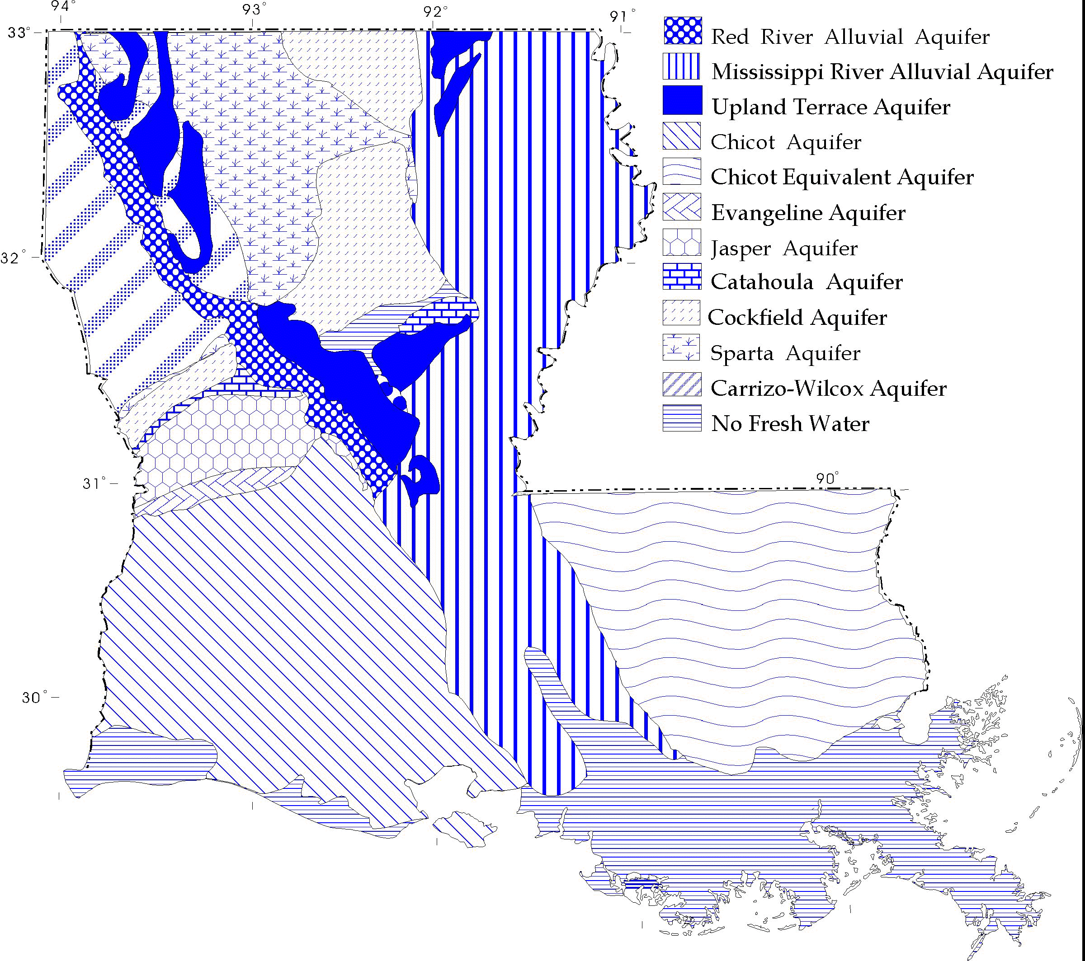
Where does the saltwater come from?
Aquifers in South Louisiana are filled with saltwater—left behind from ancient oceans

Slide 34
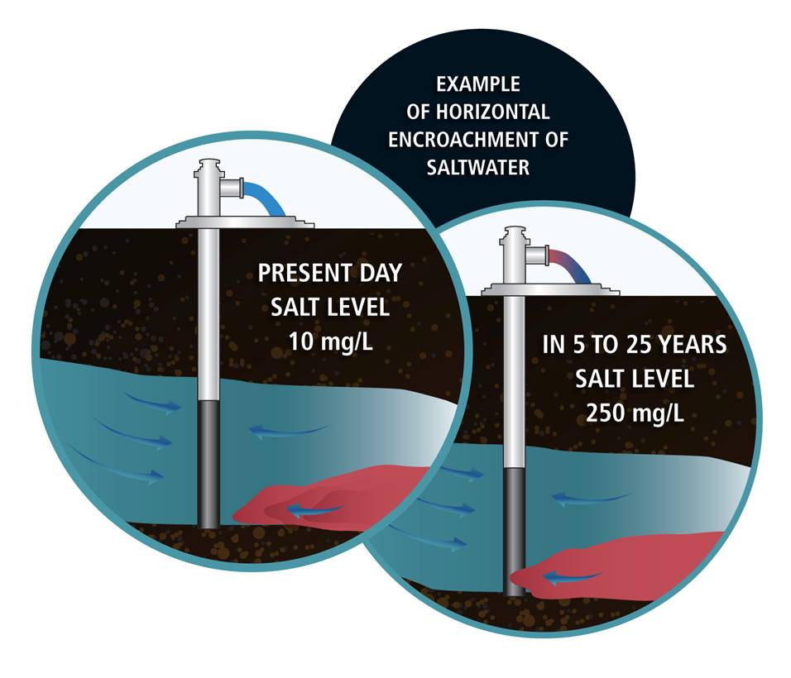
Denser saltwater moves underneath the freshwater
Notes:
Because saltwater is denser than freshwater, saltwater forms a wedge along the base of the aquifer. Water withdrawn from the well is a mixture of water from various depths within that aquifer as it enters the screen that may be 20 or 30 feet long.

Slide 35
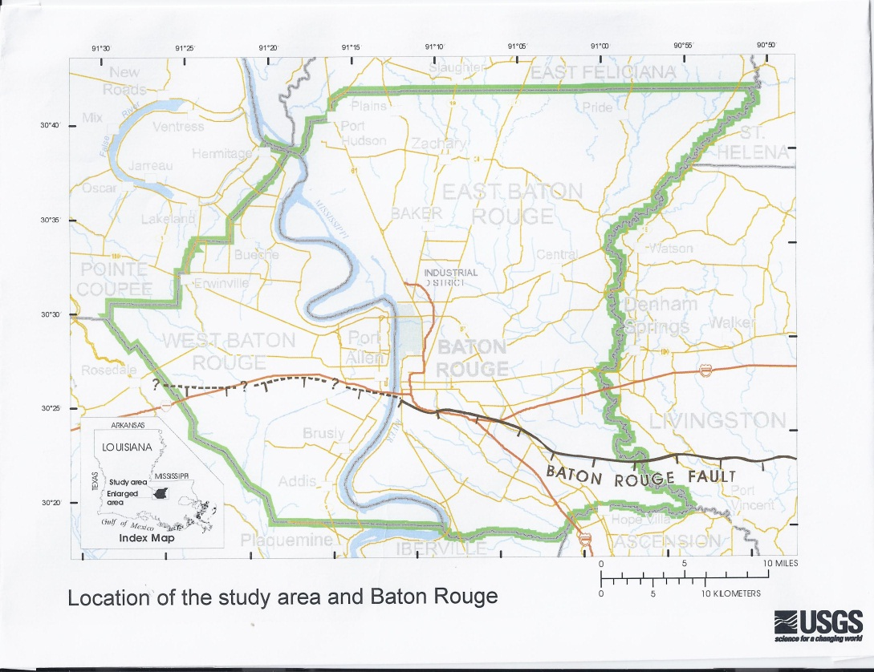
The Baton Rouge fault has served as a barrier between freshwater to the north and saltwater to the south.

Slide 36
1500 foot Aquifer
SALTWATER AQUIFERS South of Baton Rouge fault
If saltwater is in the aquifer next to the aquifer with a cone of depression, the saltwater will intrude into the freshwater aquifer, crossing the Baton Rouge fault.

Slide 37
Pink sections represent regions in which salt water intrusion has been documented.
Notes:
Point out the differences in fresh and salt water on either side of the fault. Saltwater intrusion has been documented in more than ½ of the aquifers below Baton Rouge.

Slide 38
The fault line is described as a “leaky barrier” to saltwater intrusion – meaning that most of the groundwater containing saltwater is kept to the south of the fault. However; the increase in the pumping of our freshwater has resulted in a larger cone of depression. Therefore, saltwater is “leaking” through the fault zone as it follows lowered water pressures.

Slide 39
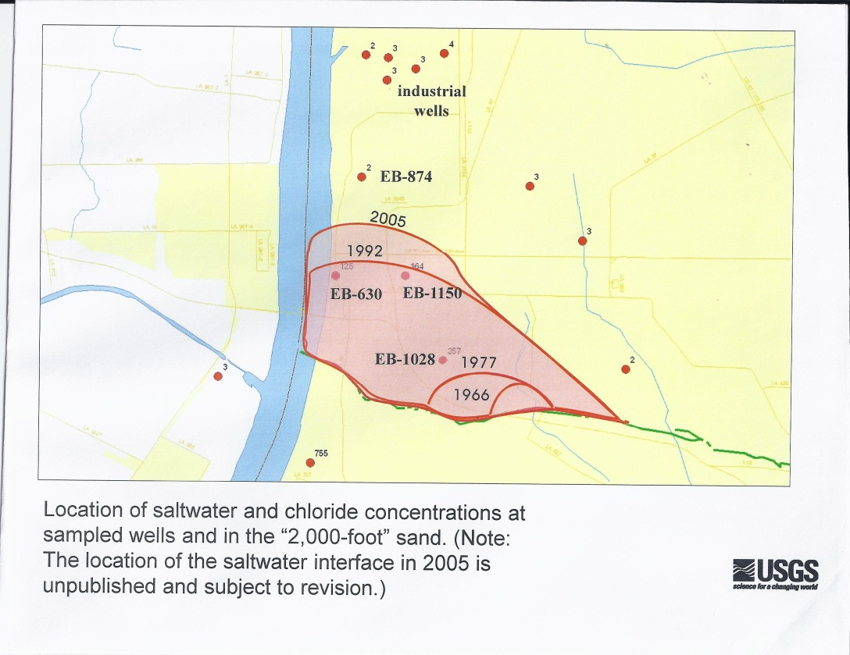
Green line is the BR fault.
Mapping of saltwater intrusion in the 2000 foot aquifer from 1966-2005. The pink regions are areas where samples have been positive for saltwater.
Notes:
EB - #’s all specific well numbers

Slide 40
Mapping of saltwater intrusion in the 1500 foot sand

Slide 41
“The state is facing a future in which water, even in Louisiana, will be a scarce resource that will demand a well-thought-out and integrated approach to stewardship…”
“A Defining Resource: Louisiana’s Place in the Emerging Water Economy” by Mark Davis and James Wilkins (Loyola Law Review, 2011)
Notes:
Encourage your students to follow news stories about saltwater intrusion in Baton Rouge.

Slide 42
Activity!
Groundwater by the Numbers!
Match the cards with numerical values with their groundwater descriptions.
Notes:
Cards to cut out are included on the CD provided by the La. Dept. of Natural Resources. Emphasize to students that you did not expect them to memorize exact values, but they should be able to apply number sense of size and scale for correct matching.

Slide 43
References
Baton Rouge's Skyline. Oct. 9, 2008 Wikipedia, http://en.wikipedia.org/wiki/File:OKC_BatonRougeSkyline.JPG (Nov. 23, 2012).
Baton Rouge Tiger Droppings , 3 Nov. 2009. http://www.tigerdroppings.com/rant/p/16113325/why-does-baton-rouge-tap-water-taste- (Nov. 23, 2012).
Baton Rouge Water Company. http://www.brwater.com/ (Nov. 23, 2012).
Groundwater Contamination. Apr 7, 2010. “Spring Rains Offer Reminder to Help Protect Groundwater from Contamination. Michigan Live, http://www.mlive.com/news/kalamazoo/index.ssf/2010/04/spring_rains_offer_reminder_to.html. (Nov. 23, 2012)

Slide 44
References
Ground Water Resources Commission Meeting. Dec. 2009. Department of Natural Resources, http://dnr.louisiana.gov/assets/docs/conservation/documents/20091202-presentation.pdf (Jan. 28, 2013).
Hydrogeologic Columns. Department of Environmental Quality, http://www.deq.louisiana.gov/portal/Portals/0/evaluation/aeps/gwbroch2-3.gif (Nov. 23, 2012).
Hydrologic Cycle, Cone of Depression. Fayette County Groundwater Conservation District. http://www.fayettecountygroundwater.com/educational_info.htm (Nov. 23, 2012).
Hydraulic Fracturing. Environmental Protection, n.d. http://eponline.com/portals/hydraulic-fracturing.aspx
(Nov. 23, 2012)

Slide 45
References
Industry. Mar. 2009. “Southwest Louisiana” Site Selection Magazine, http://www.siteselection.com/features/2009/mar/sw-louisiana/ (Nov. 23, 2012).
Lovelace, John K. Dec. 2007. Chloride Concentrations in Ground Water in East and West Baton Rouge Parishes, Louisiana, 2004–05. Rep. USGS Scientific Investigations Report 2007-5069., http://pubs.usgs.gov/sir/2007/5069/ (Nov. 23, 2012).
LAWSC Project. Simulation of Groundwater Flow in the "1,500-Foot" and "2,000-Foot" Sands and Movement of Saltwater in the “2000-Foot” Sand of the Baton Rouge Area, Louisiana. http://la.water.usgs.gov/projects.html (Jan. 3, 2013).

Slide 46
References
Prakken, L.B., 2004, Louisiana ground-water map no. 17: Generalized potentiometric surface of the Kentwood aquifer system and the "1,500-foot" and "1,700-foot" sands of the Baton Rouge area in southeastern Louisiana, March-April 2003 http://la.water.usgs.gov/publications/pdfs/SIM_2862.pdf
(Jan. 27, 2013)
Tomaszewski, John K., John K. Lovelace, and Paul A. Ensminger. 2002."Water Withdrawals and Trends in Ground-Water Levels and Stream Discharge in Louisiana." USGS.

