Slide 1
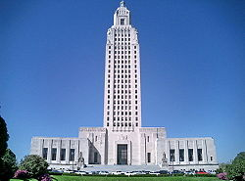
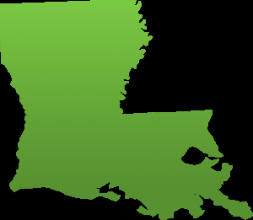
Baton Rouge Groundwater- a Valuable Natural Resource:
Can we ensure its sustainability?
Notes:
Question the students to probe what they know about the meaning of sustainability.

Slide 2
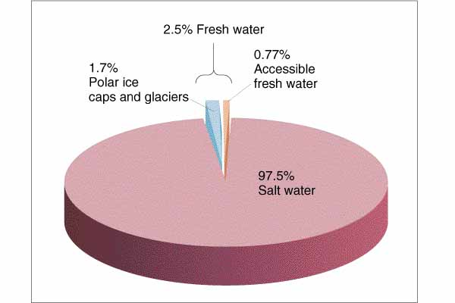
2.5% Freshwater
Notes:
To give the students an additional visual to compare amounts of freshwater to saltwater – take a gallon of water, which represents all the water on Earth. Remove 5 tablespoons – the amount of freshwater. Point out that a little less than half of that is available for use.

Slide 3

The water we drink in Baton Rouge:
comes from the Southern Hills aquifer system deep below the surface of the earth.
is naturally filtered through layers of soil, rock, and sand.
entered the ground around central and southwest Mississippi hundreds of years ago.

Slide 5
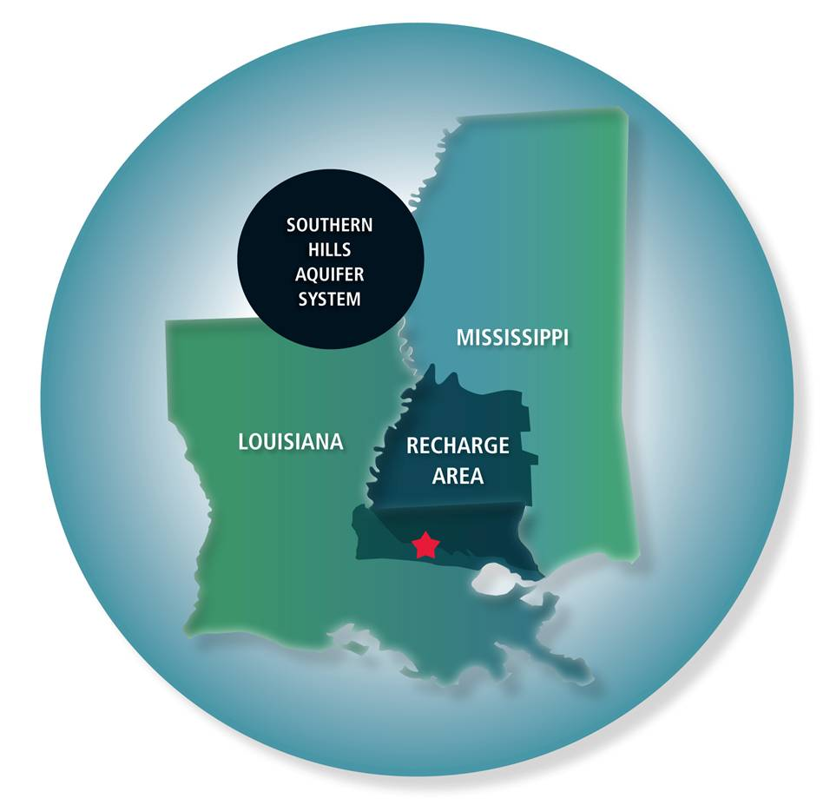
Notes:
The recharge area is the region that supplies the aquifer through rain and surface water.

Slide 6
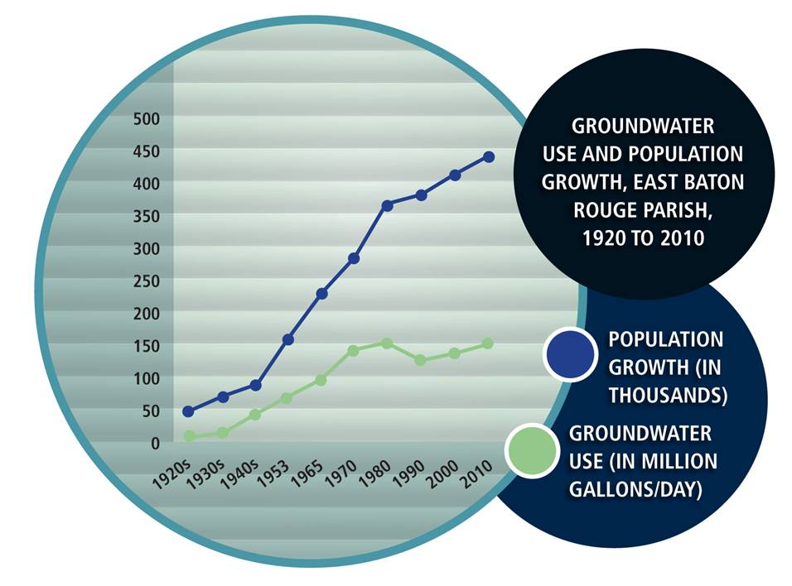
Notes:
The first Earth Day was celebrated on April 22, 1970 – which many mark as the birth of the modern environmental movement. Point out that as the graph shows – water conservation efforts have been effective; however, as populations continue to grow, additional efforts are required in order to meet the additional demands.

Slide 7
Who uses the groundwater in Louisiana?
Notes:
Ask the students if they foresee any future changes in Louisiana water use. For example, aquaculture has shown recent growth and will likely continue as the technology improves.

Slide 8
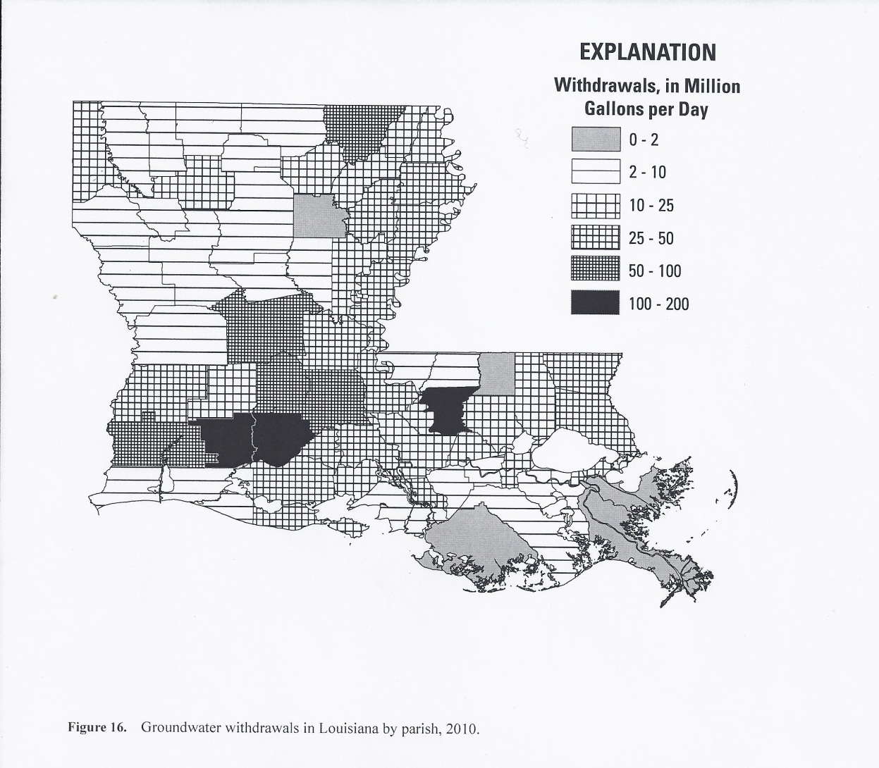
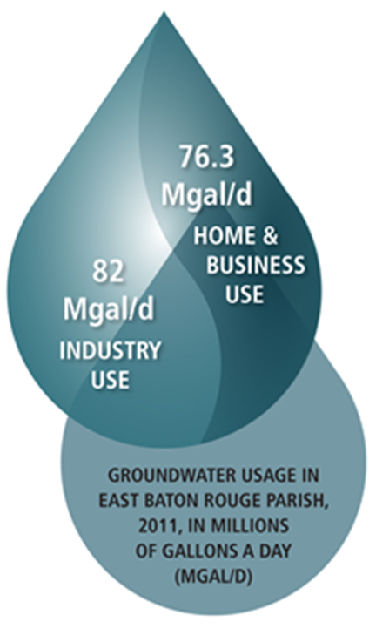
Groundwater withdrawals from EBRP
Groundwater withdrawals in Louisiana by parish
Notes:
Assist the students in picking out parishes they are familiar with. Point out where New Orleans is and ask why their groundwater use is significantly less than EBR. Southern parishes do not have direct access to fresh groundwater. Those aquifers are predominately saltwater.

Slide 9
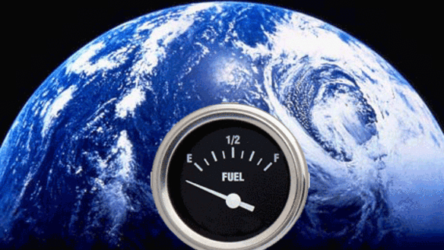
Our planet Earth has limits.
motherboard.tv
Notes:
Remind the students that renewable resources are only renewable if used in sustainable quantities.

Slide 10
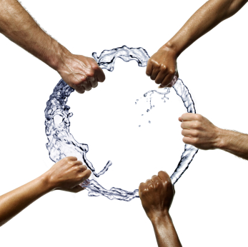
Regulation and Management of Groundwater Resources
Important to:
Ensure the quantity of water used is sustainable for the future
Ensure the quality of water is safe to drink
Notes:
Remind students of the lessons learned from Garrett Hardy’s Tragedy of the Commons –when no one takes responsibility for the use of natural resources, everyone loses. Hardy’s article described an unregulated public grazing field for cattle in which resources were quickly depleted.

Slide 11

1974 Louisiana Constitution
Article IX, Section 1, (Natural Resources and Environment; Public Policy)
The natural resources of the state, including air and water, and the healthful, scenic, historic, and esthetic quality of the environment shall be protected, conserved, and replenished insofar as possible and consistent with the health, safety, and welfare of the people. The legislature shall enact laws to implement this policy.
Notes:
Have the students read this several times, very carefully. All legislation in Louisiana must conform to The Louisiana Constitution.

Slide 12
Who owns groundwater?
If you are the landowner – you do!
Louisiana’s “Rule of Capture” gives each landowner the right to capture an unlimited amount of groundwater by tapping into the underlying aquifer.

Slide 13
Civil Code Article 490. Accession above and below the surface.
Unless otherwise provided by law, the ownership of a tract of land carries with it the ownership of everything that is directly above or under it. The owner may make works on, above, or below the land as he pleases, and draw all the advantages that accrue from them, unless he is restrained by law or by rights of others. Acts 1979, No. 180, Sec. 1.
Notes:
Challenge students to research how Louisiana surface water legislation is different from our groundwater legislation. Students may also do a comparison of other states, such as Texas or California, manage water resources.

Slide 14

Who manages our groundwater?
at least 4 federal agencies, eight state agencies, two groundwater conservation districts and more than 700 local entities
Notes:
In the following slides, students will learn about some of the groups that manage groundwater. Point out the large numbers of different interests represented in the management of water (and other natural resources). Discuss who might be stakeholders in groundwater management and why.

Slide 15

La. Department of Natural Resources
The mission of the Louisiana Department of Natural Resources (DNR) is to preserve and enhance the nonrenewable natural resources of the state, consisting of land, water, oil, gas, and other minerals, through conservation, regulation, management and development to ensure that the state of Louisiana realizes appropriate economic benefit from its asset base.
Notes:
Challenge the students to research who leads departments in our state government. Are they elected or appointed?

Slide 16
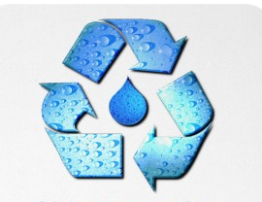
The Office of Conservation's Ground Water Resources Program manages the State's ground water resources addressing aquifer sustainability and resource conservation issues related to ground water withdrawal.

Slide 17
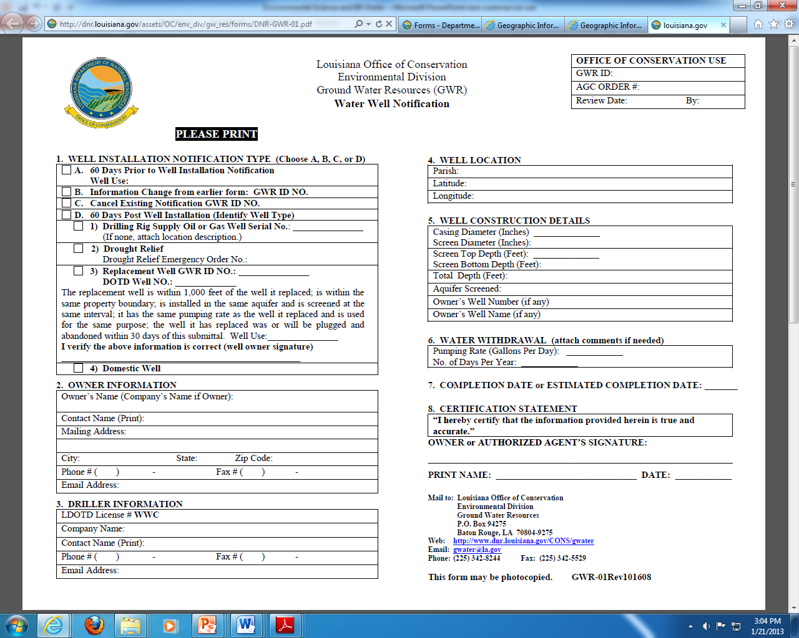
A water well notification form must be submitted to the La. Office of Conservation
Notes:
Although most individuals would not want to, interesting to know that you could install your own water well. Current cost of Baton Rouge water is about 1 cent for 5 gallons. Groundwater is free – we pay for the infrastructure to pump it from the ground and bring it to our homes.

Slide 18

Department of Environmental Quality
Enforces the Clean Water Act and protects groundwater and surface water resources from contamination
Clean Water Act (CWA), is to restore and maintain the chemical, physical, and biological integrity of the nation's waters by preventing point and nonpoint pollution sources.
Notes:
The Clean Water Act -- federal legislation passed in 1972 with developing concern over water pollution.

Slide 19
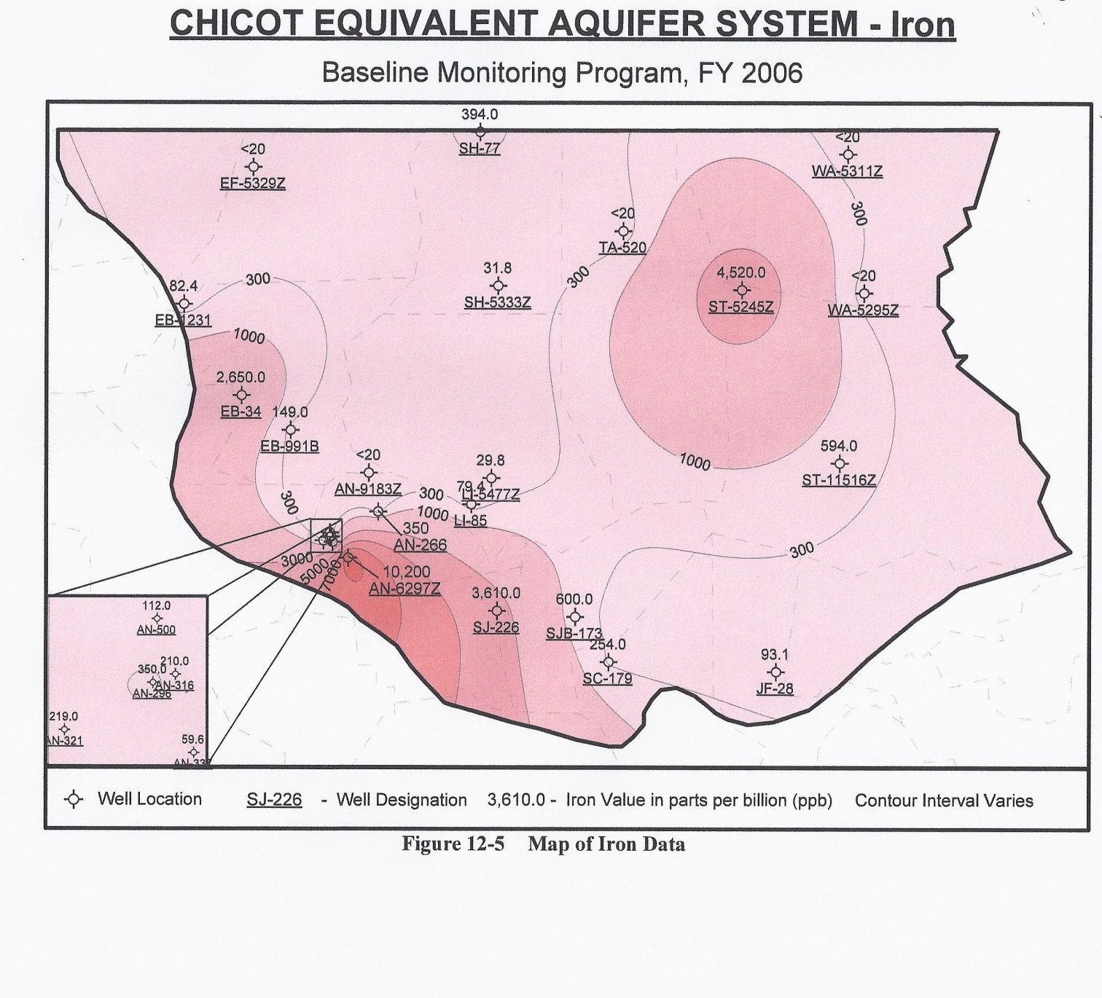
DEQ maintains records on levels of natural components of groundwater in addition to looking for signs of contaminants.
Notes:
DEQ monitors ground and surface water for a number of indicators such as mercury, sulfates, fecal coliforms, dissolved oxygen, chlorides, nitrates, and pH. These records are assessable on their website.

Slide 20

The Department of Health and Hospitals: Office of Public Health
Safe Drinking Water Program monitors the 1,403 public drinking water systems throughout Louisiana to ensure compliance with state and federal drinking water regulations.
This surveillance helps prevent waterborne disease outbreaks or chemical exposure associated with contaminated drinking water
Notes:
The Safe Drinking Water Act was originally passed by Congress in 1974. It is the main federal law that ensures the quality of Americans' drinking water. Under SDWA, EPA sets standards for drinking water quality and oversees the states, localities, and water suppliers.

Slide 21
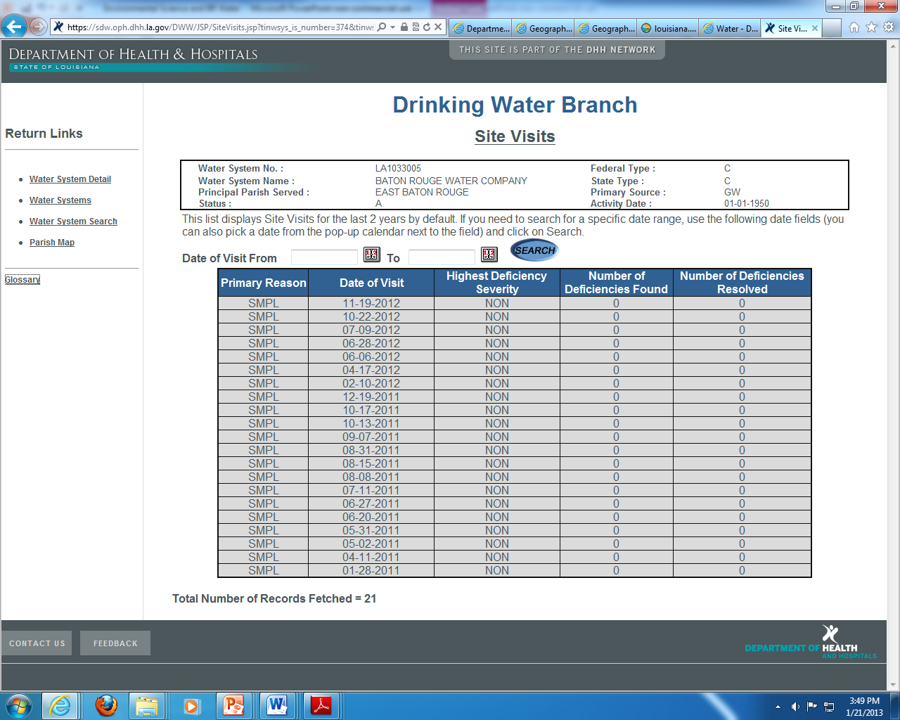
Reports from DHH show dates of water samples collected and results
Notes:
Additional reports are assessable at the DHH website.

Slide 22
United States Geological Survey (USGS)
The USGS serves the Nation by providing reliable scientific information to describe and understand the Earth; minimize loss of life and property from natural disasters; manage water, biological, energy, and mineral resources; and enhance and protect our quality of life.
The Louisiana Water Science Center is a division of USGS that provides us with specific information on our groundwater.
Notes:
Most of the scientific research on BR groundwater has been provided by scientists working at the USGS Louisiana Water Science Center in Baton Rouge. In Louisiana, USGS also has offices in Lafayette.

Slide 23
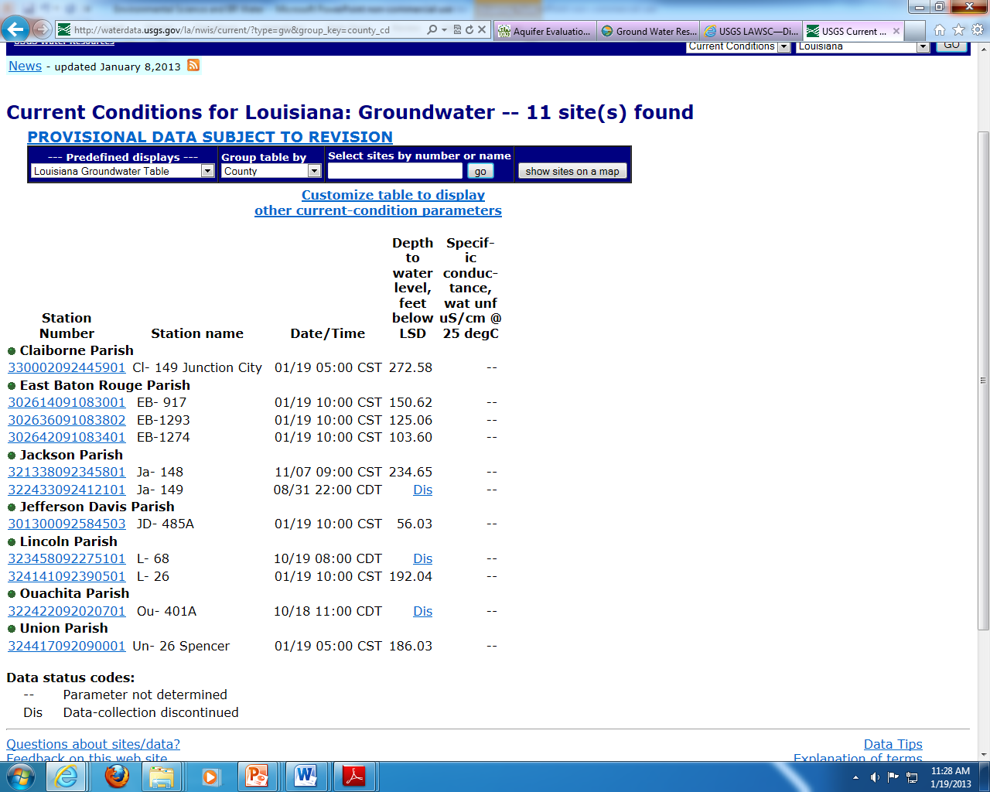
USGS provides many reports such as this one – current water levels at specific well sites in Louisiana.

Slide 24
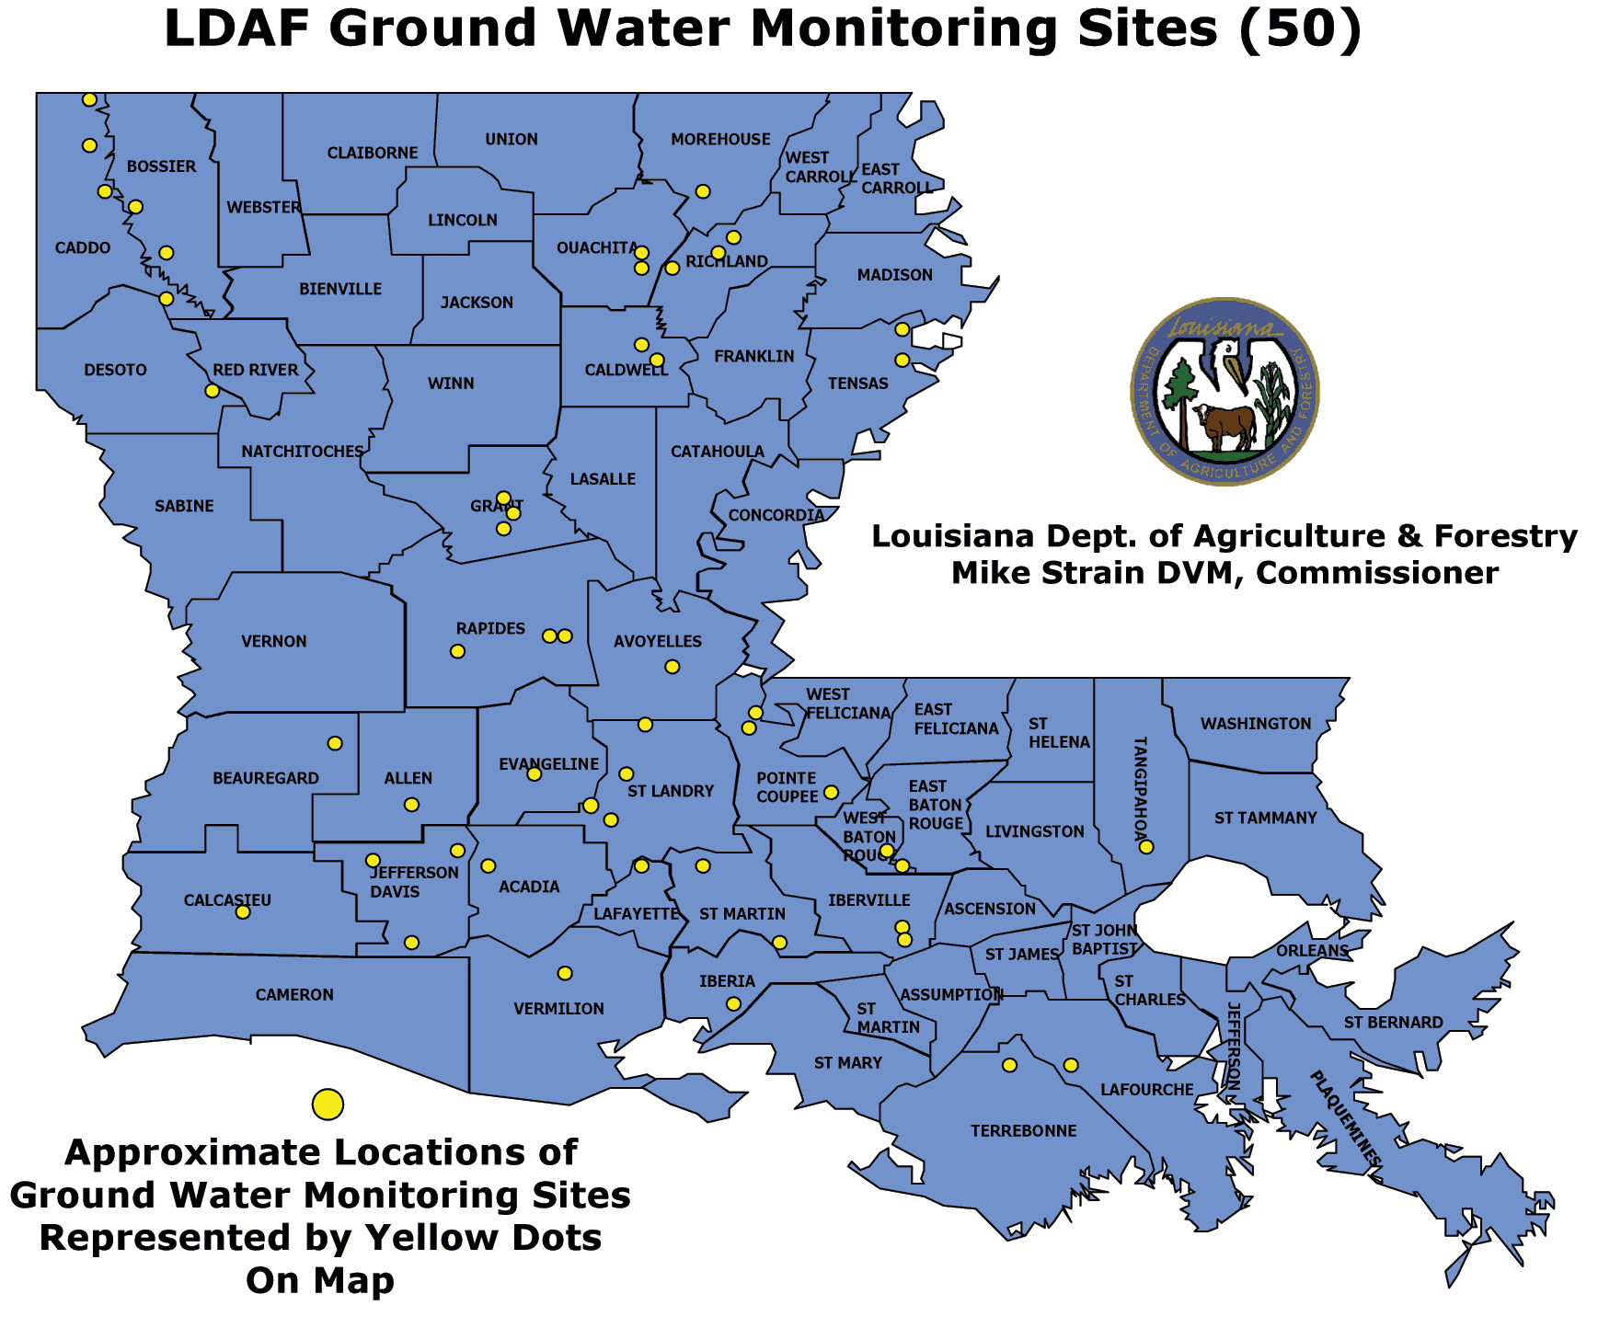
La. Department of Agriculture and Forestry monitors groundwater for pesticide contamination

Slide 25
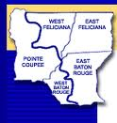
Capital Area Ground Water Conservation Commission
Function: promote the orderly development of the ground-water resources in the Capital Area District and to protect the quality of these resources
Composition: 15 Board members representing state government, district parishes, and groundwater users and stakeholders
Notes:
The Capital Area Ground Water Conservation Commission was created by La. Legislature in 1974. Meeting agendas and newsletters demonstrate their concerns of saltwater encroachment. These may be assessed at their website.

Slide 26
Problem: Our freshwater aquifers are threatened by the encroachment of saltwater.
Notes:
Because saltwater is denser than freshwater, saltwater forms a wedge along the base of the aquifer. Water withdrawn from the well is a mixture of water from various depths within that aquifer as it enters the screen that may be 20 or 30 feet long.

Slide 27
“Saltwater encroachment has been detected in six aquifers, including the “1,500-foot” and “2,000-foot” sands, north of the Baton Rouge fault in East Baton Rouge Parish. The encroachment is in response to ground-water
withdrawals, primarily for public supply and industrial uses, in Baton Rouge.”
USGS Louisiana Water Science Center (LAWSC)

Slide 28
What does the data tell us?
Notes:
The chart on this page is one of many that can be found in USGS Publications. EB (wells in East Baton Rouge and WBR (wells in West Baton Rouge. Point out the last 2 columns which report the specific conductance and chloride concentration – both indicators of saltwater intrusion.

Slide 29
Red dots mark water well sites that have been monitored for saltwater content.
Mississippi River – Downtown Baton Rouge

Slide 30
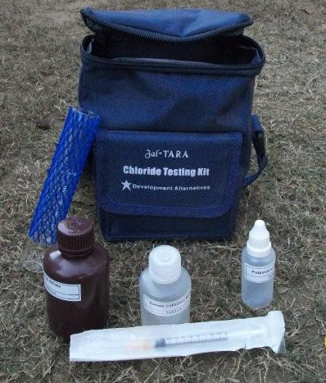
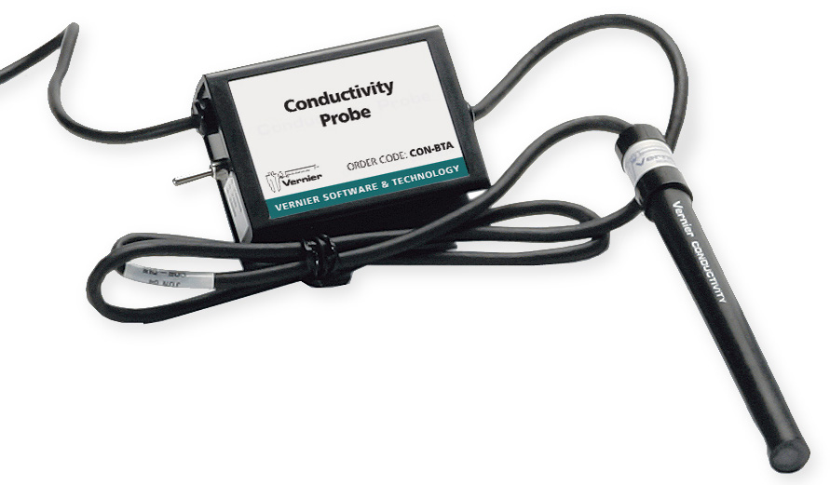
Scientists test water samples for chloride ions and conductivity in order to track saltwater intrusion.
Although seawater is composed of a multitude of dissolved substances, chloride ions are abundant and easily tested for. (usually from NaCl, KCl, or CaCl₂)
Higher salinities demonstrate higher conductivity

Slide 31
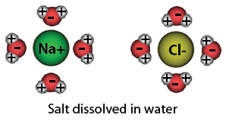

Chloride vs Chlorine
Chloride is an ion (Cl⁻) and is a component of common salt and is found in seawater.
Chlorine is a molecule (Cl₂) and is often added to water to disinfect and kill bacteria
Notes:
Important to distinguish between chloride and chlorine – both are important to monitor for water quality.

Slide 32
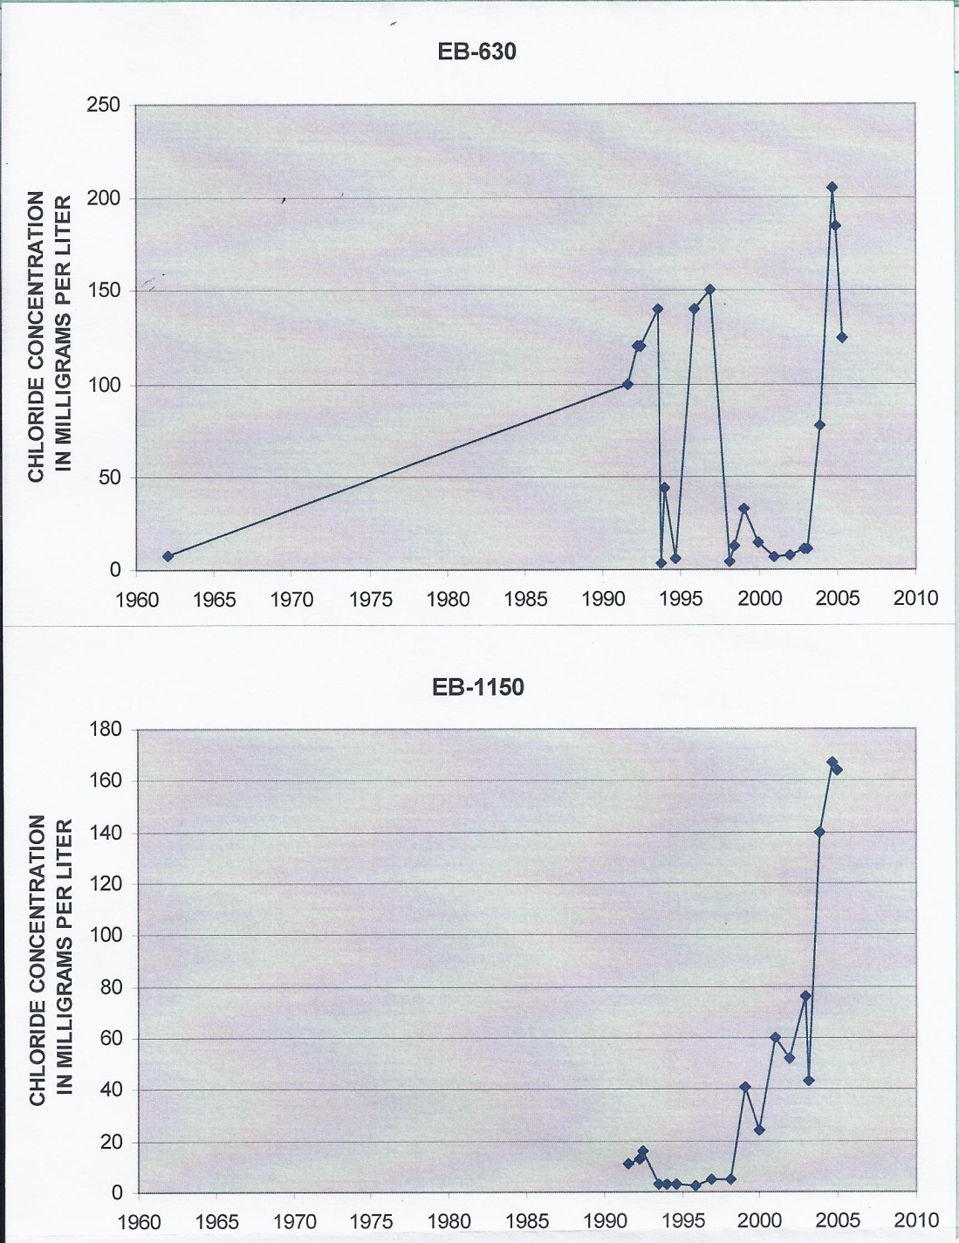
Well identification number
Graphs of chloride concentrations in 2 downtown Baton Rouge public supply wells screened in the “2,000-foot” sand.
A chloride concentration of less than 250 mg/l is the drinking water standard.
Notes:
Point out to the students the different chloride concentration scales used in each graph – each creates a different visual representation and cannot be directly compared.

Slide 33
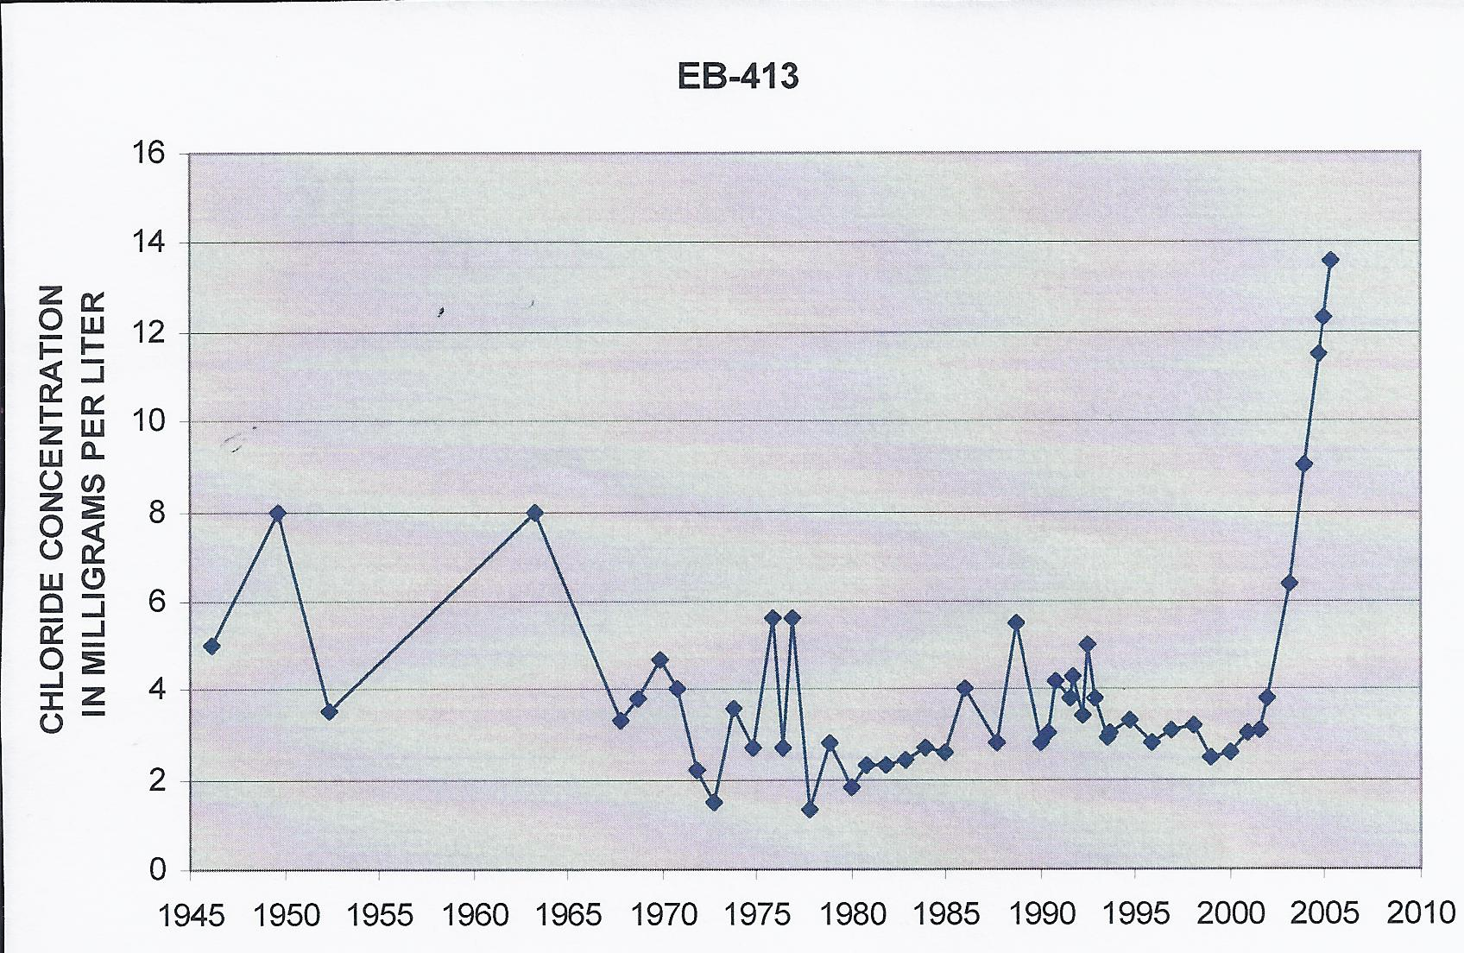
Graph of chloride concentration in a well from the 1500 foot sand

Slide 34
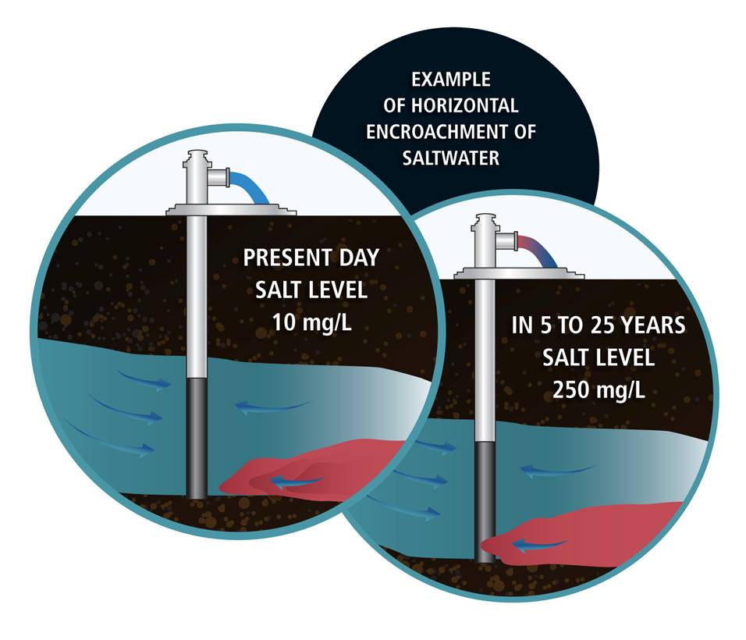

Slide 35
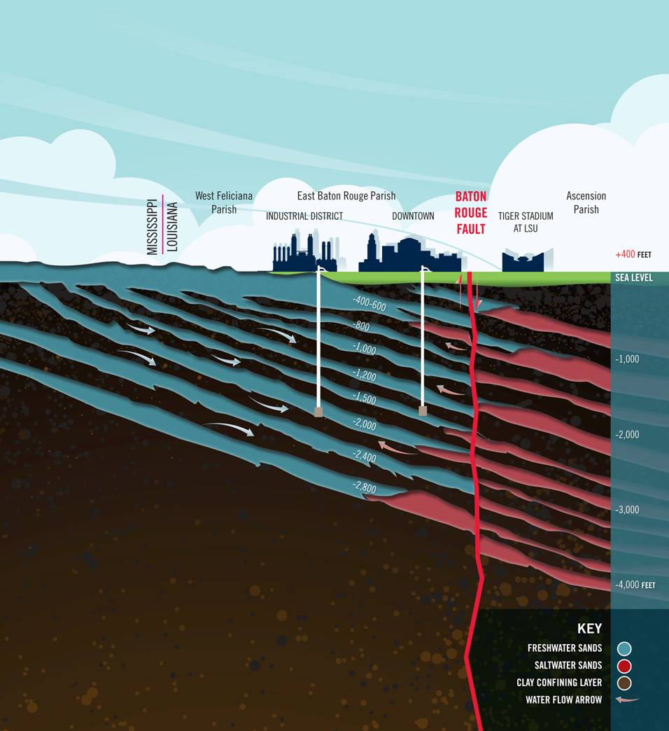
Red sections represent regions in which salt water intrusion has been documented.

Slide 36
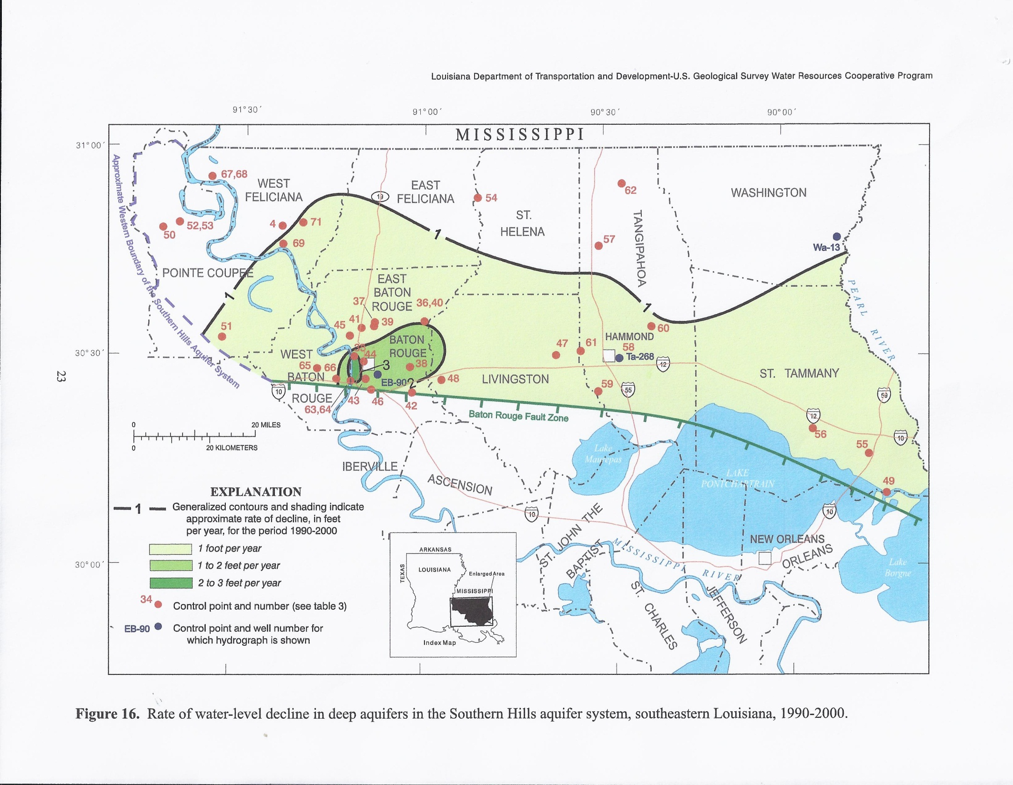
Darker green areas indicate regions with the greatest groundwater level declines.

Slide 37
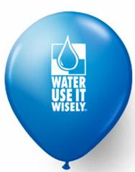
What is your responsibility?
Be informed.
Take an active roll in the formation of legislation and the establishing of policies
Do your part to conserve natural resources.
Notes:
Discuss with students the ways in which they can be involved in government as well as their individual conservation goals. Talk about how to be informed and why an educated citizenship is important.

Slide 38
References
Chlorine Molecule. http://ibchem.com/IB/ibnotes/full/bon_htm/4.2.htm
(Jan. 5, 2013).
Davis, Mark, and James Wilkins. Oct. 2011. A Defining Resource: Louisiana's Place in the Emerging Water Economy. http://law.loyno.edu/sites/law.loyno.edu/files/Davis.pdf ( 3 Jan. 2013).
Gende, Delores. Environmental Science. http://apesnature.homestead.com/chapter9.html (Jan. 3, 2013).
Louisiana Department of Agriculture and Forestry. “Water Protection Program.” http://www.ldaf.state.la.us/portal/Offices/AgriculturalEnvironmentalSciences/PesticideEnvironmentalPrograms/PesticideProgram/WaterProtectionProgram/tabid/379/Default.aspx (Jan. 3, 2013).

Slide 39
References
Louisiana Department of Environmental Quality, “Water Quality Standards.” http://www.deq.louisiana.gov/portal/tabid/69/Default.aspx (Jan. 3, 2013).
Louisiana Department of Health and Hospitals, “Safe Drinking Water Program.” http://www.dhh.louisiana.gov/ (Jan. 3, 2013).
Louisiana Department of Natural Resources. Ground Water Resources Program. http://dnr.louisiana.gov/ (Nov. 23, 2012).
Louisiana Groundwater Resources Commission. March 2012. “Managing Louisiana's Groundwater Resources.” http://dnr.louisiana.gov/index.cfm?md=pagebuilder&tmp=home&pid=907
(Jan. 3, 2013).
Lovelace, John K. Dec. 2007. “Chloride Concentrations in Ground Water in East and West Baton Rouge Parishes, Louisiana, 2004–05.” US Geological Survey. http://pubs.usgs.gov/sir/2007/5069/ ( Nov. 23, 2012).

Slide 40
References
Prakken, Lawrence B., and Lucille S. Wright. Dec. 2012. “Water Withdrawals and Trends in Ground Water Levels and Stream Discharge in Louisiana, 1996-2005.” USGS. http://la.water.usgs.gov/publications/hydrostudies.html (Jan2 6, 2013).
Sodium Chloride Model. “Water, The Universal Solvent.” http://ga.water.usgs.gov/edu/solvent.html (Jan. 3, 2013)..
Water Quantity. “Climate Change Connection.” http://www.climatechangeconnection.org/impacts/Waterquantity.htm
(Jan. 3, 2013).
Water Conservation. “City of Yuma, Arizona”, http://www.ci.yuma.az.us/5669.htm (Jan. 3, 2013).

