Slide 1
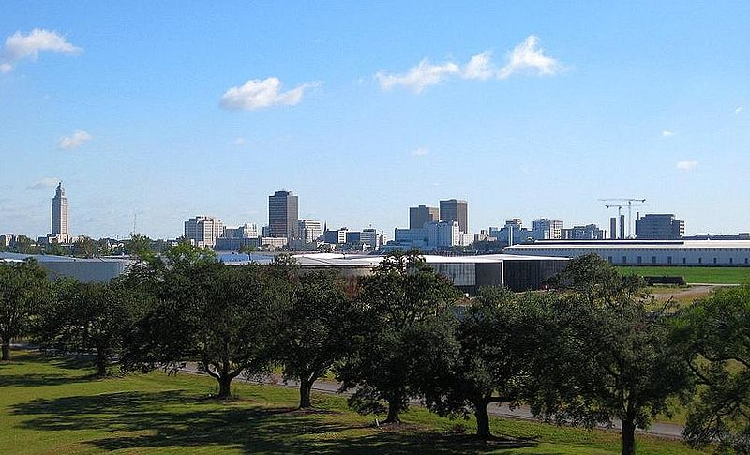
Our Groundwater in Baton Rouge, La.
UrbanPlanet, BR

Slide 2
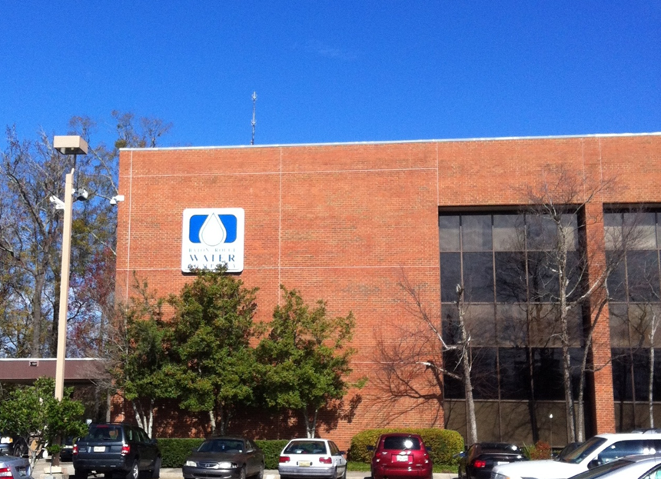
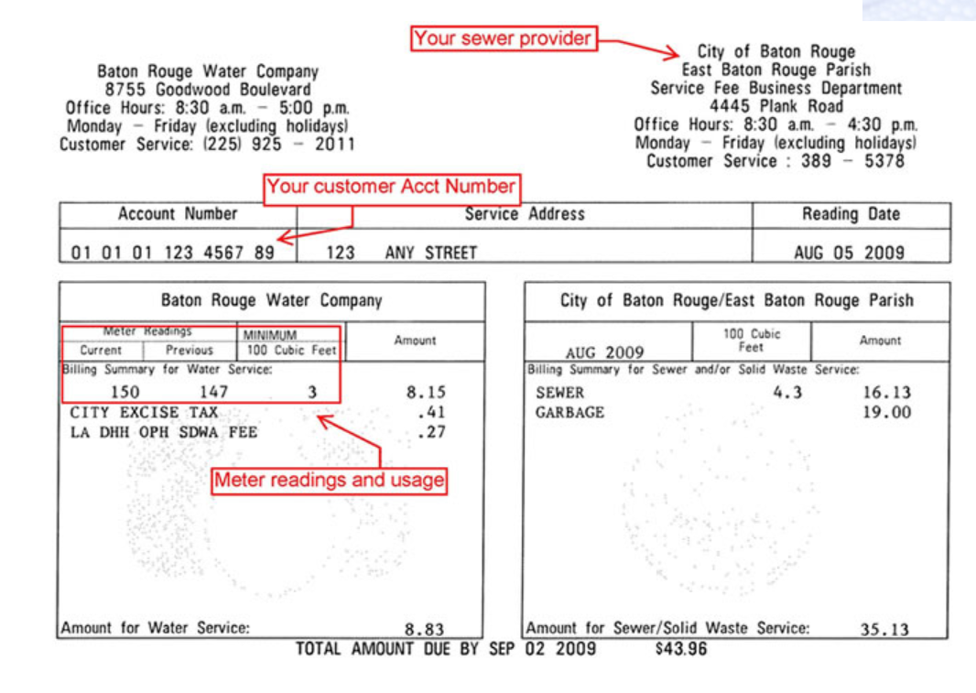
When most of us think about BR Water… we think about the company where we pay our water bill.
Notes:
Baton Rouge Water Company provides our water and the City of Baton Rouge provides sewage service – two separate companies although billed together.

Slide 3
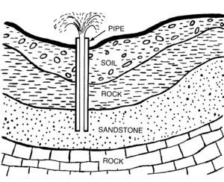
Our drinking water in Baton Rouge comes from groundwater pumped from deep below the Earth’s surface. These underground water storage areas are called aquifers.
Water is found in the layer with sand. Screens located at the bottom of the pipe keep the sand out while pumping.

Slide 4
The water that comes from aquifers deep in the ground is very clean: naturally filtered as it drifts underground over hundreds of years.

Slide 5
Each of these water pumps are bringing up water from the aquifers below Baton Rouge – some go as deep as 2800 feet.

Slide 6
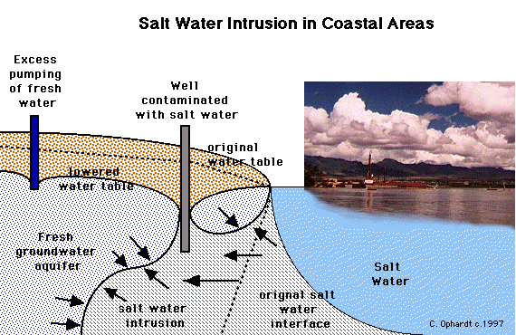
Our groundwater supply could run short if we pump water out faster than it is being replenished.
Notes:
Explain to the students that water flows downhill – or from high pressure to low pressure. Excess pumping of fresh water creates a lowered water table with lower pressure. Therefore, salt water moves in.

Slide 7
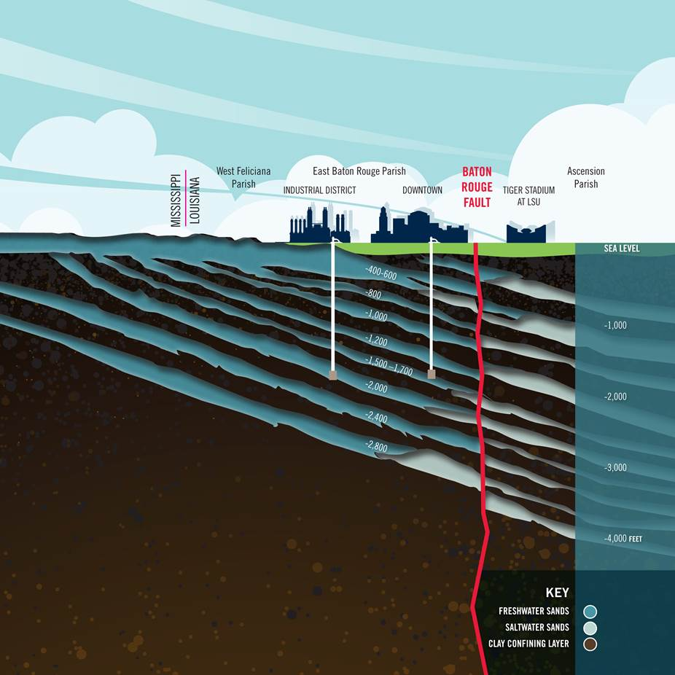
Aquifers in the Baton Rouge area are being threatened by salt water. Gray sections represent regions in which salt water intrusion has been documented.
Notes:
There are 10 aquifers below Baton Rouge. The deeper an aquifer, the more filtered or clean the water. A large percentage of our public water supply in Baton Rouge comes from the 1500 foot aquifer, but the Baton Rouge Water Company has wells in every aquifer, or “sand” as they are also called.

Slide 8
Where does the saltwater come from?
Aquifers in South Louisiana are filled with saltwater—left behind from ancient oceans
Notes:
The Baton Rouge fault provides a separation of fresh water and saltwater in our area. South of the fault is salty, with the salt most likely originating from ancient salt domes below Baton Rouge. The movement of salt water across the fault towards the north is called salt water intrusion and is cause for concern for the future sustainability of Baton Rouge groundwater.

Slide 9
What is your responsibility?
Be informed and recognize the value of our groundwater supply.
Follow the formation of legislation and the establishing of policies that affect the future of our groundwater quality and supply.
Do your part to conserve natural resources.
Notes:
Discuss with students the ways in which they can be involved in government as well as their individual conservation goals. Talk about how to be informed and why an educated citizenship is important.

Slide 10
References
Artesian Aquifer. http://enwikipedia.org/wiki/Artsian_aquifer. (January 10, 2013)
Baton Rouge's Skyline. Oct. 9, 2008 Wikipedia. http://en.wikipedia.org/wiki/File:OKC_BatonRougeSkyline.JPG. (November 23, 2012).
Baton Rouge Water Company. http://www.brwater.com/ (November 23, 2012).
Ground Water Resources Commission Meeting. Dec. 2009. Department of Natural Resources, http://dnr.louisiana.gov/assets/docs/conservation/documents/20091202- presentation.pdf (January 28, 2013).
Elmhurst College General Education. Chemistry and Issues in the Environment, “Saltwater intrusion in coastal areas”. http://www.elmhurst.edu/~chm/onlcourse/chm110/outlines/saltintrusion.html (April 20, 2014).

