Slide 1
Regulation and Management of Groundwater Resources
Important to:
Ensure the quantity of water used is sustainable for the future
Ensure the quality of water is safe to drink

Slide 2
1974 Louisiana Constitution
Article IX, Section 1, (Natural Resources and Environment; Public Policy)
The natural resources of the state, including air and water, and the healthful, scenic, historic, and esthetic quality of the environment shall be protected, conserved, and replenished insofar as possible and consistent with the health, safety, and welfare of the people. The legislature shall enact laws to implement this policy.

Slide 3
Who owns groundwater?
If you are the landowner – you do!
Louisiana’s “Rule of Capture” gives each landowner the right to capture an unlimited amount of groundwater by tapping into the underlying aquifer.

Slide 4
Civil Code Article 490. Accession above and below the surface.
Unless otherwise provided by law, the ownership of a tract of land carries with it the ownership of everything that is directly above or under it. The owner may make works on, above, or below the land as he pleases, and draw all the advantages that acrue from them, unless he is restrained by law or by rights of others. Acts 1979, No. 180,

Slide 5
Who manages our groundwater?
at least 4 federal agencies, eight state agencies, two groundwater conservation districts and more than 700 local entities

Slide 6
La. Department of Natural Resources
The mission of the Louisiana Department of Natural Resources (DNR) is to preserve and enhance the nonrenewable natural resources of the state, consisting of land, water, oil, gas, and other minerals, through conservation, regulation, management and development to ensure that the state of Louisiana realizes appropriate economic benefit from its asset base.

Slide 7
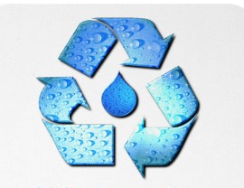
The Office of Conservation's Ground Water Resources Program manages the State's ground water resources addressing aquifer sustainability and resource conservation issues related to ground water withdrawal.

Slide 8
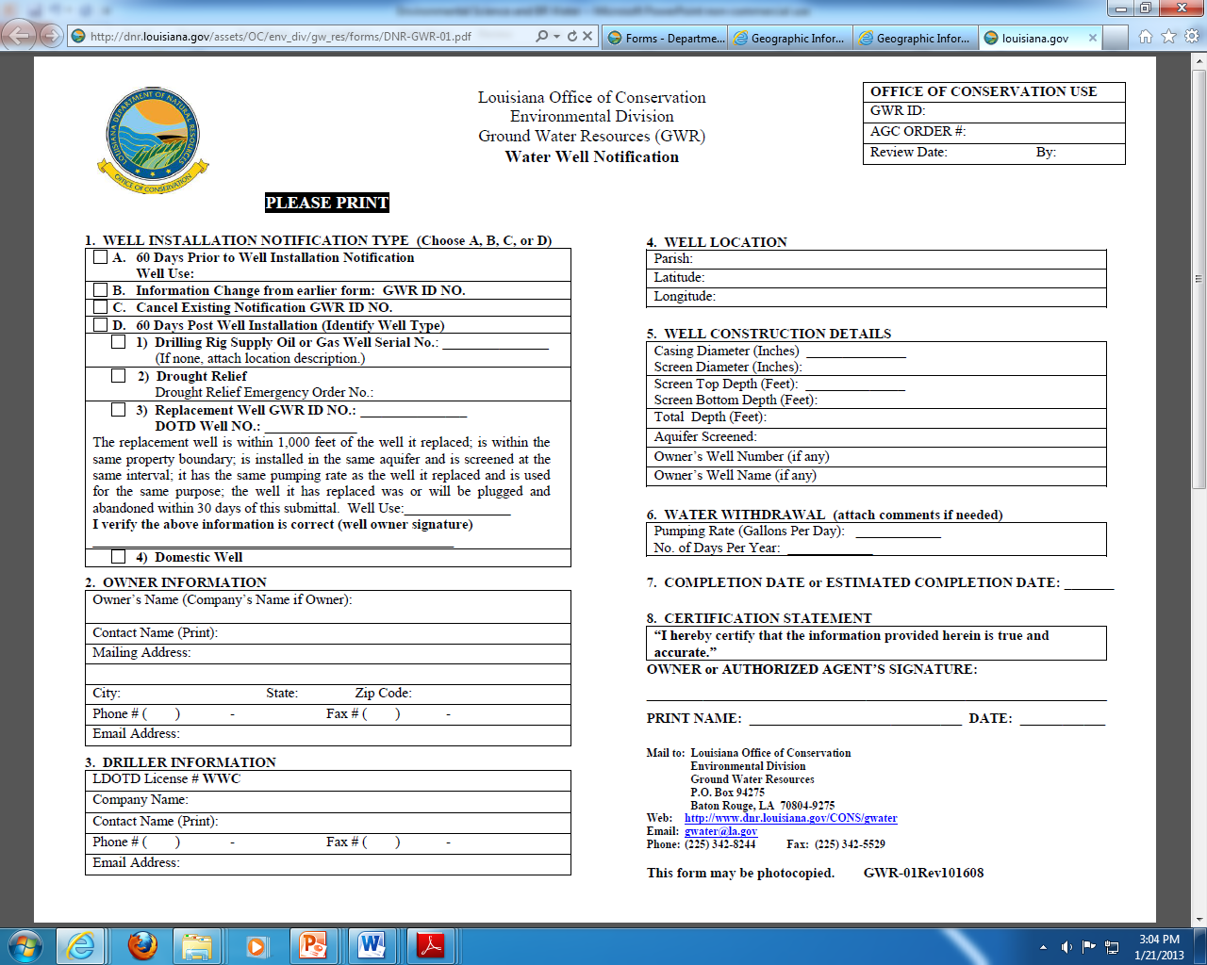
A water well notification form must be submitted to the La. Office of Conservation

Slide 9
Department of Environmental Quality
Enforces the Clean Water Act and protects groundwater and surface water resources from contamination
Clean Water Act (CWA), is to restore and maintain the chemical, physical, and biological integrity of the nation's waters by preventing point and nonpoint pollution sources.

Slide 10
DEQ maintains records on levels of natural components of groundwater in addition to looking for signs of contaminants.

Slide 11
The Department of Health and Hospitals: Office of Public Health
Safe Drinking Water Program monitors the 1,403 public drinking water systems throughout Louisiana to ensure compliance with state and federal drinking water regulations.
This surveillance helps prevent waterborne disease outbreaks or chemical exposure associated with contaminated drinking water

Slide 12
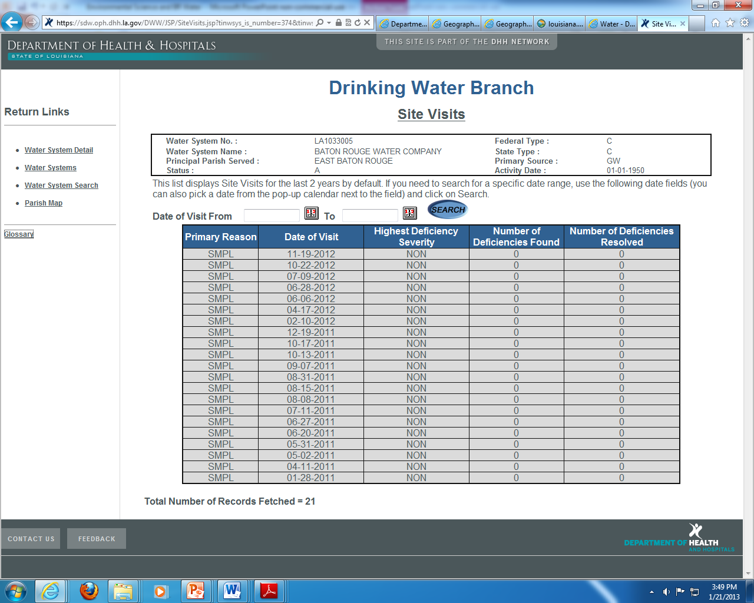
Reports from DHH show dates of water samples collected and results

Slide 13
United States Geological Survey (USGS)
The USGS serves the Nation by providing reliable scientific information to describe and understand the Earth; minimize loss of life and property from natural disasters; manage water, biological, energy, and mineral resources; and enhance and protect our quality of life.
The Louisiana Water Science Center is a division of USGS that provides us with specific information on our groundwater.

Slide 14
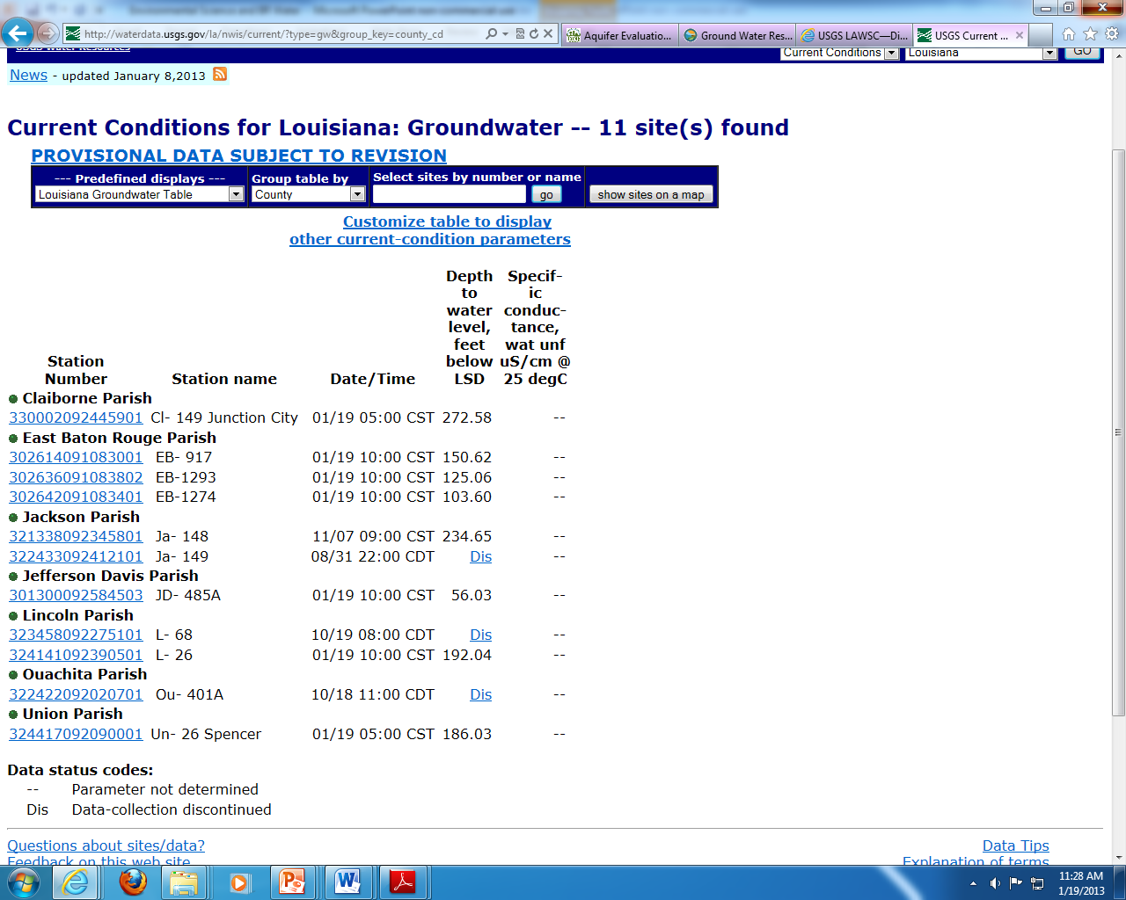
USGS provides many reports such as this one – current water levels at specific well sites in Louisiana.

Slide 15
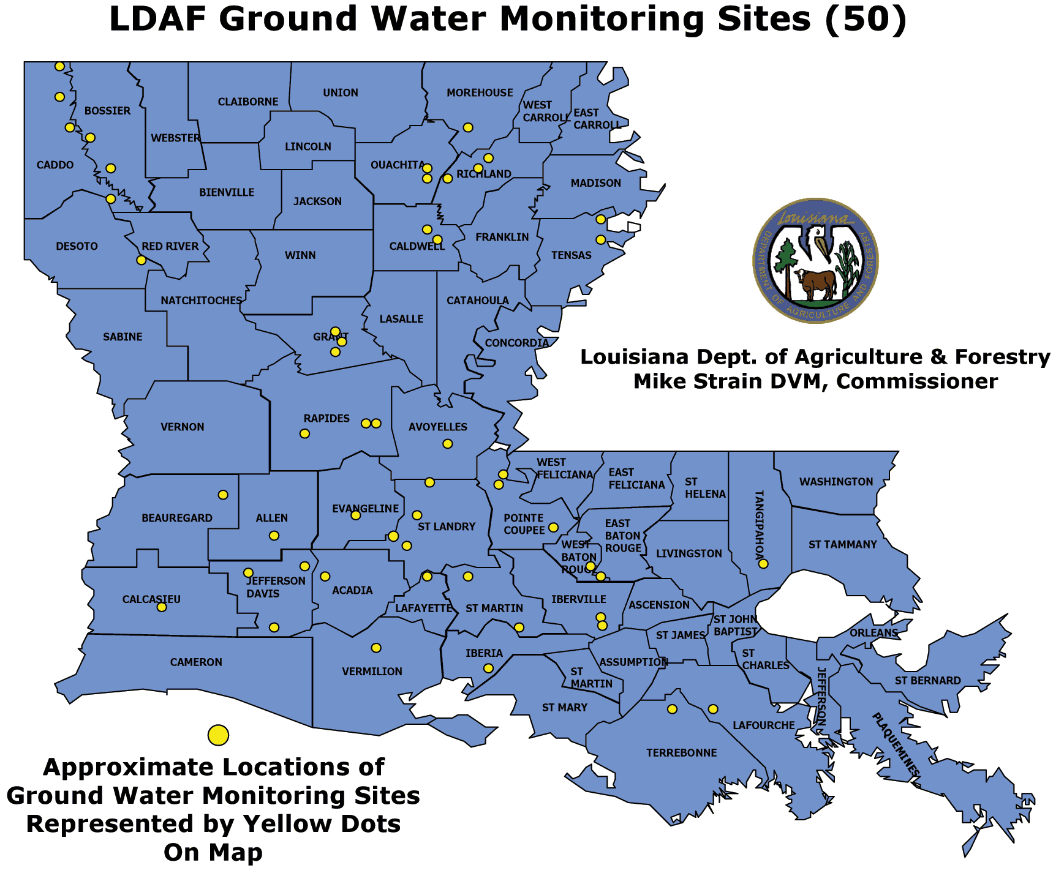
La. Department of Agriculture and Forestry monitors groundwater for pesticide contamination

Slide 16
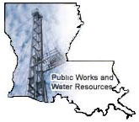
La. Department of Transportation and Development
Water Resources Section
Ensures that proper construction procedures are followed for water wells.

Slide 17
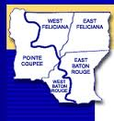
Capital Area Ground Water Conservation Commission
Function: promote the orderly development of the ground-water resources in the Capital Area District and to protect the quality of these resources
Composition: 15 Board members representing state government, district parishes, and groundwater users and stakeholders
Notes:
Use the list of members on the next slide to discuss who is actually represented and how this would impact the commission’s ability to get things done

Slide 19
The Water Resources Commission
The Water Resources Commission is composed of 27 members and the state’s Water Management Advisory Task Force has members from stakeholder groups, local, state and federal agencies, members of the Legislature and environmental organizations.

Slide 20
References
Davis, Mark, and James Wilkins. Oct. 2011 A Defining Resource: Louisiana's Place in the Emerging Water Economy. <http://law.loyno.edu/sites/law.loyno.edu/files/Davis.pdf >( 3 Jan. 2013).
Gende, Delores. Environmental Science. http://apesnature.homestead.com/chapter9.html (Jan. 3, 2013)
Louisiana Department of Agriculture and Forestry. “Water Protection Program”. http://www.ldaf.state.la.us/portal/Offices/AgriculturalEnvironmentalSciences/PesticideEnvironmentalPrograms/PesticideProgram/WaterProtectionProgram/tabid/379/Default.aspx (Jan. 3, 2013).
Louisiana Department of Environmental Quality, “Water Quality Standards “http://www.deq.louisiana.gov/portal/tabid/69/Default.aspx (Jan. 3, 2013).

Slide 21
References
Louisiana Department of Health and Hospitals, “Safe Drinking Water Program”.http://www.dhh.louisiana.gov/ (Jan. 3, 2013).
Louisiana Department of Natural Resources. Ground Water Resources Program. http://dnr.louisiana.gov/ (Nov. 23, 2012).
Louisiana Groundwater Resources Commission . 2012. “Managing Louisiana's Groundwater Resources”. <http://dnr.louisiana.gov/index.cfm?md=pagebuilder&tmp=home&pid=907>. (Jan. 3, 2013)
Lovelace, John K. Dec. 2007. “Chloride Concentrations in Ground Water in East and West Baton Rouge Parishes, Louisiana, 2004–05”. USGS. http://pubs.usgs.gov/sir/2007/5069/( Nov. 23, 2012)

Slide 22
References
Prakken, Lawrence B., and Lucille S. Wright. Dec. 2012. “Water Withdrawals and Trends in Ground Water Levels and Stream Discharge in Louisiana, 1996-2005”. USGS. http://la.water.usgs.gov/publications/hydrostudies.html (Jan2 6, 2013)
Water Quantity. “Climate Change Connection,” http://www.climatechangeconnection.org/impacts/Waterquantity.htm (Jan. 3, 2013).
Water Conservation. “City of Yuma, Arizona”, http://www.ci.yuma.az.us/5669.htm (Jan. 3, 2013).

