Slide 1

Defining Louisiana’s Coastal Zone:
A Science-Based Evaluation of the
Louisiana Coastal Zone Inland Boundary
A summary of the results of the study authorized by SCR 60 to the
Louisiana Coastal Protection and Restoration Authority
August 18, 2010
Department of Natural Resources
Office of Coastal Management
Louis Buatt
Assistant Secretary
Terry Howey
Coastal Resources Administrator
Dr. Edward Britton
Coastal Resource Scientist
LDNR-OCM
Ana C. Young
IT Geographic Support Analyst
LDNR-OCM

Slide 2
Provisions of Senate Concurrent Resolution 60
Requests the CPRA to conduct a comprehensive science-based review and analysis of the inland boundary of the Louisiana coastal zone.
Use existing data sets to conduct the study.
Consider physical, chemical, and biological data to define the limits of coastal processes.
Consider social, economic and cultural factors in conducting the study.
Prepare a report to Louisiana Legislature with findings.
Requests state and federal agencies, universities, NGOs, business and industry to assist and cooperate by providing access to information and data to facilitate this study.

Slide 3
Outcome Objective:
Maximize Effectiveness – Minimize Intrusiveness
Provide the most accurate science-based delineation of the coastal zone possible with the resources available.
Maximize the state’s ability to implement the Master Plan using coastal zone management tools of the Louisiana Coastal Resources Program.
Incorporate socioeconomic factors into the evaluation.
Minimize increasing the regulatory burden to stakeholders.

Slide 4
More or less?
The USGS projects that land loss in coastal Louisiana between 1956 and 2050 will be 2038 square miles.
This report recommends incorporating 1,939 square miles into the coastal zone.
Without increased, successful restoration, it this recommendation is adopted there will still be 99 square miles smaller in land area in 2010.

Slide 5
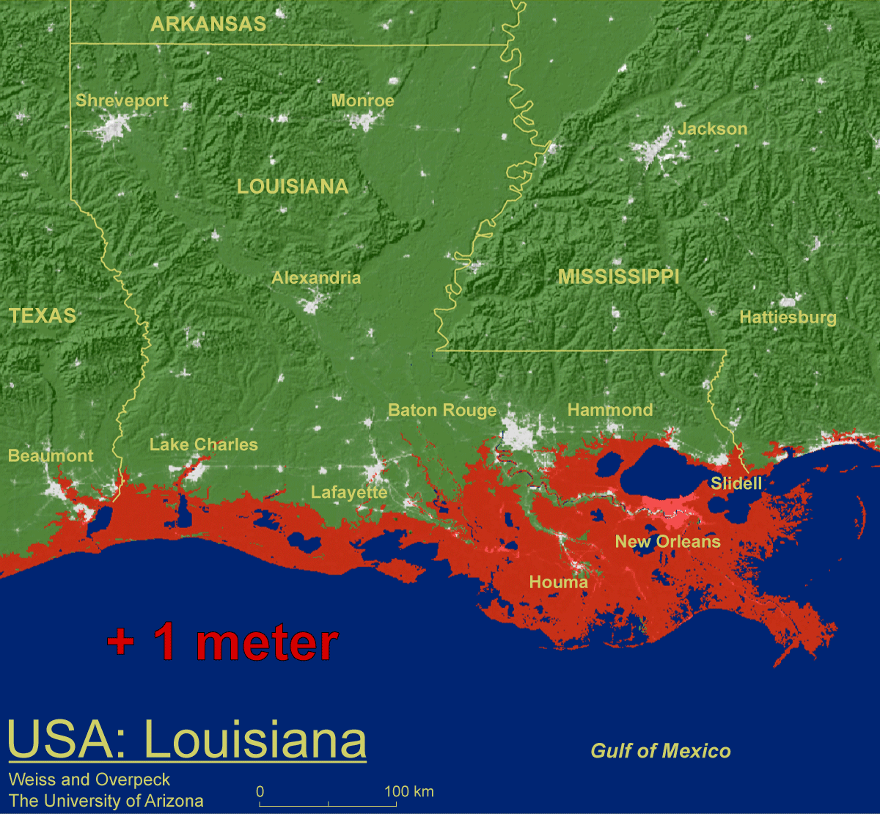
If we do nothing:
Coastal Louisiana at the End of this Century
Showing One Meter of Sea Level Rise

Slide 6
THE BIG PICTURE:
Long Term Outcome Vision
Sustainable Coastal Communities
Sustainable Commerce and Industry
Sustainable Fisheries Production
Sustainable Coastal Ecology
Sustainable Employment Opportunities
Sustainable Coastal Louisiana Culture

Slide 7
Methodology:
Economics in the Coastal Zone
  Oil and Gas Industry
  1st in oil production
  2nd in marketed gas production
  3rd in natural gas reserves
  2% of total US crude oil reserves
  5% of US natural gas reserves
  320,000 oil and gas industry jobs
  Producing $12.7 billion in household income
  Creating $70.2 billion in sales for LA companies
Chemical Industry
  26,000 jobs
Maritime Industry
  1st in water transportation (tonnage) by state
  The Port of South Louisiana is the largest single port in the U.S.
  The ports of New Orleans, Lake Charles, Greater Baton Rouge and Plaquemines all are in the top 15.
Commercial and Recreational Fishing
Tourism
Outdoor Recreation

Slide 8
Methodology:
Scientific Criteria
1975
Geology
Vegetation
Elevation (5’ & 25’)
Soils
100 yr flood
Salinity (inland extent)
Range of brackish water clam, blue crab, fish (e.g., Striped mullet), birds (migrating waterfowl), mammals (e.g., Eastern mole), reptiles (e.g., Fence lizard)
2010
Geology
Vegetation
Elevation (5’, 8’ & 10’)
STATSGO Soils
Inundation - storm surge (SLOSH Model)
Predicted subsidence/sea level rise
Watershed boundaries
Boundaries of existing coastal programs

Slide 9
Methodology:
Proposed Hierarchical
Management Approach
Coastal Use Permit (CUP): Management primarily by the Coastal Use Permitting procedure.
Intergovernmental Coordination (IGC): Management primarily by means of the Consistency Determination procedure.
Watershed Planning (WSP): Management primarily through incentive programs and planning initiatives.
Notes:
9

Slide 10
Methodology:
Data Analysis / Scoring Criteria
The study area was defined as all watersheds that touch the coast, and divided into one kilometer square cells (91,648).
Queries were run on the nine data sets and a value was assigned to each cell.
These cells were grouped according to the four levels of coastal influence and color coded for visual display.

Slide 11
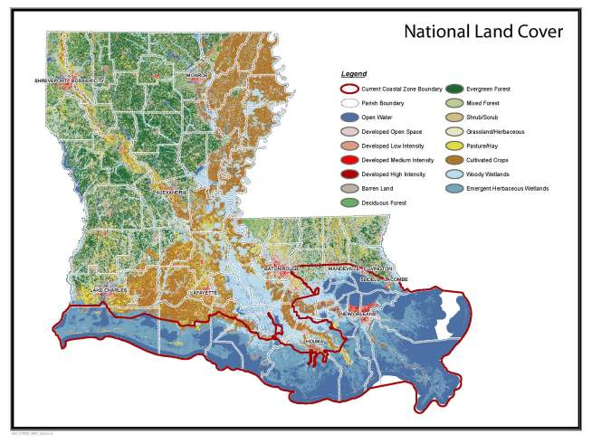
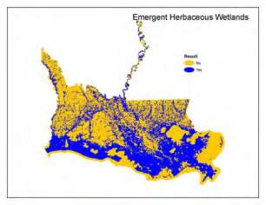
Data Query: Does the cell contain emergent herbaceous wetlands (fresh, intermediate, brackish or salt marsh)?

Slide 12
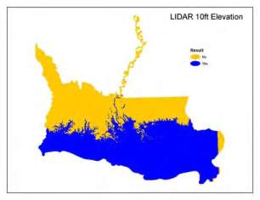
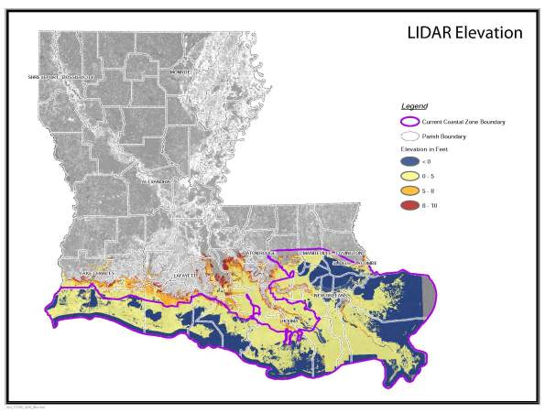
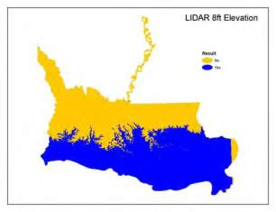
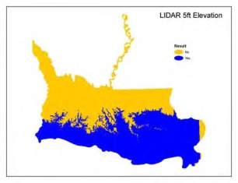
Data Queries: Is any part of the cell at an elevation of:
5 feet or lower?
8 feet or lower?
10 feet or lower?

Slide 13
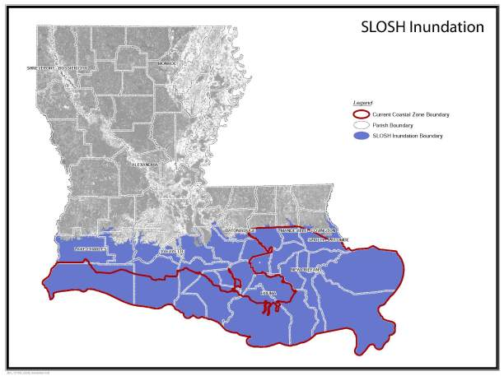
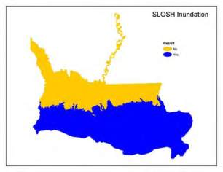
Data Query: Is any part of the cell contained within the inland extent of storm surge per the SLOSH model outputs?

Slide 14
2010 Proposed Boundary
DRAFT
October 19, 2010

Slide 15
Proposed Coastal Zone:
Comparison of CUP and IGC Areas
CUP Management Area | IGC Management Area
CUP applicants are eligible for federal USACE PGP approvals, providing "one stop permit shop" permitting for wetlands projects. | CUP applicants must continue to have wetlands permits issued through federal USACE process; state PGP will not apply.
Projects in this area may receive priority consideration for state restoration project selection. | Area eligible for consideration for restoration, but receives no priority CZM consideration.
Parishes eligible to receive funding for ongoing implementation of Local Coastal Programs. | Parishes may receive funding for specific projects only when funding becomes available.
Parishes in this area with an approved LCP process CUPs for local concern uses. | Parishes are not eligible to establish LCPs or to process CUPs for local concern uses.
Activities subject to full force and power of state’s federal consistency authority under CZMA. | Activities subject to limited federal consistency CZMA authority under CZMA to direct actions of government.
Nineteen original coastal parishes continue to be eligible for direct GOMESA funding. | Parishes added to this area become eligible for state portion of GOMESA, if available.
More opportunities and options for mitigation activities available. | More opportunities and options for certain mitigation activities may be available.

Slide 16
Potential Benefits:
Coastal Zone/CUP Area
Parishes in the coastal zone receive priority funding for structural and non-structural projects. Non-structural project include coastal protection options such as building elevation, buy-out and smart growth program.
Sustainable development through coastal zone management in areas where restoration projects and other Master Plan measures will be implemented is another important benefit.
  Uncoordinated development, such as has occurred along upper Bayou Lafourche, can lead to additional challenges and increase the cost of restoration projects.
  The cost of re-introducing freshwater into Bayou Lafourche was increased tremendously by the need to dredge the bayou in order to resolve flooding and bank stability challenges created by unmanaged development in the riparian zone and adjoining water bottoms.
Hierarchical management will provide addition benefits by allowing targeted management appropriate to location and use.

Slide 17
Potential Benefits:
CUP Management Area
CUP applicants are eligible for federal USACE Programmatic General Permit (PGP) approvals, providing "one stop permit shop" permitting for wetlands projects.
Projects in this area may receive priority consideration for state restoration project selection.
Parishes eligible to receive funding for ongoing implementation of Local Coastal Programs.
Activities subject to full force and power of state’s federal consistency authority under CZMA.
Nineteen original coastal parishes continue to be eligible for direct Gulf of Mexico Energy Securities Act (GOMESA) funding.
Parishes in this area with an approved Local Coastal Program (LCP) process CUPs for local concern uses.
More opportunities and options for certain mitigation activities may be available.
Permit tracking available through OCM web-based system.

Slide 18
Potential Benefits:
IGC Management Area
Area eligible for consideration for restoration.
Parishes added to this area become eligible for state portion of GOMESA, if available.
Activities subject to limited federal consistency CZMA authority under CZMA to direct actions of government.
More opportunities and options for certain mitigation activities may be available.
Provide increased consistency with Master Plan goals in the IGC management area by oversight in the broader coastal zone for riparian activities and hydrologic modifications by governmental bodies which could affect Master Plan implementation.

Slide 19
Summary:
Next Steps
CPRA proposed public review and comment period (August/September 2010)
Approval by CPRA with suggested minor changes (December 2010)
Statutory changes needed to adopt updated coastal zone as recommended by CPRA (2011 Regular Session of the Louisiana Legislative)
Effective date of changes to CZB (January 2012)

Slide 20
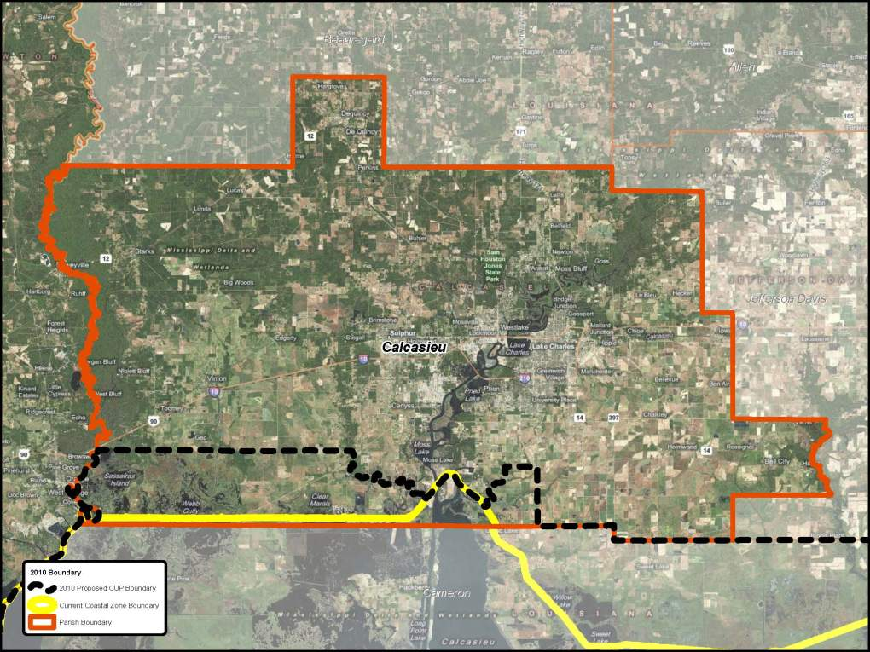

Slide 21
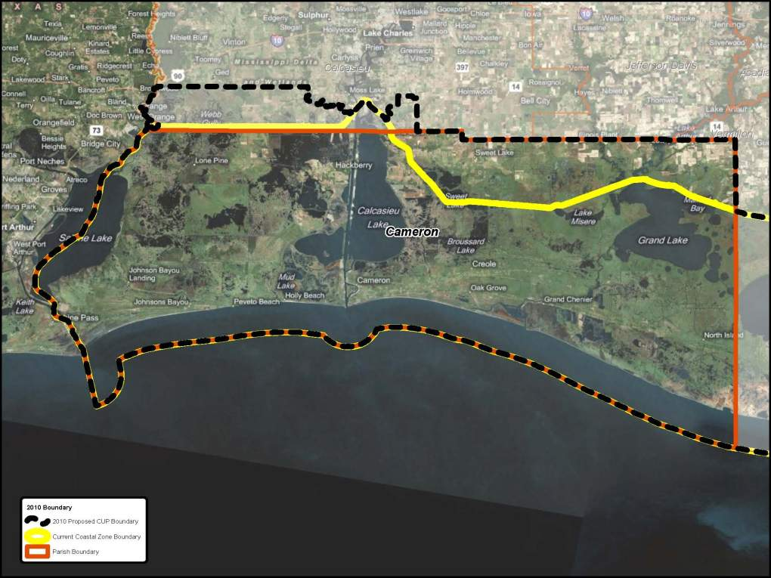
Cameron

Slide 22
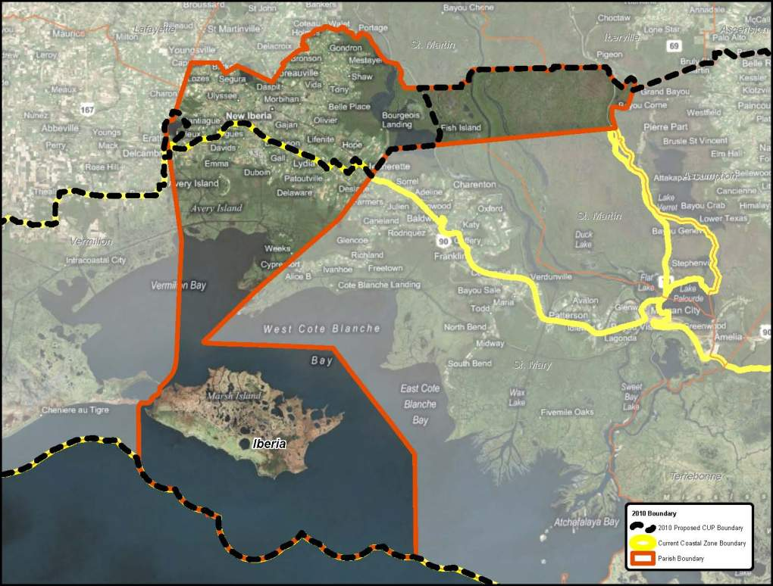
Iberia

Slide 23
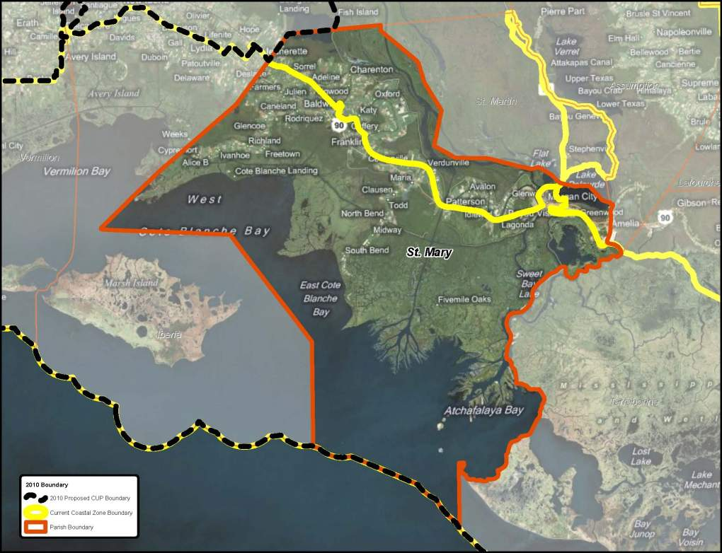
St. Mary

Slide 24
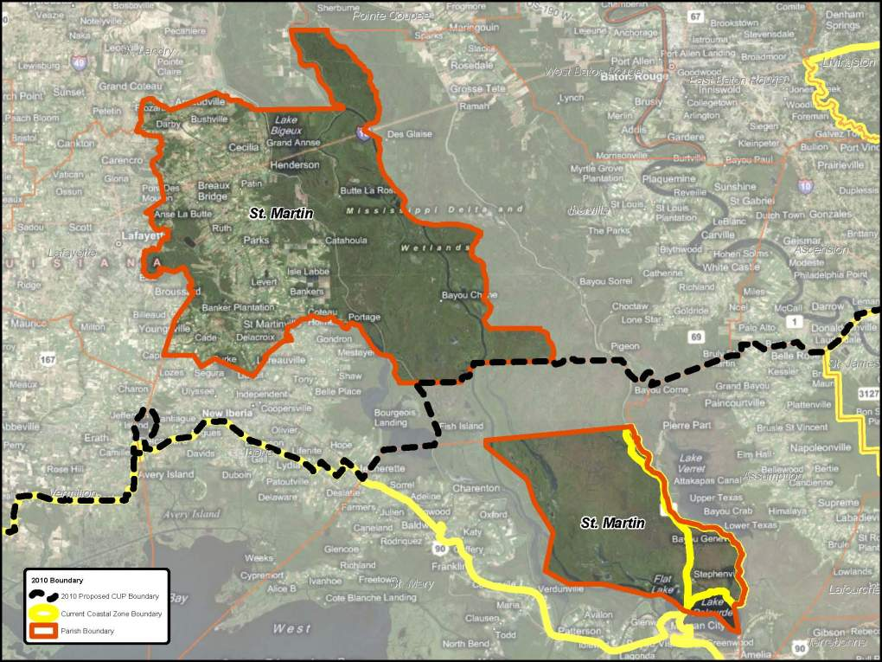
St. Martin

Slide 25
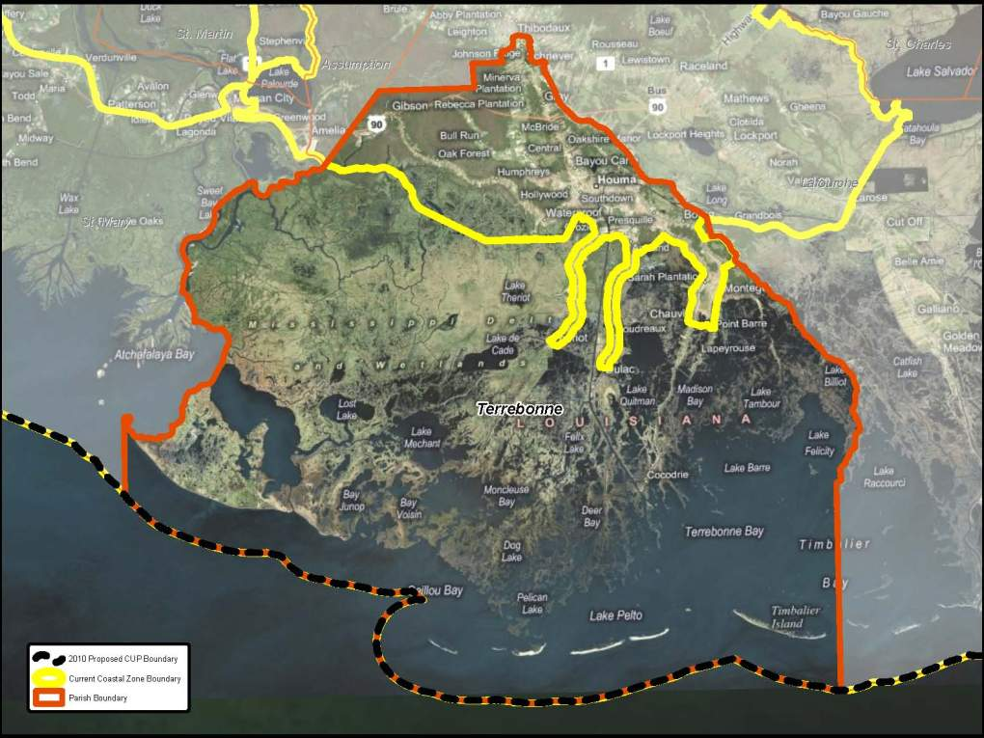
Terrebonne

Slide 26
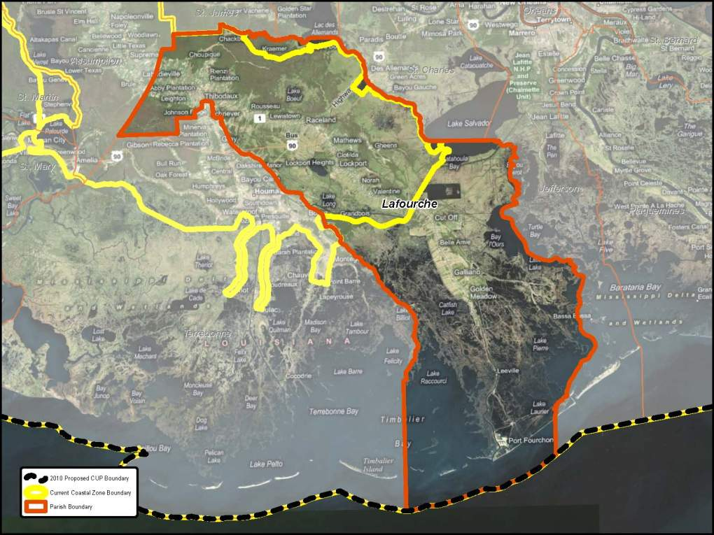
Lafourche

Slide 27
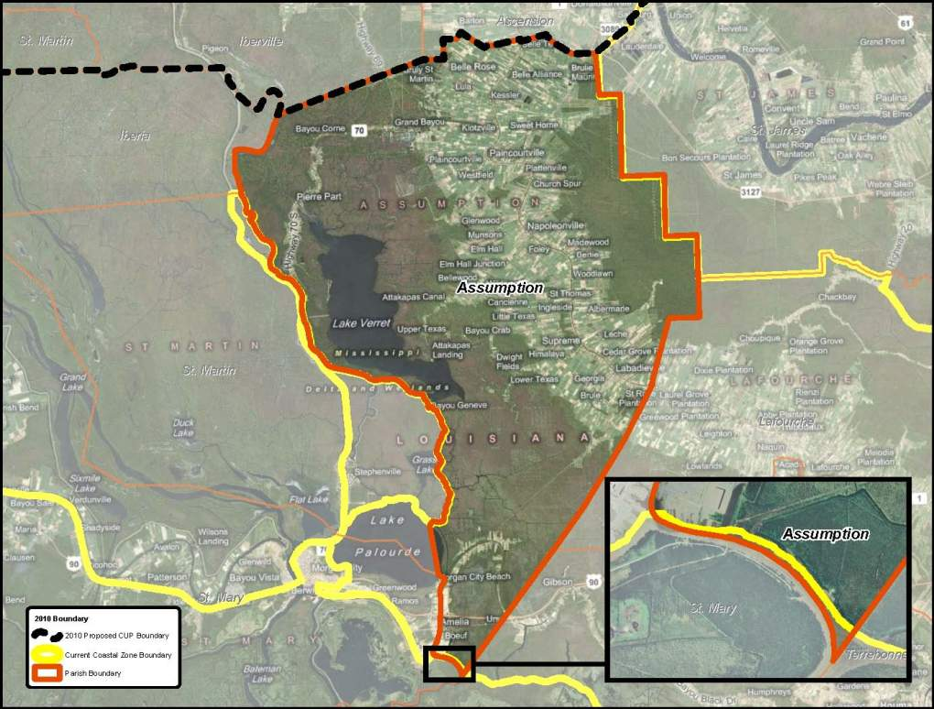
Assumption

Slide 28
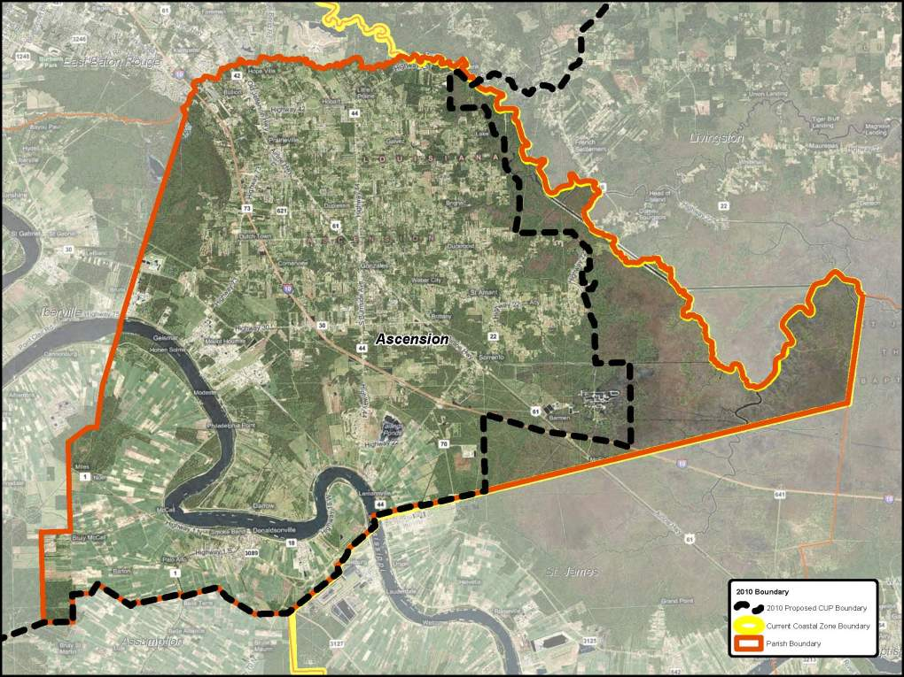

Slide 29
