Slide 1
Ground Water Resources Commission Meeting
Wednesday, April 7, 2010

Slide 2
Mr. John Adams
DNR Office of Conservation
Adoption of Minutes
February 3, 2010

Slide 3
Mr. Gary Snellgrove
DNR Office of Conservation
Statewide Water Management
Plan Update

Slide 4

Statewide Water Management Plan
Months 1 & 2
RFP Advertisement,
Receipt & Evaluation
Month 8
Issue Draft Comprehensive Report and Receive Public Comment
Months 3-7
Award Contract
Contract execution (ongoing)
Months 9 - 11 Publish FINAL REPORT
Research, Evaluate, Study, Compile statistics, Identify best management practices, Prioritize, Outreach
Timeline

Slide 5
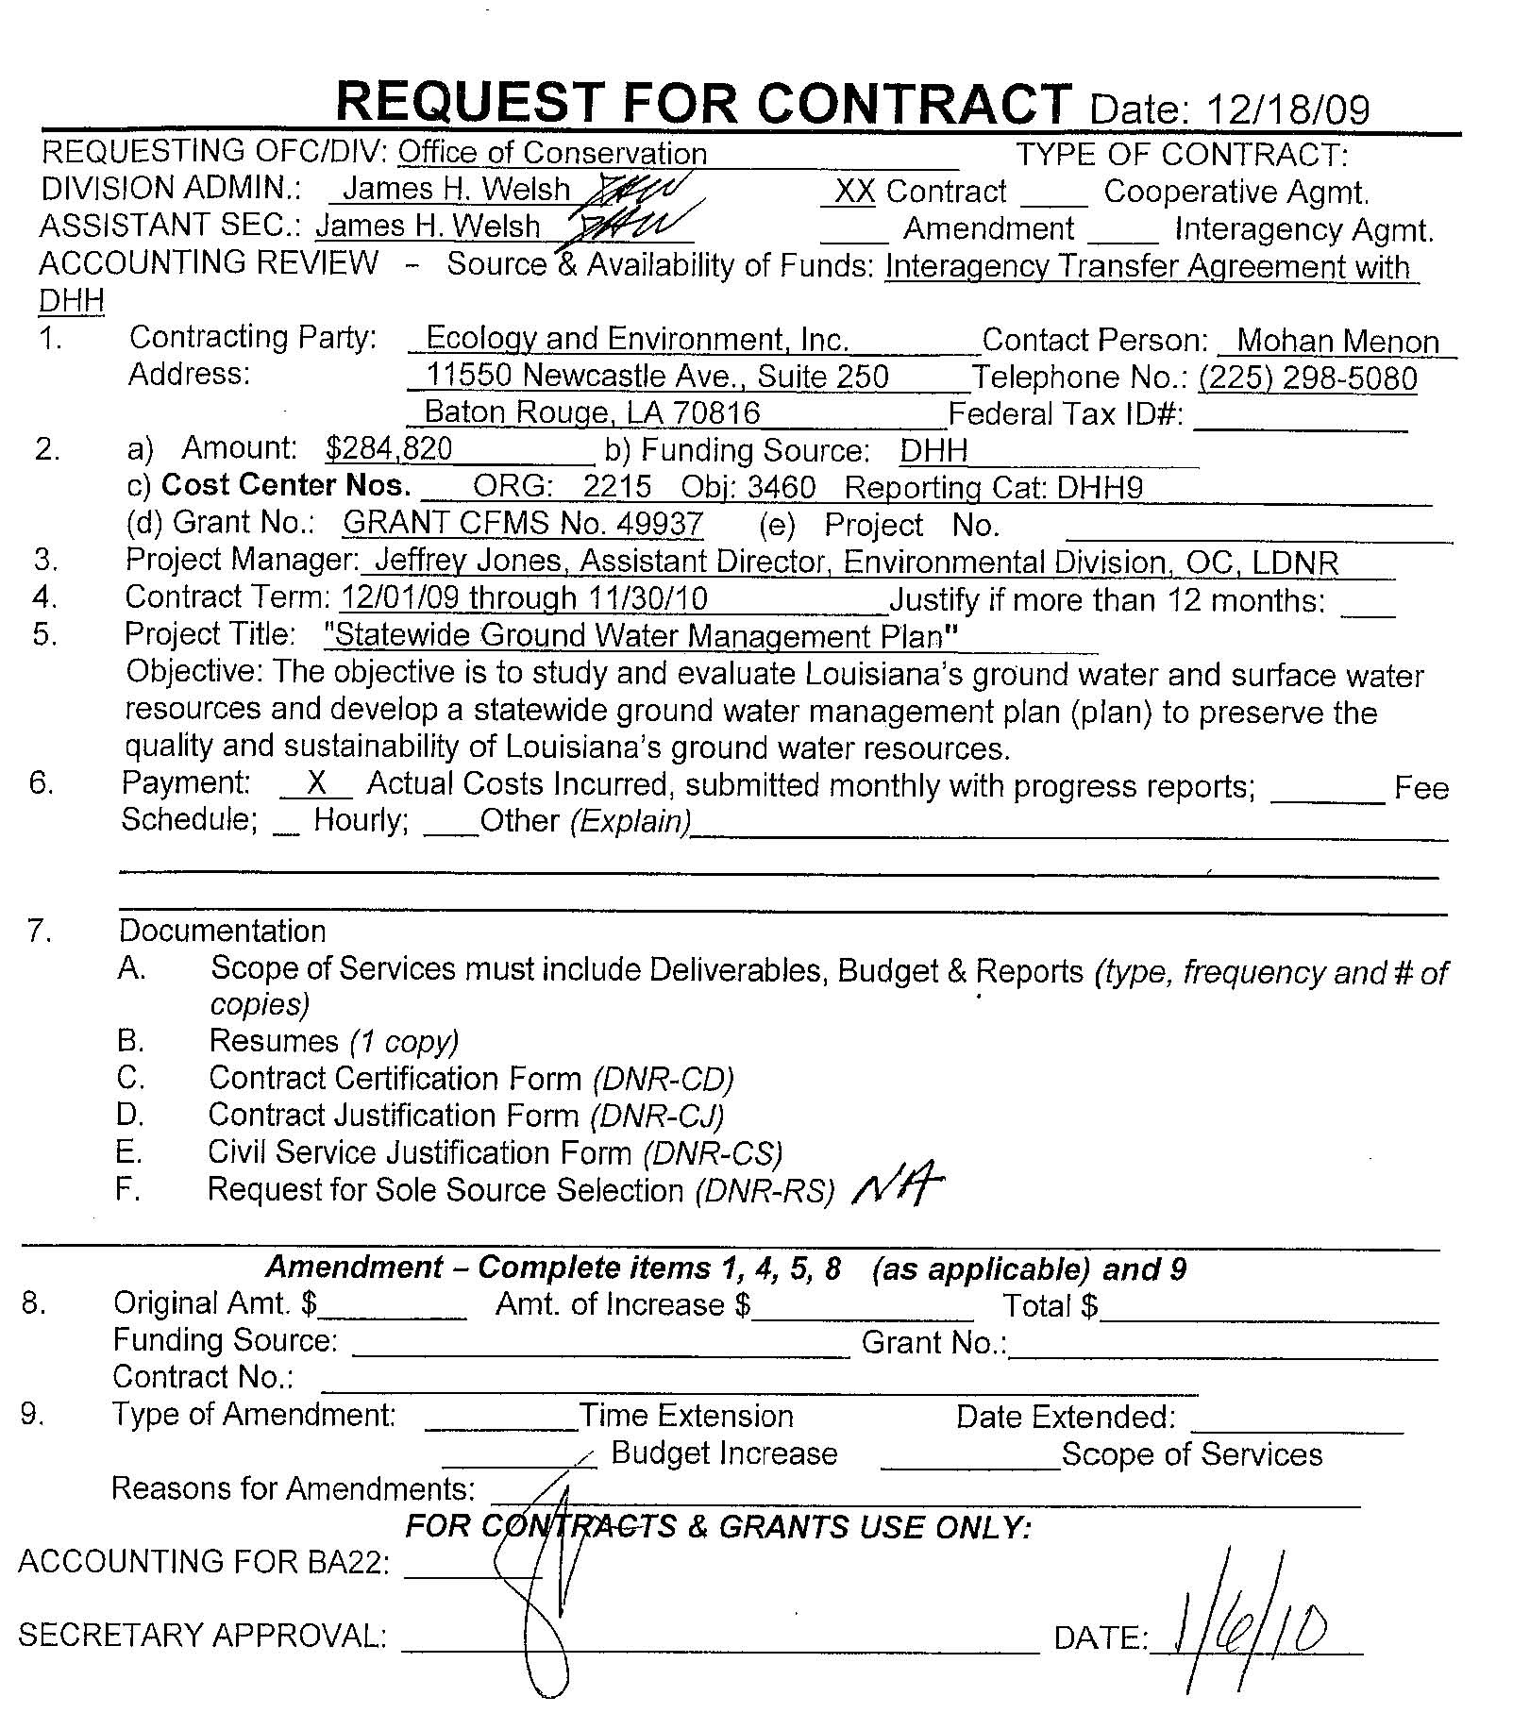
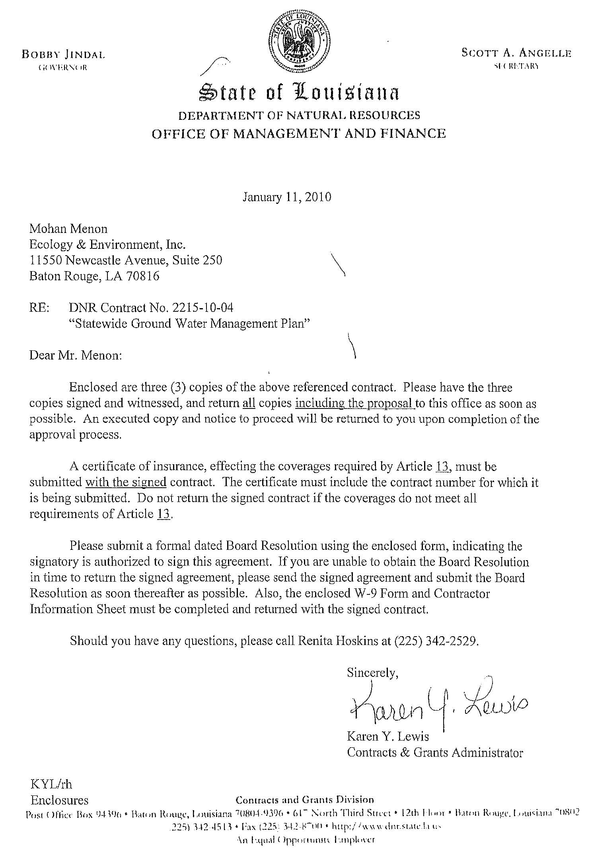
Statewide Water Management Plan
Division of Administration
Office of Contractual Review
Approved March 24, 2010

Slide 6
Mrs. Christel Slaughter
SSA Consultants, LLC
Liason Services Update

Slide 7
House Concurrent Resolution 1 Discussion

Slide 8
Mr. Gary Snellgrove
DNR Office of Conservation
Louisiana Ground Water Monitoring Network Summary

Slide 9
Louisiana Ground Water Monitoring Network
Intrastate Interagency Resources Summary
Water Well Use / Aquifer Sustainability Evaluation Perspective
Statewide
Comprehensive
Water Quality
Water Level
Accessible
Adequate

Slide 10
Louisiana Ground Water Monitoring Network
DNR
Water Well Registration & Notification Files
178,000 Well Driller Registration Records
4,400 New Wells Installed / Registered Statewide Annually
  Water Level Measurement Required
Computer Database

Slide 11
Louisiana Ground Water Monitoring Network
DEQ
Aquifer Sampling & Assessment Program
196 Water Wells Sampled Every 3 Years
  Water Quality (Environmental Parameters)
14 Aquifers
  1 Well Sampled on Average Every 400 square miles
Data Summary Reporting
Computer Database

Slide 12
Louisiana Ground Water Monitoring Network
DHH
Office of Public Health – Public Supply Water Wells
2687 Active Public Supply Water Wells
Sampled/Tested Every 3 Years
  Water Quality (Health Parameters)
Computer Database

Slide 13
Louisiana Ground Water Monitoring Network
USGS
LGS
La. Water Science Center Database
Includes Over 22,000 Well Locations with Historical Data
  Ground Water Level and Quality Data
12 Real Time Ground Water Monitoring Well Sites
13 Daily Ground Water Monitoring Well Sites
Numerous Aquifer Studies and Reports
  Caddo, Bossier, DeSoto Wilcox Aquifer Well Sampling and Testing Activity
    1,100 Wells in 2 years
    Water Quality

Slide 14
Louisiana Ground Water Monitoring Network
Other Resources
1. LSU – Shreveport Monitoring Wells
2. St. Tammany Parish Requirements
3. Capital Area Ground Water Conservation Commission
Conservation Water Well Location & Use Evaluation
Order of the Commissioner – Require Additional Information
As Needed, Case by Case

Slide 15
Mr. Chris Piehler
LA Department of Environmental Quality
Water Quality Protection Programs

Slide 16
Mr. Glenn Cambre & Mr. Jake Causey
LA Department of Health and Hospitals
Drinking Water Protection Programs
16

Slide 17
Ground Water Resources Program Update
17

Slide 18
Mr. Gary Snellgrove
DNR Office of Conservation
Evolution of the Water Well Driller Program
Katrina & Rita Water Well damage – LRA Funding Update
Haynesville Shale Frac Water Supply Implementation Update
Statewide Water Well Notification Audit & Enforcement Update
Public Outreach and Education
18

Slide 19
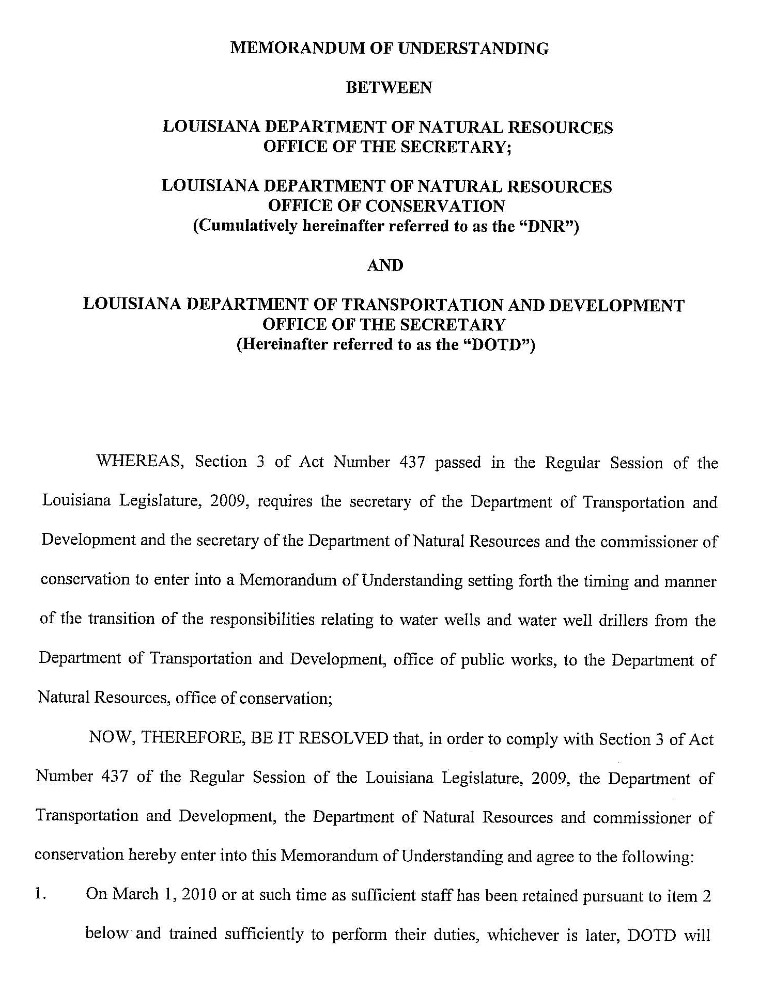
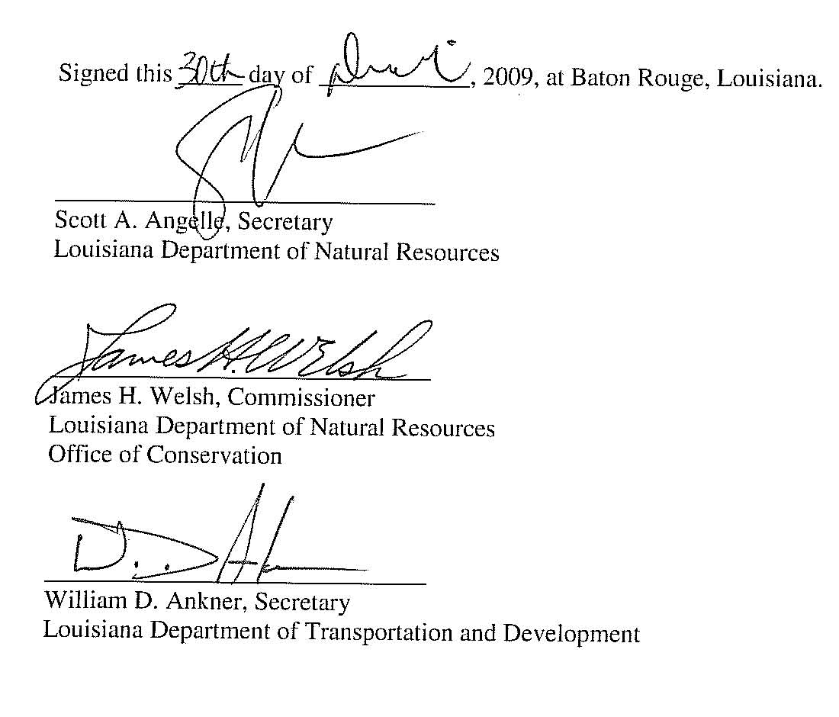
Evolution of the Water Well Driller Program
August 15, 2009 – ACT 437 Statutorily Effective to transfer DOTD well construction program to DNR
January 1, 2010 – DNR DOTD MOU Implemented
January 2010 – DOTD District Managers informed to continue well inspections
February 2010 – Database Merger Discussions (ongoing)
March 2010 – Review of water well driller regulations to revise and update (ongoing)
March 1, 2010 – Transfer of DOTD Files
March 8, 2010 – Staff Engineer Hired
March 22, 2010 – Staff Engineer Hired
March 25, 2010 – Commissioner Selects Driller Advisory Committee Designee
April 2010 – Driller Licensing Renewal procedure begun
19

Slide 20
Hurricanes Katrina & Rita
Water Well Damage Assessment
Ongoing discussions with LRA for funds to cover damaged well P&A / repair costs
April 6, 2010
LRA informs $360,000 is available

Slide 21
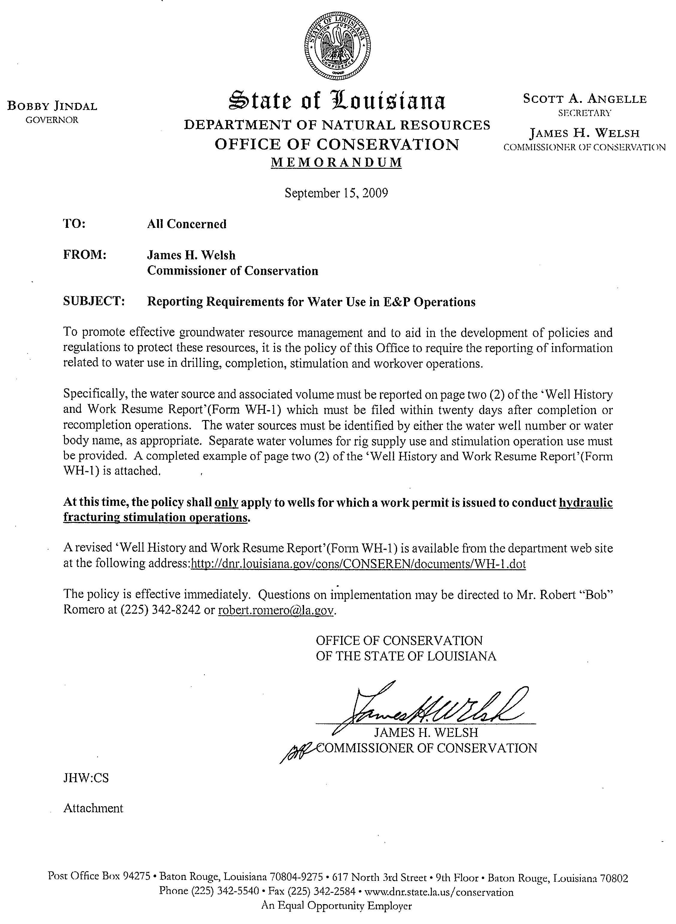
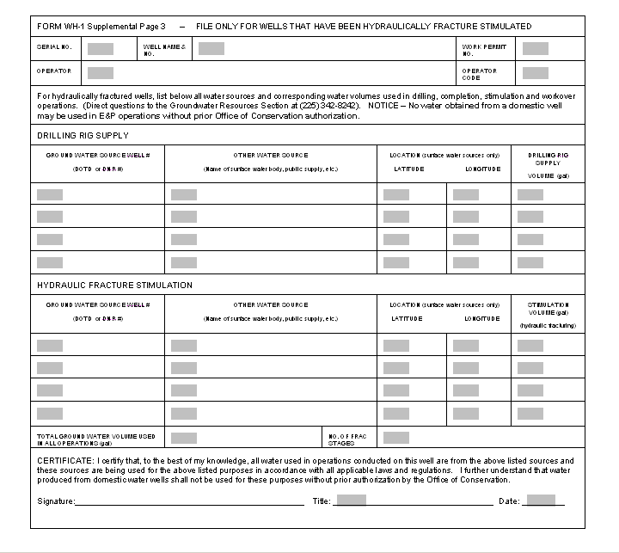
Haynesville Shale Frac Water
Mandatory Drilling & Frac Water Supply Source and Volume Reporting

Slide 22
Haynesville Shale Frac Water
Mandatory Drilling & Frac Water Supply Source and Volume Reporting
Actions of the Commissioner:
Requires operators to report water sources and volumes
Issued on September 15, 2009
Enforceable effective October 1, 2009
Revised form on March 1, 2010
Provides valuable groundwater resource management tool
Statistics

Slide 23
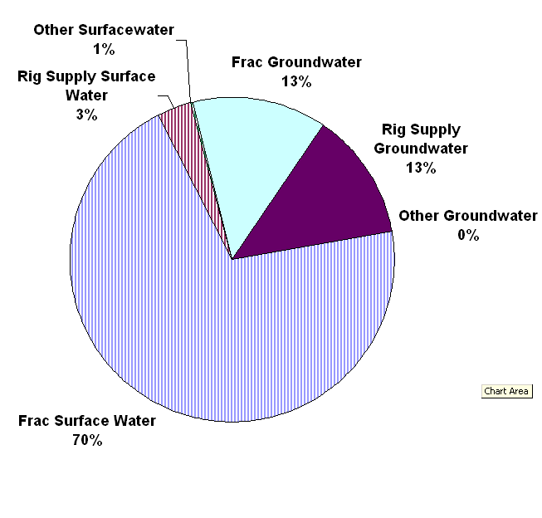
Haynesville Shale Natural Gas Well Development
Drilling and Stimulation Operations
Reported Water Usage from 10/1/2009 to 3/30/2010 WH-1 Information
Source | Volume (Gallons)
Frac Groundwater | 59,125,355
Frac Surface Water | 319,693,662
Drilling Rig Groundwater | 56,077,229
Drilling Rig Surface Water | 14,839,146
Other Groundwater | 609,000
Other Surface Water | 2,247,000
As of 3/30/2010
141 Reporting wells
490 Total work permits

Slide 24
Statewide Well Notification Audit and Enforcement
Initiated a comprehensive statewide audit schedule
  Two year plan to audit all ground water wells drilled in Louisiana after July 1, 2001
  To date, 30 parishes audited
  Current status of implementation
2009 Schedule
January | February | March | April | May | June | July | August | September | October | November | December
Caddo, Red River, Bossier, DeSoto |  |  |  |  | Calcasieu, Cameron | Jeff Davis, Vermillion | Acadia, Lafayette | Allen, Evangeline, St. Landry | Bienville, Webster | Claiborne, Jackson, Lincoln | Ouachita, Morehouse, Union
CARIZZO – WILCOX (Haynesville) |  |  |  |  | CHICOT |  |  |  | SPARTA

Slide 25
Statewide Well Notification Audit and Enforcement
Comprehensive statewide audit schedule continued…
2010 Schedule
January | February | March | April | May | June | July | August | September | October | November | December
EBR, E. Feliciana, WBR, W. Feliciana | Livingston, St. Helena, Tangipahoa, Washington | St. Tammany | E. Carroll, Madison, Richland, W. Carroll | Catahoula, Concordia, Franklin, Tensas | Caldwell, Grant, LaSalle, Natchitoches, Sabine, Winn | Beauregard, Vernon | Avoyelles, Pointe Coupee, Rapides | Assumption, Iberia, Iberville, St. Martin, St. Mary | Ascension, St. Charles, St. James, St. John | Jefferson, Lafourche, Terrebonne | Orleans, Plaquemines St. Bernard
SOUTHEAST LOUISIANA |  |  | MS RIVER ALLUVIAL |  | OTHER
Annual Statewide Schedule - Beginning 2011 and proceeding annually
January | February | March | April | May | June | July | August | September | October | November | December
Bienville, Bossier, Caddo, Desoto, Red River, Webster | Claiborne, Jackson, Lincoln, Morehouse, Ouachita, Union | Acadia, Calcasieu, Cameron, Jeff Davis, Vermillion | Allen, Beauregard, Evangeline, Lafayette, St. Landry | EBR, E. Feliciana, Livingston, St. Helena, WBR, W. Feliciana | E. Carroll, Franklin, Madison, Richland, Tensas, W. Carroll | Caldwell, Grant, LaSalle, Natchitoches, Sabine, Winn | Avoyelles, Catahoula, Concordia, Rapides, Vernon | Assumption, Iberia, Iberville, Pointe Coupee, St. Martin | Ascension, St. Charles, St. James, St. John, Tangipahoa, Washington | Orleans, St.Tammany | Jefferson, Lafourche, Plaquemines, St. Bernard, St. Mary, Terrebonne

Slide 26
Statewide Well Notification Audit and Enforcement Results
Parish Actions
Caddo 71
Red River 28
Bossier 65
DeSoto 53
Calcasieu 83
Cameron 24
Jefferson Davis 88
Vermilion 161
Acadia 114
Lafayette 91
Allen 31
Evangeline 40
St. Landry 95
Bienville 60
Parish Actions
Webster 43
Claiborne 33
Jackson 23
Lincoln 47
Ouachita 39
Morehouse 97
Union 27
East Baton Rouge 33
East Feliciana 24
West Baton Rouge 5
West Feliciana 8
Livingston 36
St. Helena 24
Tangipahoa 126
Washington 65
St. Tammany 471
26

Slide 27
Public Outreach & Education
  Groundwater Awareness Week

Slide 28
Mrs. Phyllis Darensbourg
Department of Natural Resources
Louisiana Ground Water Week Activity

Slide 29
Next Meeting Date
Wednesday, June 2, 2010
11:00 AM
TBA

