Slide 1
LOUISIANA
HAYNESVILLE SHALE
OVERVIEW
SUSTAINING LOUISIANA’S FRESHWATER AQUIFERS
A CASE STUDY
IN
BRINGING COMMUNITY AND INDUSTRY TOGETHER
James H. “Jim” Welsh
Commissioner of Conservation
Louisiana Office of Conservation

Slide 2
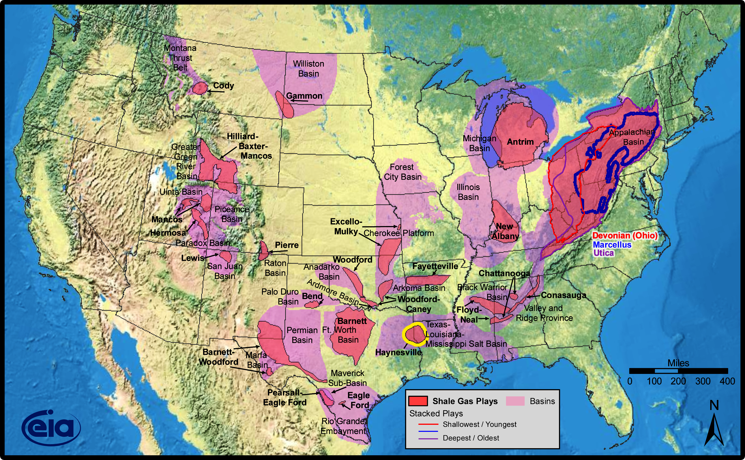
Shale Gas Plays, Lower 48 States
Source: Energy Information Administration based on data from various published studies
Updated: May 28, 2009

Slide 3
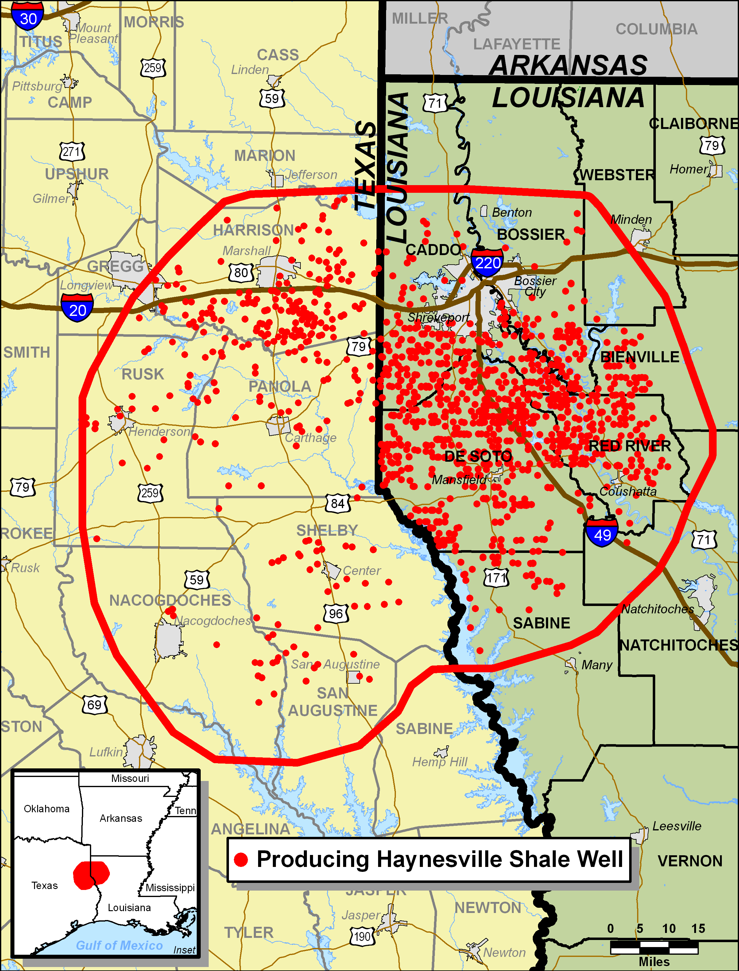
Current Haynesville Shale Activity

Slide 4
GENERALIZED LITHOSTRATIGRAPHIC COLUMN WITH
REPRESENTATIVE HAYNESVILLE SHALE WELLBORE

Slide 5
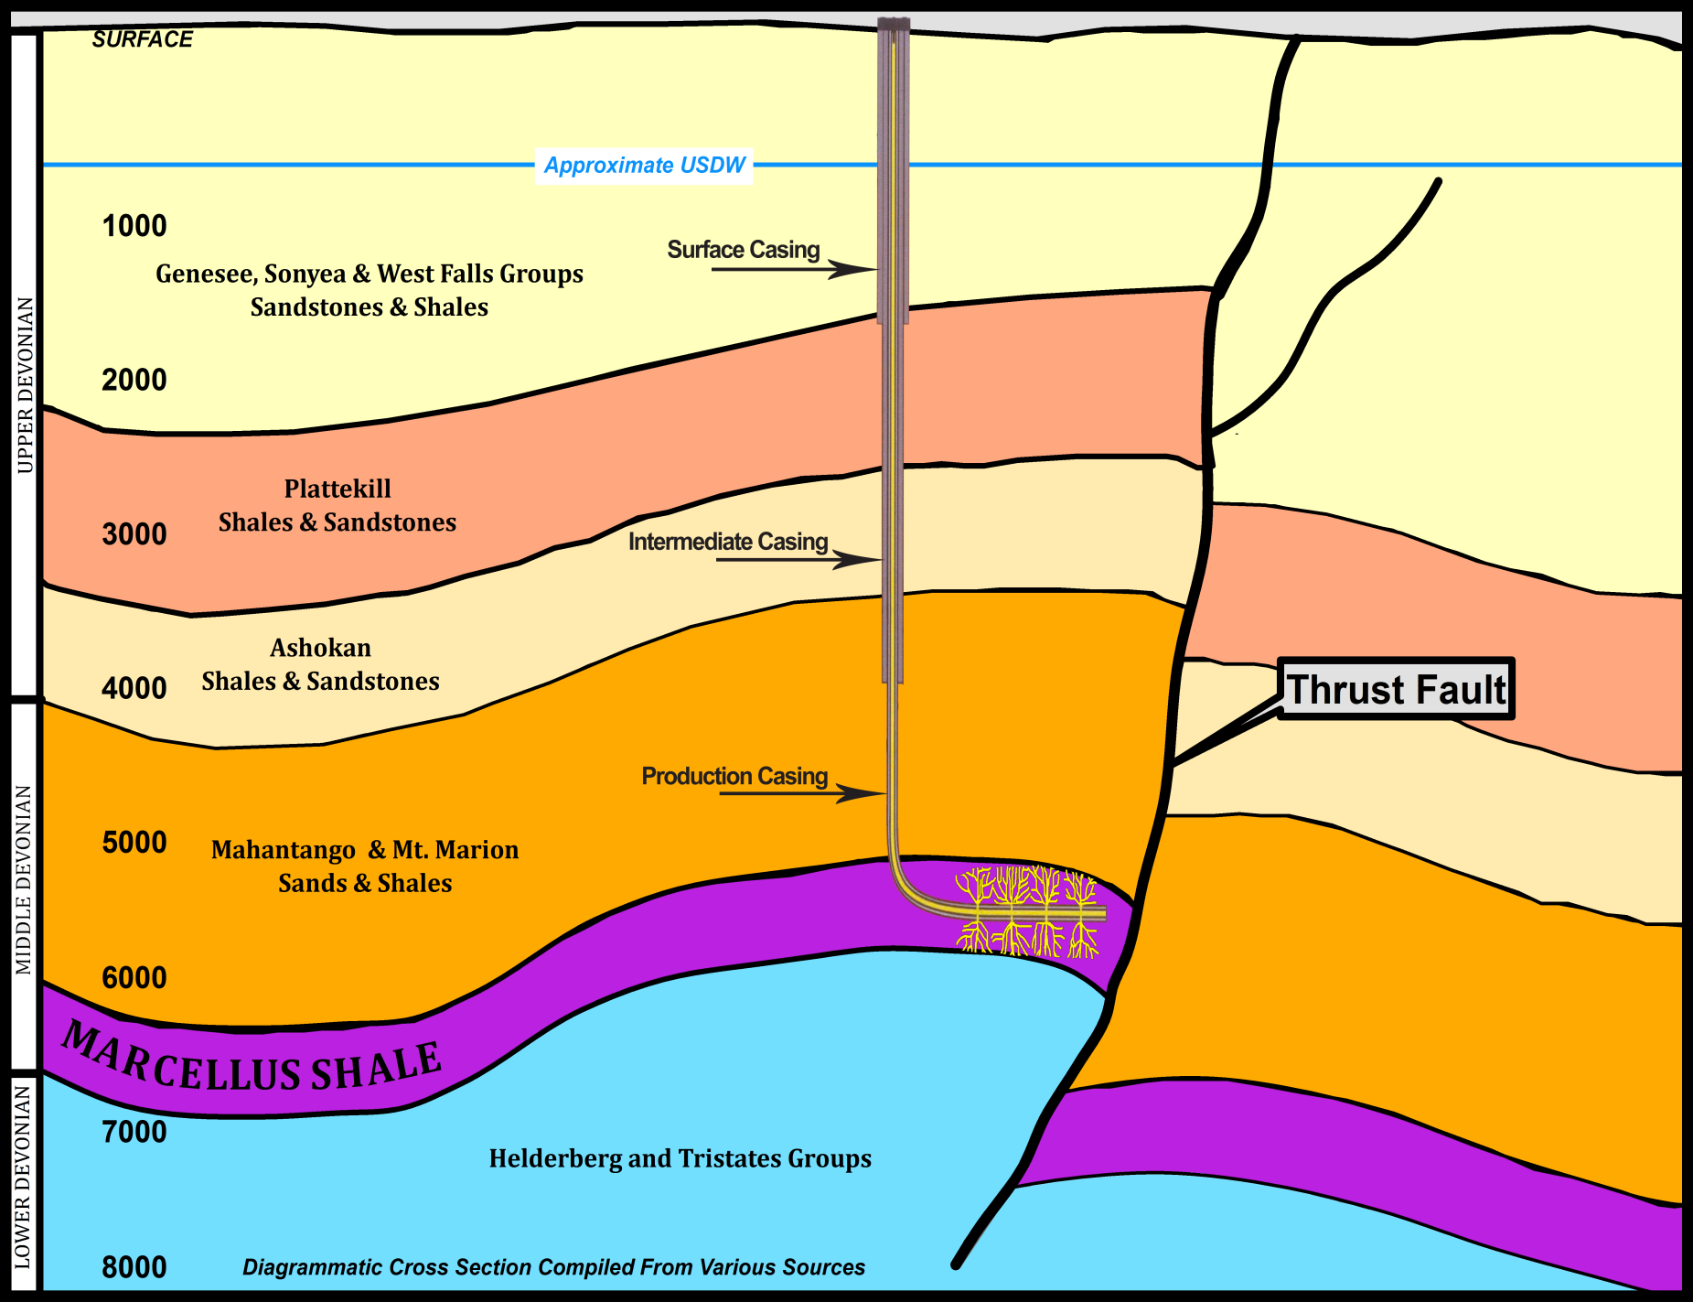
Generalized Cross-Section of Marcellus Shale With Representative Wellbore

Slide 6
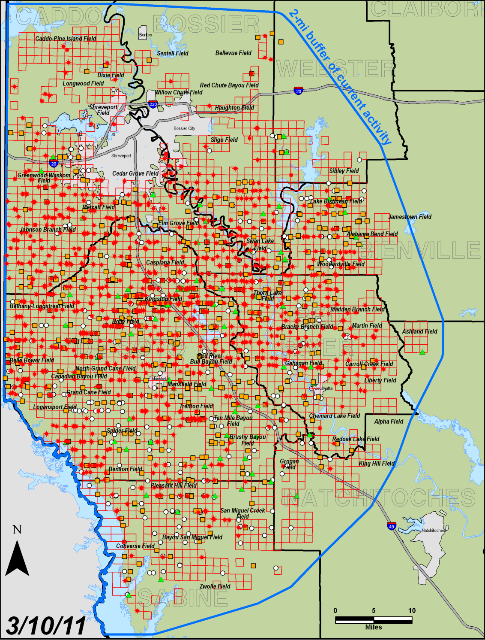

Current Haynesville Shale Activity in LA

Slide 7
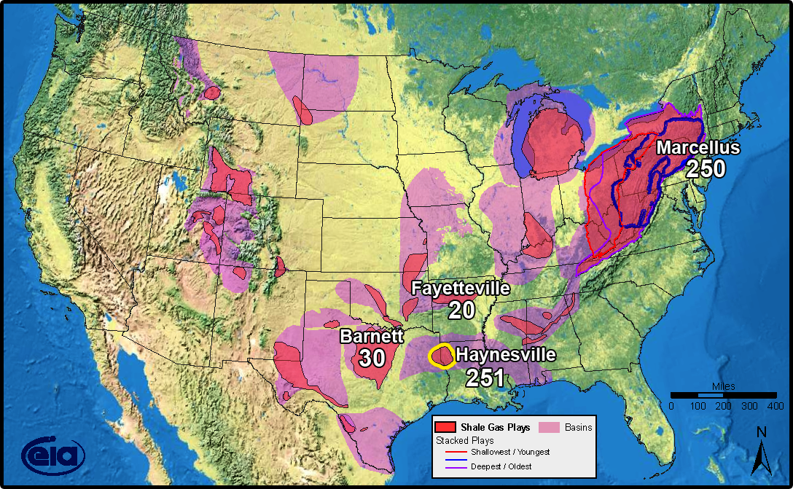
Estimated Ultimate Recovery in Tcf
(Tcf = Trillion cubic feet)
Data compiled from various sources by Office of Conservation Engineering Division
2008

Slide 8
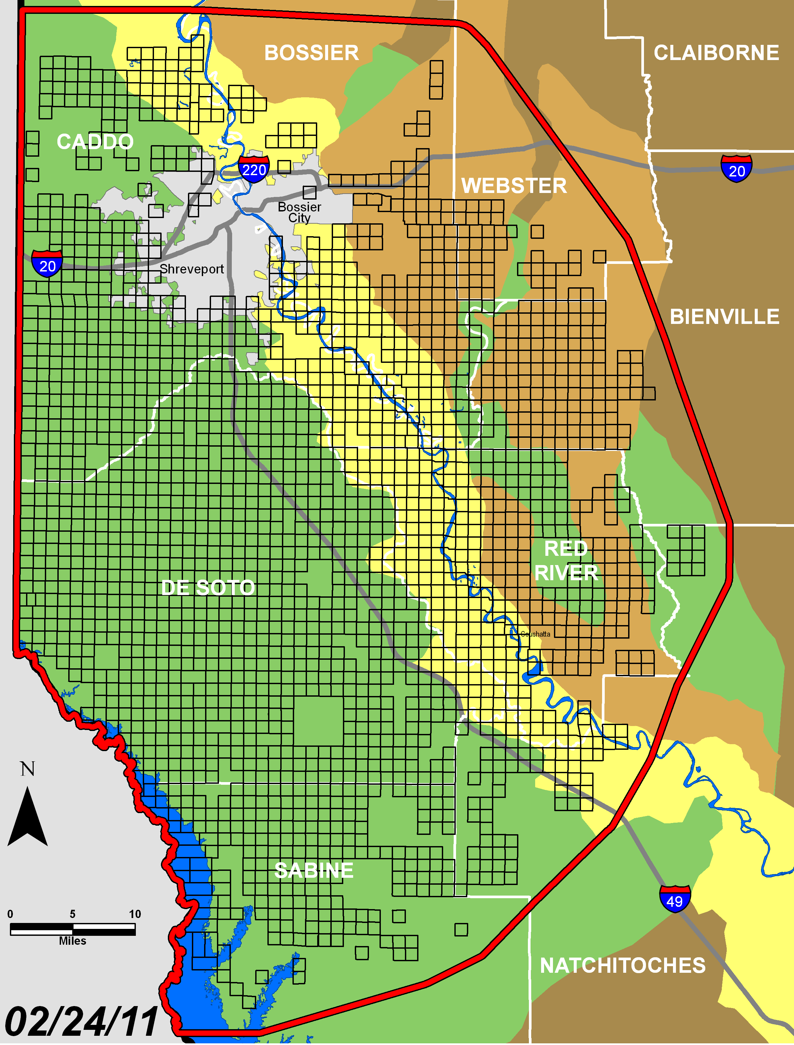

Northwest Louisiana Aquifers

Slide 9
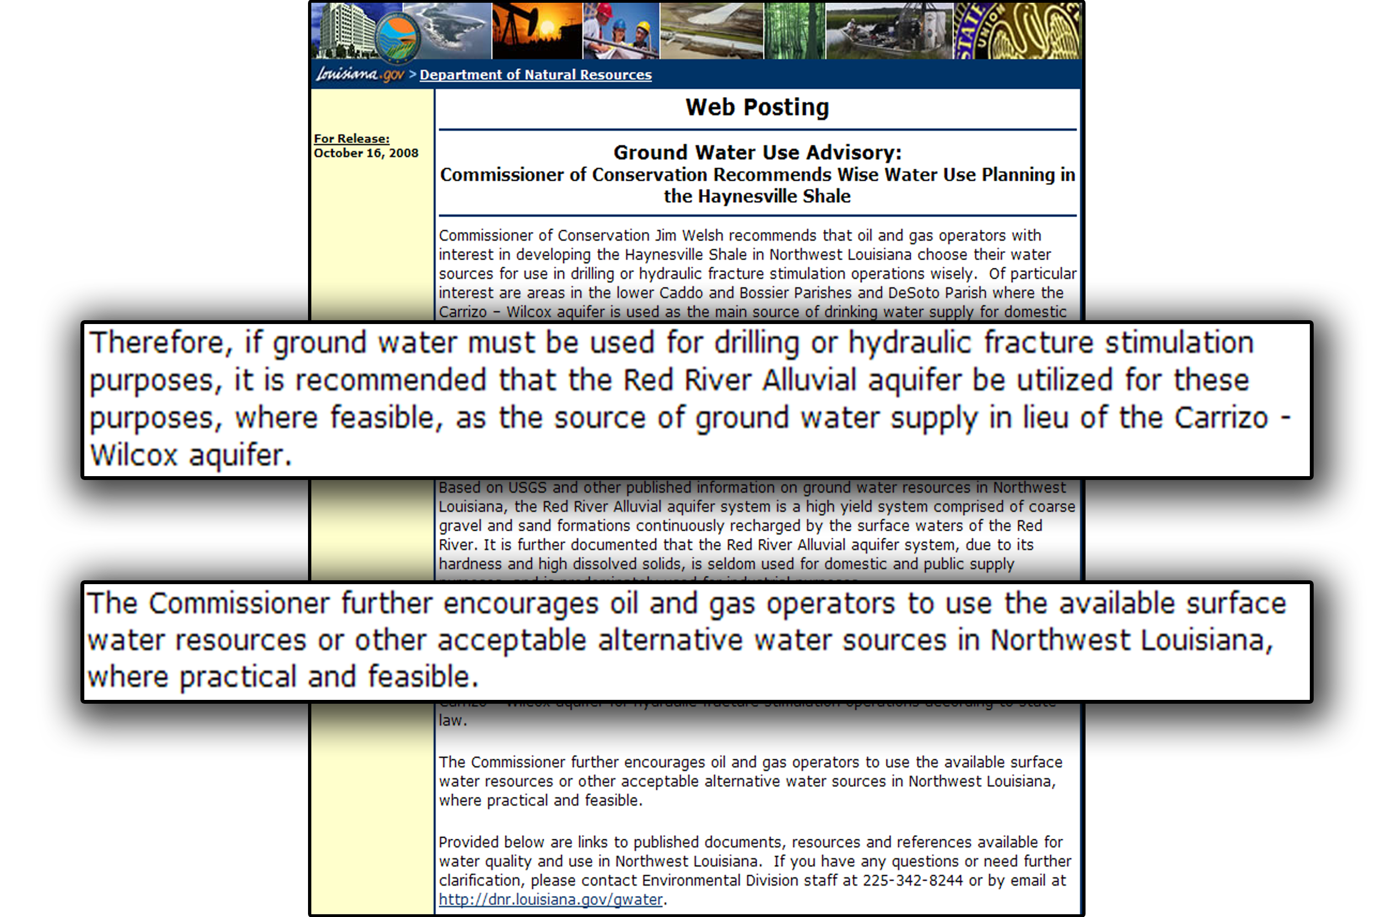
Ground Water Use Advisory

Slide 10
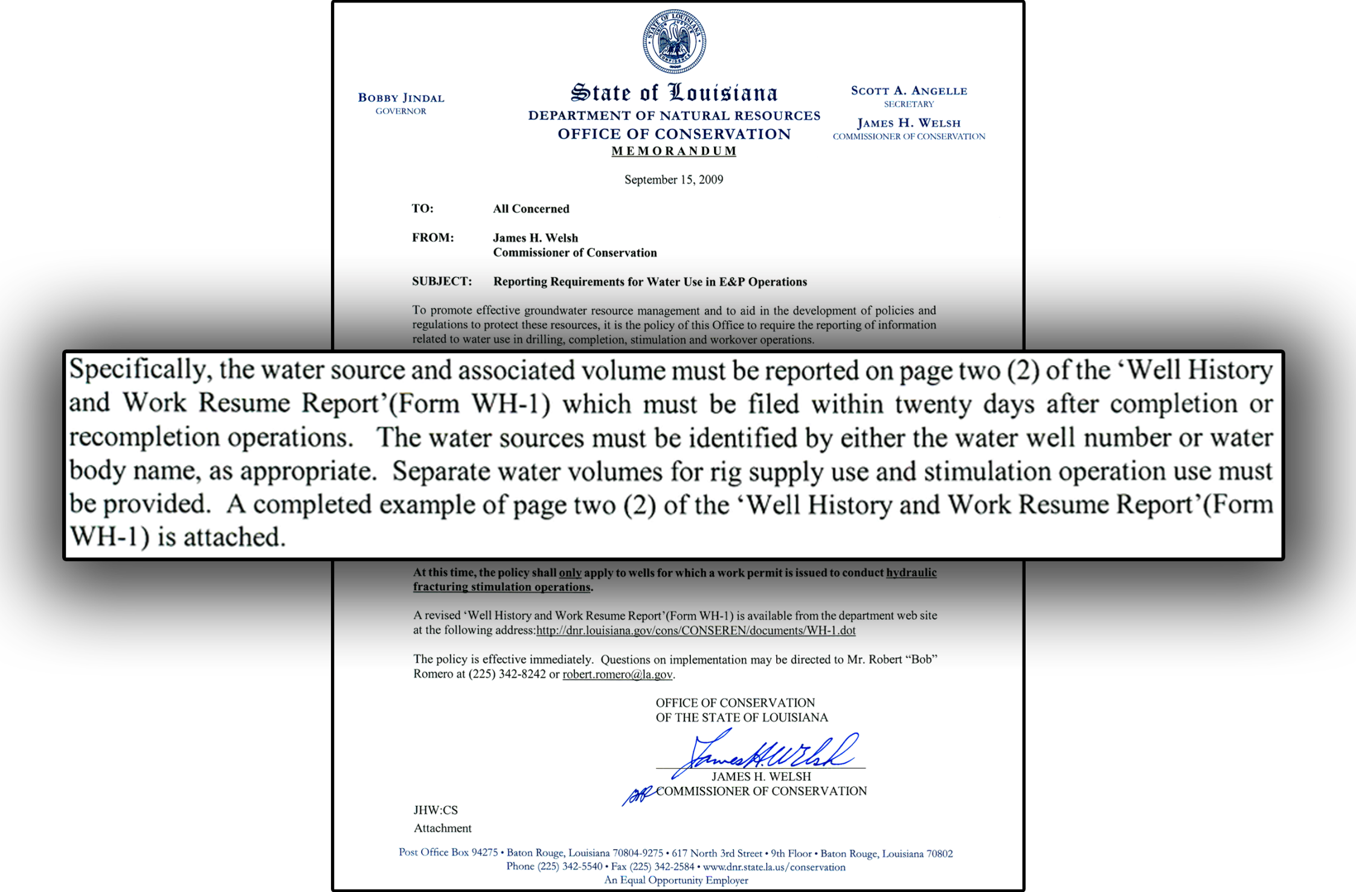
Directive Issued to Industry for Frac Water Reporting
Due to revisions of the WH-1 form, water source and associated volumes are now reported on page 3.

Slide 11
Drilling and Stimulation Operations
Haynesville Shale Natural Gas Well Development
Reported Usage from 10/1/2009 to 2/1/2011
Source | Volume (Gallons)
Frac Groundwater | 810,384,455
Frac Surface Water | 3,340,652,866
Drilling Rig Groundwater Supply | 395,802,431
Drilling Rig Surface Water Supply | 59,403,197
Other Groundwater | 24,403,351
Other Surface Water | 13,917,380
Water Stats
Frac Stages | 8982
Total Frac Water Used (gallons) | 4,151,037,321
Volume per Frac Stage(gallons) | 462,150
Average Frac Stages per Well | 10.1
Average Water Use per Well | 4,928,734
Average Frac Water Use per Well | 4,351,251
10

Slide 12
E&P Waste Fluids Use for Frac Water Supply
LAC 43:XIX.Subpart 1.Chapter 3 Amendment
Allows Operators to Use E&P Waste Fluids
for Frac Supply Purposes
Promulgated November 20, 2009
Amended June 20, 2010
Limitations:
  Used as Frac Supply Only
  By the Same Operator
  With Operator Affidavit Confirming Landowner Consent
11

Slide 13
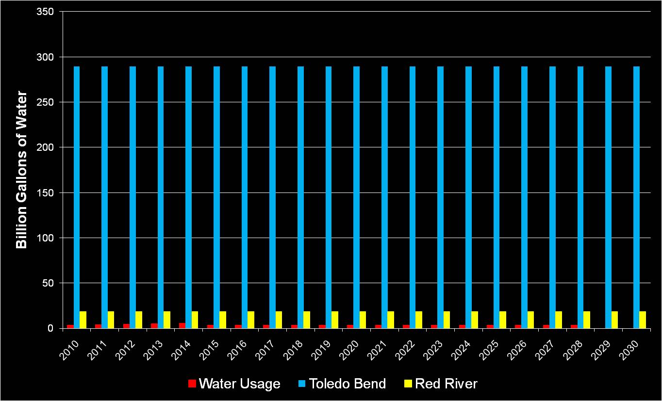
Red River & Toledo Bend Yield Capacity
Red River & Toledo Bend Yield Capacity vs. Projected Surface Water Usage @ 70% Level
Sources: Jim Pratt, Executive Director – Sabine River Authority
Jamie Triplett, Hydraulic Eng. – US Army Corps of Eng.

Slide 14
DNR / Conservation
Haynesville Shale Water Resource Management Summary
Agency Action:
Timely Response
Sufficient Oversight
  i. Policy and Regulation Adjustments
  ii. Resource Use Reporting and Monitoring
  iii. Increased Waste Minimization / Recycling Opportunities
  iv. Industry and Public Education / Outreach

